Slide 1
Common sequencing errors
http://genepool.bio.ed.ac.uk/sanger/Sanger_troubleshooting_guide_v1.pdf
https://www.nucleics.com/DNA_sequencing_support/DNA-sequencing-troubleshooting.html

Slide 2
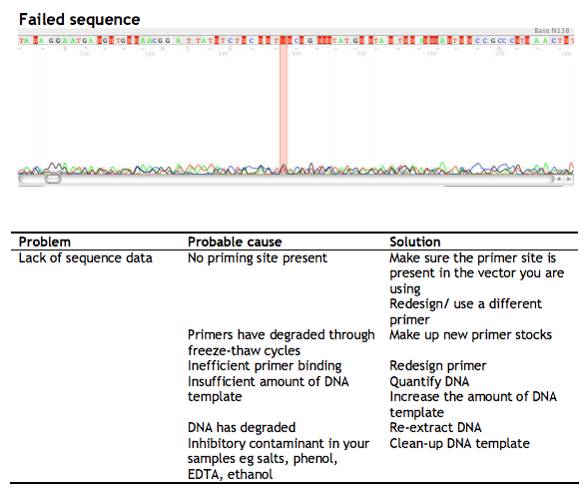

Slide 3
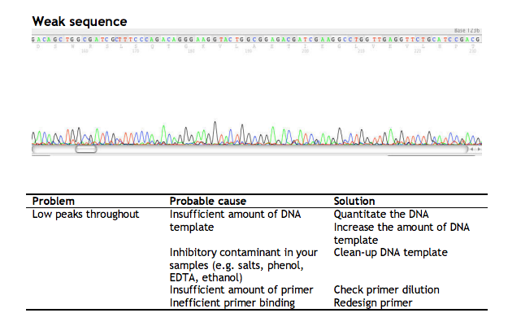

Slide 4
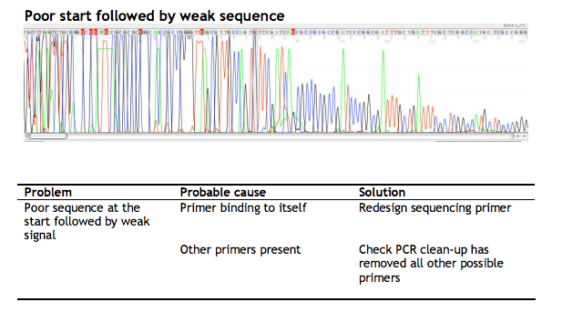

Slide 5
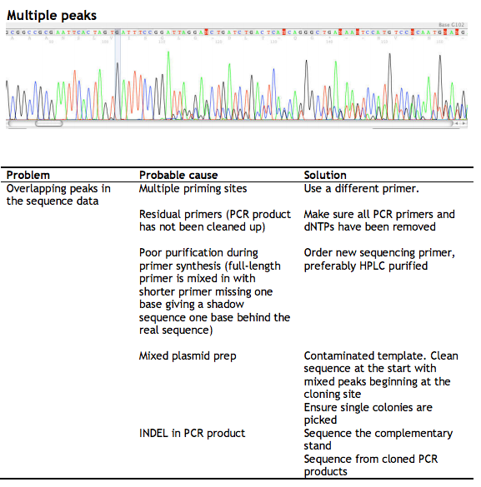

Slide 6
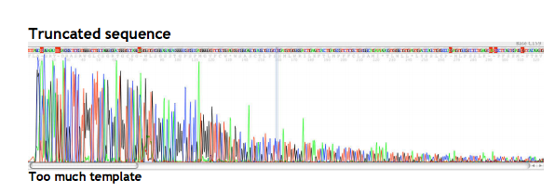

Slide 7
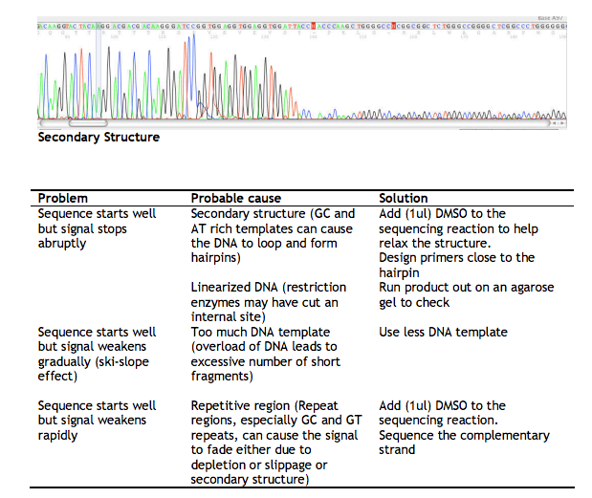

Slide 8
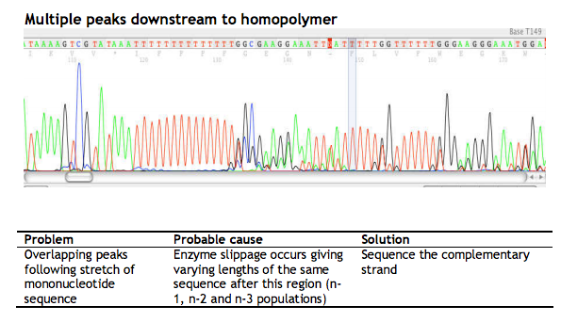

Slide 9
