Slide 1
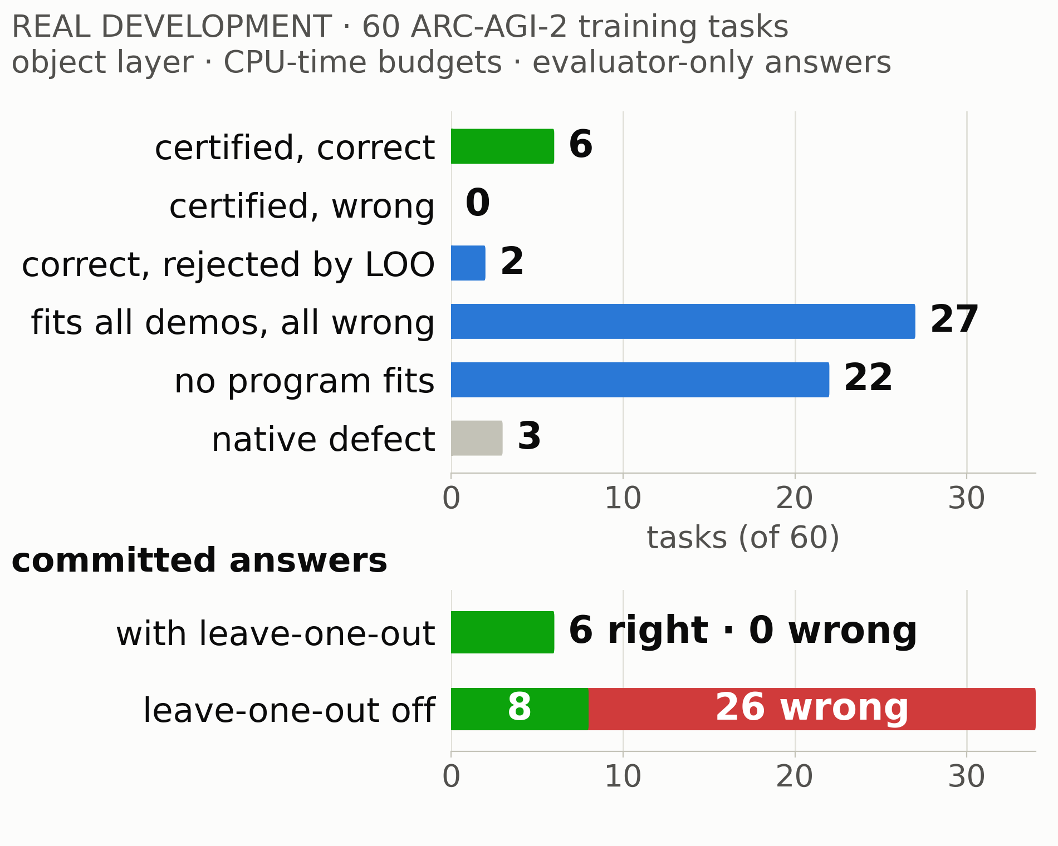
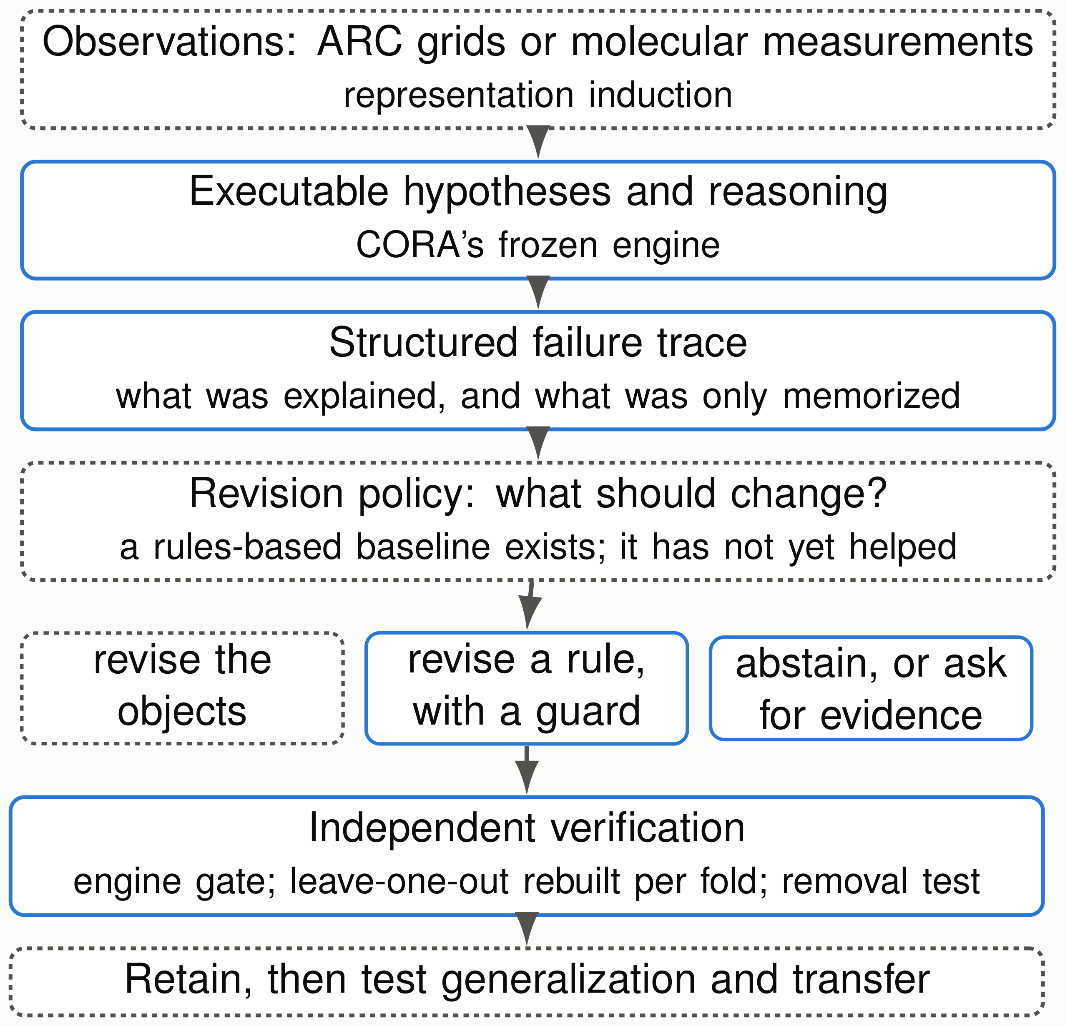
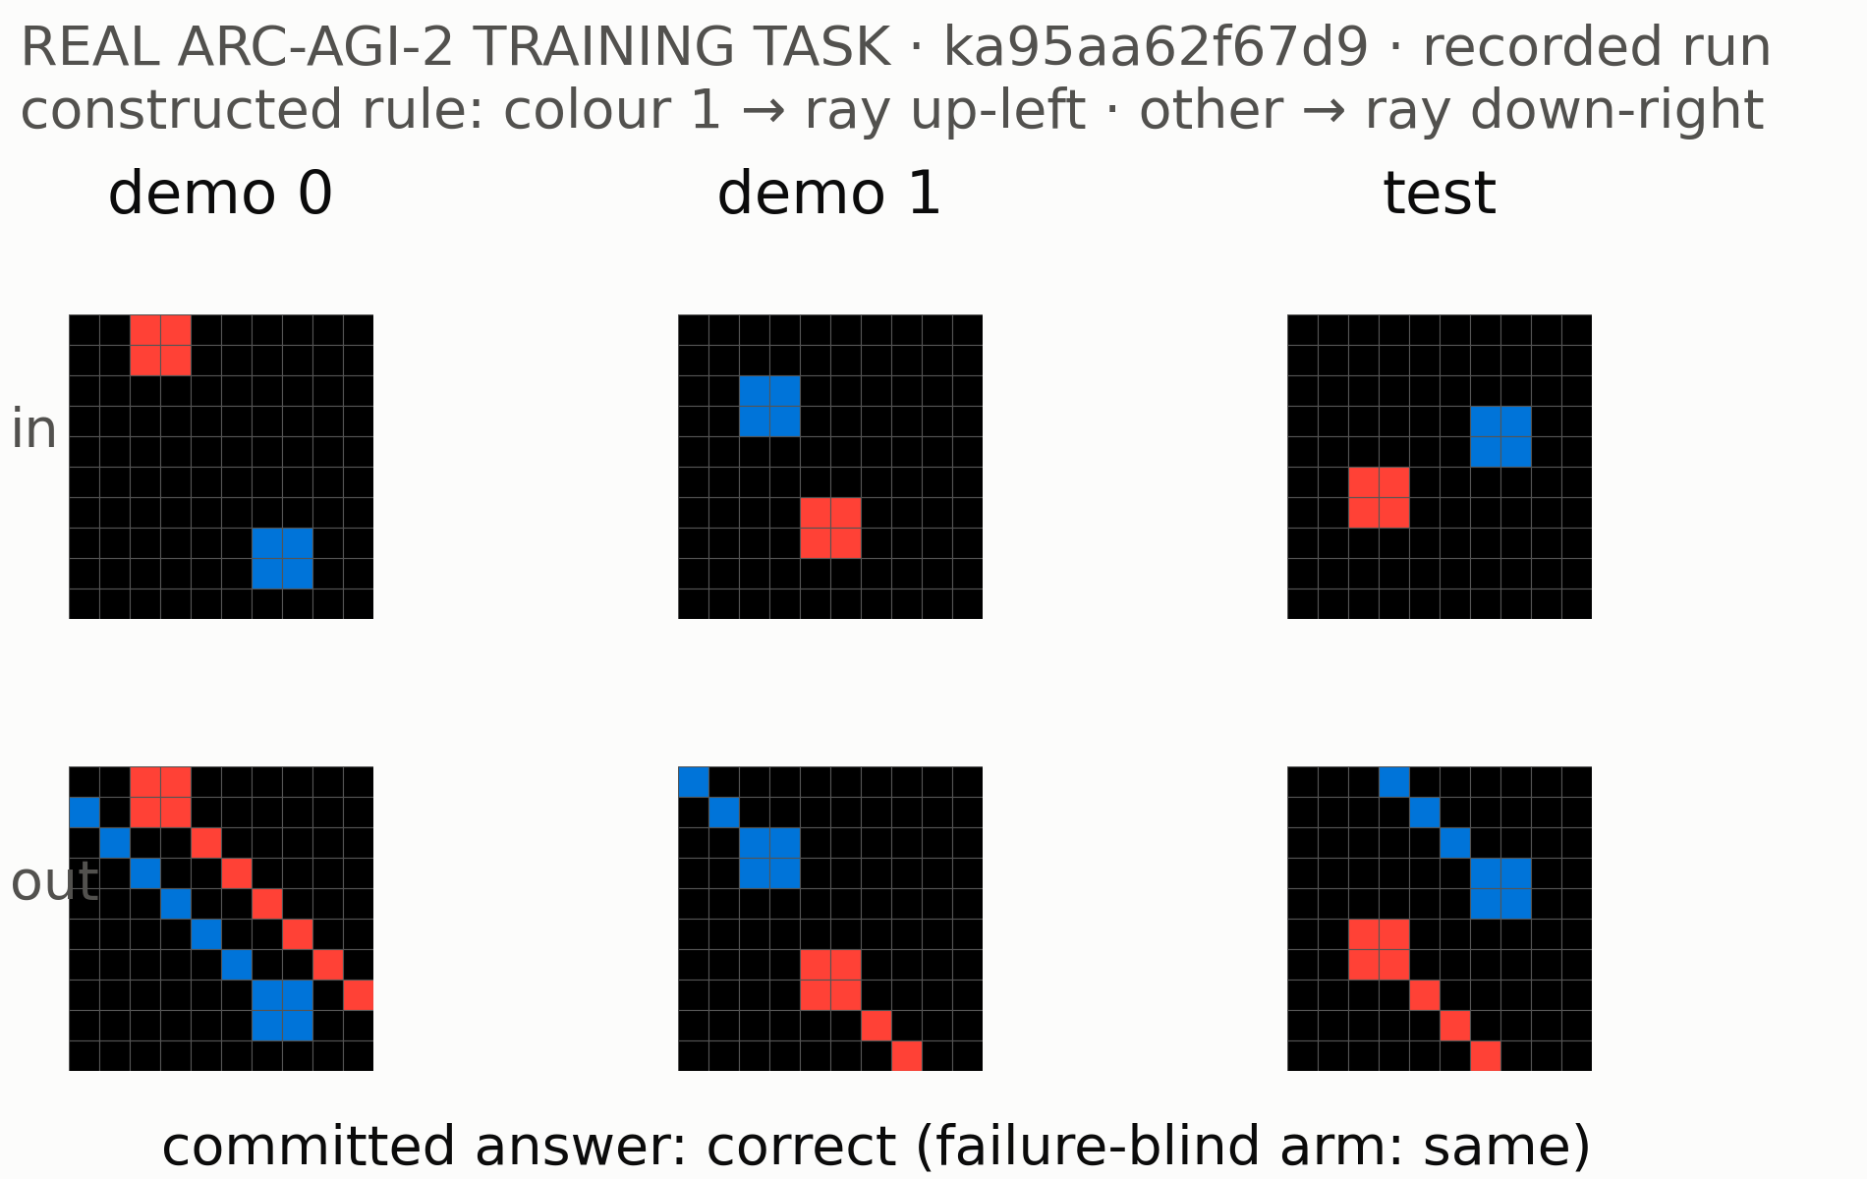
Learning What to Change: From Visual Reasoning
Learning What to Change: From Visual Reasoning
to Scientific Hypothesis Revision
to Scientific Hypothesis Revision
Chimdi Walter Ndubuisi
Chimdi Walter Ndubuisi
University of Missouri
University of Missouri
Executable reasoning, failure diagnosis and generalization across semantic domains · REVIEW DRAFT, 18 October
Executable reasoning, failure diagnosis and generalization across semantic domains · REVIEW DRAFT, 18 October
The question
Where CORA fails on real tasks
A revision architecture solid: built ·
How can a system learn to reason about things it was
DONE
dashed: proposed
never explicitly programmed to understand?
Three
parts:
1. Representation:
can it induce the right entities
from sparse data of a new kind?
2. Rules: can it discover the executable rules that act
on them?
3. Revision and transfer: when it fails, can it tell
which part to change, and does that procedure
carry over to a domain whose meaning is different?
These questions were shaped in discussion with Toni Kazic.
Why one solved puzzle proves little
Several programs can fit every demonstration and still
Object reasoner, 60 exposed training tasks. Figure: run with-
disagree on the test. On 60 exposed ARC-AGI-2 train-
out the frozen assets (27 all-wrong fits; check off, 8 right and
ing tasks, CORA’s object reasoner had demonstration-
26 wrong). As submitted, with the assets: 26, and 8 right and
fitting programs that were all wrong on 26 tasks (with
25 wrong. In both, the check accepted 6 answers, all correct,
its frozen assets).
and a correct candidate existed on 8. This is one branch, not
The next falsifiable test RUNNING
A failure can come from three different places, and
a reliable solver.
each needs a different change:
58 independently selected training tasks, frozen before the run.
• the representation (which objects exist);
Building a missing rule, verified
It asks whether failure information chooses better revisions
• the rule (what happens to them);
than an equally equipped failure-blind constructor. One new
• the evidence (the examples do not decide).
DONE, NARROW
arm learns what to change from what the solver could only
The wrong revision can break what already worked.
memorize, and where from the boundary with what it explains.
Paired sign tests, Holm-corrected; results will be reported only
after validation.
Where this sits
Scientific prediction PROPOSED,
• Popper (Cropper & Morel): program induction that
NOT TESTED
learns from failed hypotheses.
With molecular measurements, should the system revise its
• DreamCoder (Ellis et al.), LILO (Grand et al.): grow-
representation, revise its hypothesis, or ask for an experiment?
ing reusable program libraries.
What could transfer is the revision policy and the verification
• Model Discovery Agent (Murphy): model inade-
interface, not ARC operators. A biological check needs toler-
quacy driving hypothesis revision and experiment
ance, real replicates, held-out conditions and experiments, not
design.
exact match. The problem contract (questions for Pierce and
• Frontier neural reasoners are strong; they are com-
Real training task. Frozen CORA and extra search both fail.
Toni) is in review; no biological result is claimed.
parisons, not straw men.
CORA built a rule that says where it applies as well as what
The narrower question here: choosing which component to re-
it does: colour-1 objects shoot a ray north-west, others south-
Benchmark context
vise, and showing that this choice beats an equally equipped
east.
It was installed reversibly, rebuilt in 3 of 3 leave-one-
system that does not use the diagnosis.
out folds, and answered correctly. Limits: the failure autopsy
selected the task; it is an exposed training task; a failure-blind
Official ARC-AGI-2 public scores: native CORA 0.00; a re-
constructor found the same rule.
production of the published NVARC Qwen3-4B pipeline 27.64,
Four achievements, four statuses
Synthetic task: a single-step ring around the minority-colour
which is not CORA. The CORA-FHR research entry (18 Oc-
cell, 3 of 3 folds, correct.
tober) scored 0.00, as its local rehearsal predicted (no new
answer committed). The guarded rule came later and is not
achievement
status
Does learning from the failure help?
part of it.
detect certain reasoning failures
built, with limits
NOT ESTABLISHED
The question I want to pursue
construct and verify an executable
shown: one synthetic
correction
task, one exposed real
learn to choose better revisions
task
• A frozen 10-case pilot: failure record 2 correct, failure-blind 1
Can a reasoning system learn from the boundary be-
from failures
not established
correct plus 1 tie abstention, 0 wrong, 0 lost. One discordant
tween what its current knowledge explains and what it
pair (p = 0.5) is not evidence.
cannot, decide what must change, and acquire a capa-
transfer a revision policy to biology not tested
• A hand-designed controller that picks the kind of revision
bility that generalizes? ARC offers a controlled place
missed the only task that extra search fixed: 6 against 7.
to find out before testing it in science.
• Why construction rarely fires: of 62 eligible tasks, 20 left no
Every number, with its scope and hash:
evidence and 39 had evidence no rule fitted. Of 25 such real
records/CORA_SUMMIT_CLAIM_LEDGER_20261017.md. Authorship and
The message
cases, 18 were inexpressible in the grammar.
credits are pending collaborator review.
Constructing a rule and learning which revision to
Intelligence may require more than finding an answer.
make are different capabilities.
It may require recognizing when the concepts and
rules used to build the answer are inadequate, and de-
ciding what must change.

