Slide 1
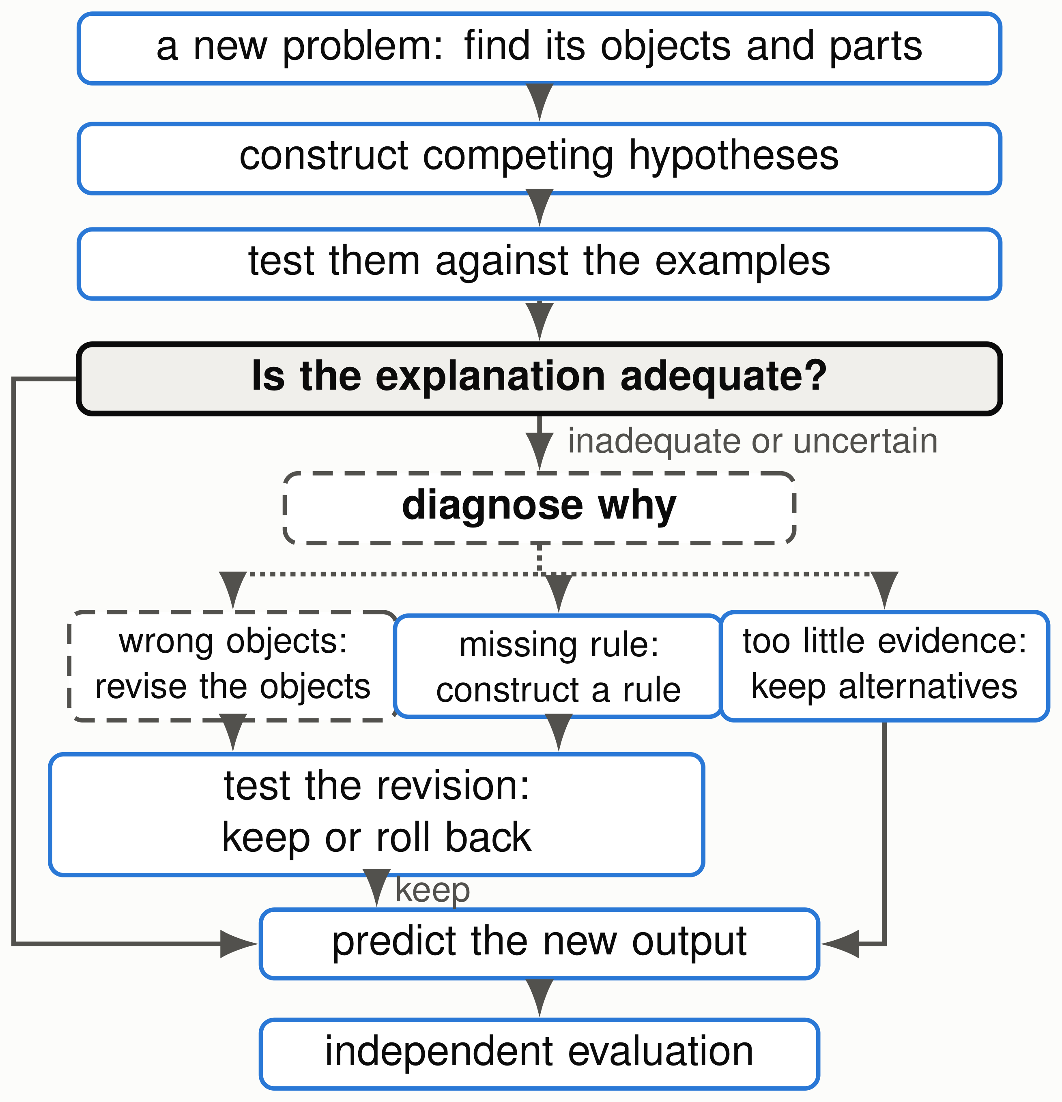
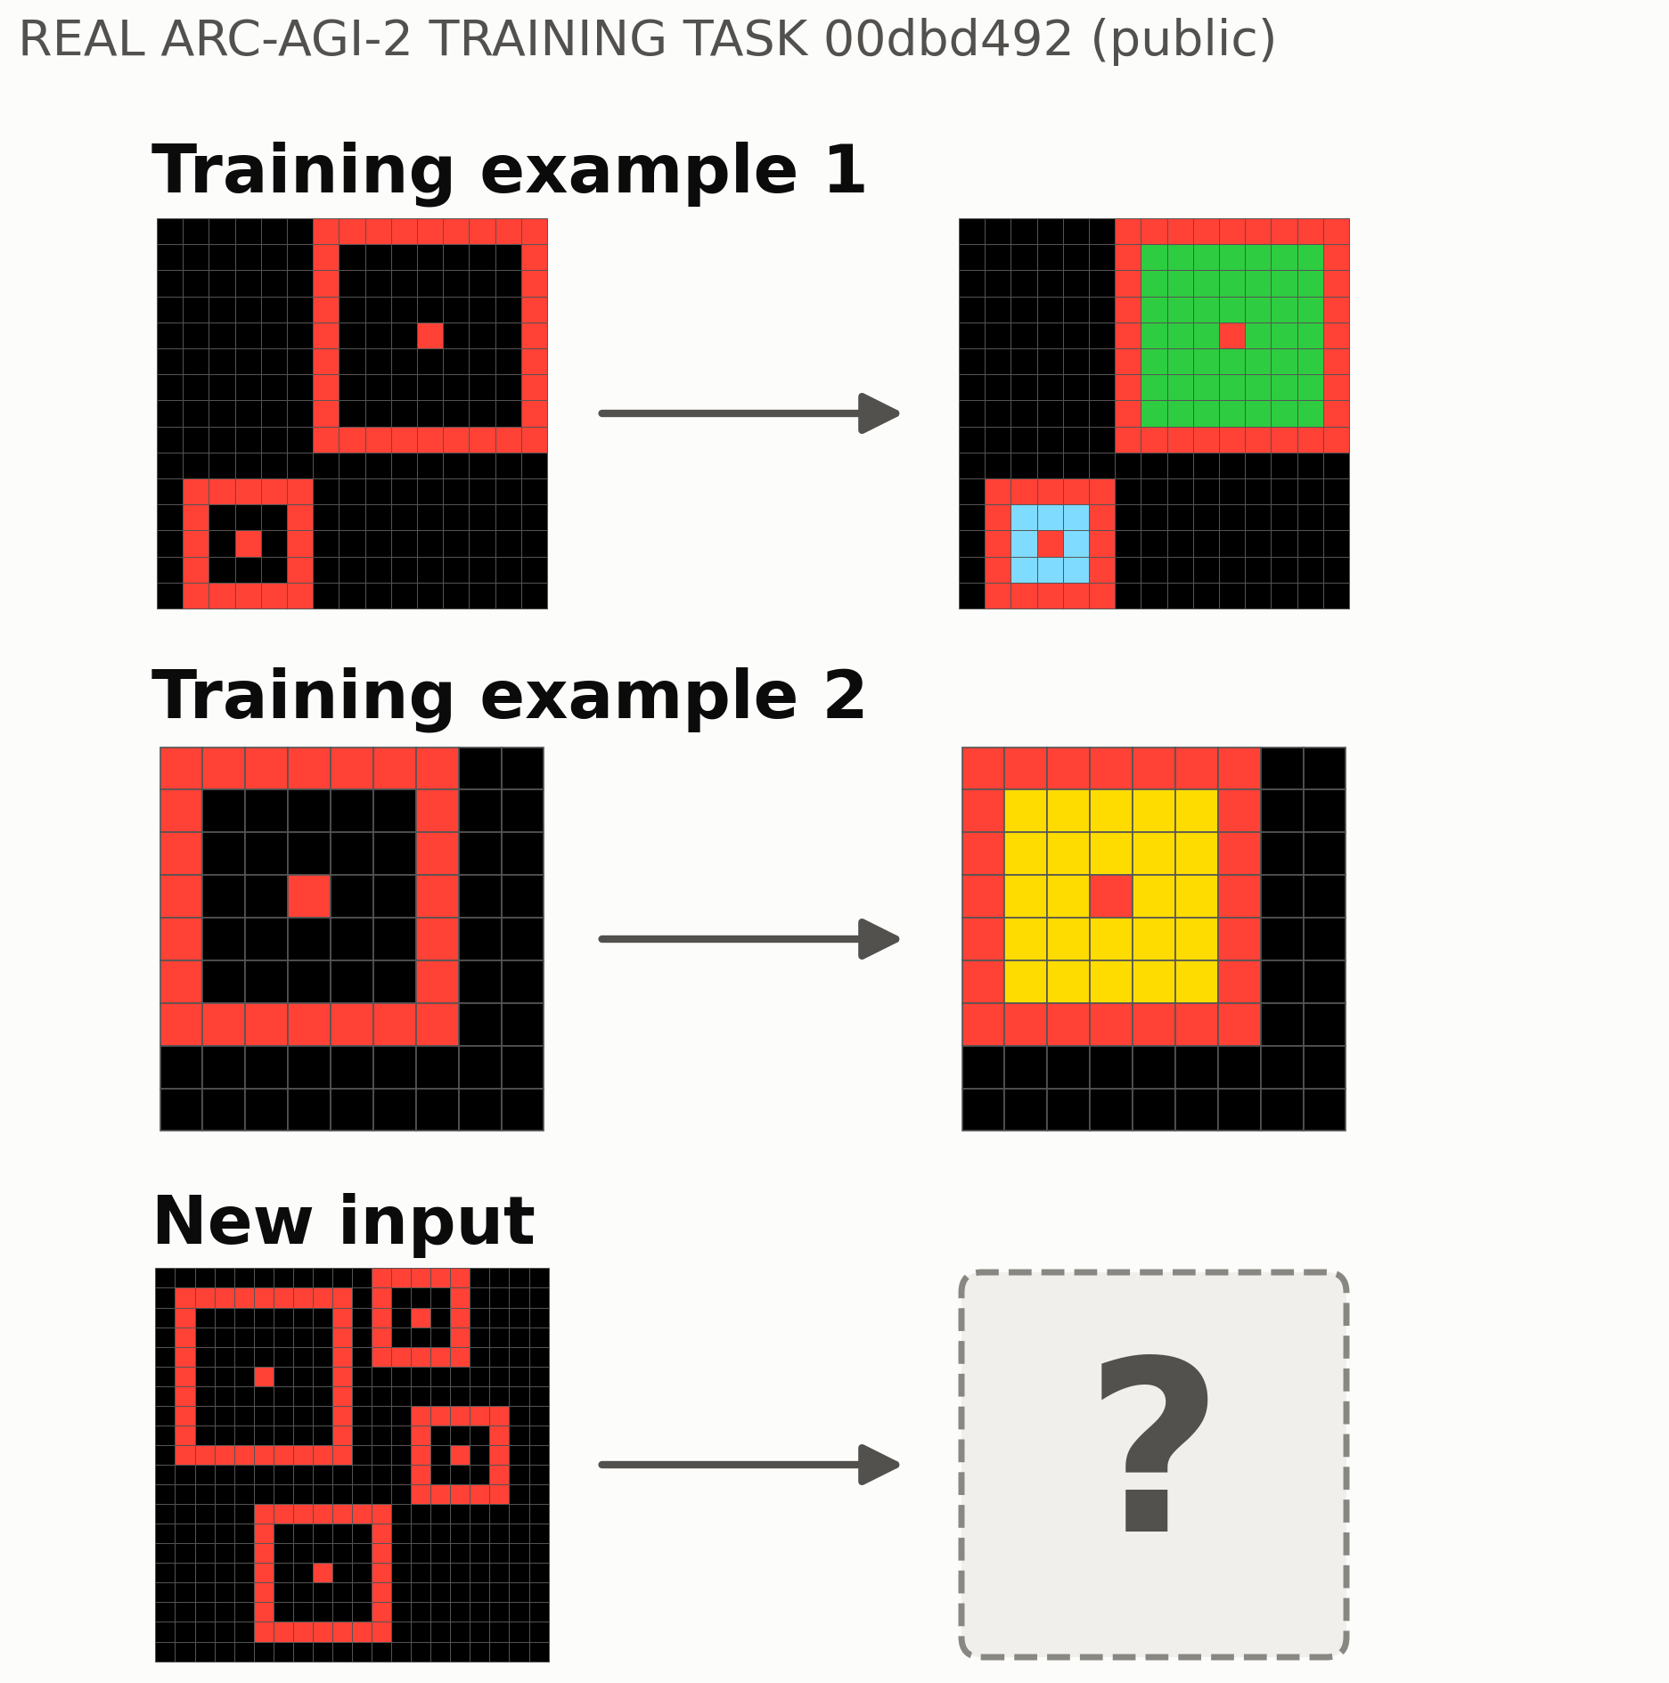
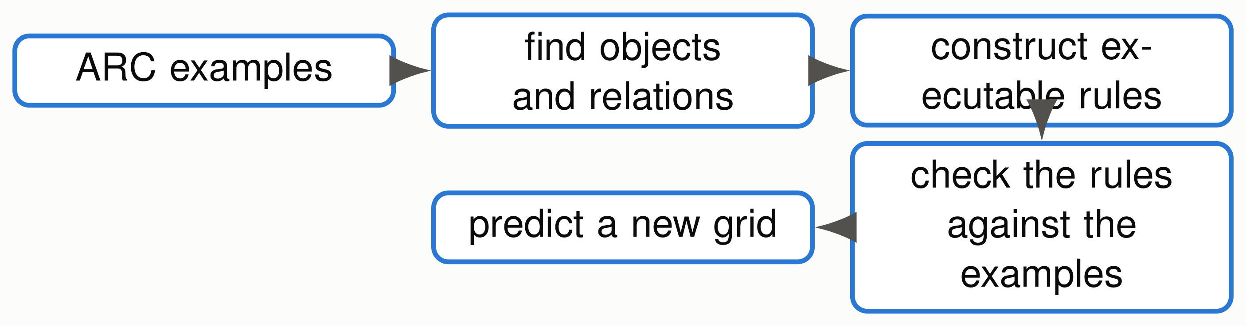












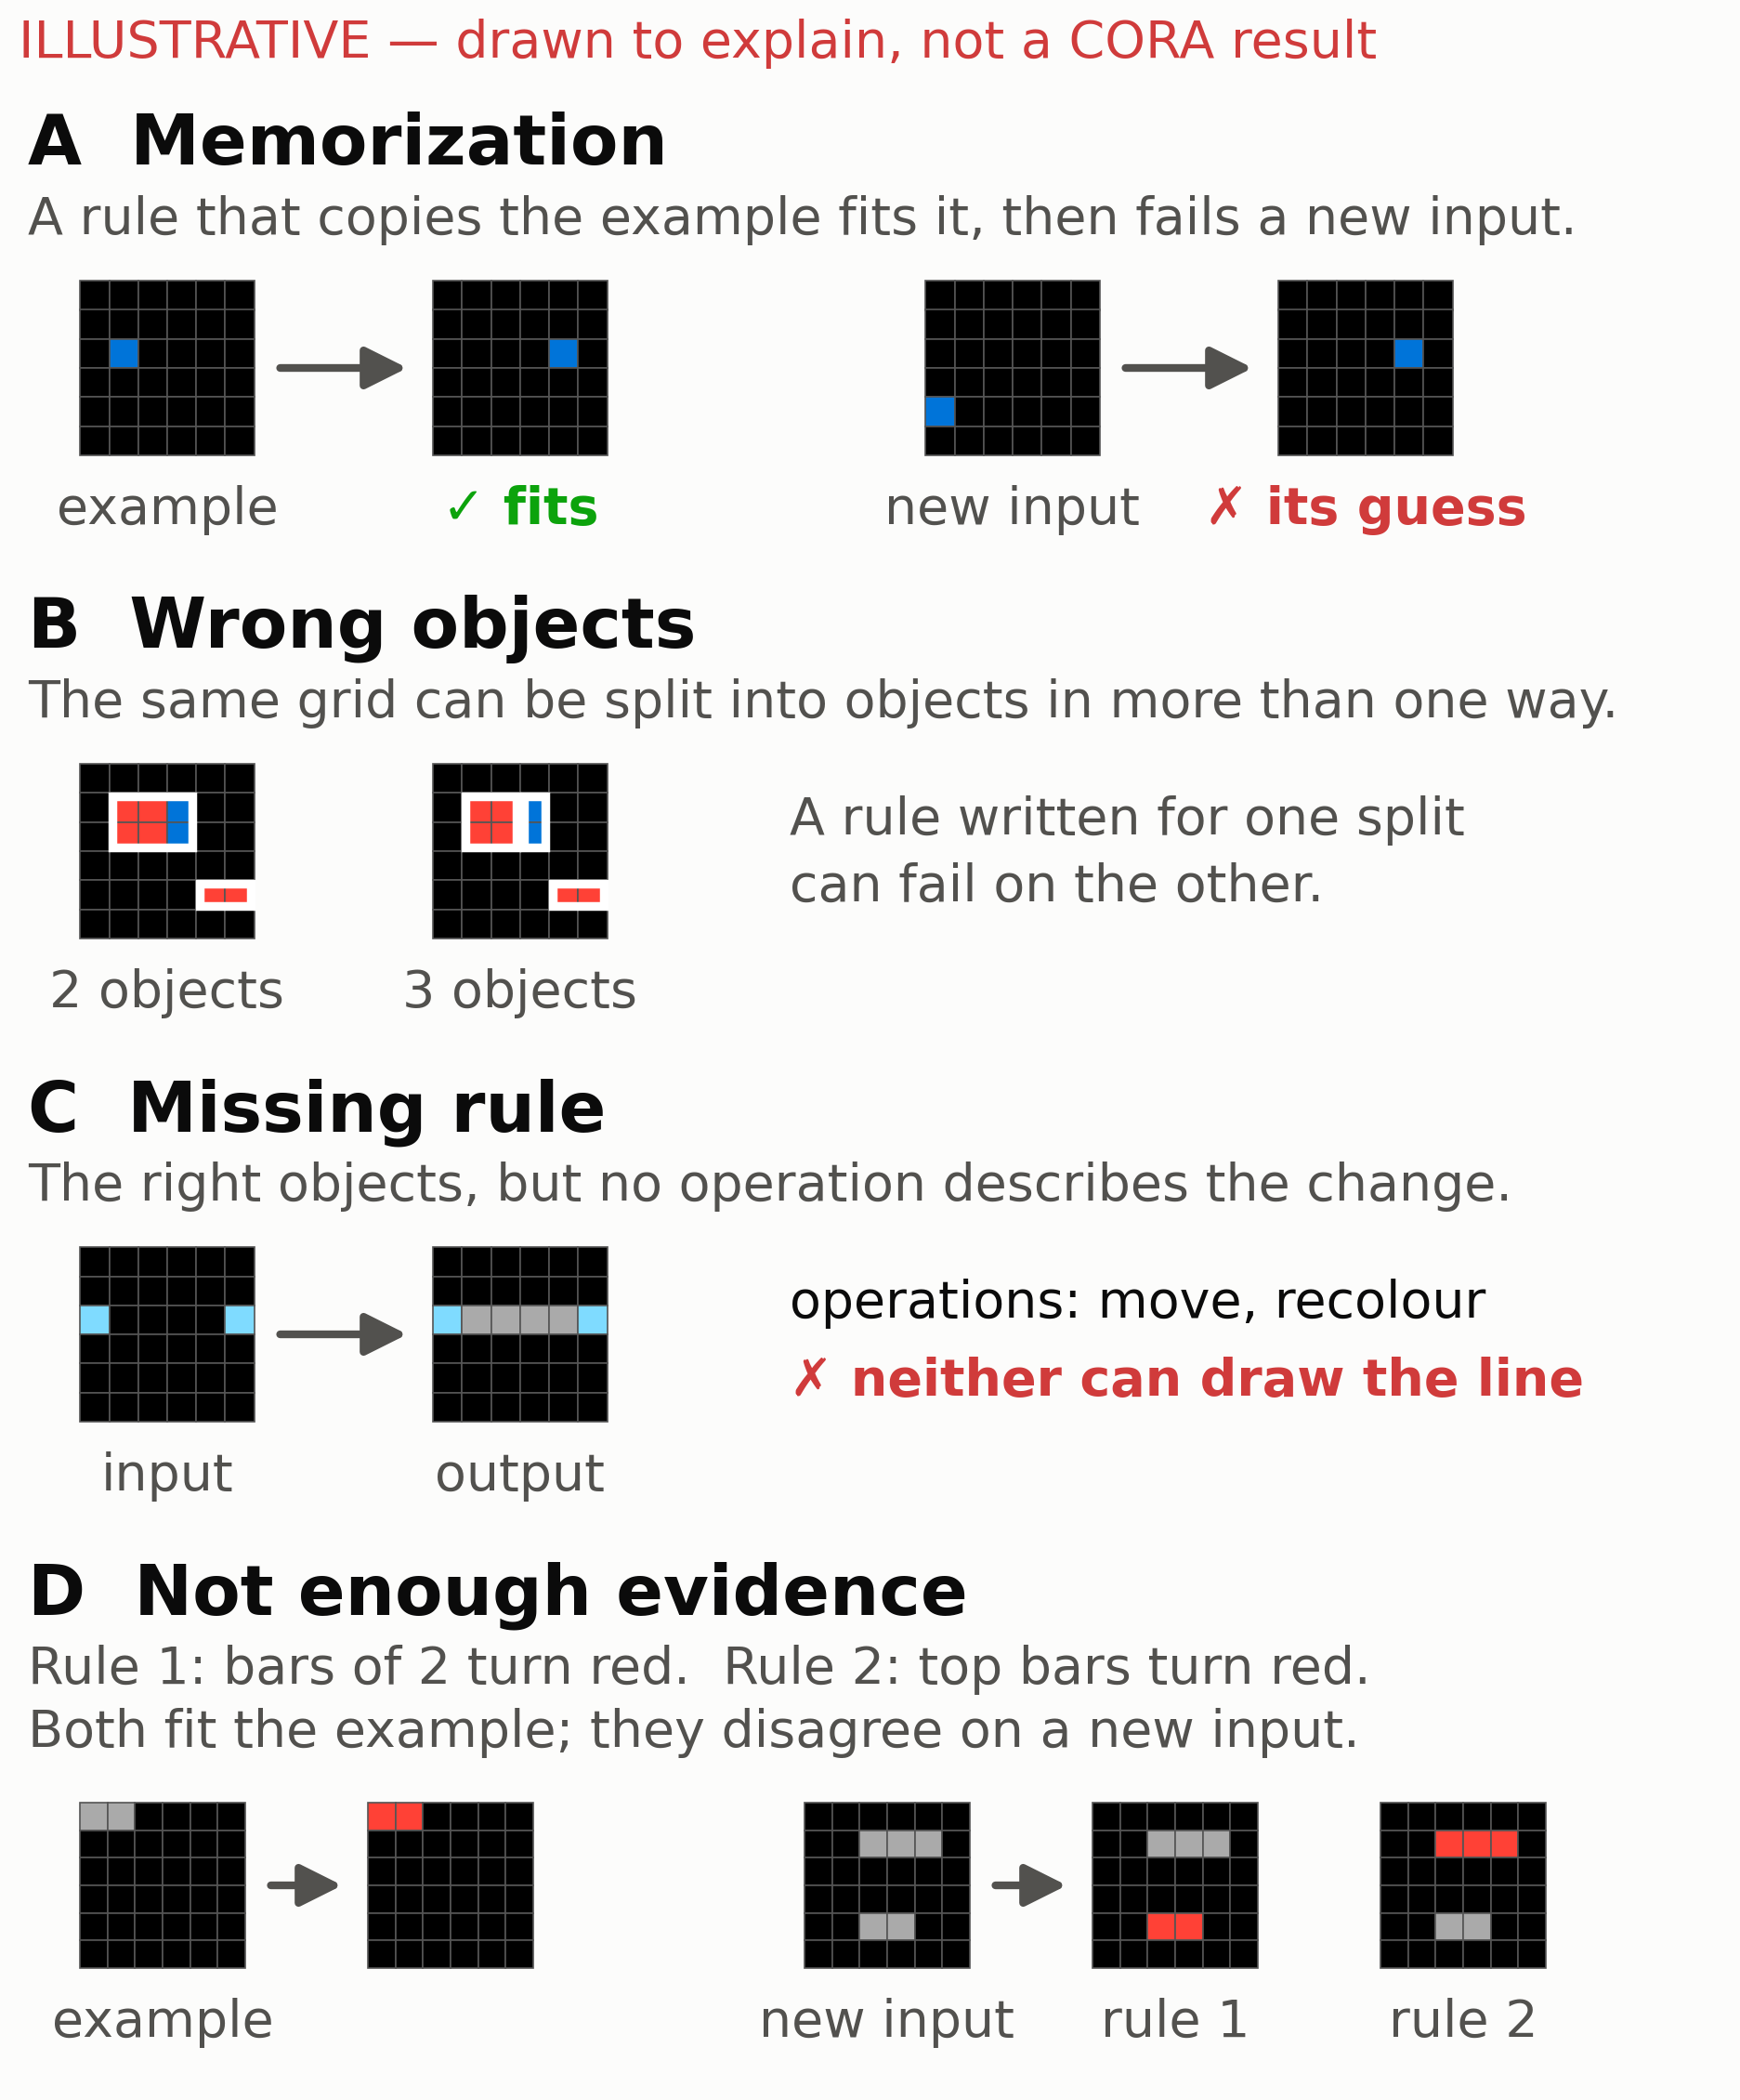
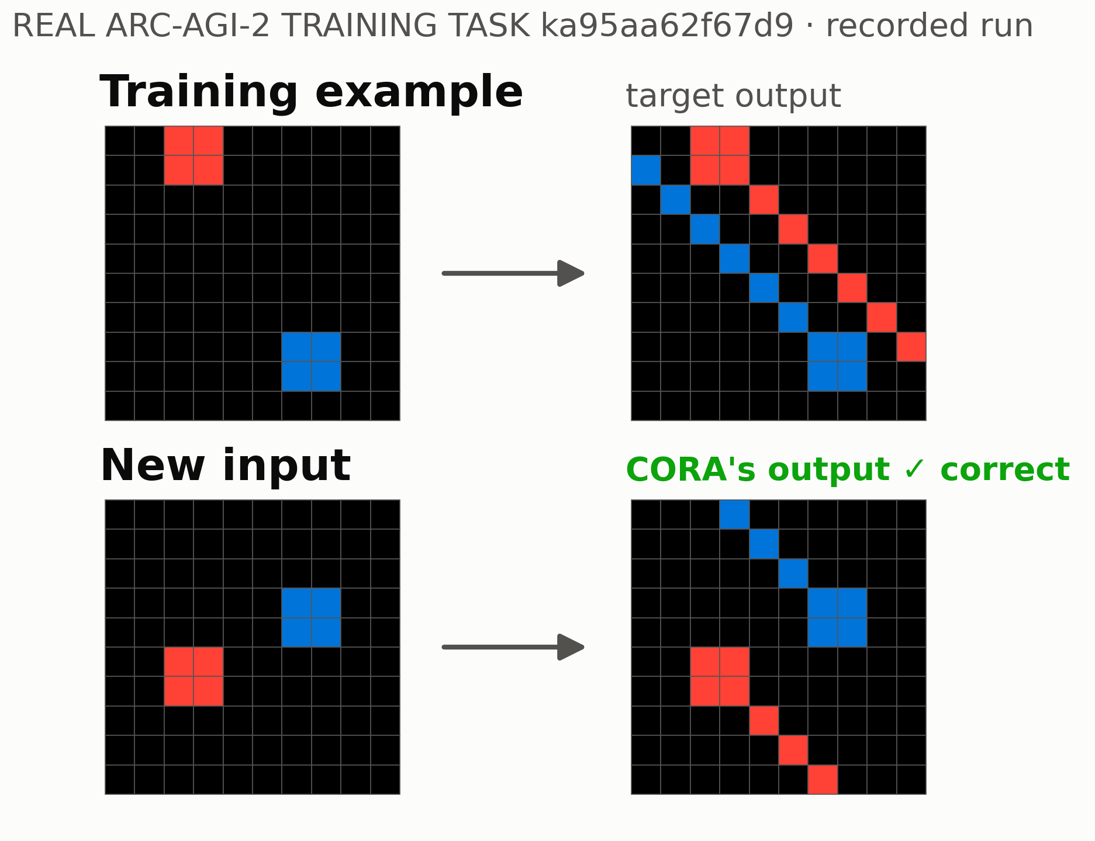
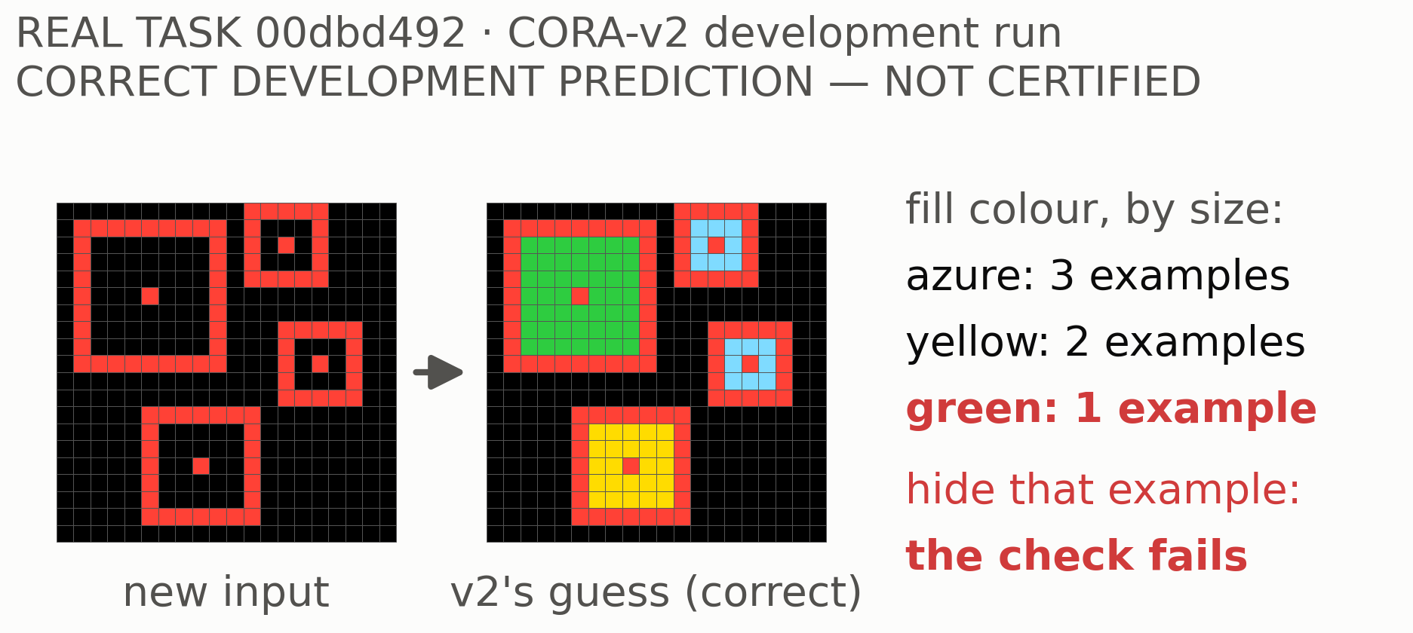
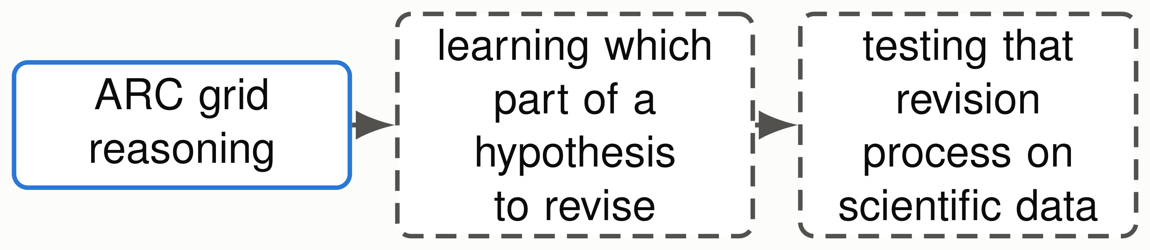


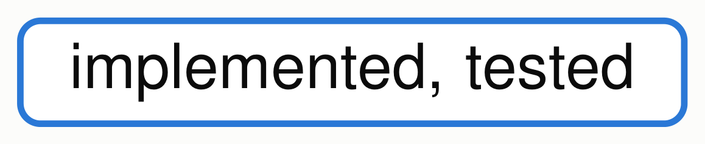
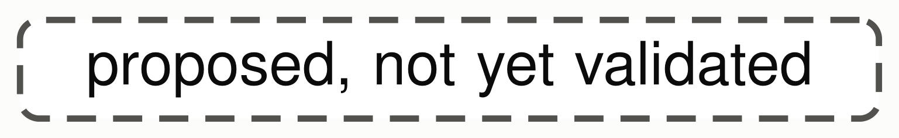
LEARNING WHAT TO CHANGE
LEARNING WHAT TO CHANGE
From Visual Reasoning to Scientific Hypothesis Revision
From Visual Reasoning to Scientific Hypothesis Revision
Chimdi Walter Ndubuisi · University of Missouri
Chimdi Walter Ndubuisi · University of Missouri
REVIEW DRAFT 19 October: for collaborator review, not for print
REVIEW DRAFT 19 October: for collaborator review, not for print
Can a reasoner recognize when its explanation is inadequate,
and determine what needs to change?
Solving a problem is not the same as knowing why the solution works, or what to change when the available concepts and rules fall short. A question shaped in discussions with
Toni Kazic.
Aims, not yet all achieved: find objects and relations →write executable hypotheses →notice inadequacy →choose a justified revision →test it independently →transfer the
procedure.
1 · Why ARC is a useful test
2 · CORA: what I built
3 · Learning what to revise
ARC tasks require inferring a transformation from a
CORA is an executable ARC reasoning system used
few examples and applying it to a new input.
to investigate how models construct, test and revise
hypotheses from sparse visual examples.
Fitting is not enough [DONE]
6
26
supported
answers accepted,
tasks where every rule
all correct
that fit the examples
failed the test
Recognizing an inadequate explanation: partly built
60 exposed ARC-AGI-2 training tasks; CORA’s object
(CORA-v2). Knowing which revision helps: not yet shown.
Each frame’s fill colour depends on its size.
reasoner as submitted.
CORA never sees the hidden answer.
Four reasons to revise
A rule CORA built [DONE, NARROW]
CORA-v2 [DEVELOPMENT]
Compares alternative executable hypotheses and
records why it is uncertain.
On 118 exposed development tasks: 4 correct and 1 wrong
exploratory guesses; nothing certified.
Depending on an object’s colour, extend a line toward
Inventing new operations [RUNNING]
one of two corners: blue up-left, red down-right.
Automatically constructed conditional operation; rebuilt 3 of 3
Automatic rule-language extension, a separate CORA
times with one example held out. An exposed task chosen in
experiment: can a system build new reusable operations
development; a constructor that ignored the failure record
itself? 475 of 497 proposal units done (19 October); no
found the same rule, so diagnosis did not cause this gain.
verdict; not part of CORA-v2 or any Kaggle entry.
Did it generalize? [NEGATIVE]
From ARC to science [FUTURE, NOT TESTED]
These are different possible causes. Telling them
0 / 58
apart, from the examples alone, is the research
problem.
new verified solves from rule construction
58 separately selected, still exposed training tasks; every
construction variant; no wrong answers; no advantage from
Proteins · single-cell and omics data · plant phenotypes ·
the failure record.
pathways suggested by maize lesion mimics, checked with
molecular or perturbation evidence. What could transfer is the
revision policy, not ARC operations.
Building a rule is not the same as learning which revision improves an
Two approaches to ARC, official public ARC-AGI-2 scores
unseen prediction. That is what we are trying to test.
NVARC / Qwen3-4B: 27.64%
CORA: 0.00% (also 0.00% with
reproduced third-party method,
rule construction)
not CORA; neural training and
original research; explicit
[DONE] [NEGATIVE] [DEVELOPMENT]
per-task adaptation
hypotheses, tested revisions
[RUNNING] [FUTURE, NOT TESTED]
Open question: can learned neural proposals help an executable rea-
soner find which part of a hypothesis to revise?
Related work: Popper (Cropper & Morel 2021); DreamCoder (Ellis et al. 2021); LILO (Grand et al. 2024); Model Discovery Agent (Murphy 2026). The failure-to-revision idea is not new; the question is which component to revise, against matched
controls. Numbers: records/CORA_SUMMIT_CLAIM_LEDGER_20261017.md · AI coding assistance used for parts of the code and text · authorship pending collaborator review.

