Slide 1
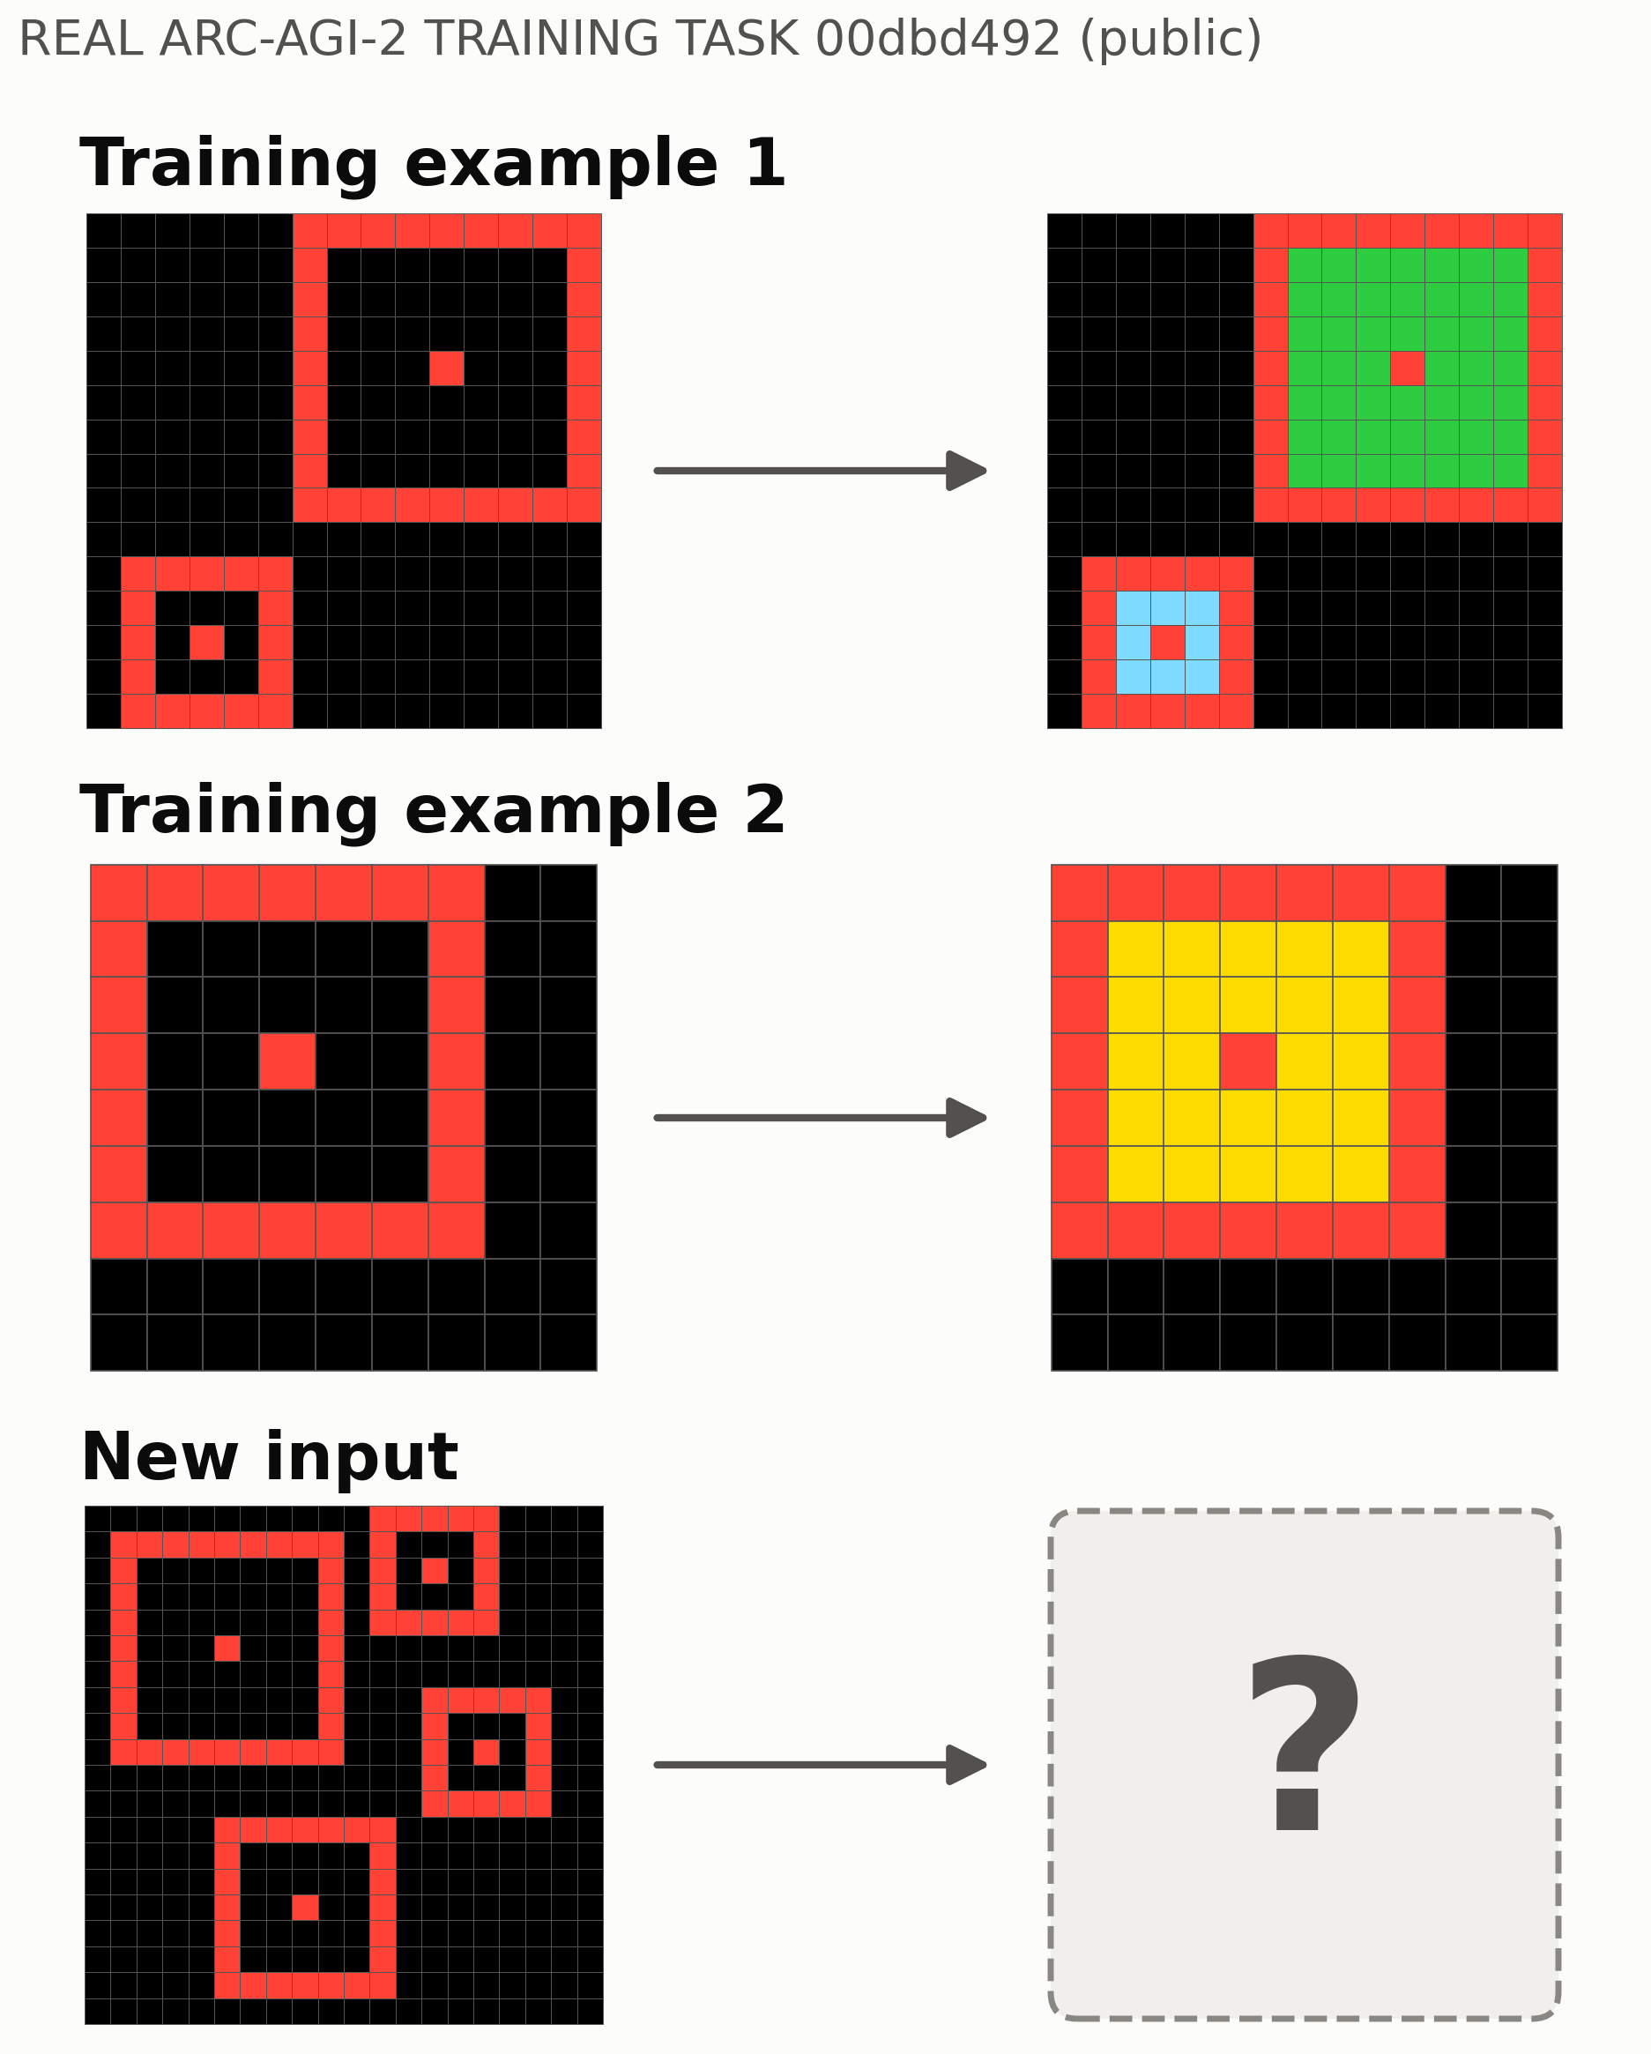
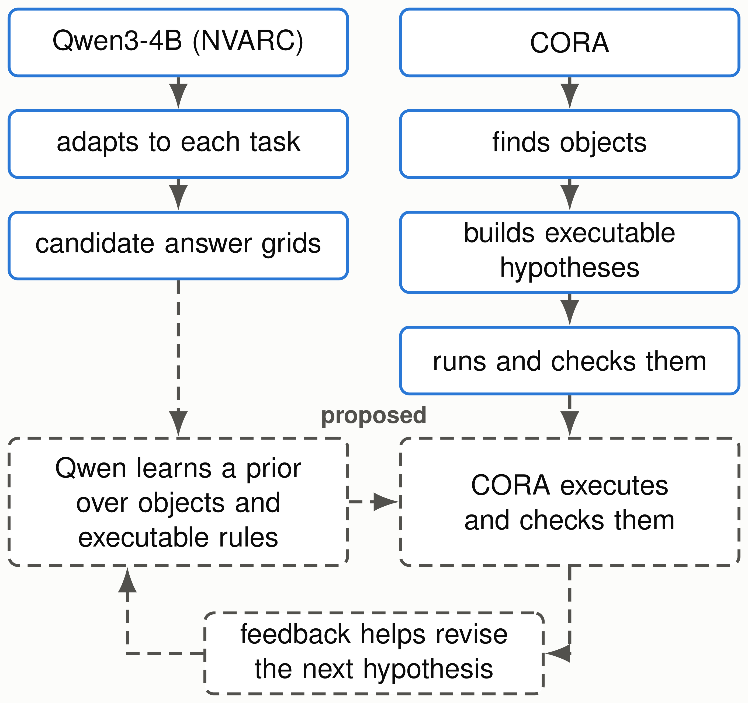






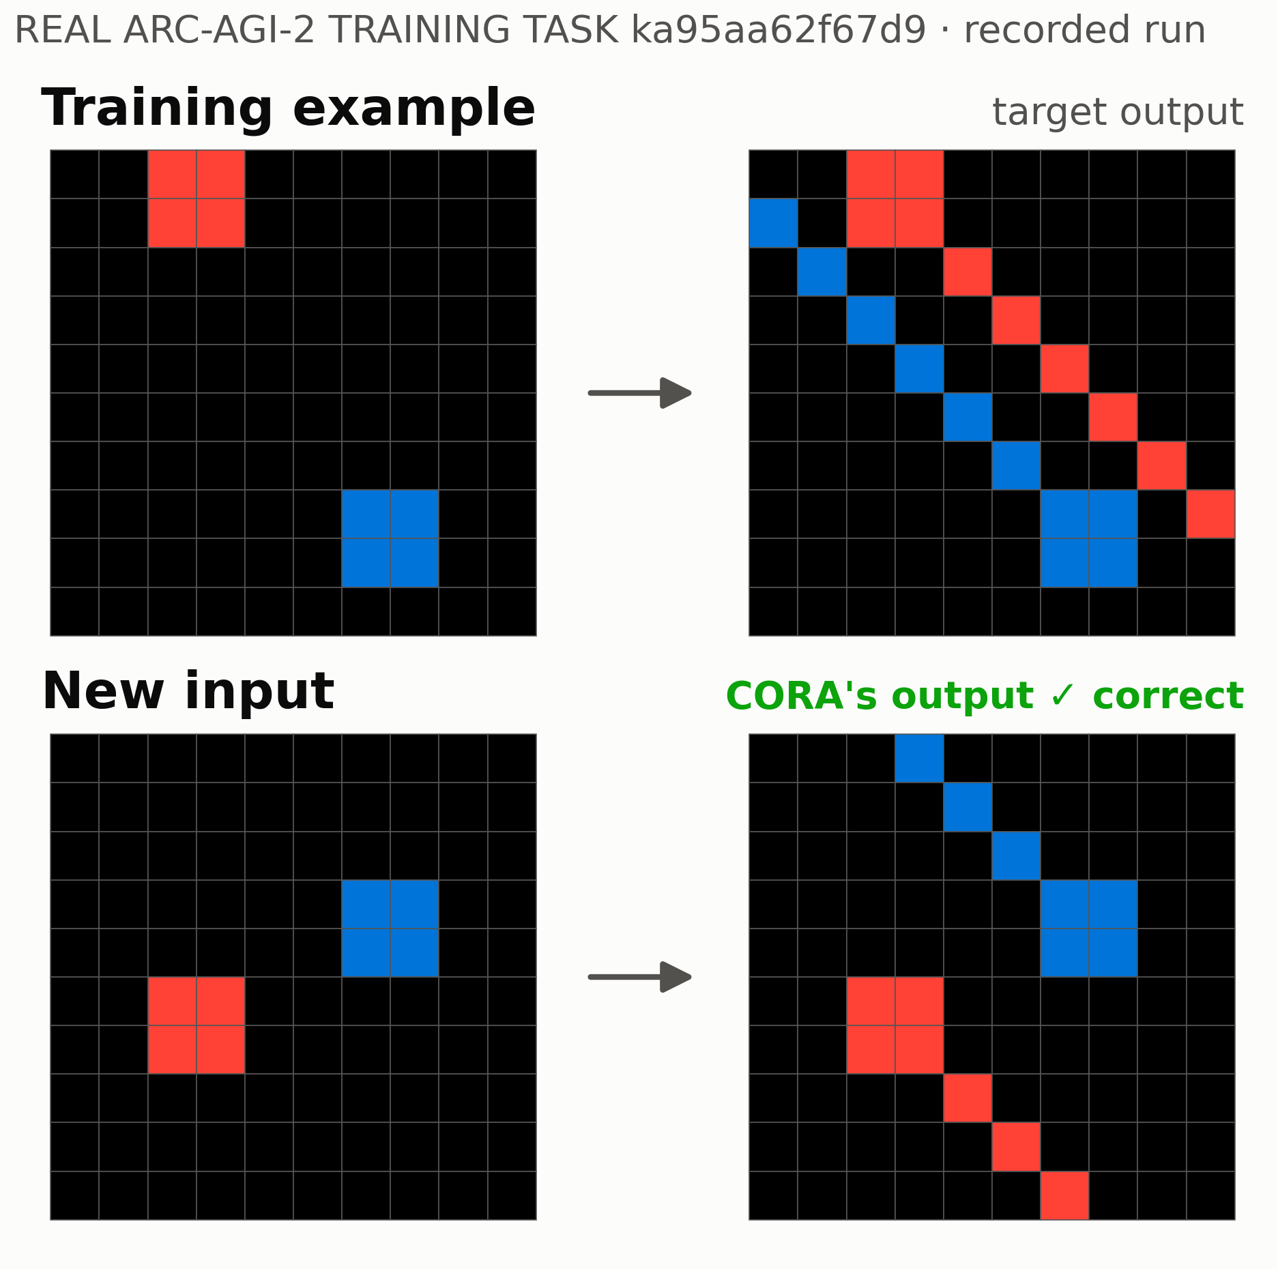


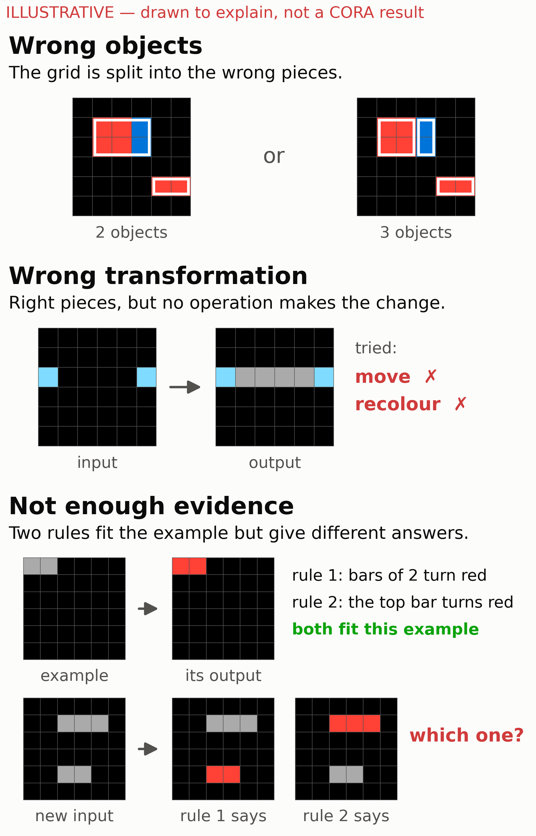
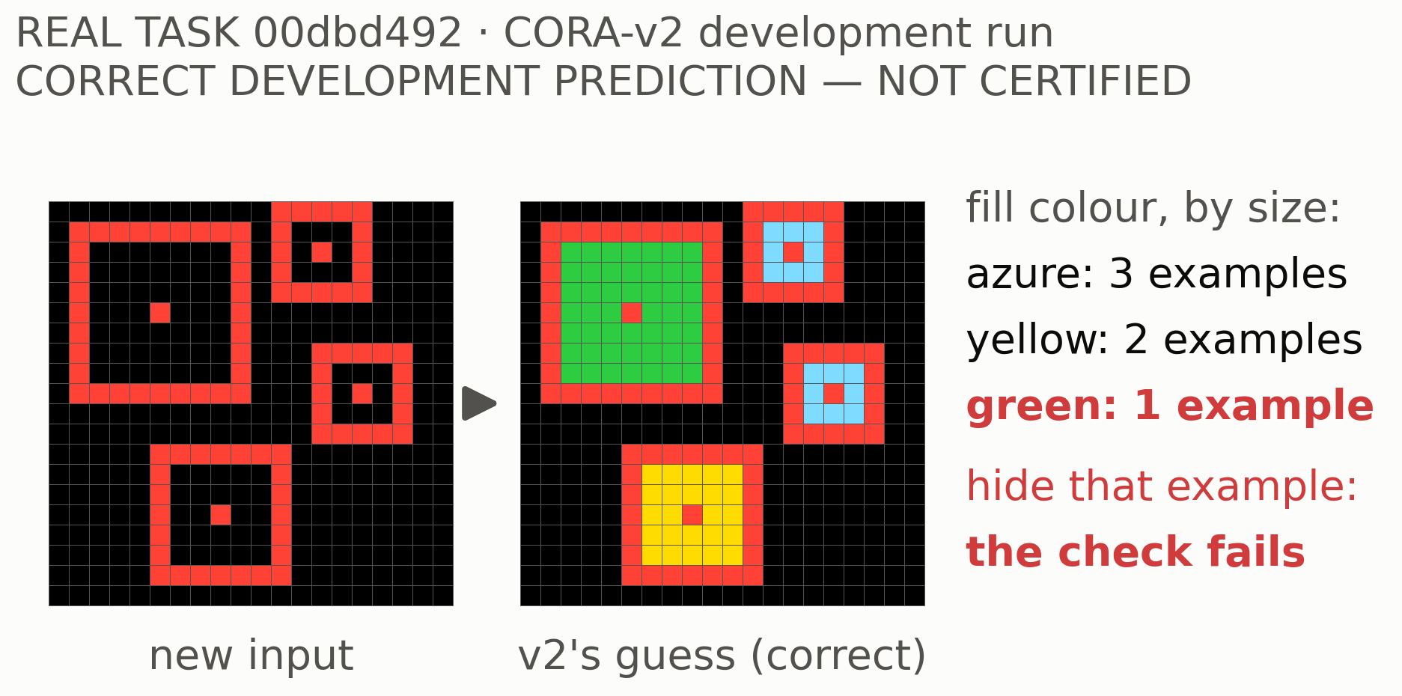
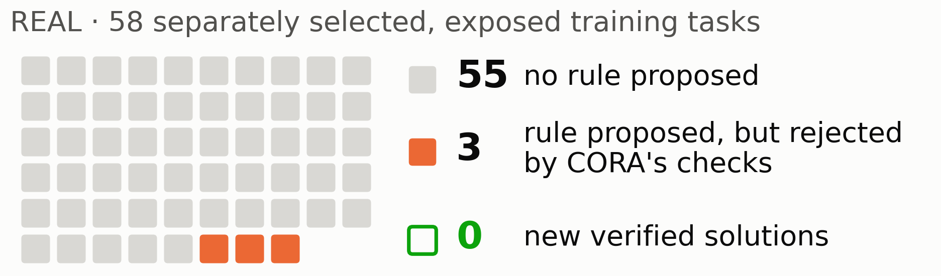
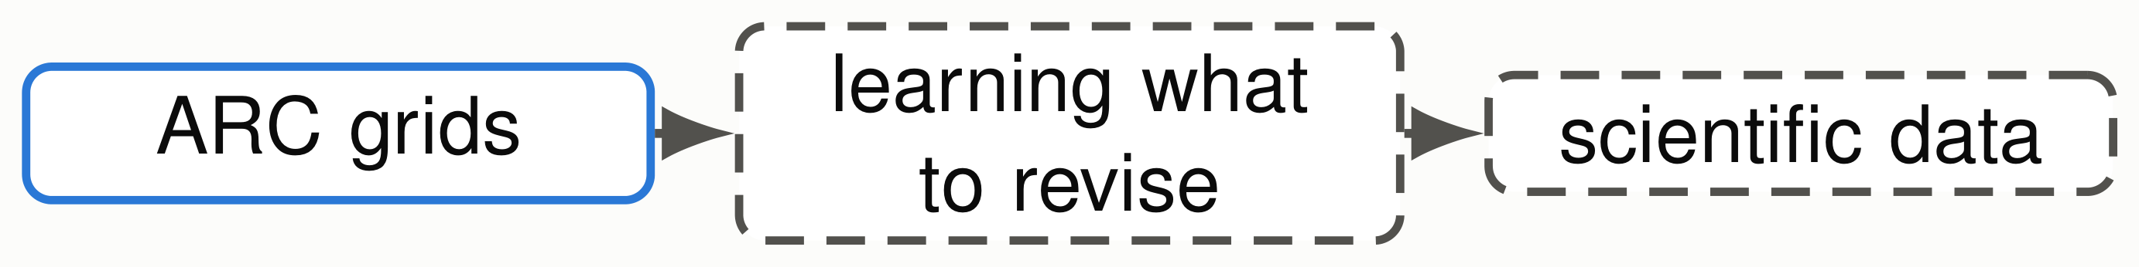


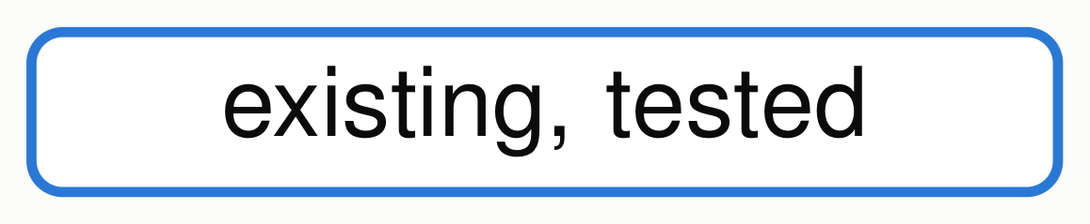
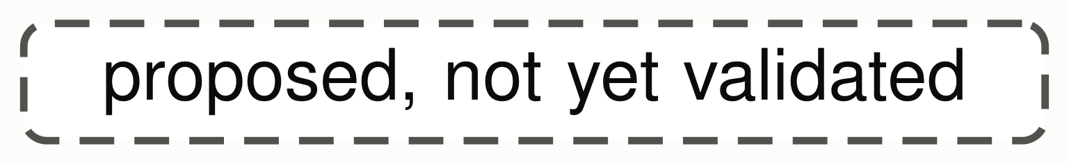
LEARNING WHAT TO CHANGE
LEARNING WHAT TO CHANGE
From Visual Reasoning to Scientific Hypothesis Revision
From Visual Reasoning to Scientific Hypothesis Revision
Chimdi Walter Ndubuisi · University of Missouri
Chimdi Walter Ndubuisi · University of Missouri
REVIEW DRAFT 19 October: for collaborator review, not for print
REVIEW DRAFT 19 October: for collaborator review, not for print
Can a reasoner recognize when its explanation is inadequate,
and determine what needs to change?
Find what is missing, choose a revision, test it. A question shaped in discussions with Toni Kazic.
1 · Why reasoning fails
2 · What CORA has demonstrated
3 · How neural learning may help
One rule must fit both examples and the new input.
CORA writes rules as programs.
existing neural baseline
existing symbolic reasoner
Fitting is not enough [DONE]
27.64%
0.00%
reproduced;
original
6
26
not CORA
CORA
accepted,
tasks: every
all correct
fitted rule failed
60 exposed training tasks.
A rule CORA built [DONE, NARROW]
Can neural learning help a reasoner discover
Rule: each frame’s fill colour depends on its size.
useful representations and rules—and can
executable verification help it determine what to
Three ways an explanation fails
change when those explanations are inadequate?
Solid: existing. Dashed: proposed; the neural proposal
interface has not yet been implemented or experimentally
validated. Scores: official public.
CORA-v2 [DEVELOPMENT]
Rule: blue objects send a line up-left; red ones,
Keeps all fitting rules; flags thin evidence.
down-right.
✓constructed by CORA
✓correct on this task
✓rebuilt 3 of 3 times, one example hidden
= also found without the failure record
An exposed training task, not a Kaggle success.
Did it generalize? [NEGATIVE]
118 exposed tasks: 4 right, 1 wrong guess; none certified.
0 / 58
From ARC to science [FUTURE, NOT TESTED]
new verified solutions
Proteins, omics, plant phenotypes: only the revision policy
could transfer.
Every variant found 0; no wrong answers.
Telling these apart is the research problem.
Building a rule is not learning which revision improves an unseen prediction. That is what we test.
[DONE] [NEGATIVE] [DEVELOPMENT]
[FUTURE, NOT TESTED]
Prior work: Popper, DreamCoder, LILO, Model Discovery Agent; failing and revising is not new. Neural baseline: NVARC’s published method, reproduced. Numbers: records/CORA_SUMMIT_CLAIM_LEDGER_20261017.md · AI coding assistance
used · authorship pending review.

