Slide 1


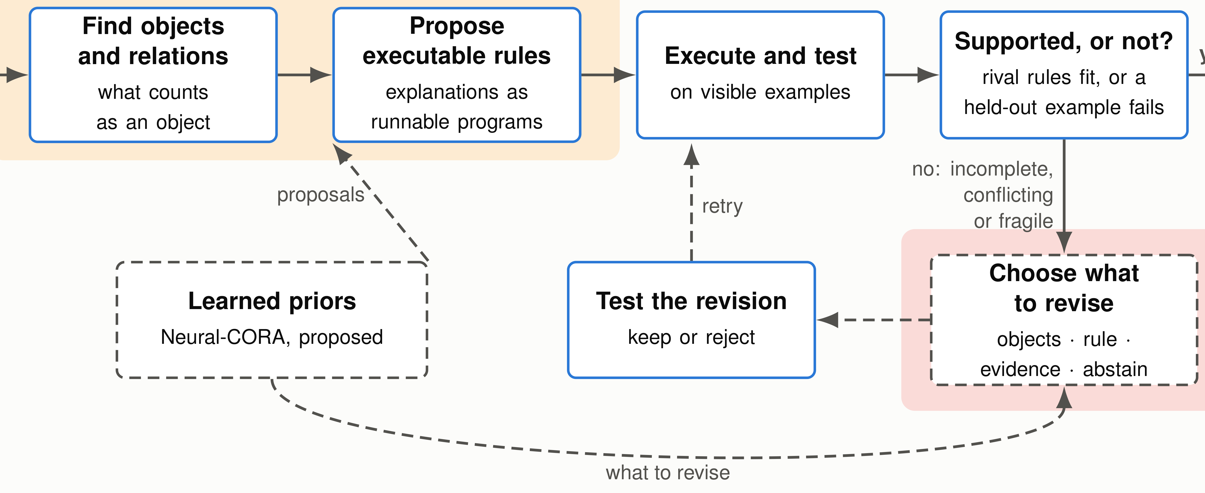
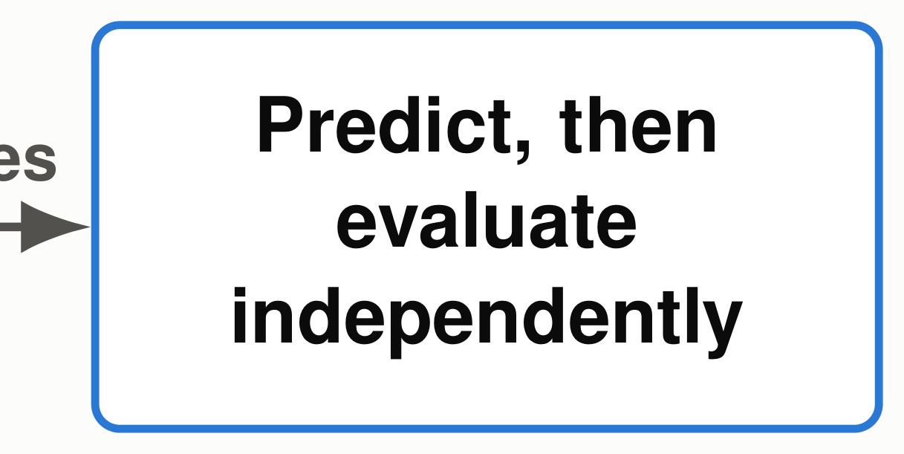








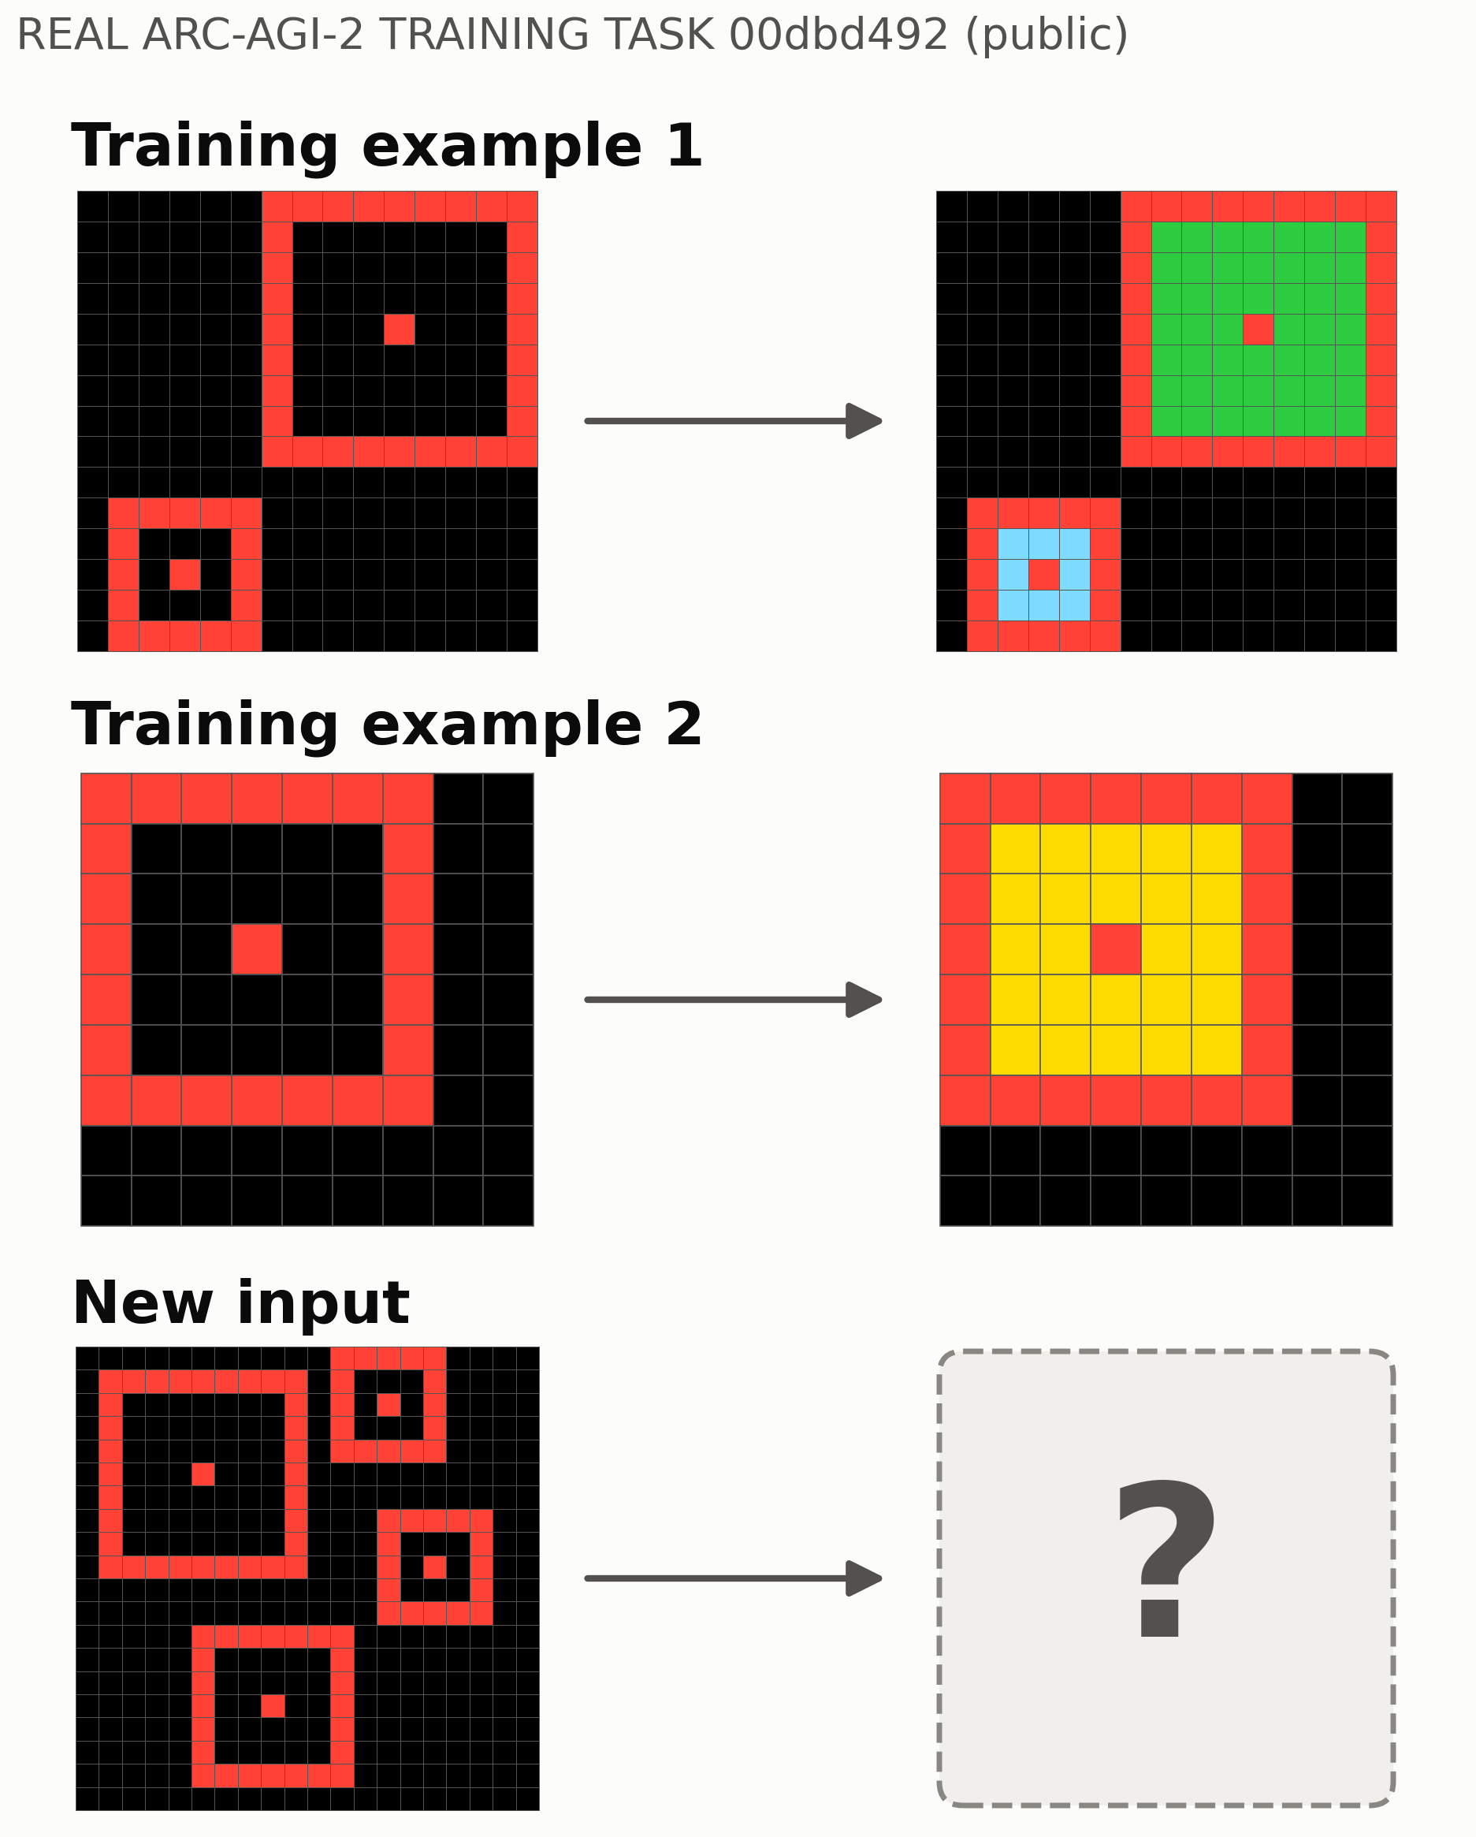
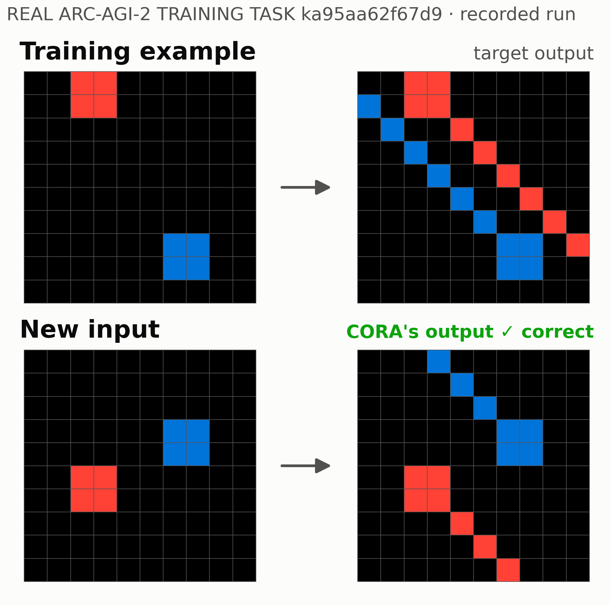
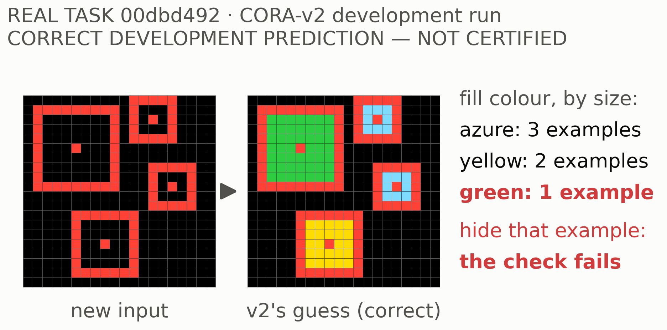
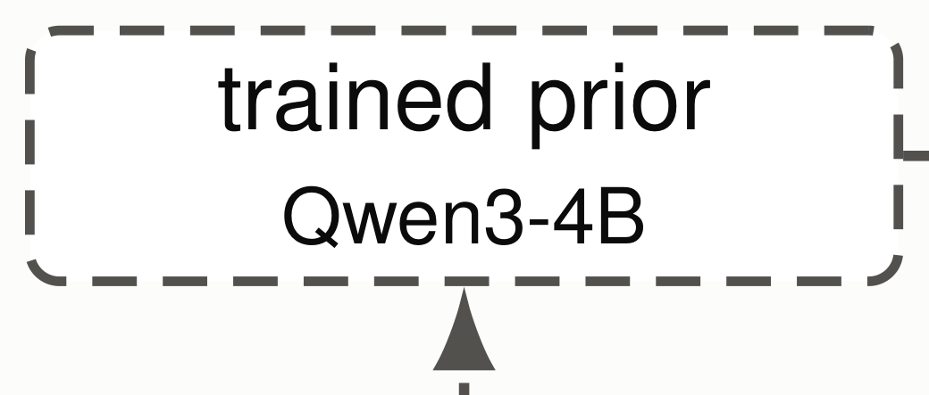

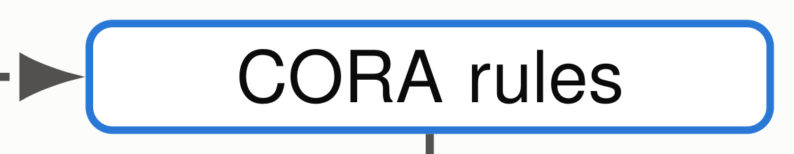


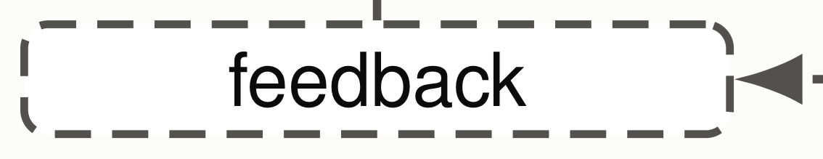

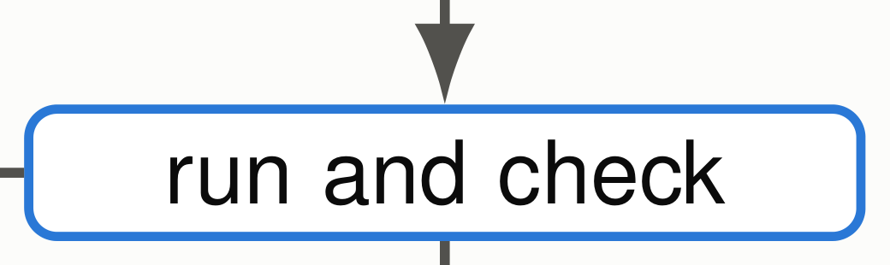

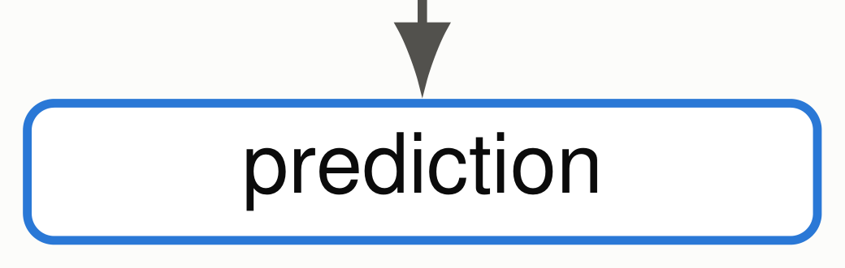
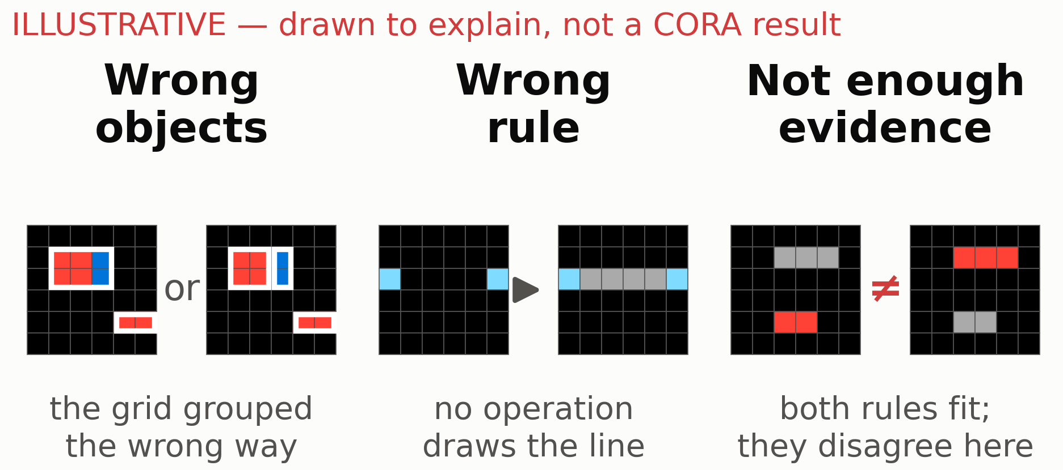
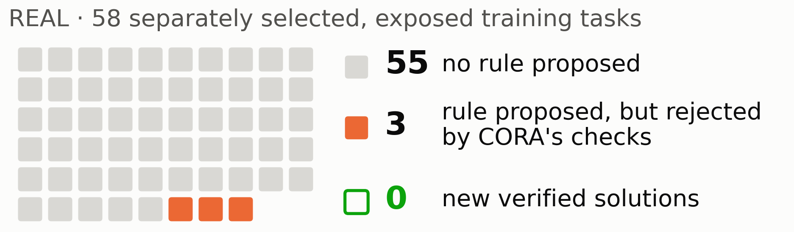
LEARNING WHAT TO CHANGE
LEARNING WHAT TO CHANGE
From Scientific Observations to Executable Reasoning and Hypothesis Revision
From Scientific Observations to Executable Reasoning and Hypothesis Revision
Chimdi Walter Ndubuisi · University of Missouri
Chimdi Walter Ndubuisi · University of Missouri
REVIEW DRAFT 19 October: for collaborator review, not for print
REVIEW DRAFT 19 October: for collaborator review, not for print
How can a machine learn the objects, relationships
ILLUSTRATIVE SCHEMATIC, not data
and rules in unfamiliar data—and know what to
?
reconsider when its explanation is not enough?
maize lesion-mimic pattern
Biology illustrates the difficulty: measurements do not arrive with the correct entities, mechanisms or
What process could explain these patterns?
reasoning rules already identified.
Observed pattern̸ = identified mechanism.
One reasoning loop
BOTTLENECK 1 · measured: CORA often cannot propose a usable rule
visible evidence only: no hidden answer
Scientific question
Observations
what explains an
images · measurements
observation?
· ARC grids
BOTTLENECK 2
unproven: can it
learn which part to
revise?
Solid: implemented and tested. Dashed: proposed. Grey: context. A tested revision is not automatically a correct explanation.
ARC is our controlled testbed
Done: a rule CORA built [DONE, NARROW]
Visible doubt [DEVELOPMENT]
Few examples, a new input, one exact answer.
One example decides the green fill, so CORA-v2 keeps its
correct guess uncertified.
Next: learning inside CORA [PROPOSED]
Rule: blue objects send a line up-left; red ones,
down-right.
Rebuilt 3 of 3 times with one example hidden; correct on an
exposed training task, not a competition solve. Also found
Rule: each frame’s fill colour depends on its size.
without the failure record.
Where it fails [NEGATIVE]
A trained prior would only order CORA’s own search.
Why rules fail
No result yet.
0 / 58
NVARC (published Qwen3-4B method), reproduced: 27.64%
public. Native CORA and CORA with rule construction: 0.00%
new verified solutions from rule construction
public.
Memorization: fits the examples, fails the new input.
Every variant: 0; no wrong answers.
If revision selection works on ARC, test the reasoning procedure—not ARC grid operations—on independently validated biological
questions. [UNTESTED]
Prior work: Popper (Cropper & Morel 2021), DreamCoder (Ellis et al. 2021), LILO (Grand et al. 2024), Model Discovery Agent (Murphy 2026); details in the explainer. Numbers: records/CORA_SUMMIT_CLAIM_LEDGER_20261017.md. AI coding
assistance used. Authorship pending collaborator review.

