Slide 1
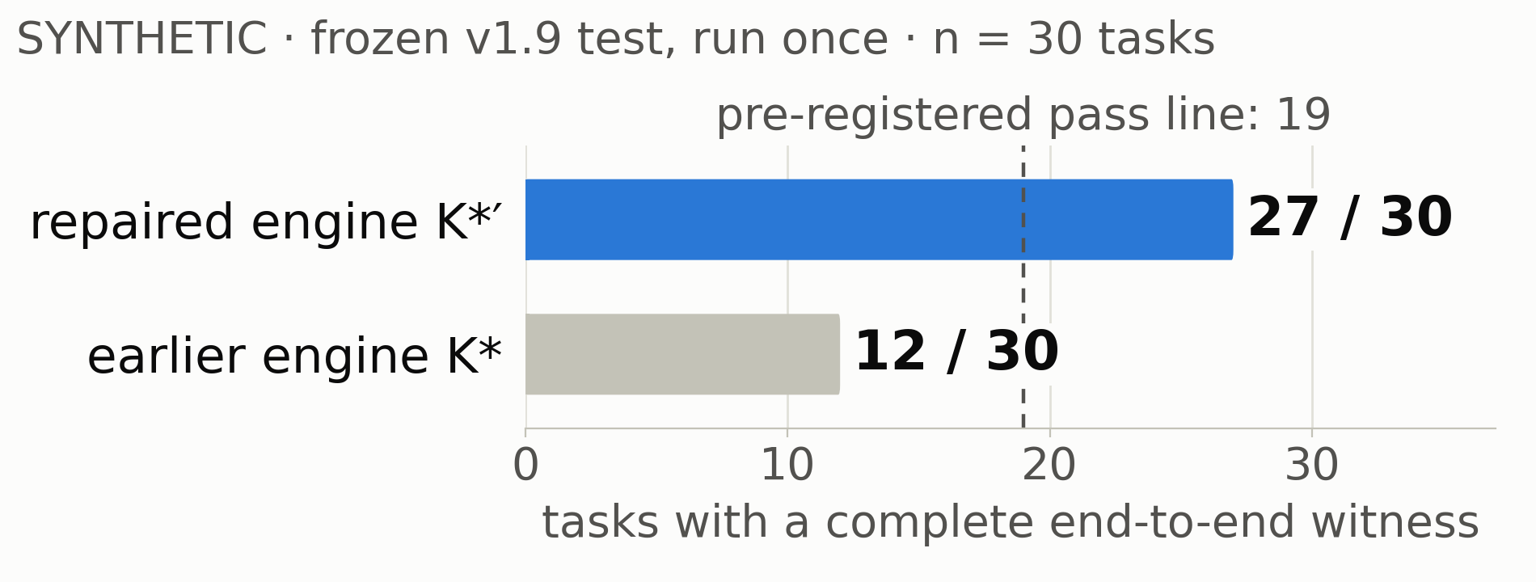
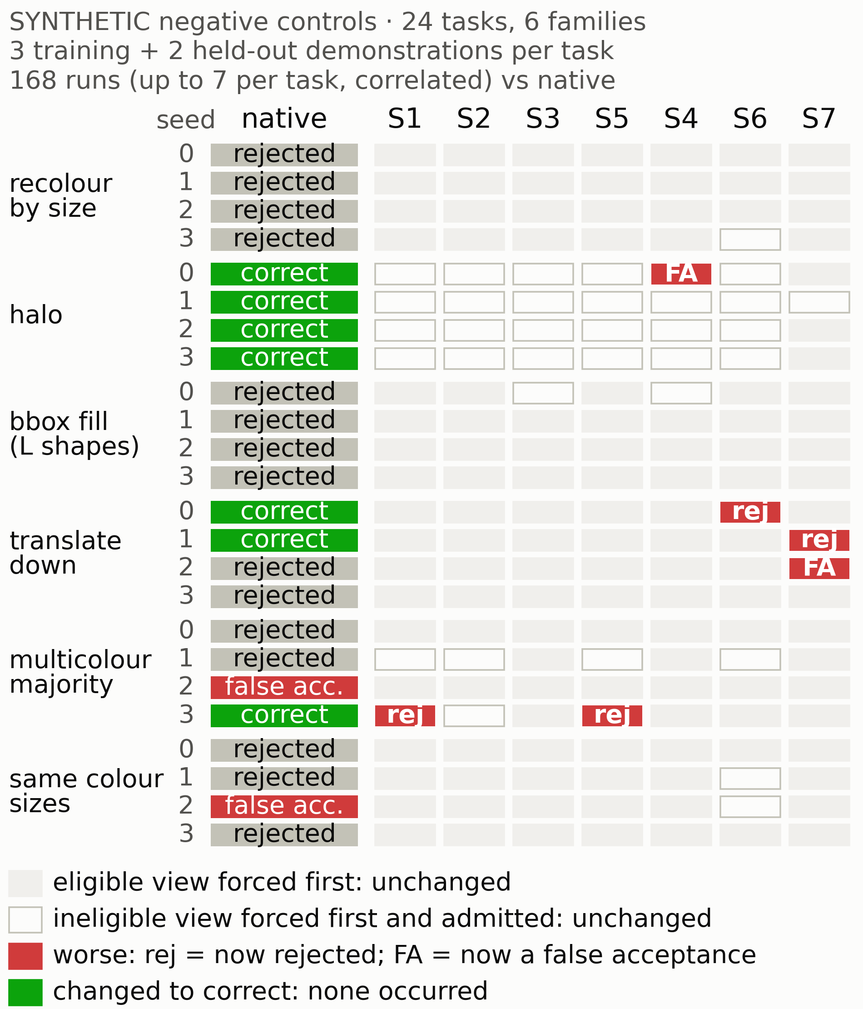
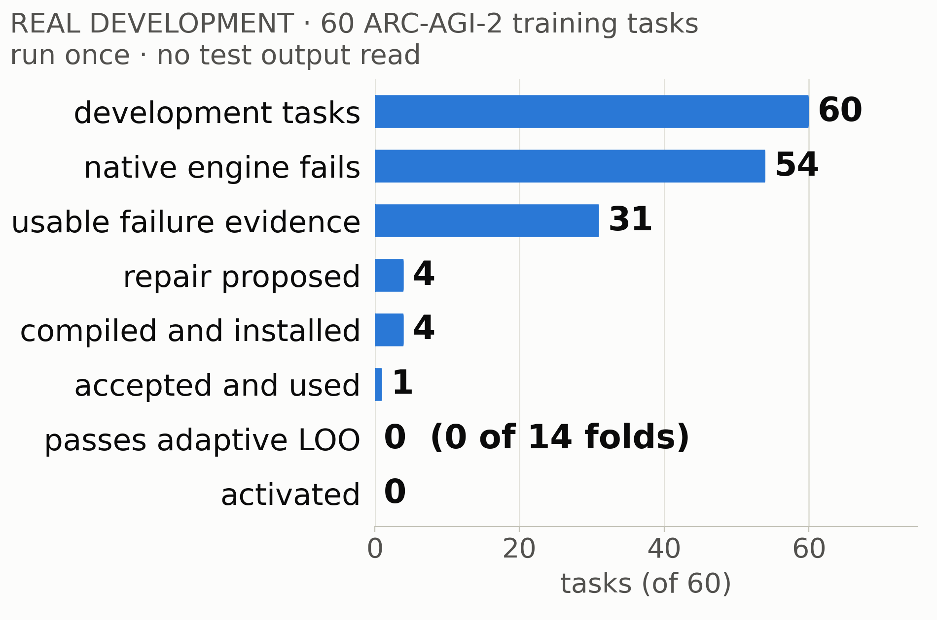
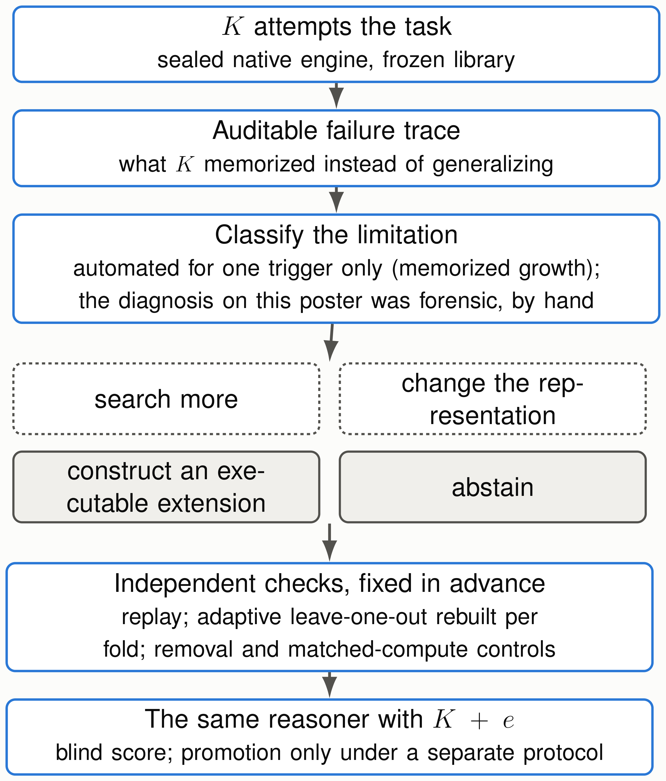
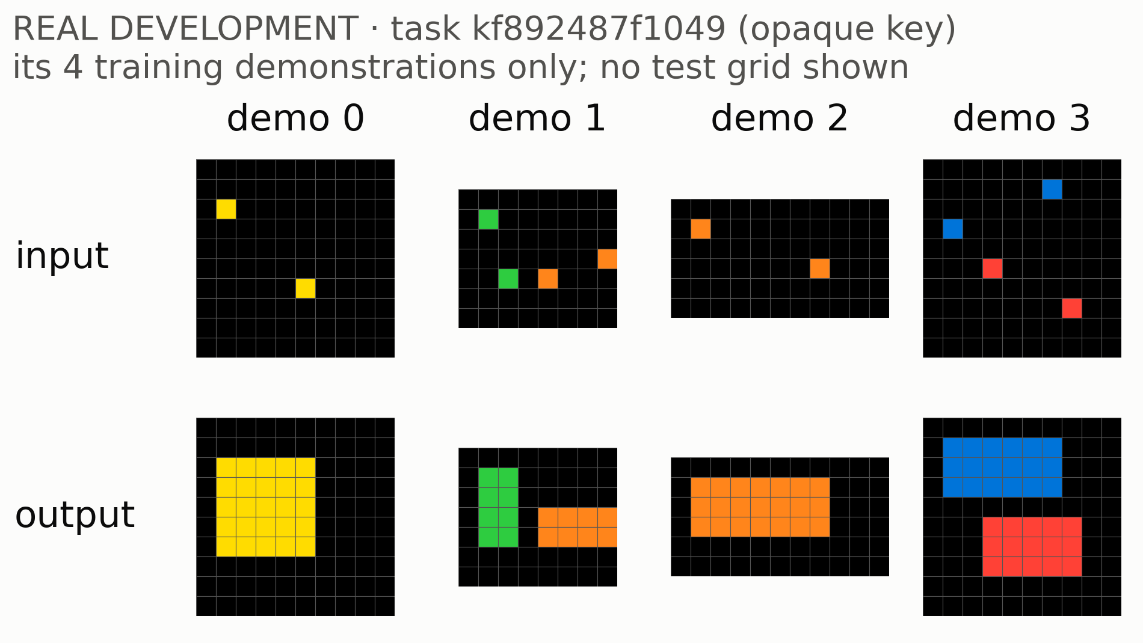
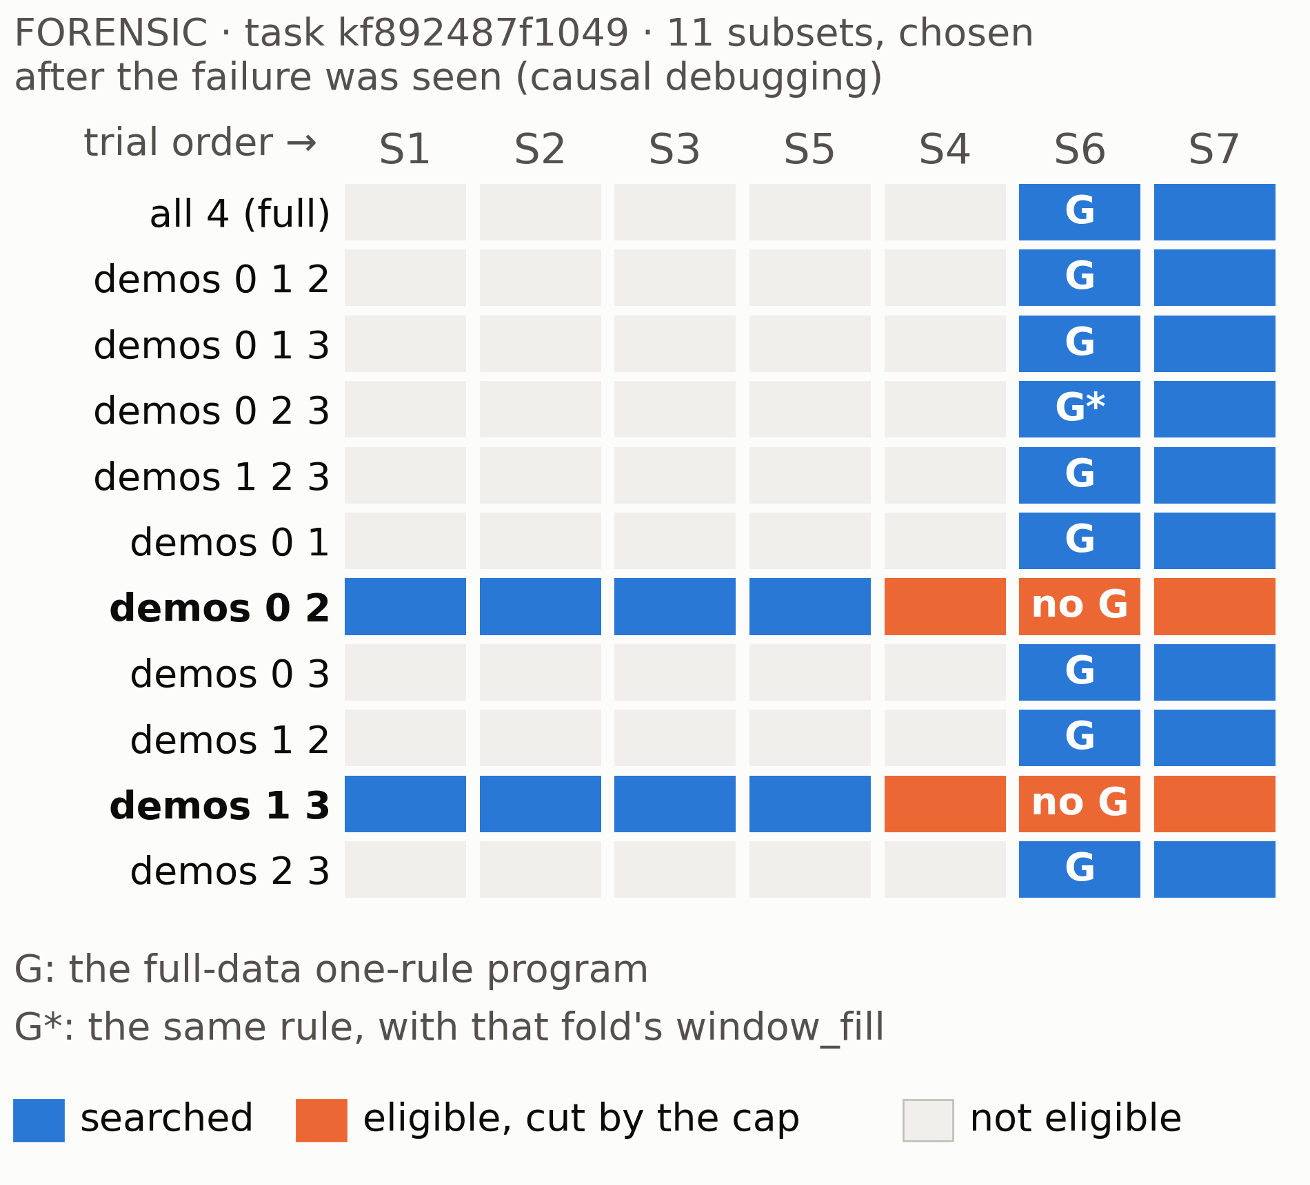
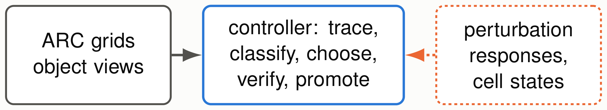
When Search Is Not Enough: Diagnosing Failure
When Search Is Not Enough: Diagnosing Failure
Before Constructing Verified Reasoning Capabilities
Before Constructing Verified Reasoning Capabilities
Chimdi Walter Ndubuisi
Chimdi Walter Ndubuisi
University of Missouri
University of Missouri
CORA on ARC-AGI-2 · development results · ARC Prize Research Summit, 23 October 2026
CORA on ARC-AGI-2 · development results · ARC Prize Research Summit, 23 October 2026
The question
What has been measured
Negative controls before any repair
How can a reasoning system know when
its existing way of solving problems is in-
adequate, and acquire a better one without
compromising the evidence used to judge
it?
A failed solve can need different responses:
• search correction:
the answer is expressible,
A synthetic claim only. The repaired engine also accepted ev-
search missed it
ery deliberately wrong extension it was given (5 of 5, 28 of 28).
• representation correction: the needed view was
screened out
• executable capability construction: the language
lacks it
• evidence insufficiency: the examples underdeter-
mine the rule
• certification failure:
a valid candidate fails the
checks
The CORA loop
No task gained. Forcing one view to be searched first harmed
One constructed extension was accepted and used by the un-
5 of 24 tasks: 4 of the 7 natively correct tasks lost their answer,
changed engine; none survived adaptive leave-one-out. No
and 1 rejected task became a false acceptance. The variant-
new ARC solve: the certified training score stays 185/1,000.
first repair we had built was therefore not run.
The right view was cut, not missing
What a valid repair must respect
• Every fold, inner and outer, selects its representation from
its own training demonstrations only.
• Anchoring a fold to the parent’s view would use the fold’s
held-out demonstration: forensic only, never a certificate.
• Removing duplicate views reaches S6 on both failing pairs,
from the fold’s data alone.
Tested on 41 synthetic tasks,
it gained 1 and harmed 4 (2 correct answers lost, 2 false
acceptances) through the coarse views it let in: rejected.
• Observed, not a theorem: removing a demonstration made
an eligible view ineligible in 7 of 724 development compar-
isons (pooled coverage).
Solid: implemented and measured.
Dashed: proposed, not
A portable controller? BIOLOGICAL
automated. A general failure-type controller is proposed, not
implemented.
APPLICATION: UNTESTED
Four claims, four kinds of evidence
implemented
untested
(a) the extension causes the
development only: nothing
solve
accepted without it, or with
matched compute; not
The hypothesis: the controller and its evidence and certificate
(b) the real failure trace
certified
interfaces are portable; ARC operators are not. A test needs
matters
demonstrations-only and
typed adapters, training-only diagnosis, held-out perturbations
shuffled failures never gave an
and cell states, and confounder controls. No biological data or
accepted, used extension (4
result exists here.
(c) a bounded semantic
tasks)
extension
not established
Not claimed · evidence
(d) retention and later reuse
untested
The engine searches at most four eligible views, in a fixed or-
der. With only demonstrations 0 and 2, or 1 and 3, finer views
No ARC-AGI-2 solve or score gain; no semantic invention; no
become eligible and fill the four slots. The colour-layer view S6,
automatic failure-type controller; no domain generality; no
where G lives, is never searched. Two of the four slots are du-
results from the separate VDCG project. The 120-task pilot is
plicates: S2 and S5 give the reasoner exactly S1’s input there.
frozen and has not been run.
Can a neural model pick the view?
Not here.
In a pre-
Every number, with commit and hash:
registered synthetic test (35 cases that needed a different
records/CORA_SUMMIT_POSTER_EVIDENCE_20261012.md; figure hashes:
view), the fixed order picked right 35 times; a frozen Qwen2.5-
figures/PROVENANCE.json.
1.5B 19 times, and only once when shown the reasoner’s real
failure record (a shuffled record did the same); I-JEPA 3 times.

