Slide 1
Go for Pythonists
Aditya Mukerjee
(@chimeracoder)

Slide 2
“About the Author”
Background: Server-side engineer/data scientist
  Professional work: ~50% Python (data work)
Began using Go in September
HackNY fellow (2011)
Currently Hacker-in-Residence at Quotidian Ventures

Slide 3
Python is awesome!

Slide 4
Easy to read, even for non-Pythonistas
Only one (obvious) way to do it
Semi-standard style (PEP 8, etc.)
Dynamic typing => easy to prototype
Duck typing is awesome!
Relatively fast (vs. some interpreted languages)
Extensible (C extensions, etc.)
Docstrings => great documentation culture
Great library support
Great community

Slide 5
Python can be not-so-awesome....

Slide 6
Dynamic + strong typing = careless, fatal errors:
  eg. string concatenation with an integer literal
Slow (compared to C)
Migrating code between versions requires work (ie, py3k)
Threading

Slide 7
Go applies the Pythonic philosophy to a C-style language
(http://talks.golang.org/2012/splash.article)

Slide 8
Why Go?
Easy to read, even for non-Go programmers
Only one (obvious) way to do most things
Completely standard style
Very opinionated compiler
  Catches “lint” + much more
Migrating code between versions requires no work ('go fix')
Static typing => easy to catch errors
Duck typing is still awesome!
Type inference => concise (unlike Java)
Godoc => similar to docstrings
Extensible (C extensions, etc.)
Good (growing) library support
Great community

Slide 9
Basic Datatypes
Python | Go
int | int, int32, int64
float | float, float32 float64
tuple | array (mutable, fixed size)
list | Slice
bytes | []byte
string | string
dictionary | maps (ie, map[string]int)

Slide 10
Syntax
Fairly similar to C
  However, types come after declarations
Yes, there are braces. I know, I know.

Slide 11
Semicolons!
Unlike Javascript, truly optional
However, 'for' loops require same-line braces

Slide 12
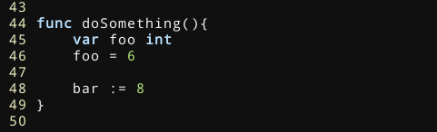
Declaration

Slide 13
Zero values
By default, an uninitialized value carries the 'zero value' for that type
Encourages you to design your application in such a way that the default values are meaningful

Slide 14
Zero values
Go | Zero value
int, int32, int64 | 0
float, float32 float64 | 0.0
Slice | nil
string | “”
Pointer (any kind) | nil
maps | nil
Channel | nil

Slide 15
Error handling
Explicit is better than implicit
Don't raise exceptions – return errors
Advantages:
  Errors are are very visible within the code
  The compiler forces you to address them – or ignore the explicitly
  Errors can contain arbitrary information (interface)
Disadvantages
  A little weird to get used to (coming from Python)
  Verbose

Slide 16
Let the compiler be your guide

Slide 17
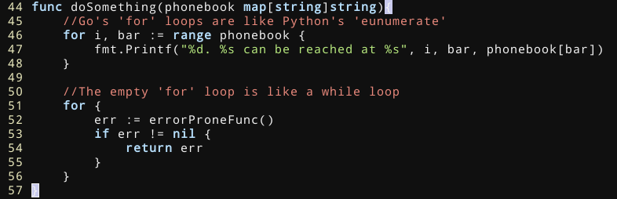
Basic structures: if/for

Slide 18

Structs
Similar to Python classes
No inheritance
Extra fields cannot be defined at runtime
Capitalized fields/methods are exported

Slide 19
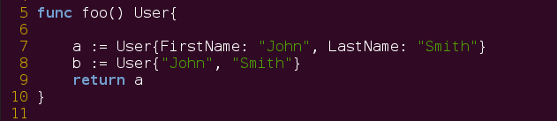
Initializing structs

Slide 20
“New”
Allocates memory, initializes (zeros) it, and returns a pointer

Slide 21

Methods
Methods appear outside the struct definition
Like Python, “implicit” parameter is really explicit
  Unlike Python, you generally don't use “self”
Automatically dereference pointers

Slide 22
Interfaces
Duck typing: 'If it .look()s like a Duck and .quack()s like a duck, it's a duck'
If any type provides the methods of an interface, it belongs to the interface
  The method name and signature (with return value) must match
Like Python, you simply use struct and it 'just works'.
Unlike Python, safety can be checked at compile-time
  Remember: all methods are known at compile-time

Slide 23
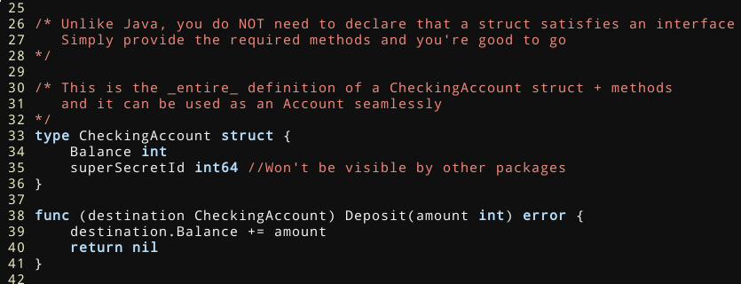

Slide 24
Concurrency
Use goroutines/channels
'Don't communicate by sharing memory; share memory by communicating'
Goroutines are lightweight, green threads which are multiplexed onto multiple OS threads
  If one blocks, the others still run
  Very small memory footprint – you can easily have hundreds of thousands of goroutines running.
Advantage: Concurrent code looks very similar to non-concurrent code
  Compare to callbacks

Slide 25
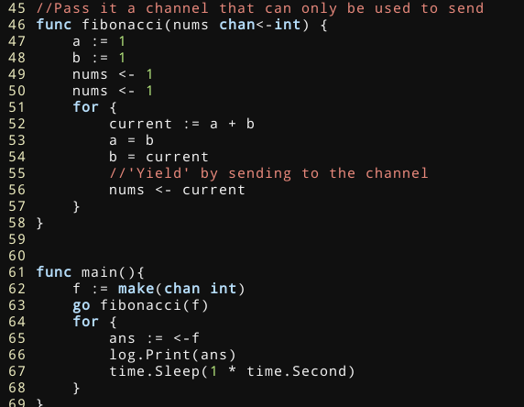
Using Channels: Generators

Slide 26
Concurrency: Channels of channels
Channels are first-class values
Easy to implement rate-limiting for API calls, etc.
The 'select' keyword lets you for any one of several channels to stop blocking

Slide 27
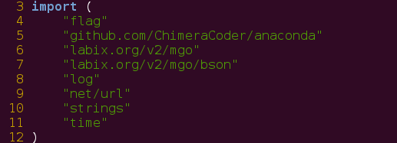
Package Management
Instead of virtualenv, Go has $GOPATH
  Both do the same thing and in very similar ways
'go get' will fetch a remote package, compile and install it

Slide 28
Common Pitfalls for Pythonistas
Use slices, not arrays
Unexported (lowercase) fields are not externally visible
  Packages like “encoding/json” cannot view them
Execution ends when the main() function terminates, even if other goroutines are running
  sync.WaitGroup is the solution to this

Slide 29
Things I (sometimes) miss
List comprehensions
  Life without sugar
Generics
  Not as necessary as you might think, but still helpful
NumPy/SciPy
  Scientific computation libraries are being developed, but they are a work in progress
The GIL
  Just kidding!

Slide 30
Where to go from here?

Slide 31
Community
'gofmt' makes all Go code standardized
Reading the source code is easy
#go-nuts
Go NYC Meetup
  'Go for MongoDB @10Gen on Tuesday, March 12)

Slide 32
Further Resources
The Go spec: http://golang.org/ref/spec
Effective Go
http://www.golang-book.com/ (Caleby Doxsey)
Writing Web Applications in Go: http://golang.org/doc/articles/wiki/

Slide 33
gojson
https://www.github.com/chimeracoder/gojson
Generate struct definitions for arbitrary JSON
Eliminates need for type assertions
If unmarshalling into a struct succeeds, you're guaranteed to know what operations you can perform on it

Slide 34
Credits
All slides are licensed CC-BY-SA
'Go Gopher' courtesy of Renée French

