Slide 1

Theory, Application and Explainability of Neural Network Models for Data Classification
Orji Chimzurumoke
Department of Mathematics and Statistics
University of Houston-Downtown
Committee:
Dr. Gogovi Gideon
Dr. Jegdic Katarina
Dr. Shoemaker Katherine

Slide 2
Table of Contents
Neural Network Fundamentals
Activation Functions
Cost Function
Backpropagation
Exploratory Data Analysis
Training and Testing the Model
Using LIME to Interpret the Model
Conclusions

Slide 3
Neural Network Fundamentals
Neural Networks mimic what happens in the brain (perceptrons)^{[1]}
Mathematically manipulated neurons passed on to other neurons
Might be more than one layer of neurons
Neural Networks usage
Modeling complex relationships between inputs and outputs
Recognizing images including handwriting
Enhancing grainy images
Translating from one language to another (NLP)
Advertising
1. P. Wilmott, “Machine learning: an applied mathematics introduction,” Machine Learning and the City: Applications in Architecture and Urban Design, pp. 147–171, 2022.

Slide 4
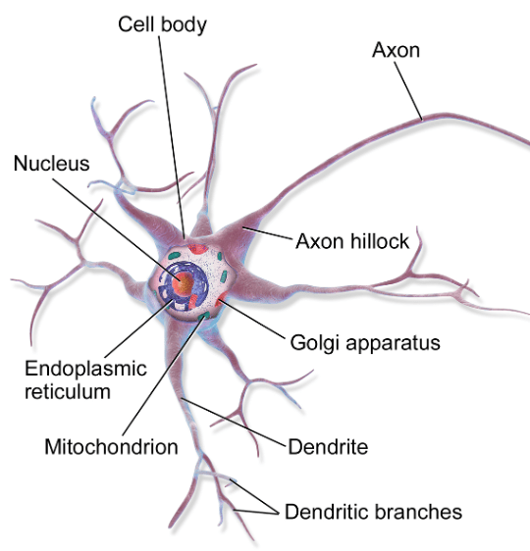
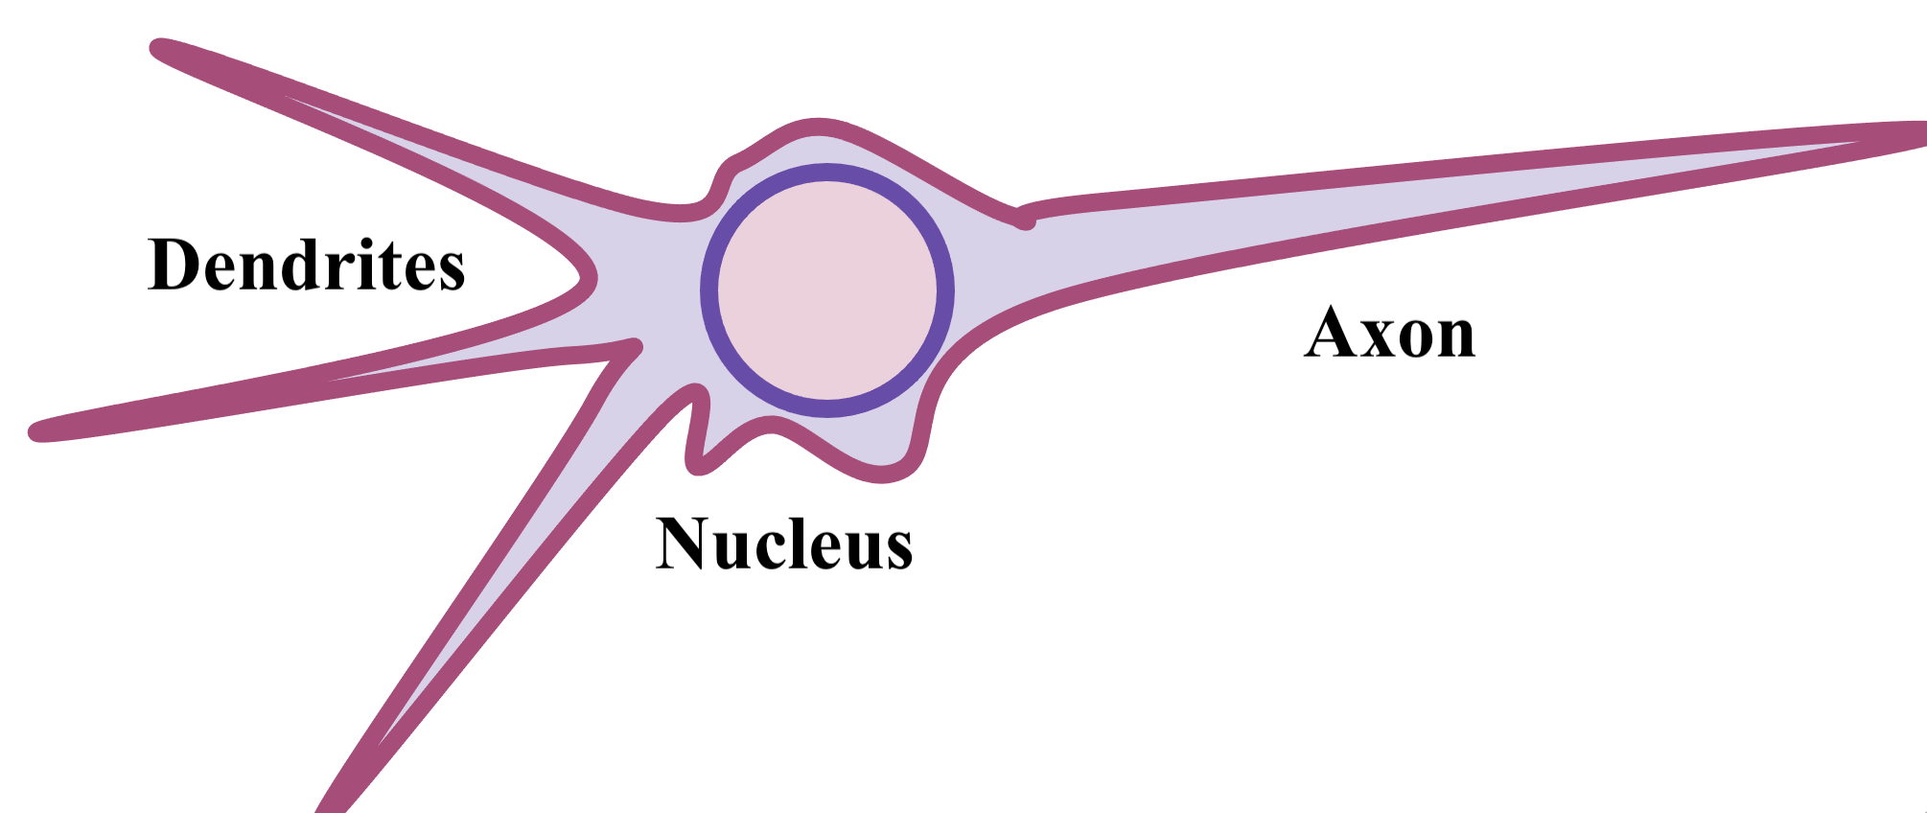
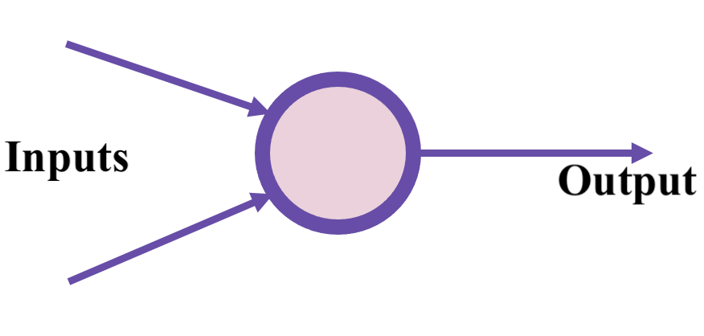
Neural Network Fundamentals
Simplified biological neuron to Perceptron Model

Slide 5
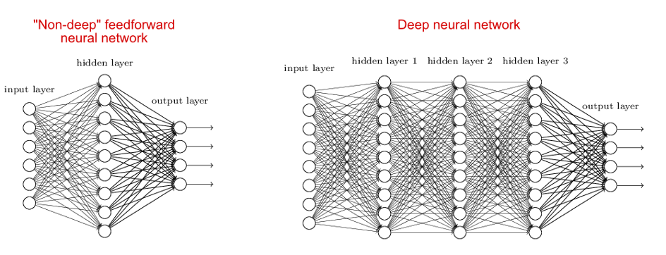
Network Architecture and Types
A typical feed-forward neural network has a left input layer, right output layer and one hidden layer in between
Universal Approximation Theorem: States that, under quite weak conditions, as long as you have enough nodes (in the hidden layer) then you can approximate any continuous function with a single-layer neural network to any degree of accuracy.^{[1]}

Slide 6
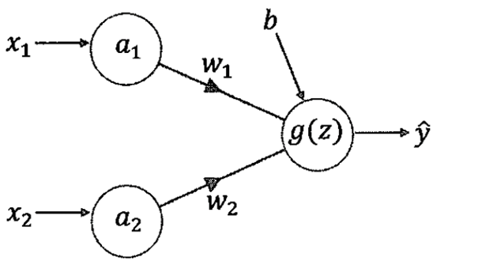
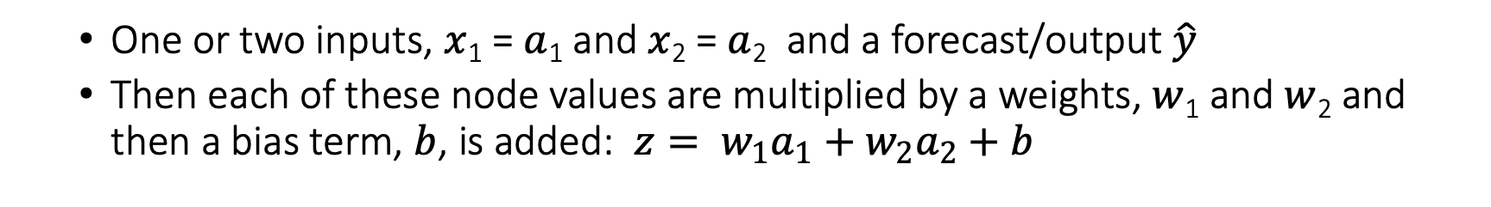
This result is then acted on by a function $g(z)$ to give the output.
Network Manipulation
One or two inputs, $x$­₁ = $a$₁ and $x$₂ = $a$₂ and a forecast/output $\hat{y}$
Then each of these node values are multiplied by a weights, $w$₁ and $w$₂ and then a bias term, $b$, is added: $z= w_{1}a_{1}+w_{2}a_{2}+b$

Slide 7
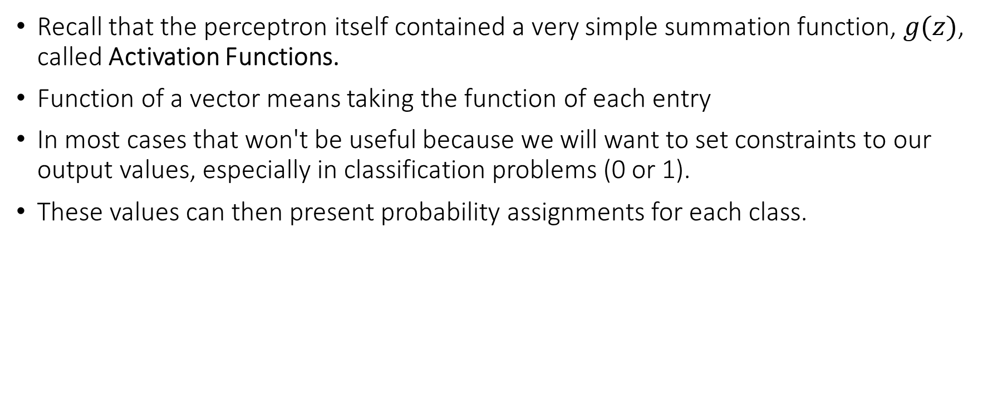
Network Manipulation
Recall that the perceptron itself contained a very simple summation function, $g(z)$, called Activation Functions.
Function of a vector means taking the function of each entry
In most cases that won't be useful because we will want to set constraints to our output values, especially in classification problems (0 or 1).
These values can then present probability assignments for each class.

Slide 8
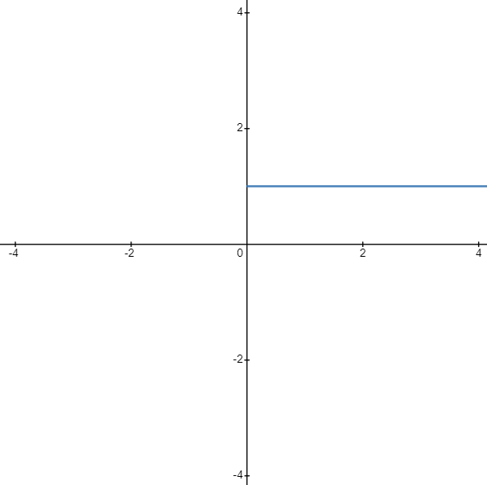
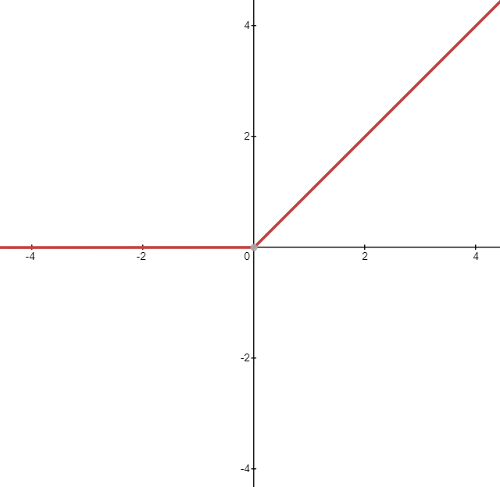
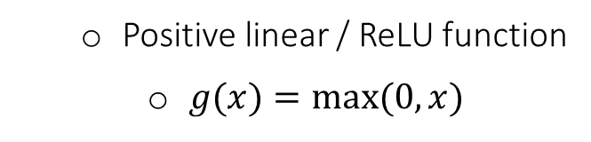
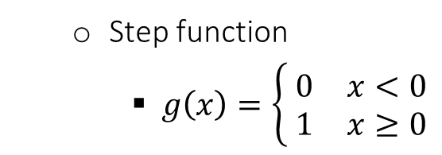
Activation Functions
Akin to the brain, neurons whereby an electrical signal once it reaches a certain level will fire the neuron so that the signal is passed on. If the signal is too small, then the neuron does not fire^{[1]}
Step function
$g\left(x\right)=\left\{ \begin{matrix}0 & x<0 \\ 1 & x≥0\end{matrix}\right.$
Positive linear / ReLU function
$g(x)=max(0,x)$

Slide 9
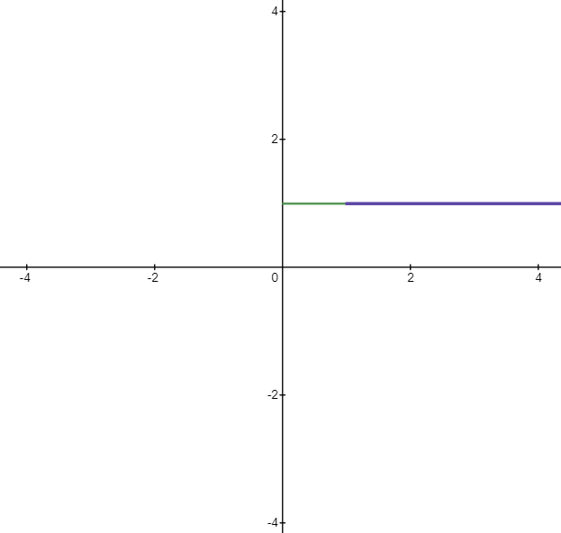
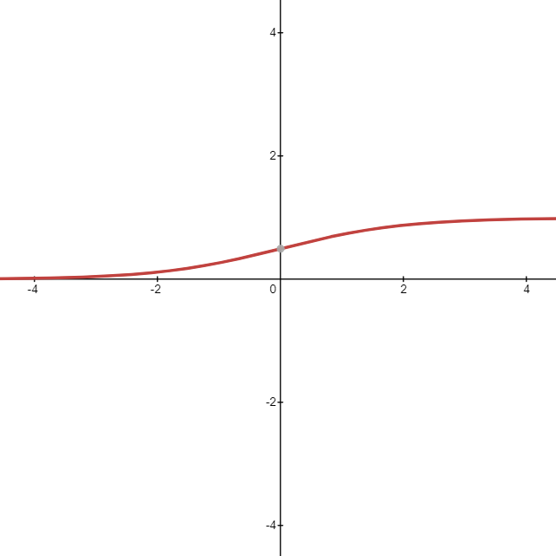

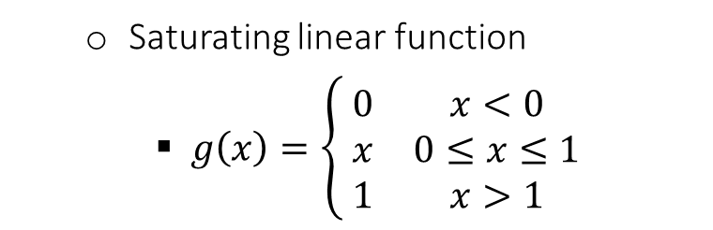
Activation Functions
Saturating linear function
$g\left(x\right)=\left\{ \begin{matrix}0 & x<0 \\ x & 0≤x≤1 \\ 1 & x>1\end{matrix}\right.$
Sigmoid or logistic function
$g\left(x\right)=\frac{1}{1+e^{−x}}$

Slide 10
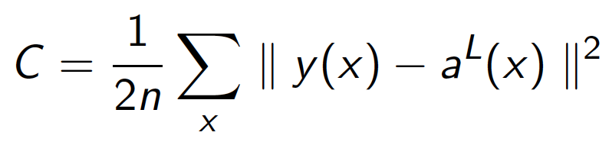
Cost function
Like simple forms of regression, we need to have a measure of how good our algorithm is doing at fitting the data.
Thus, we need a cost function (often referred to as a loss function).
We can keep track of our loss/cost during training to monitor network performance.
A common cost function is the quadratic cost function:
Simply calculate difference between real values y(x) and predicted values a(x).

Slide 11
Backpropagation
Once we get the cost/loss value, we go back and adjust the weights and biases. This is backpropagation.
Main idea is that we can use the gradient to go back and adjust w_{i} and b_{i} to minimize the output of the error vector on the last output layer.

Slide 12
Application
Breast cancer is the most common cancer diagnosed among US women (excluding skin cancers)^{[2]}
It is second leading cause of cancer death among women after lung cancer^{[2]}.
Early diagnosis/identification can save lives.
We demonstrate use of neural network models for Classification using breast cancer data^{[3]} from UCI ML repository.
2. C. E. DeSantis, J. Ma, M. M. Gaudet, L. A. Newman, K. D. Miller, A. Goding Sauer, A. Jemal, and R. L. Siegel, “Breast cancer statistics, 2019,” CA: a cancer journal for clinicians, vol. 69, no. 6, pp. 438–451, 2019.
3. Source: Breast Cancer Wisconsin (Diagnostic) Data Set

Slide 13
Goal
Use neural networks to classify the data into benign and malignant subsections.
Extend to explaining which of the computed is/are the major contributors of cancer.

Slide 14
Data Set Description
The following real-valued features are computed for each cell nucleus:
radius (mean of distances from center to points on the perimeter)
texture (standard deviation of gray-scale values)
perimeter
area
smoothness (local variation in radius lengths)
compactness (perimeter2 / area - 1.0)
concavity (severity of concave portions of the contour)
concave points (number of concave portions of the contour)
symmetry
fractal dimension ("coastline approximation" - 1)
The mean, standard error and "worst" of these features were computed for each image, resulting in 30 features.

Slide 15
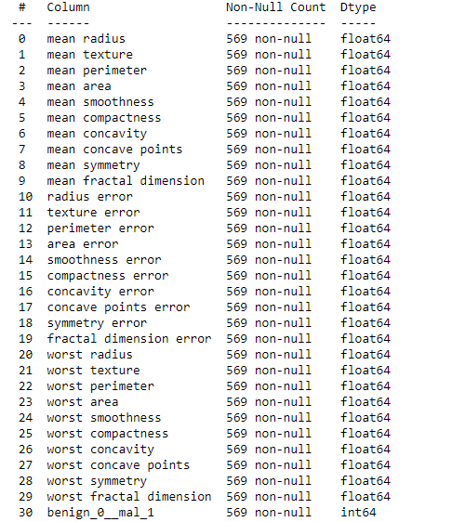
Exploratory Data Analysis (EDA)
Features are computed from a digitized image of a fine needle aspirate (FNA) of a breast mass.
They describe characteristics of the cell nuclei present in the image^{[4]}
4. K. P. Bennett and O. L. Mangasarian, “Robust linear programming discrimination of two linearly inseparable sets,” Optimization methods and software, vol. 1, no. 1, pp. 23–34, 1992.

Slide 16
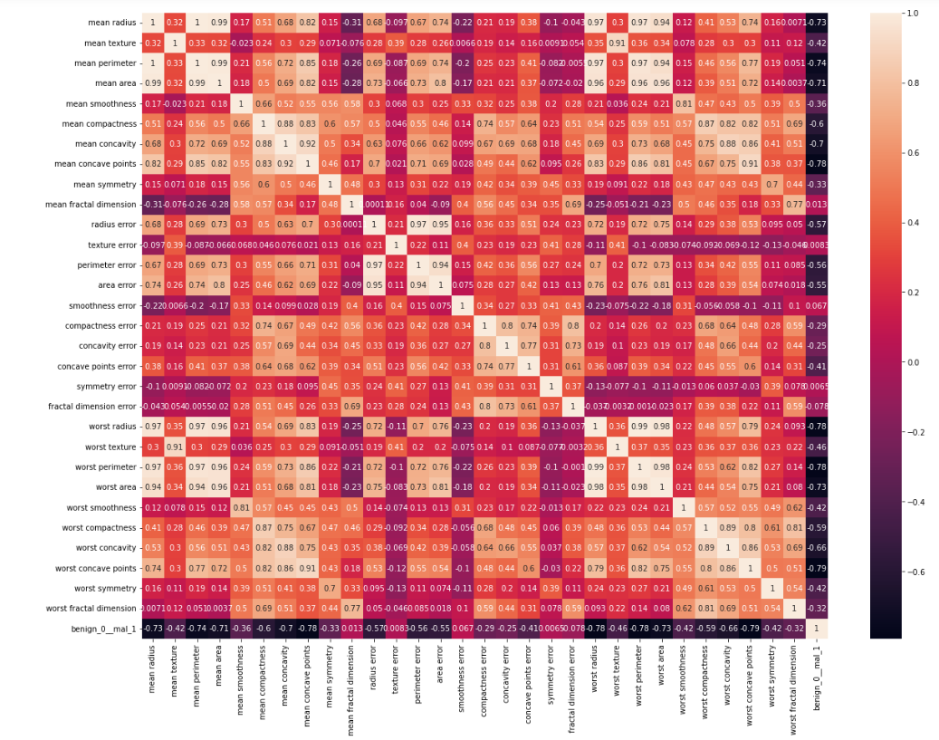
EDA

Slide 17
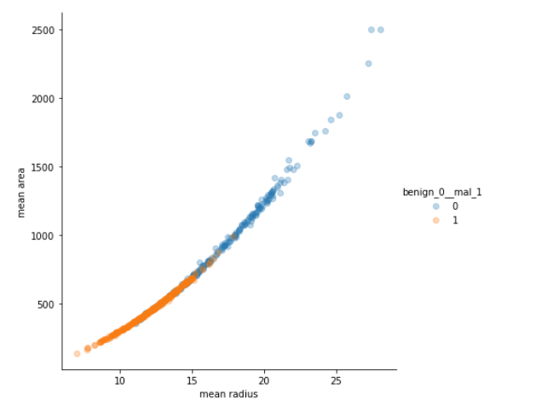
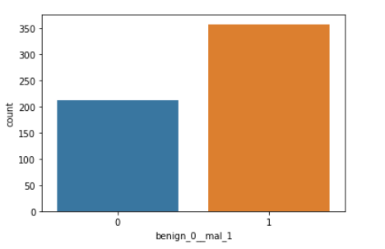
EDA
There is almost double the number of malignant tumors compared to benign tumors in the count plot
It consistently shows that radius, perimeter and smoothness have a high similarity whether it is the mean, worst, or error estimate in the pair plot

Slide 18
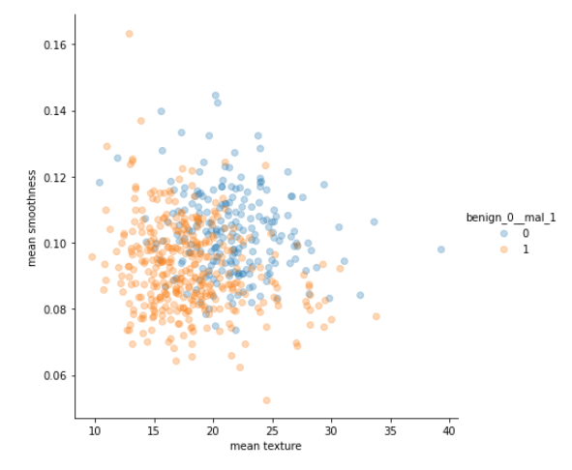
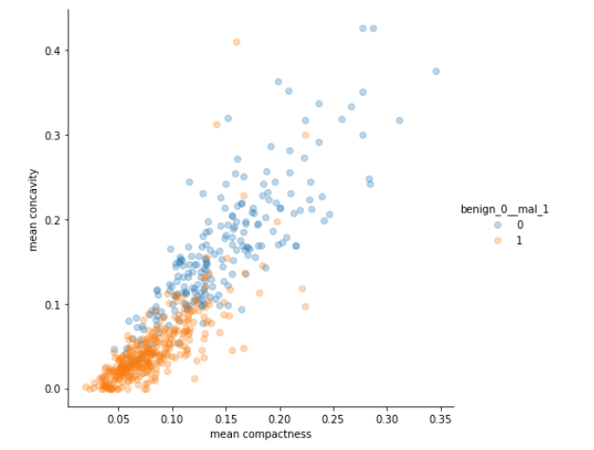
EDA
Malignant tumors are shown to
be more rugged and rough
compared to benign tumors
Benign tumors are shown to be consistently more compact and concave compared to malignant tumors

Slide 19
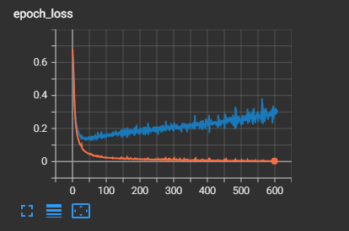
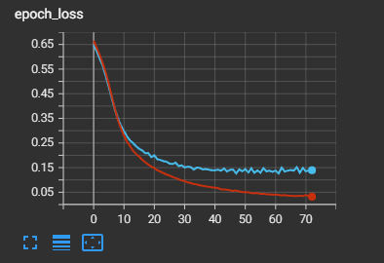
Training and Testing the Model
For the model we chose the sigmoid activation function for all versions to demonstrate overfitting mitigation.
30 input nodes (features), 15 nodes for a hidden layer, 1 output node
Initial run showing the most overfitting
Second run implementing early stoppage

Slide 20
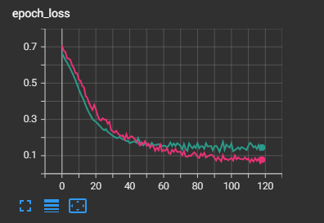
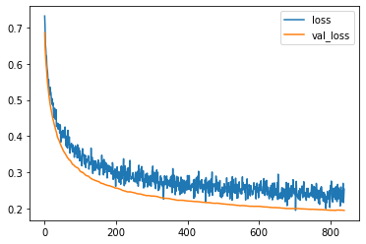
Training and Testing the Model
Third run adding dropout layers to the input and hidden layer(0.5)
Fourth run applying a learning rate to the output layer (0.005)

Slide 21
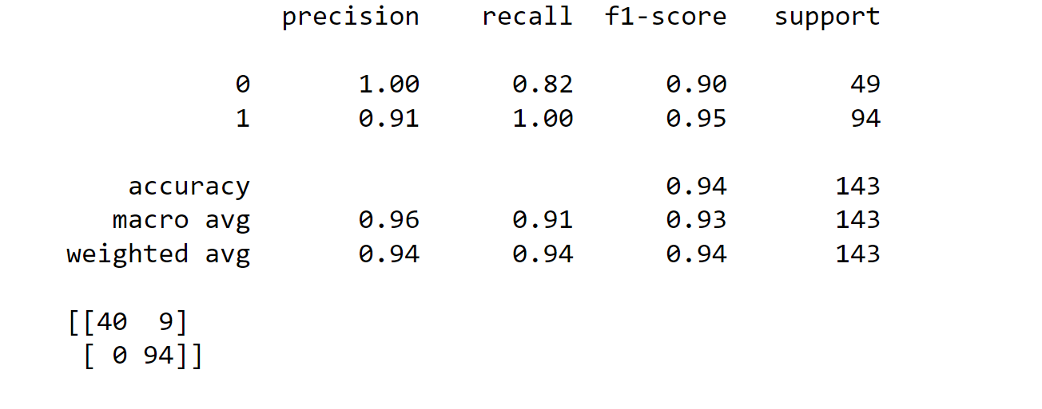
Model Evaluation

Slide 22
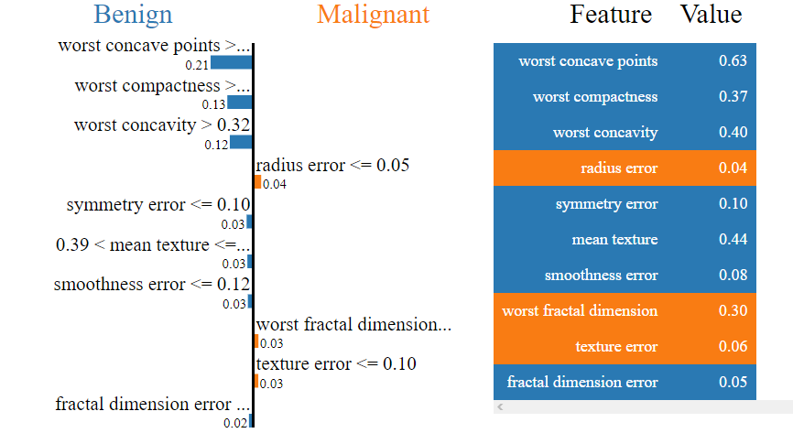
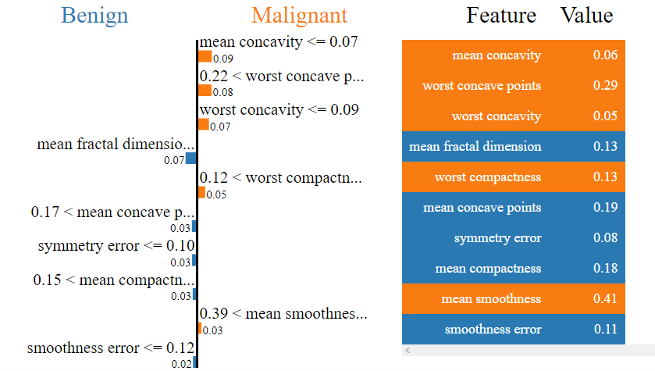
Using LIME to Interpret the Model
Local Interpretable Model-agnostic Explanations (LIME)
LIME can be considered as a "white-box," which locally approximates the behavior of the machine in a neighborhood of input values^{[5]}
5. Ribeiro, Marco Tulio, Sameer Singh, and Carlos Guestrin. "Why should i trust you?" Explaining the predictions of any classifier." Proceedings of the 22nd ACM SIGKDD international conference on knowledge discovery and data mining. 2016.

Slide 23
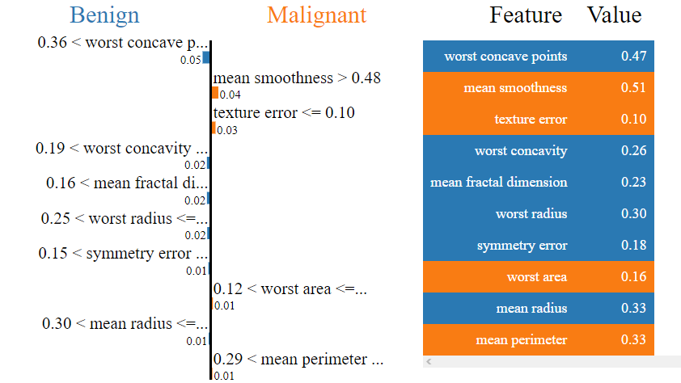
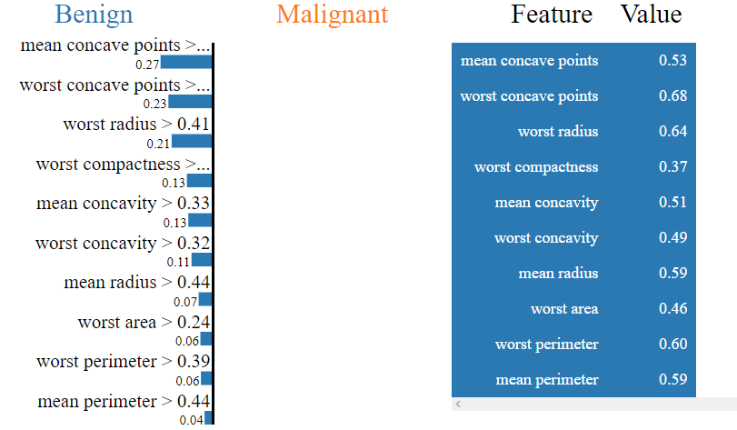
Using LIME to Interpret the Model

Slide 24
Conclusions
Explained what artificial neural networks are and its flexibility through multiple activation functions
Implemented overfitting techniques to reduce model miss-classifications to 9 out of 143 entries and a F-1 score of 90% and 95%
Neural Networks have shown to help further research in early detection of both benign and malignant tumors.
Interpretable machine learning (LIME) gives insight to how worst concave points is the strongest feature in determining a tumor’s state.

