Slide 1


Predictive Pioneers
PREDICTIVE MAINTENANCE OF MACHINERY USING AI/ML
ENGINEERING CAPSTONE PROJECT
Chinmay Shukla
[8915036]
Harsh Mahajan
[8840722]
Devendra Katre
[8909025]
Vivek Solanki
[8925804]

Slide 2
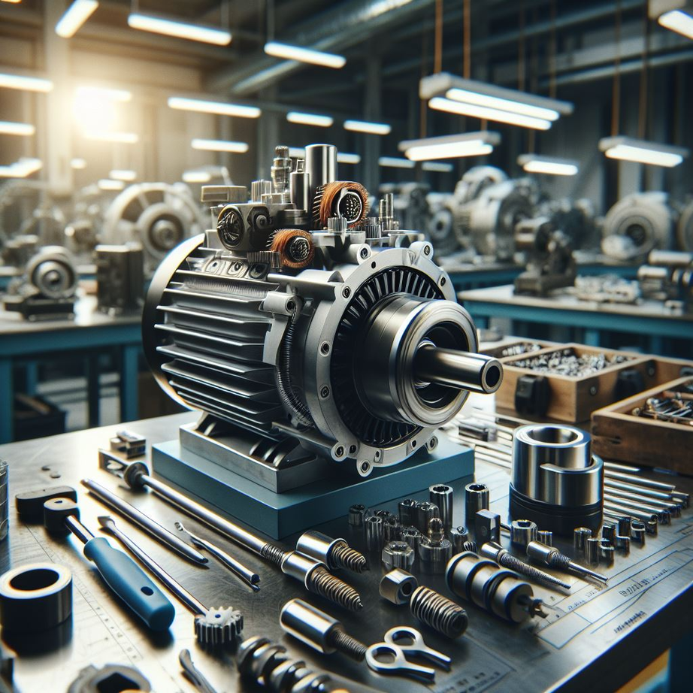
Project Description
An advanced IoT-enabled system.
Real-time monitoring.
AI/ML algorithms.
Intuitive dashboard.

Slide 3




Problem Statement
Unexpected Machinery Failures
Limited Real-Time Monitoring
Lack of Centralized Data Visualization
Reliance on Manual Analysis
01
02
03
04

Slide 4
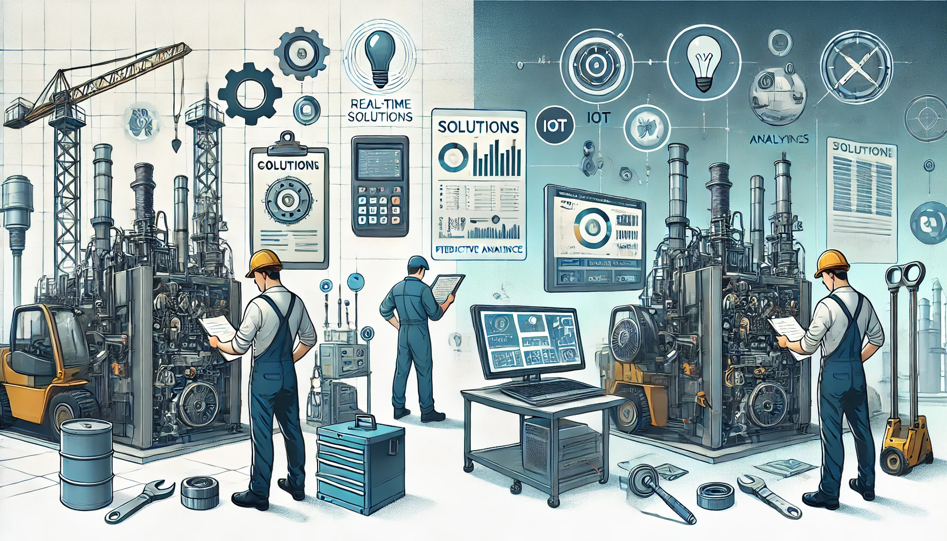
Current
01
Manual Monitoring
02
Preventive Maintanence
03
Condition - Based Maintanence
04
Advanced IOT - Based Solutions
05
Commercial Predictive Maintanence

Slide 5
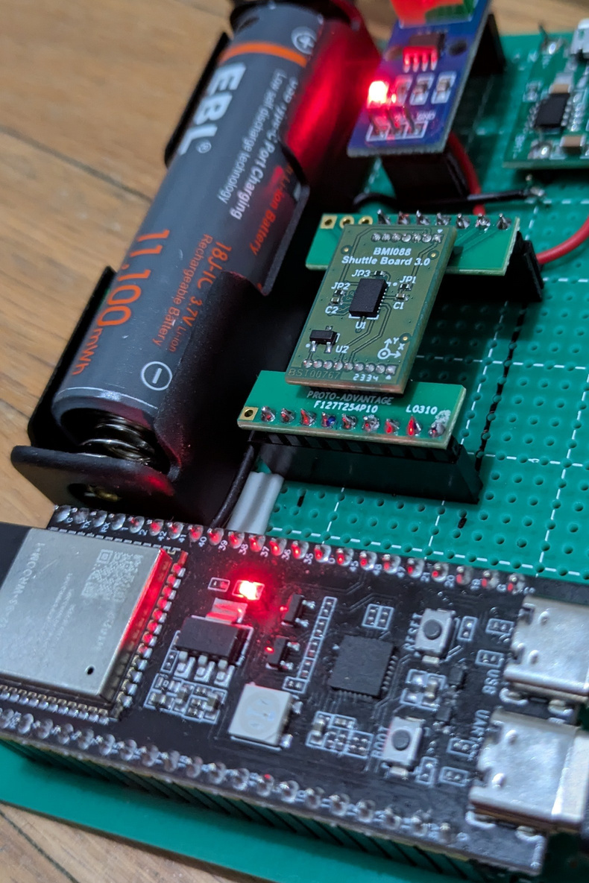
Project Requirements
01
Core Functionality
02
Edge Computing & ML
03
Data Pipeline
04
Real Time Inferencing
05
Additional Refinements

Slide 6
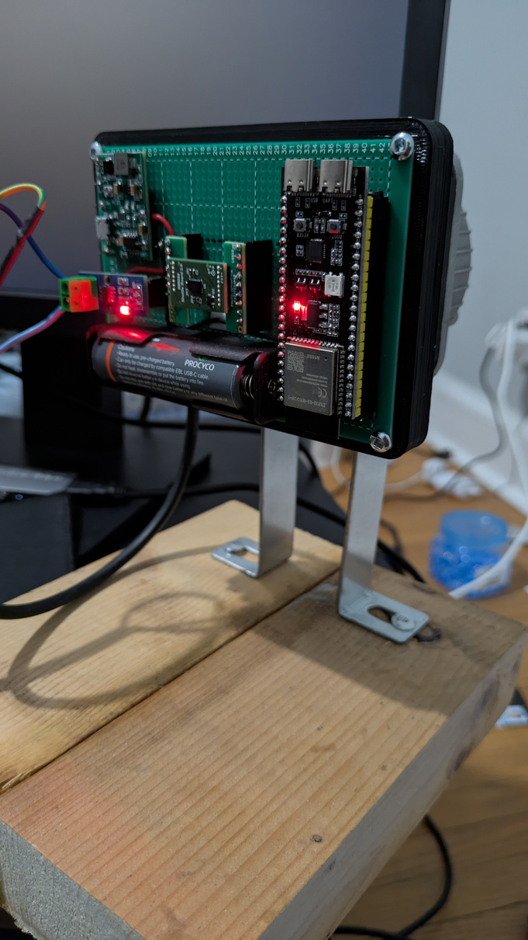
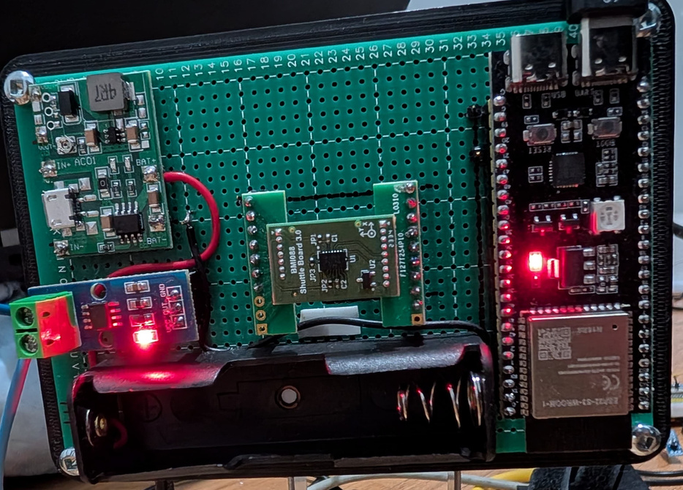
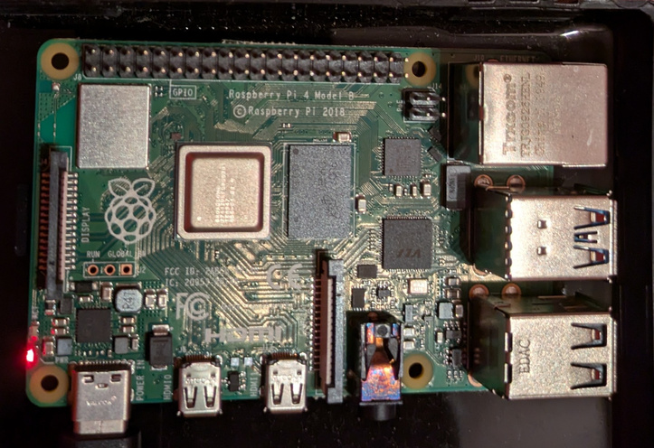
Results
Data Acquisition
Edge Computing
Machine Learning
Equipment

Slide 7
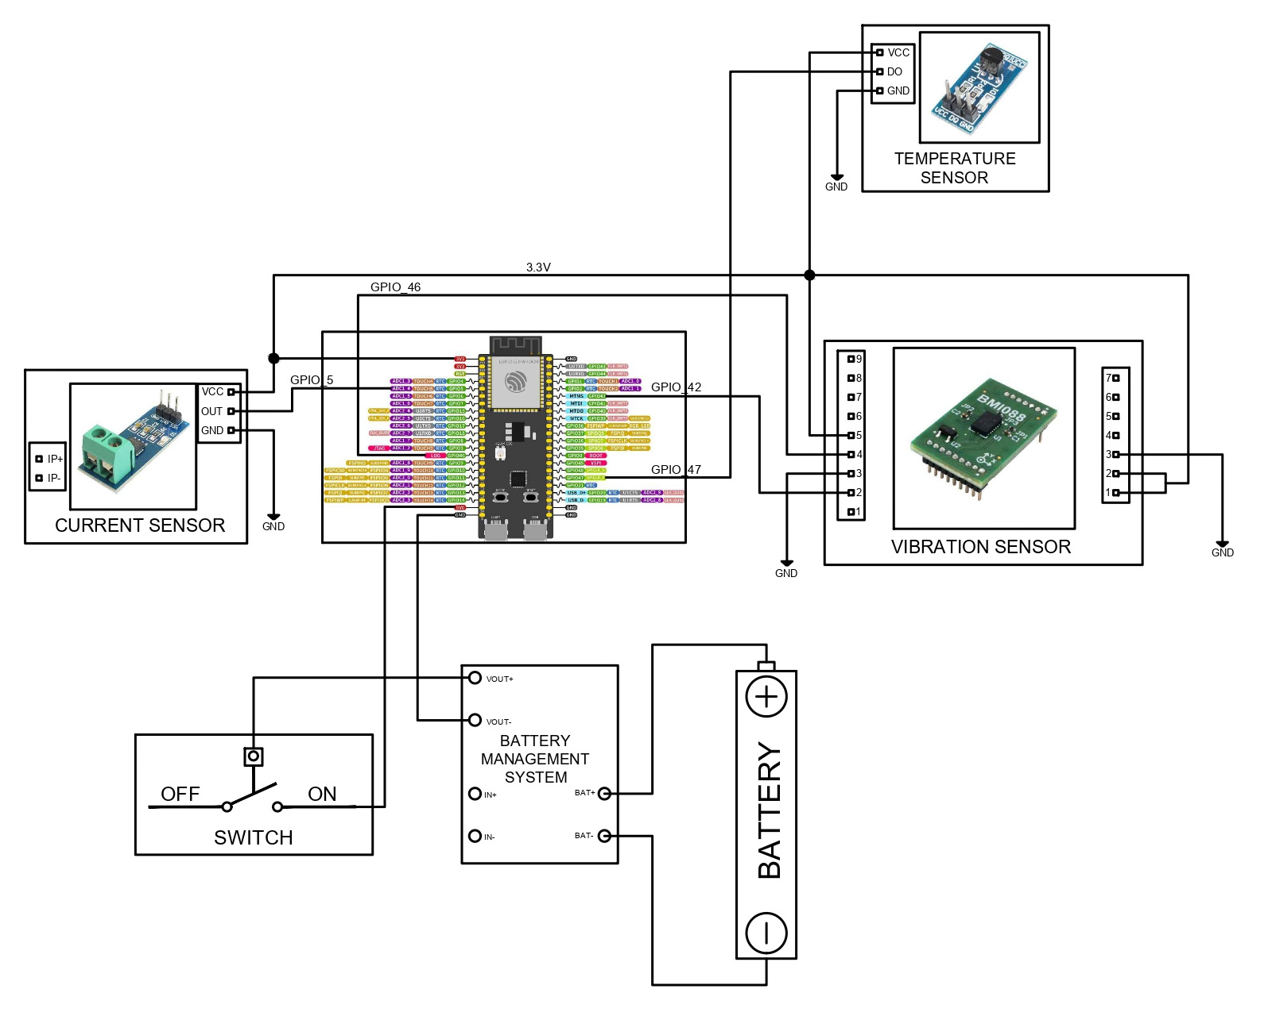
Wiring Diagram

Slide 8
Future Scope
01
Modular Design
02
Platform Independent
03
Network Independent
04
Real - Time Inferencing
05
Simultaneous model training and monitoring

Slide 9
Predictive Pioneers
THANK YOU

