Slide 1

Eventloop

Slide 2
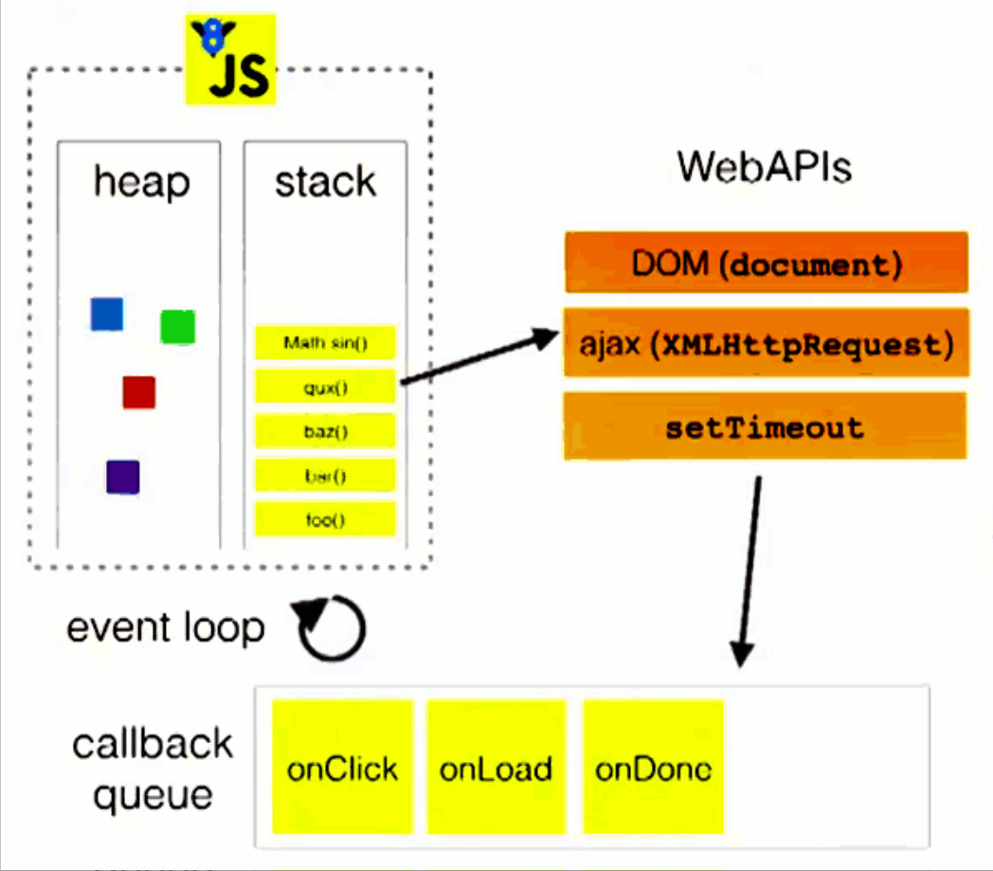
Eventloop
A programming construct or design pattern that waits for and dispatches events or messages in a program.
Works by making a request to some internal or external "event provider" (that generally blocks the request until an event has arrived), then calls the relevant event handler ("dispatches the event").

Slide 3
Macro Task and Micro Task
Macro Task | Micro Task
Script | Promise Callback
setTimeout | MutaionObserver
setInterval | process.nextTick(nodejs)
I/O | Object.observe
UI Event
setImmediate (nodejs)
Promise Function

Slide 4
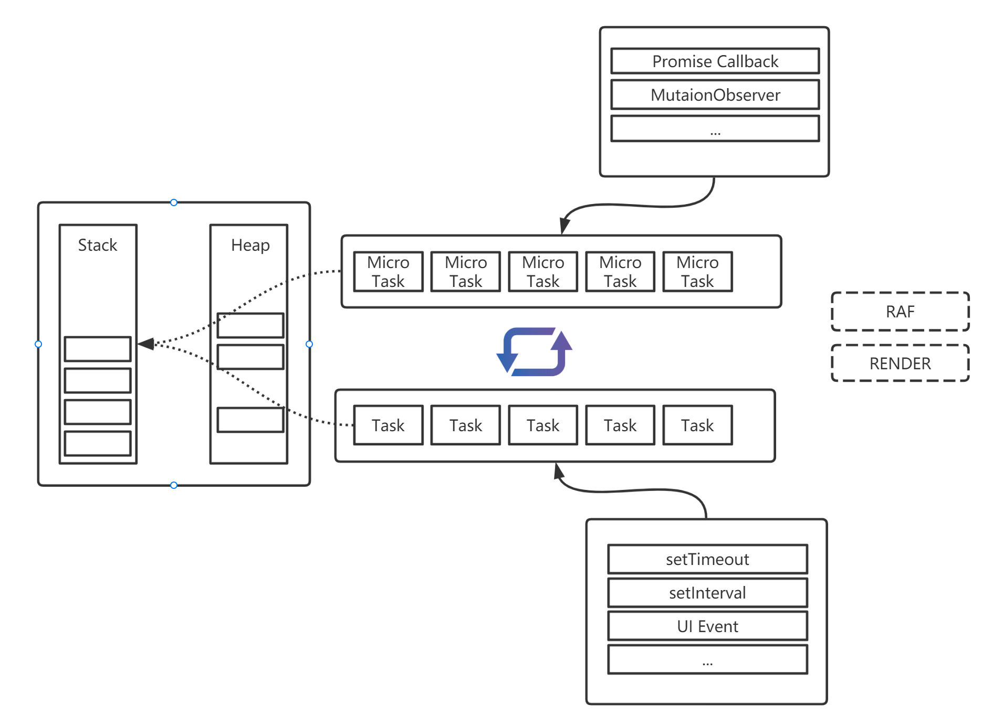
Browser Eventloop

Slide 5
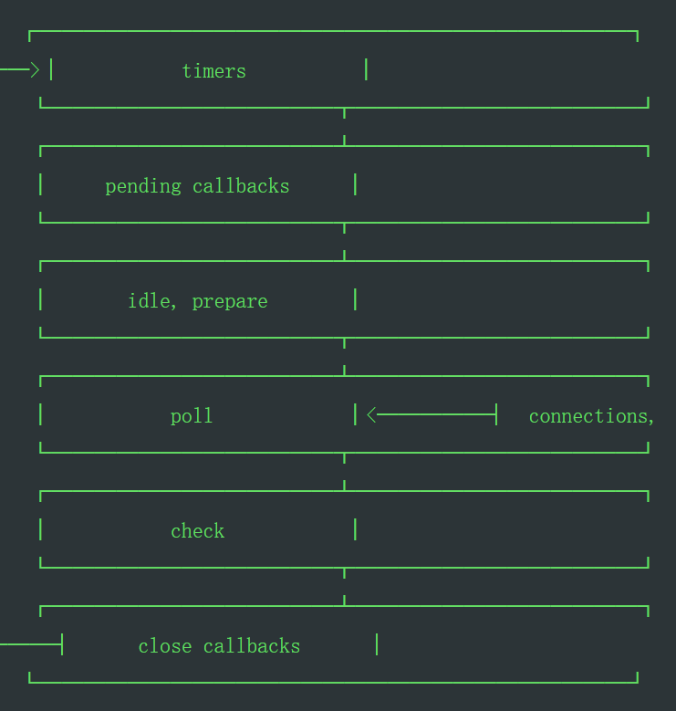
NodeJs Eventloop
timers: executes callbacks scheduled by setTimeout() and setInterval(), Technically, the poll phase controls when timers are executed.
pending callbacks: executes I/O callbacks deferred to the next loop iteration
idle, prepare: only used internally
poll: retrieve new I/O events; execute I/O related callbacks, node will block here when appropriate
check: setImmediate() callbacks
close callbacks: some close callbacks,

Slide 6
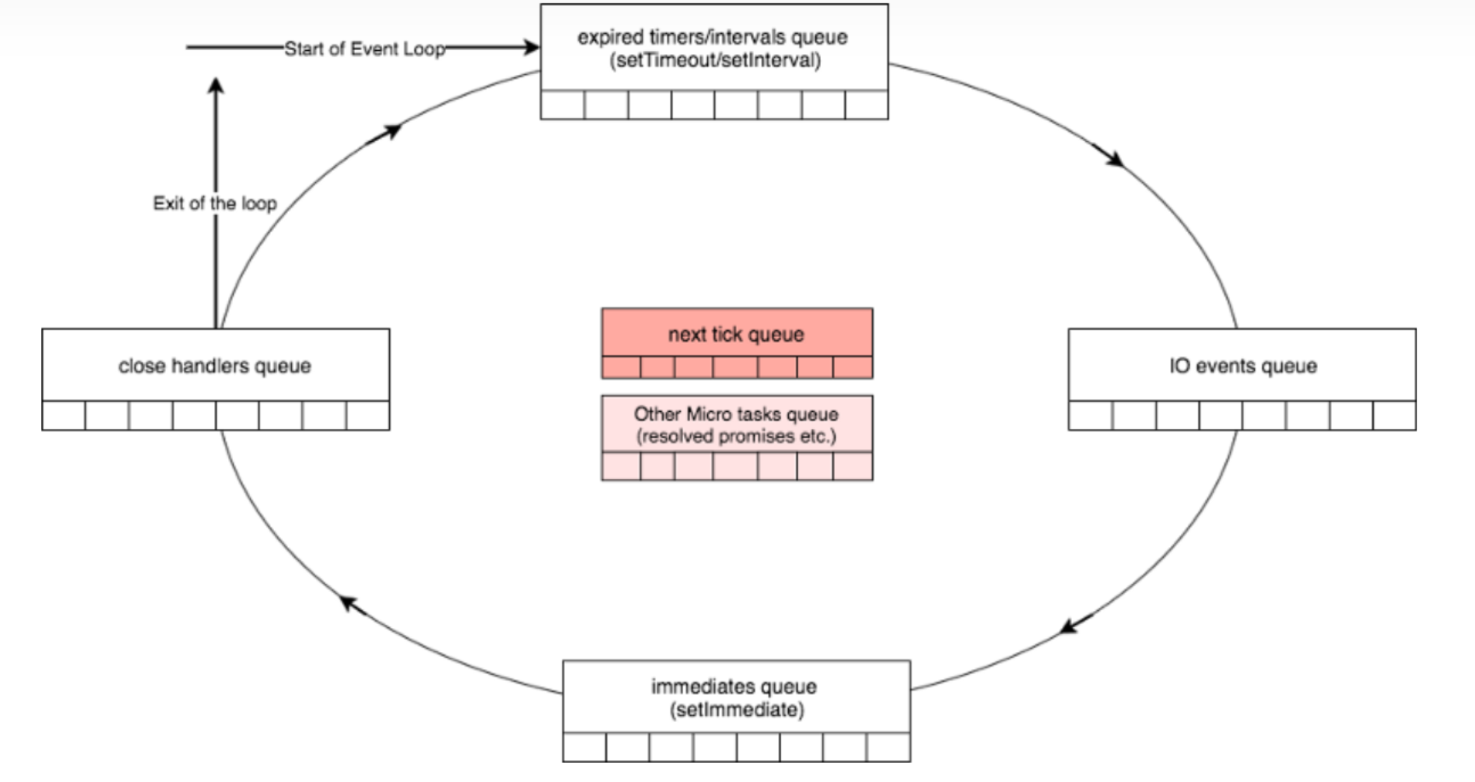
Eventloop of Nodejs

Slide 7
Poll
If the poll queue is not empty, the event loop will iterate and executing them
If the poll queue is empty,
If scheduled by setImmediate(), the event loop will end the poll phase and continue
Or it will wait at poll phase for
Once the poll queue is empty the event loop will check for ready timers, if there’s any, the event loop will wrap back to the timers phase

Slide 8
Best Practice
Avoid heavy calculation
Call nextTick and Promise recursively may cause blocking
Some same-purpose apis may have different behavior
E.g. dns.lookup vs dns.resolve
Thread pool issue
Use css animation if possible

