Slide 1

Eventloop

Slide 2
Eventloop
Definition:
Mechanism which is responsible for executing the code, collecting and processing events, and executing queued sub-tasks.
Loop
of
UI event callbacks
Timer callbacks
Promise callback
.
.
.
Events

Slide 3
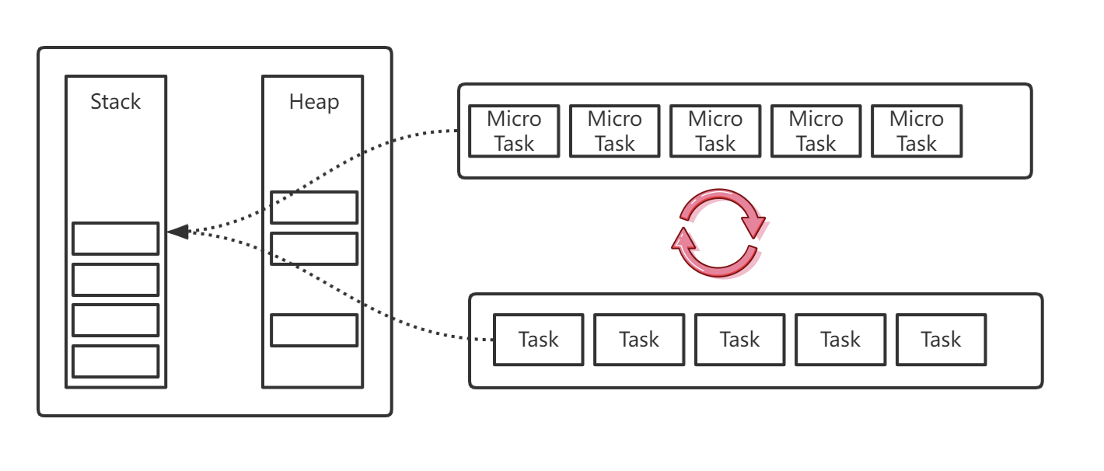
Eventloop

Slide 4
(Macro)Task and Micro Task
Task | Micro Task
Script | Promise Callback
setTimeout | MutaionObserver browser
setInterval | Object.observe browser
I/O | process.nextTick nodejs
UI Event
Promise Function
setImmediate nodejs

Slide 5
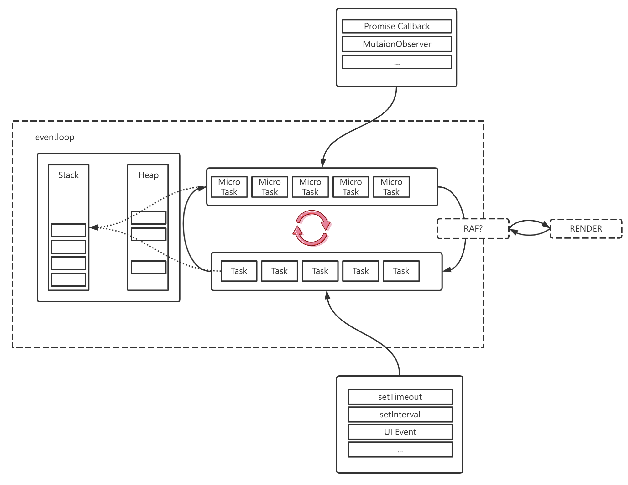
Eventloop: Browser

Slide 6
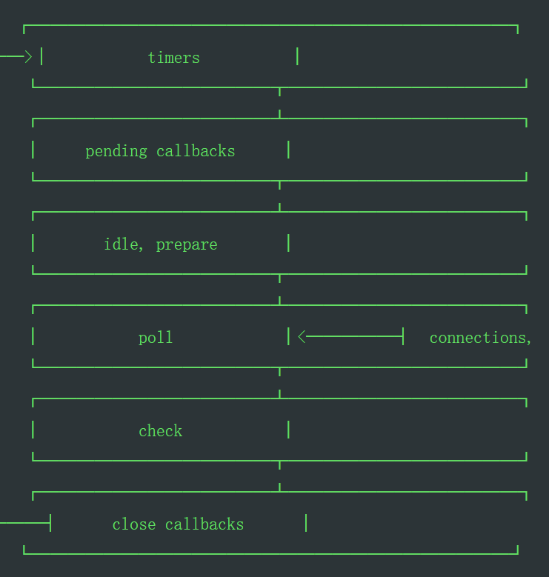
Eventloop:nodejs
Timers
executes callbacks scheduled by setTimeout() and setInterval(), Technically, the poll phase controls when timers are executed.
Pending callbacks
executes I/O callbacks deferred to the next loop iteration
Idle
prepare: only used internally
Poll
retrieve new I/O events; execute I/O related callbacks, node will block here when appropriate
Check
setImmediate() callbacks
close callbacks
some close callbacks,

Slide 7
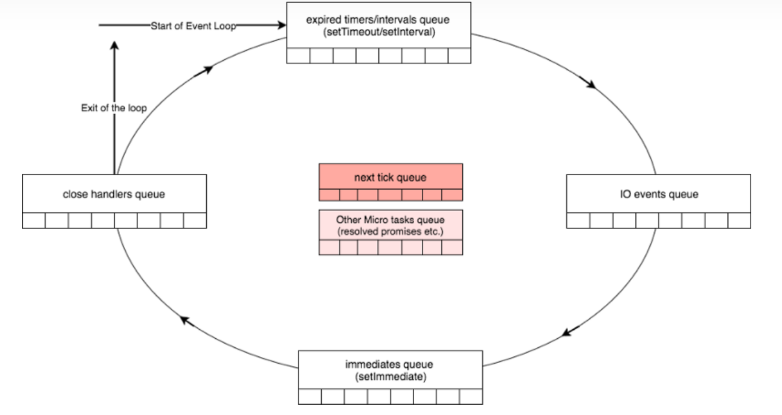
Eventloop of Nodejs

Slide 8
Poll
If the poll queue is not empty, the event loop will iterate and executing them
If the poll queue is empty,
If there’s tasks scheduled by setImmediate(), the event loop will end the poll phase and continue
Once the poll queue is empty the event loop will check for ready timers, if there’s any, the event loop will wrap back to the timers phase

Slide 9
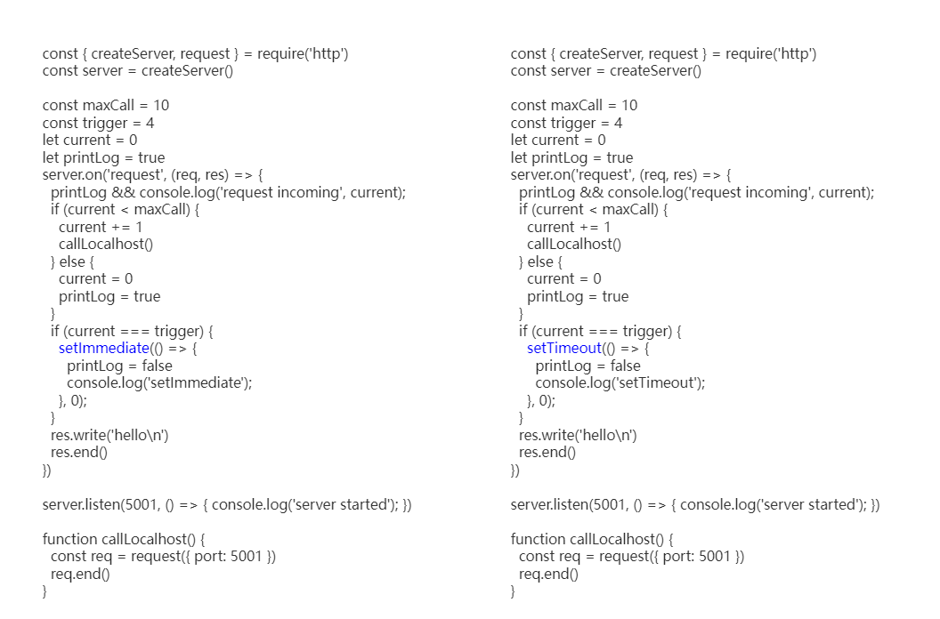

Slide 10
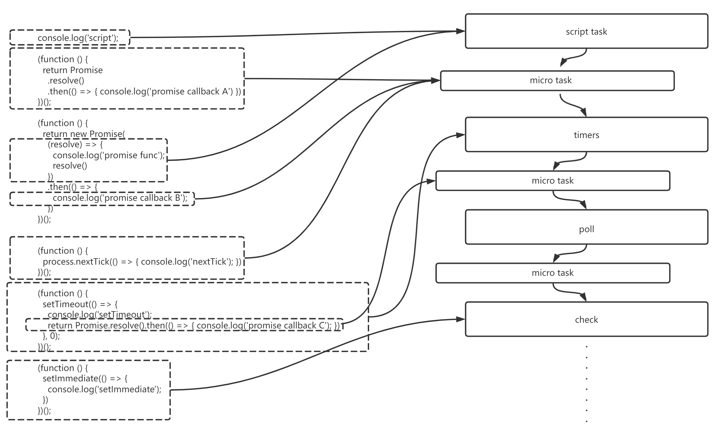

Slide 11
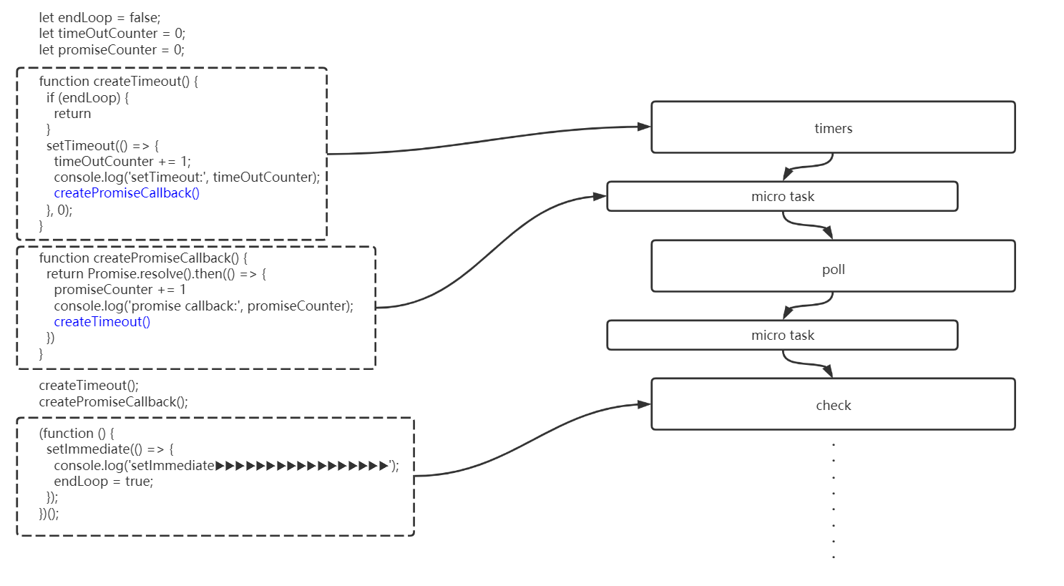

Slide 12
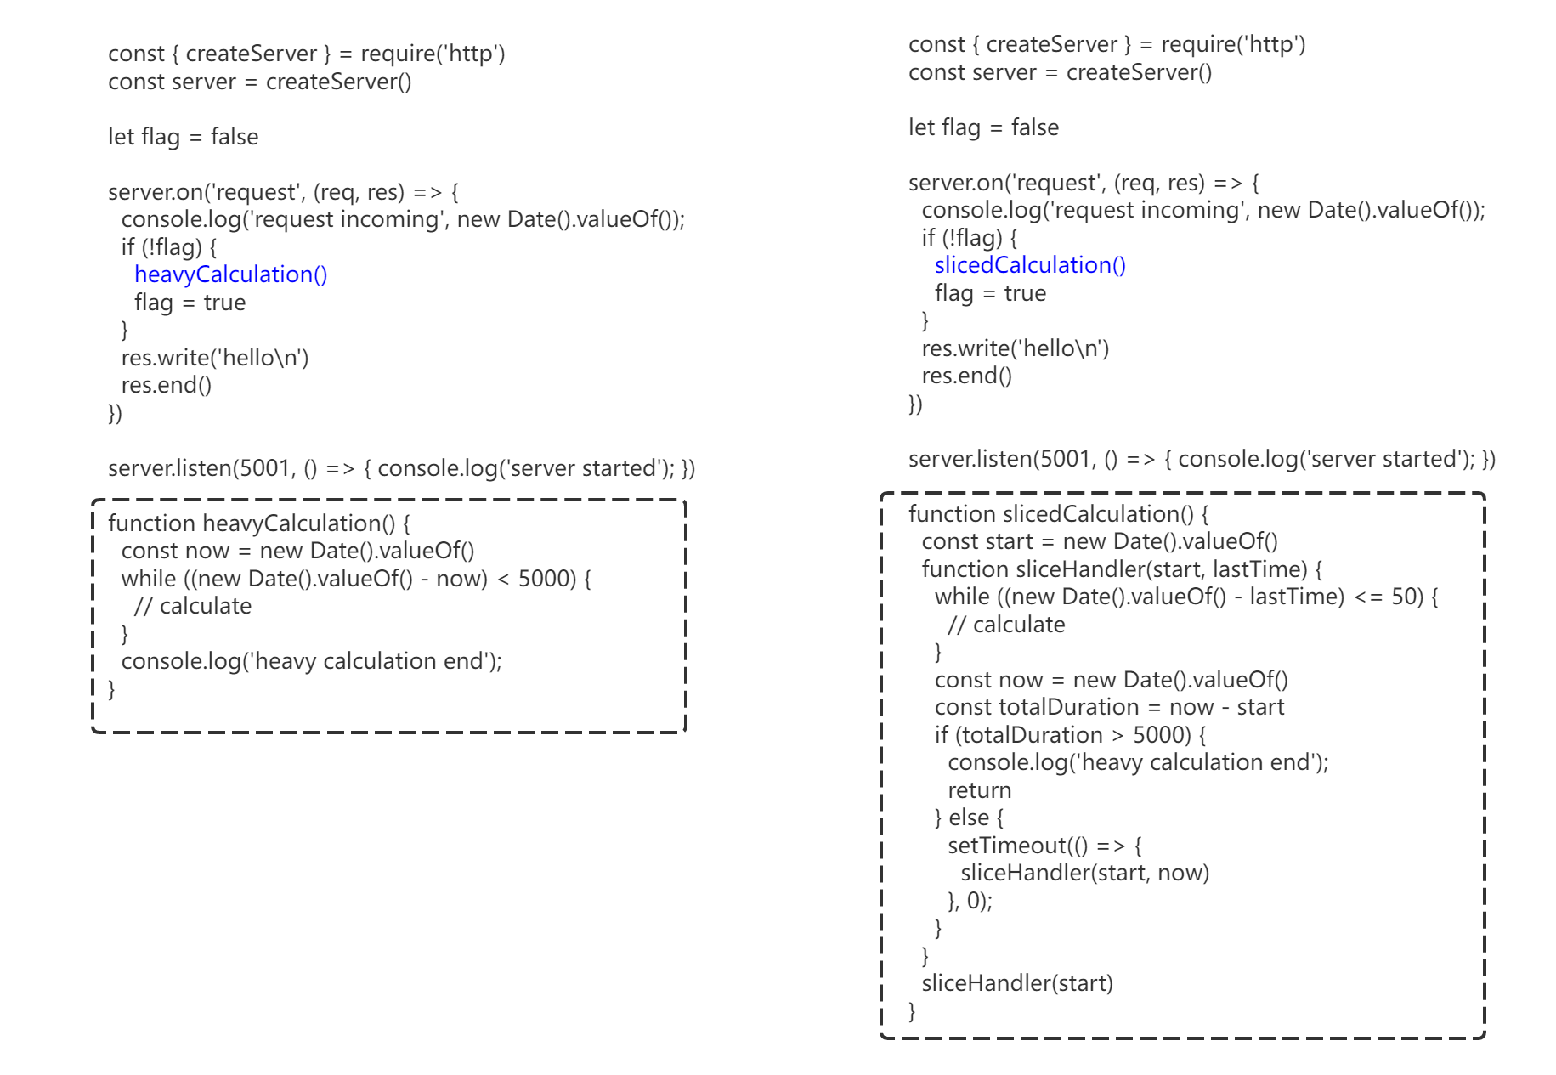

Slide 13
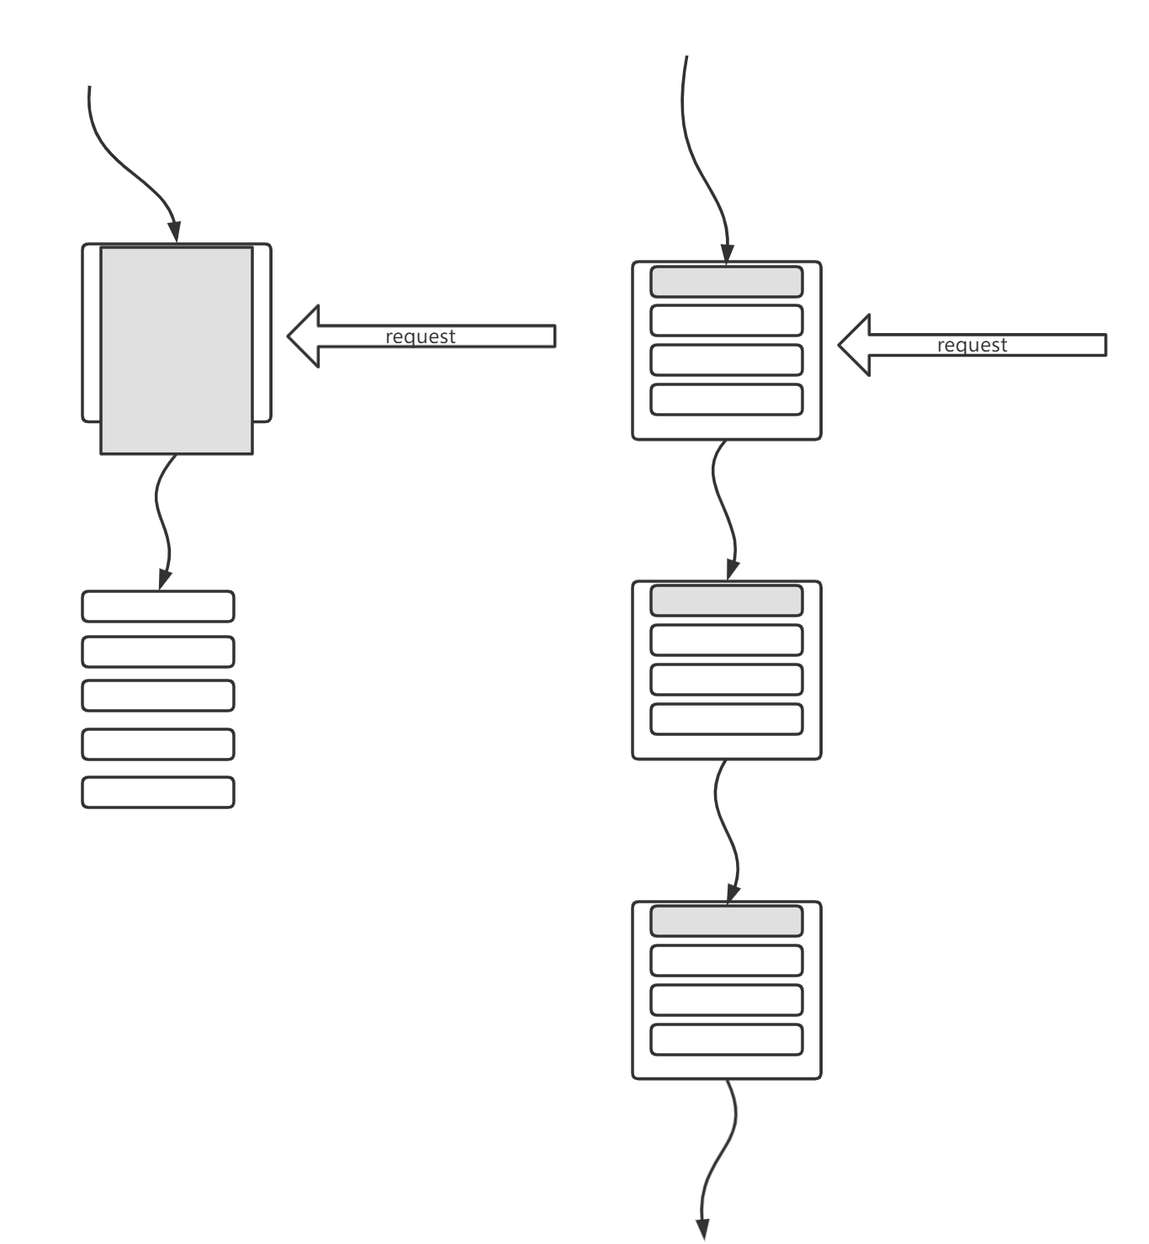
Intensive Calculation VS Sliced Calculation

