Slide 1
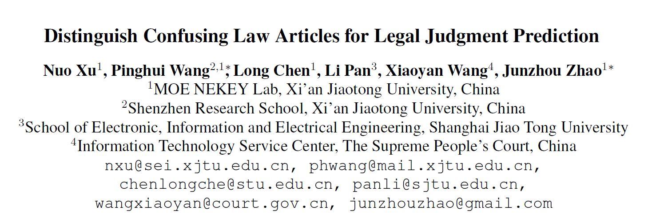
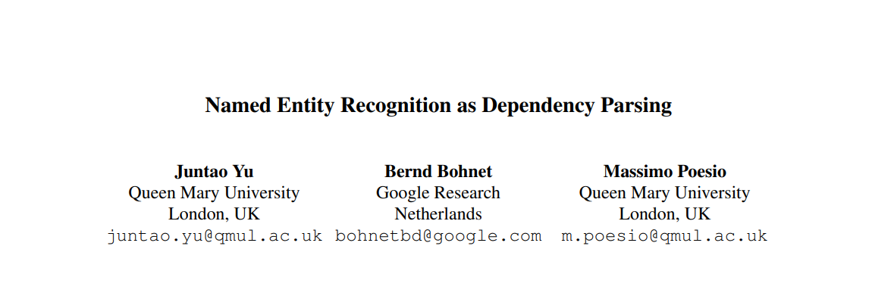
ACL2020

Slide 2
Main Work
In this paper, we use ideas from graph-based dependency parsing to provide our model a global view on the input via a biaffine model
The biaffine model scores pairs of start and end tokens in a sentence which we use to explore all spans，so that the model is able to predict named entities accurately
We show that the model works well for both nested and flat NER through evaluation on 8 corpora and achieving SoTA performance on all of them, with accuracy gains of up to 2.2 percentage points.

Slide 3
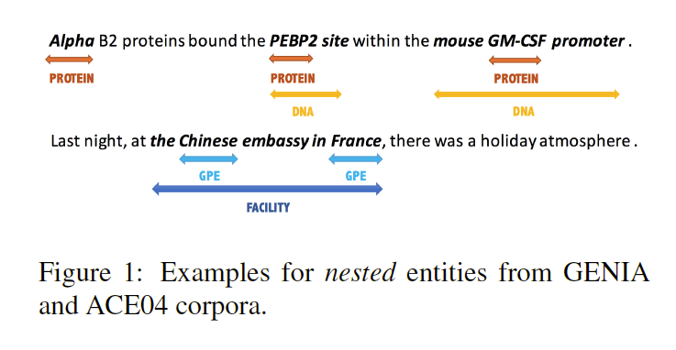
CASE

Slide 4
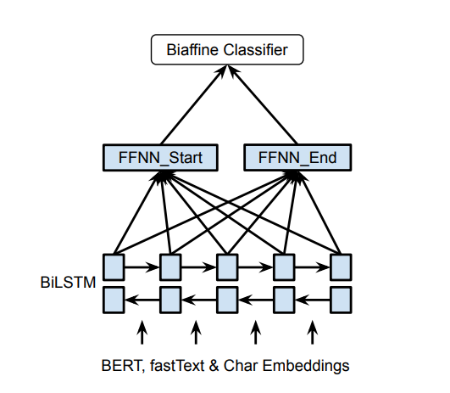
Model

Slide 5
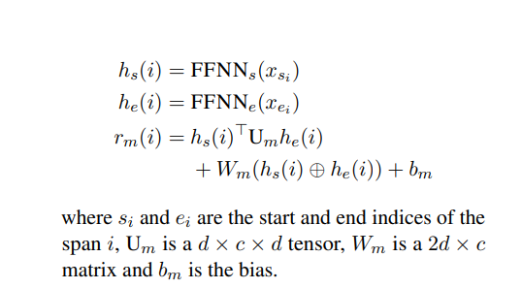
Biaffine Classifier

Slide 6
STRATEGY
For nested NER, a entity is selected as long as it does not clash the boundaries of higher ranked entities.
We denote a entity i to clash boundaries with another entity j if si < sj ≤ ei < ej or sj < si ≤ ej < ei
(the Bank of China: the Bank of clashs Bank of China)
For flat NER, we apply one more constraint, in which any entity containing or is inside an entity ranked before it will not be selected

Slide 7
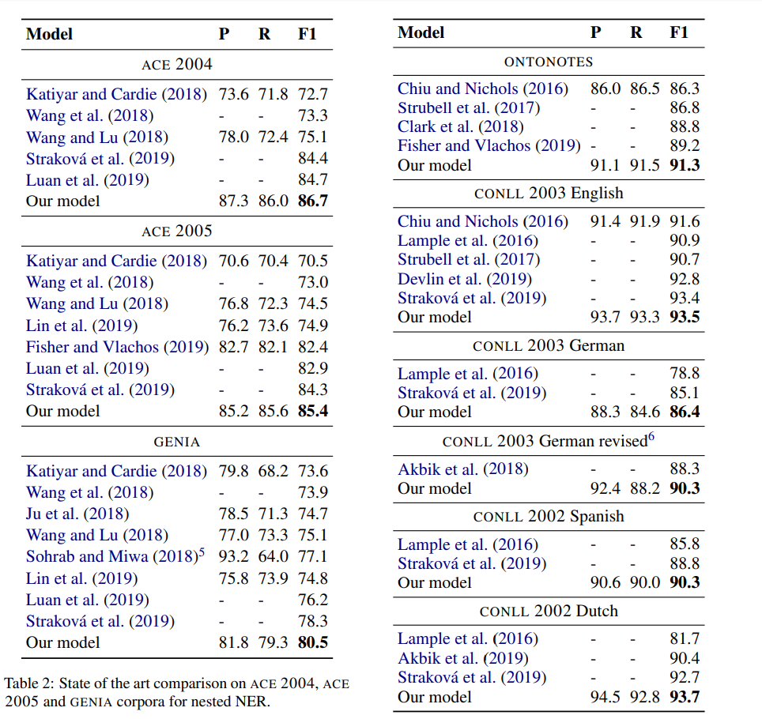
Result

Slide 8
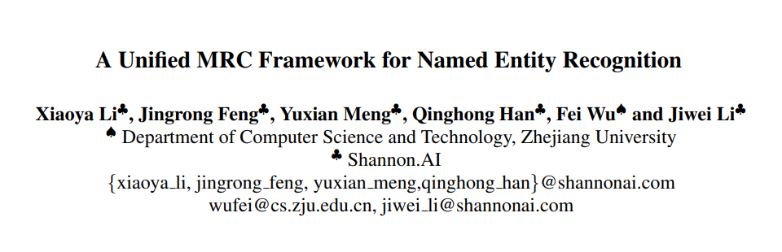
ACL2020

Slide 9
Main Work
In this paper, we reformalize the NER task as a MRC question answering task.
This formalization comes with two key advantages:
being capable of addressing overlapping or nested entities;
the query encodes significant prior knowledge about the entity category to extract.
The proposed method obtains SOTA results on both nested and flat NER datasets, which indicates its effectiveness.

Slide 10
Dataset Construction
Firstly we need to transform the tagging-style annotated NER dataset to a set of (QUESTION, ANSWER, CONTEXT) triples.
The question generation procedure is important since queries encode prior knowledge about labels and have a significant influence on the final results.

Slide 11
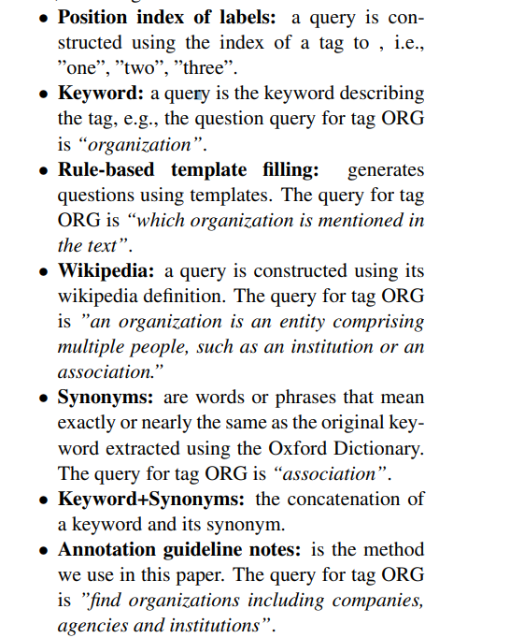
How to Construct Queries

Slide 12
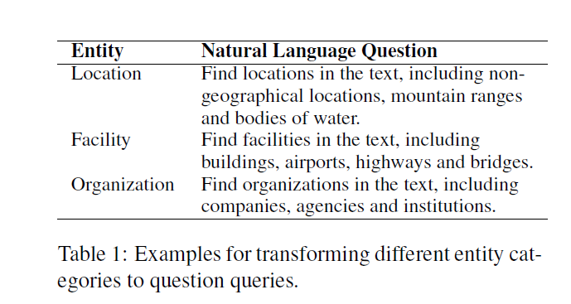
Annotation Guideline Note

Slide 13

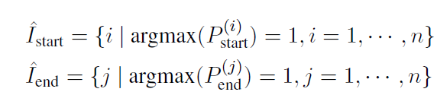

Model
Model Backbone
To be in line with BERT, the question and the passage are concatenated, forming the combined string:
Span Selection
the strategy is to have two binary classifiers, one to predict whether each token is the start index or not, the other to predict whether each token is the end index or not.

Slide 14
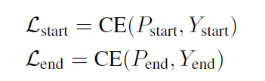

Train and Test
Two losses for start and end index predictions:
The start-end index matching loss is given as follows:

Slide 15
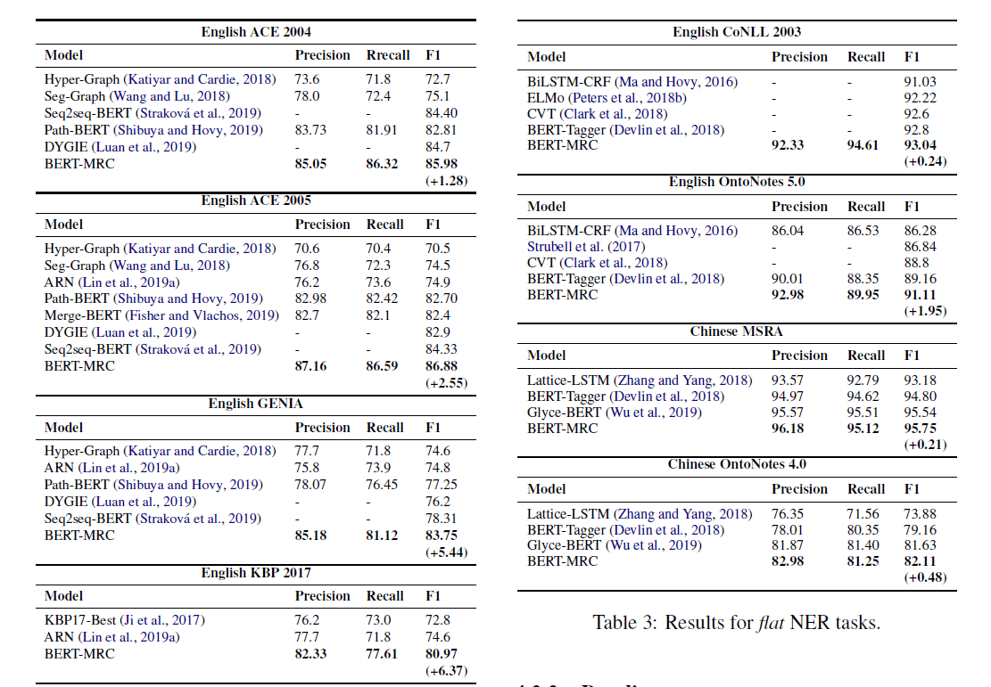
Result

Slide 16
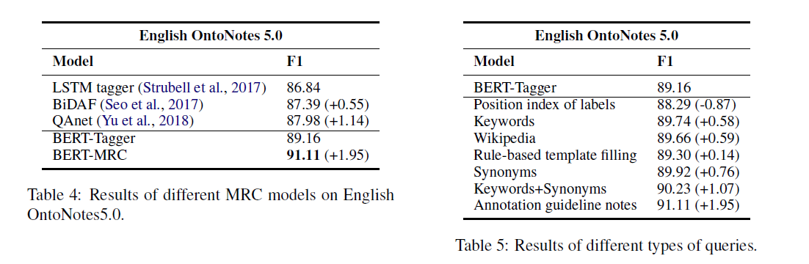
Result

Slide 17
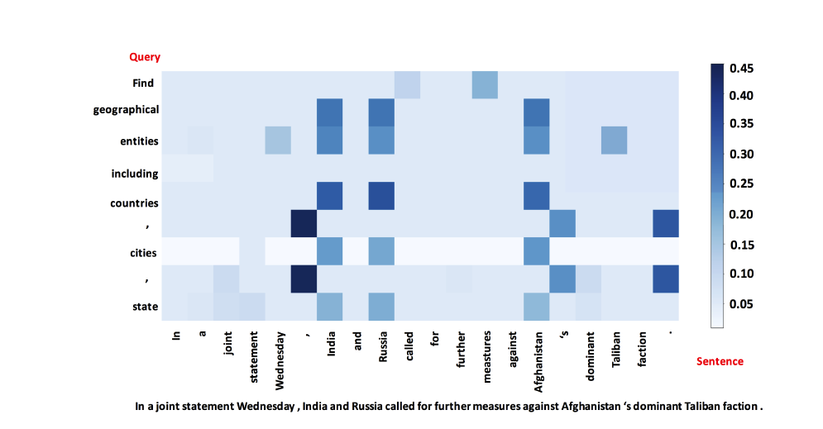
Result

Slide 18
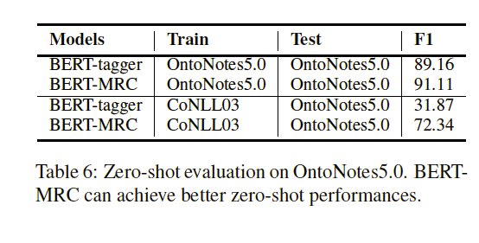
Result

