Slide 1
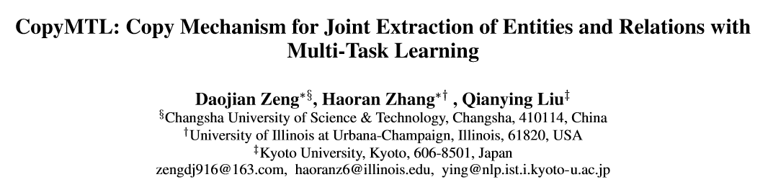

Slide 2
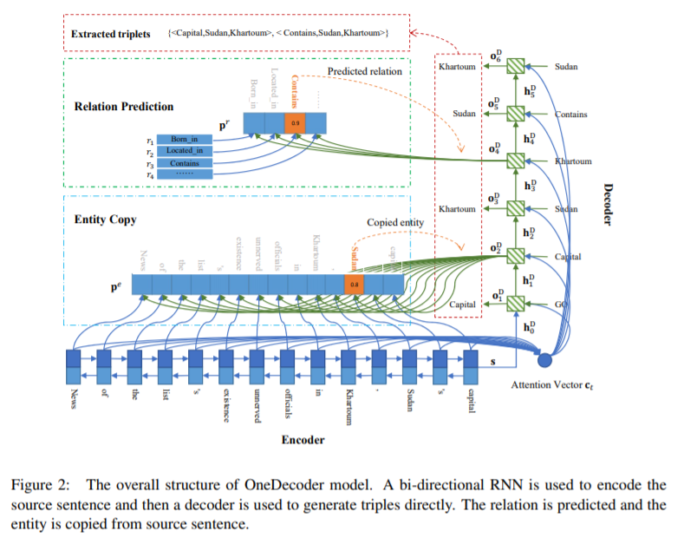
Background: CopyRE

Slide 3
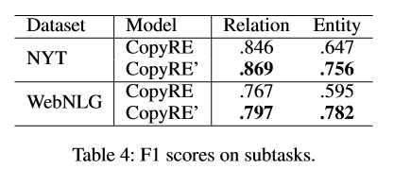
Problem
First, the entity copying in CopyRE is unstable and it depends on an unnatural mask to differ the head(h) and tail(t) entities
Second, CopyRE cannot extract entities that have multiple tokens. The copy-based decoder always points to the last token of any entities, which limits the applicability of the model.

Slide 4
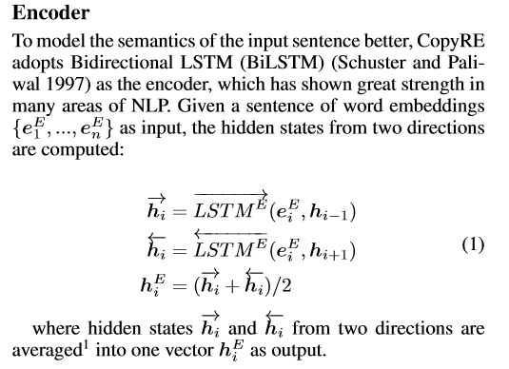
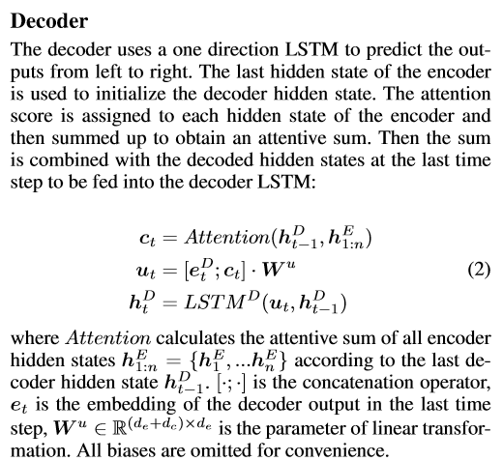
Background

Slide 5
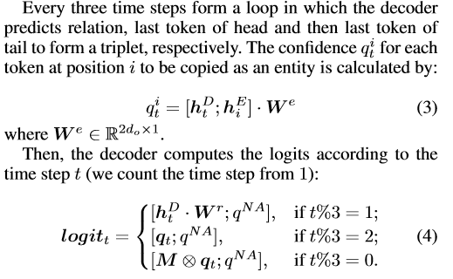
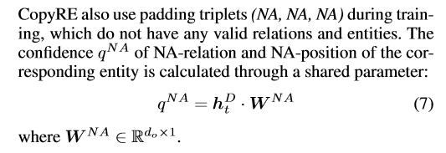
copyRE

Slide 6
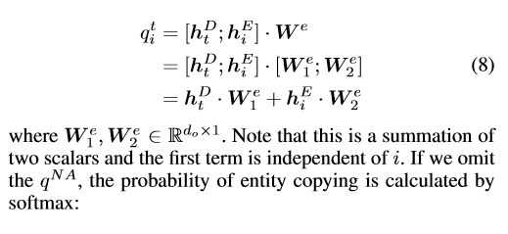
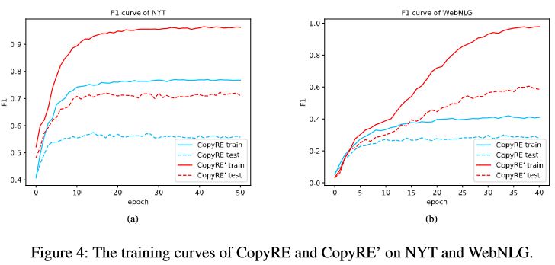
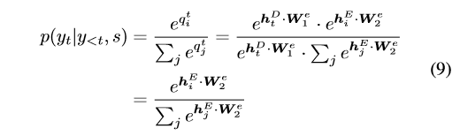
Unstable and Abnormal dependency to the mask

Slide 7
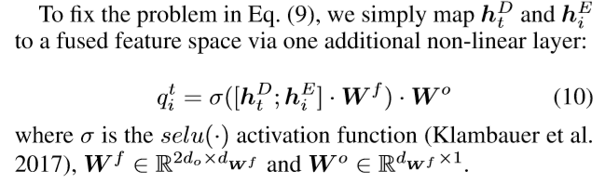
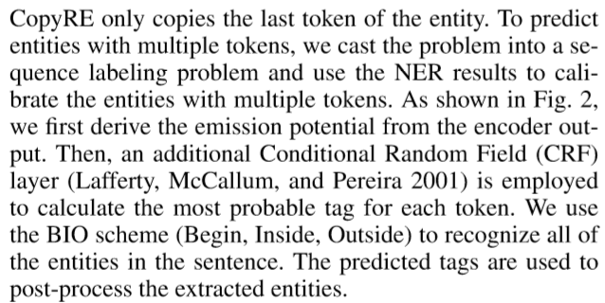
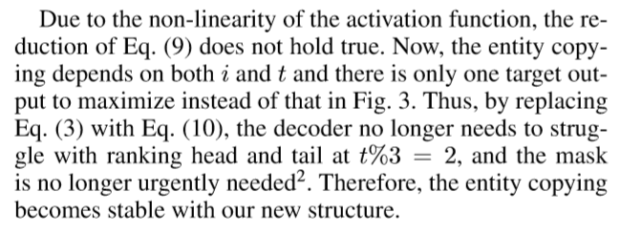
Our Change

Slide 8
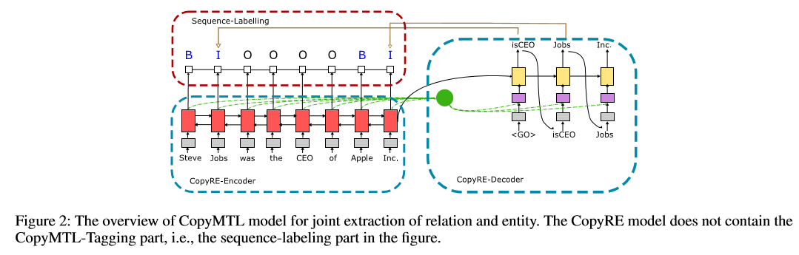
Model

Slide 9
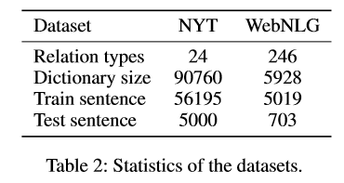
Dataset

Slide 10
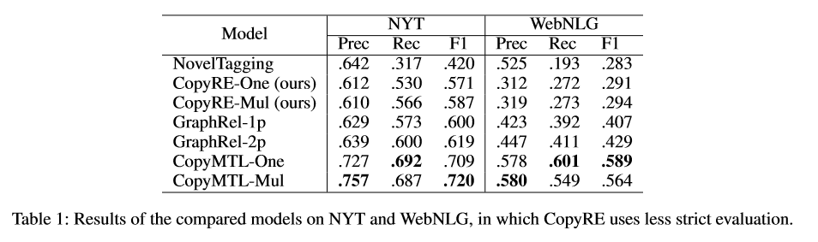
Experiment

Slide 11
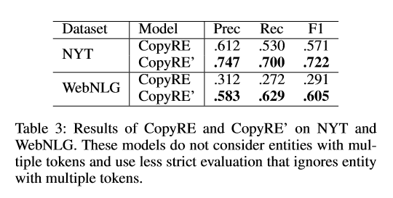
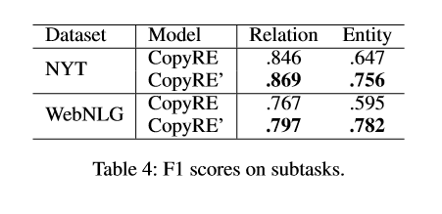
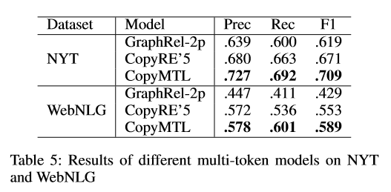
Experiment

Slide 12
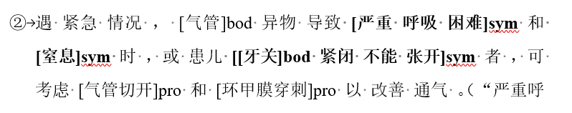
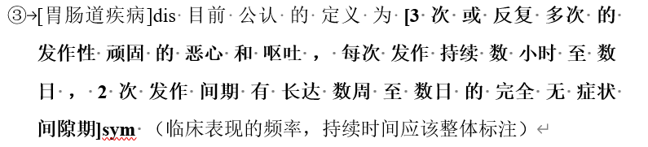
进展和问题
之前的想法漏掉了症状主体

Slide 13
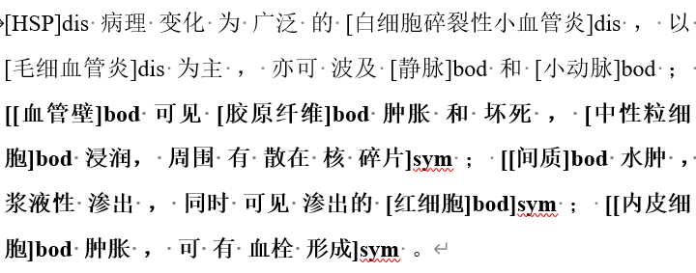
进展和问题
{ pos:[] sent_id: disease: 白细胞碎裂性小血管炎
pos:[] sent_id: body: 血管壁，胶原纤维，中性粒细胞
pos:[] sent_id: decorate: 浸润pos:[] sent_id: subject: 肿胀和坏死，散在核碎片
pos:[] sent_id: item:pos:[] sent_id: people:pos:[] sent_id: frequency:}
{ pos:[] sent_id: disease: 白细胞碎裂性小血管炎
pos:[] sent_id: body: 间质，红细胞
pos:[] sent_id: decorate: 浆液性，渗出pos:[] sent_id: subject: 水肿，渗出的红细胞
pos:[] sent_id: item:pos:[] sent_id: people: pos:[] sent_id: frequency:}
{ pos:[] sent_id: disease: 白细胞碎裂性小血管炎
pos:[] sent_id: body: 内皮细胞
pos:[] sent_id: decorate: pos:[] sent_id: subject: 肿胀，血栓形成
pos:[] sent_id: item:pos:[] sent_id: people: pos:[] sent_id: frequency:}

