Slide 1
Asking Clarification Questions in Knowledge-Based Question Answering
Jingjing Xu1, Yuechen Wang2, Duyu Tang3, Nan Duan3, Pengcheng Yang1,
Qi Zeng1, Ming Zhou3, Xu Sun1

Slide 2
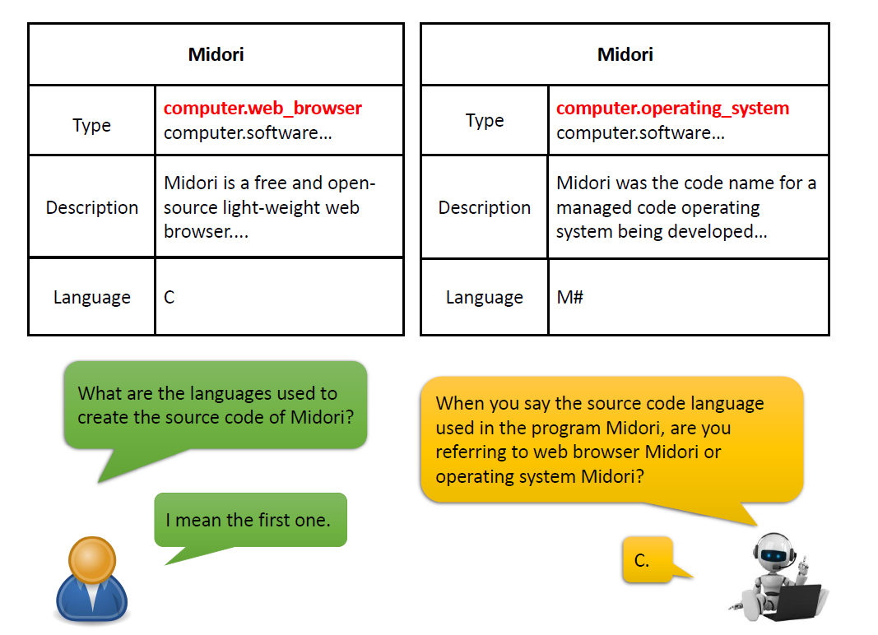
Introduction
Ambiguity
Clarification
Feedback

Slide 3
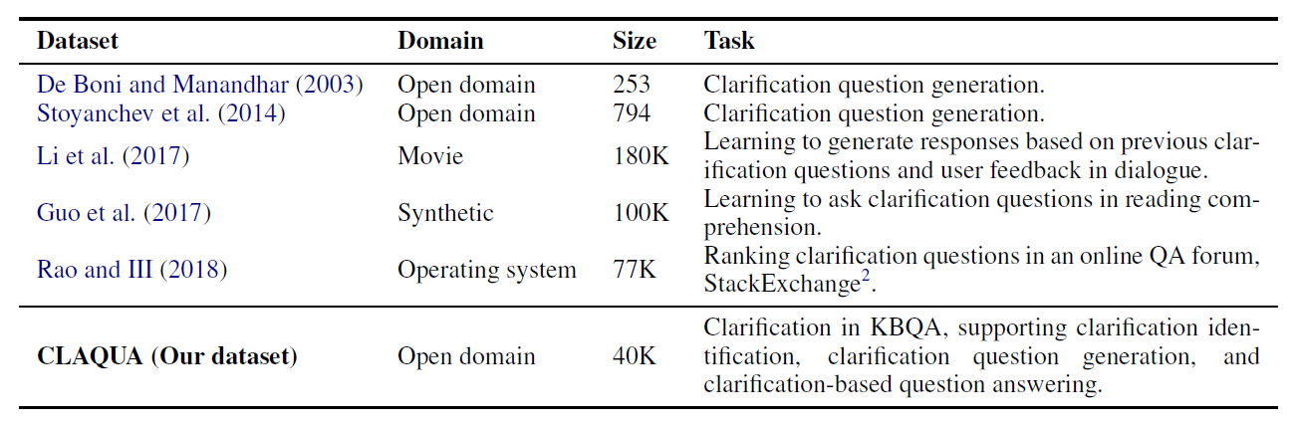
Introduction
This work explores how to use clarification to improve current KBQA systems
This work introduces an open-domain clarification corpus, CLAQUA, for KBQA
covers various domains
support three tasks

Slide 4
Introduction
two cases of Ambiguity
single-turn: an entity name refers to multiple entities in a knowledge base while the current utterance lacks necessary identifying information.
multi-turn: mainly comes from the omission where a pronoun refers to multiple possible entities from the previous conversation turn
three sub-tasks
Clarification Identification
Clarification Question Generation
Clarification-based Question Answering

Slide 5
Framework
Clarification
Identification
Clarification
Question
Generation
Clarification-based
Question Answering

Slide 6



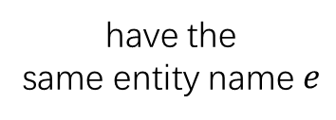







Data Collection
Sub-Graph Extraction
single-turn
multi-turn
Ambiguous Question $Q_{a}$Annotation
Clarification Question $Q_{c}$ Annotation
$$p$$
$$p$$
$$e_{1}$$
$$e_{1}$$
$$p$$
$$p′$$
$$e_{2}$$
$$p$$
$$e_{2}$$
have the
same entity name $e$

Slide 7
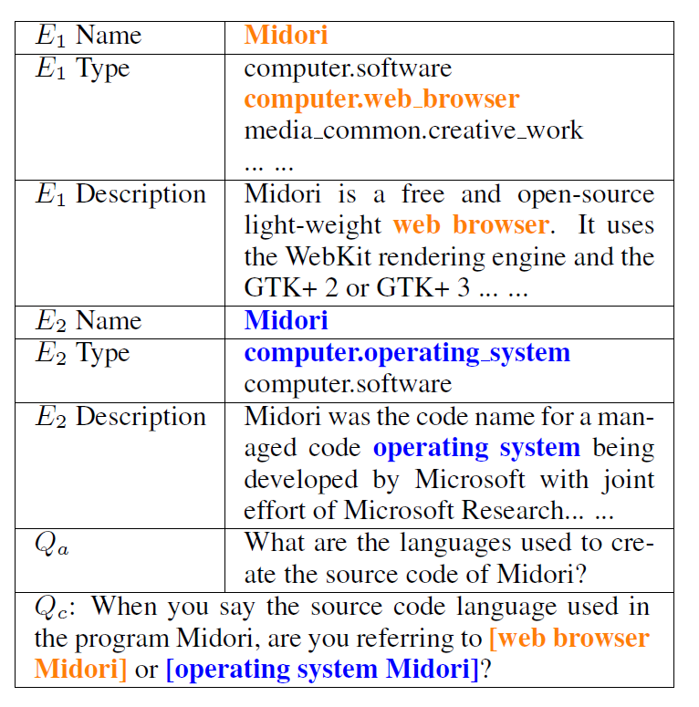
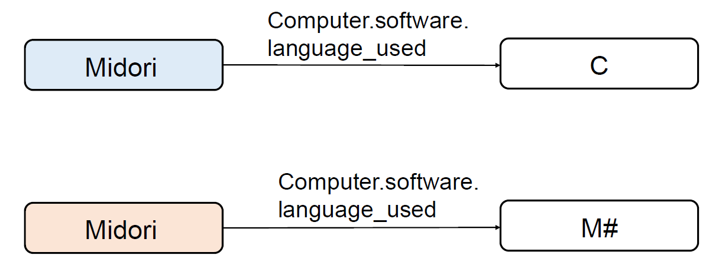


Data Collection: single-turn
Entity name $e$ + Predicate $p$
Multi-Choice: $e_{1}$ or $e_{2}$?

Slide 8
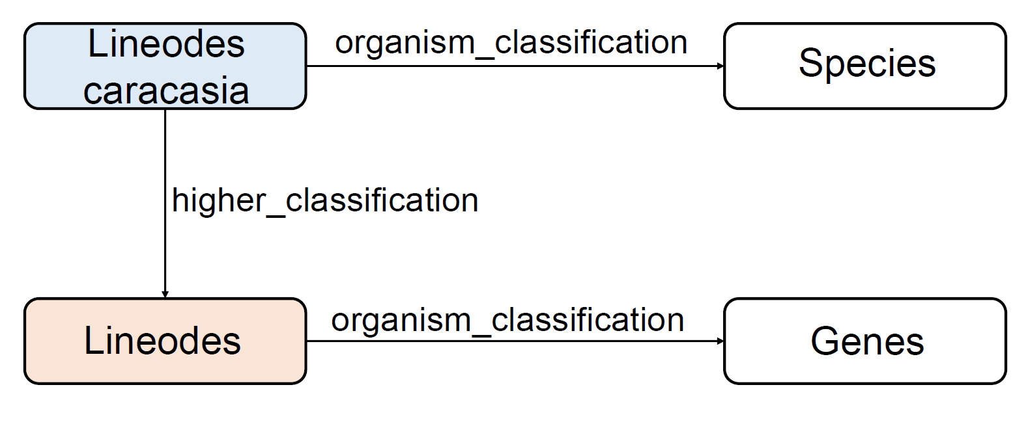
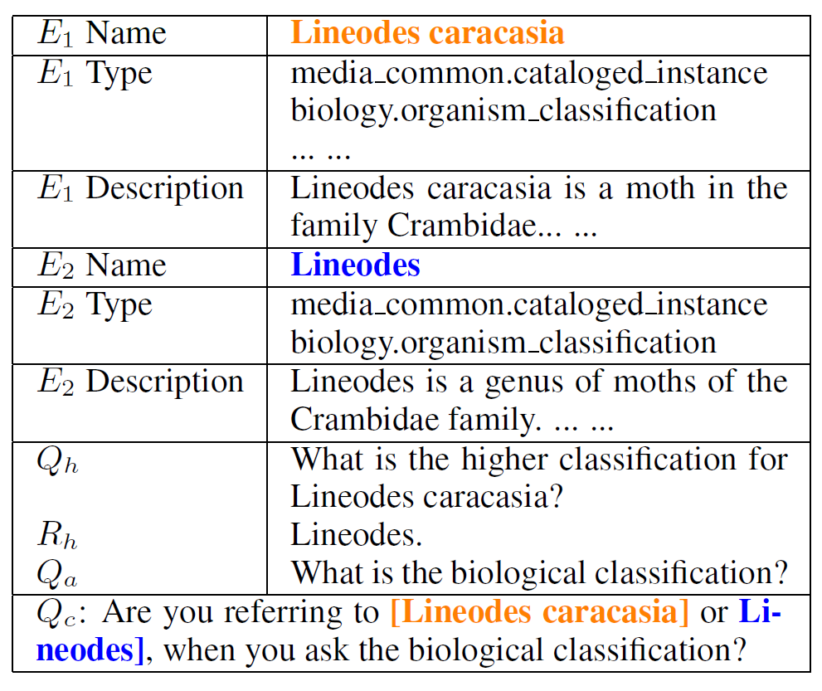



Data Collection: multi-turn
$(e_{1}, p^{′}, e_{2})$
$(pron., p^{′},?)$
Multi-Choice: $e_{1}$ or $e_{2}$?

Slide 9
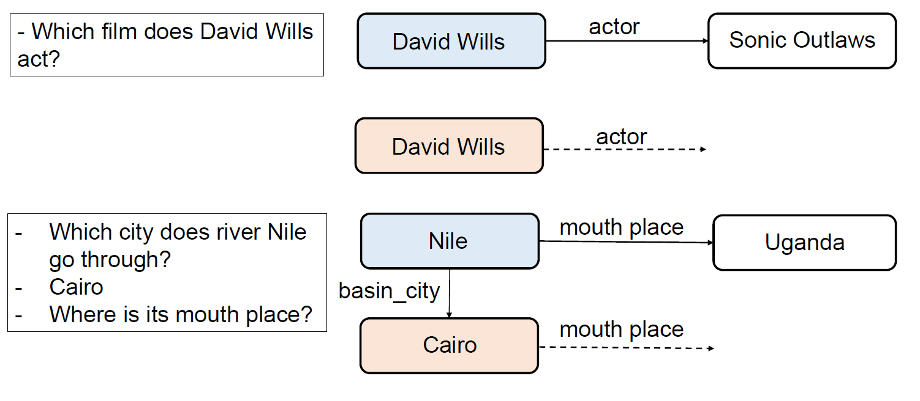
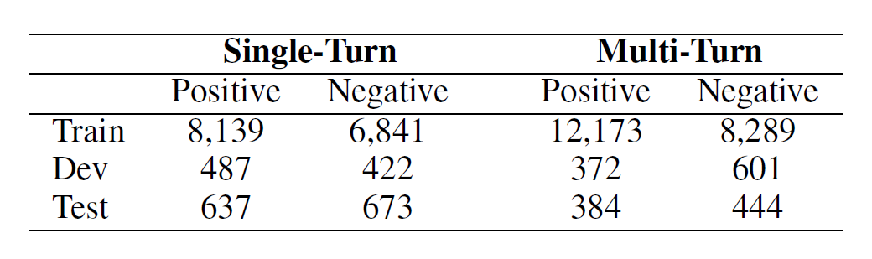

Clarification Identification
Classification Problem: context + entity information $→$ $\{0, 1\}$
single-turn: $\left\{Q_{a}, E_{1}, E_{2}\right\}$
multi-turn: $\{Q_{p}, R_{p}, Q_{a}, E_{1}, E_{2}\}$
negative samples

Slide 10
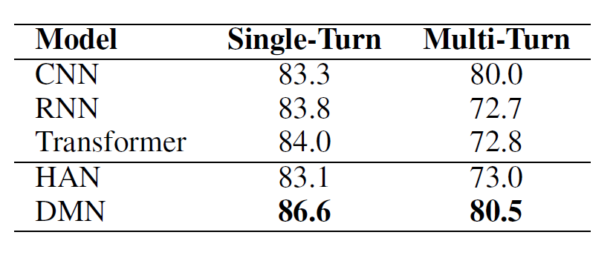
Models and Results
Unstructured Model: context [SEL] entity information
Structured Model:
use separate structures to encode different source information and adopt an additional structure to model the inter-relation of the source information.

Slide 11
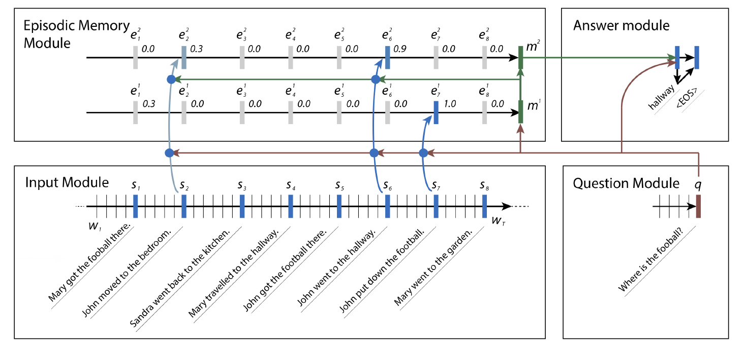
DMN: Dynamic Memory Network

Slide 12
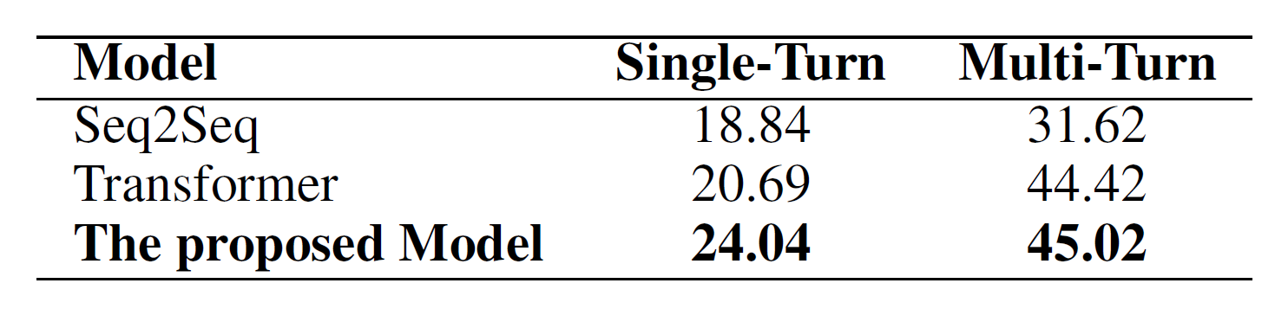

Clarification Question Generation
$\left\{Q_{a}, E_{1}, E_{2}\right\} or \left\{Q_{p}, R_{p}, Q_{a}, E_{1}, E_{2}\right\}$ $→Q_{c}$
Unstructured Models : Seq2Seq, Transformer
Structured Model: Coarse-to-fine model

Slide 13
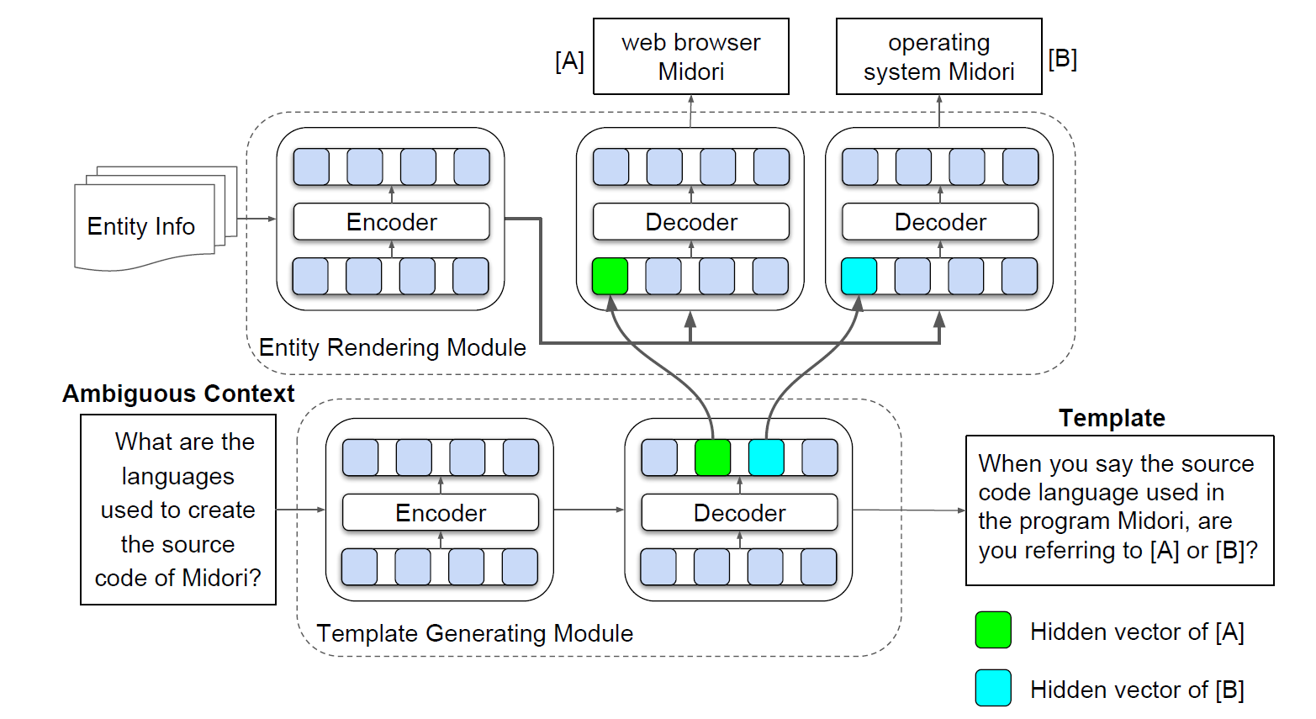
Coarse-to-fine Model
Clarification Question: entity phrases and pattern phrases
When you say the source code language used in the program Midori, are you referring to [A] or [B]

Slide 14
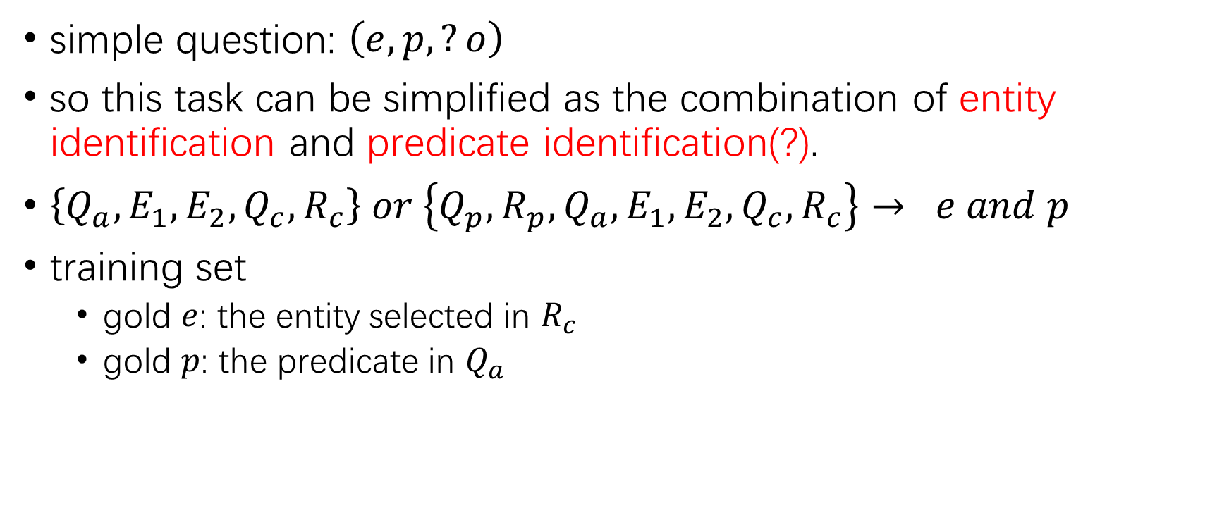
Clarification-Based Question Answering
simple question: $\left(e, p, ?o\right)$
so this task can be simplified as the combination of entity identification and predicate identification(?).
$\left\{Q_{a}, E_{1}, E_{2}, Q_{c}, R_{c}\right\} or \left\{Q_{p}, R_{p}, Q_{a}, E_{1}, E_{2}, Q_{c}, R_{c}\right\}→ e and p$
training set
gold $e$: the entity selected in $R_{c}$
gold $p$: the predicate in $Q_{a}$

Slide 15
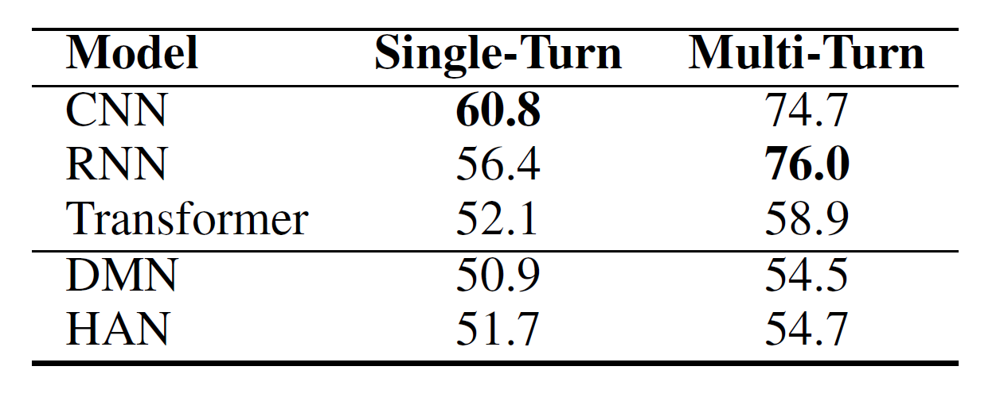
Model and Results

Slide 16
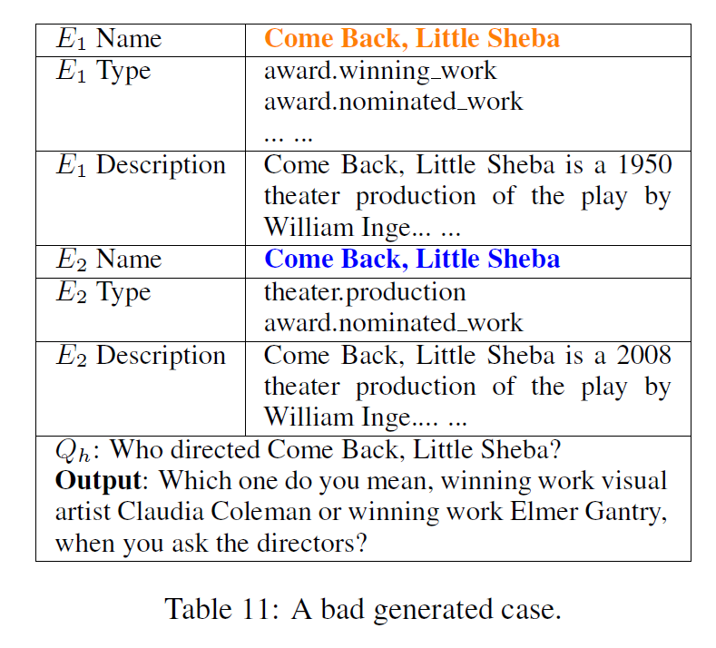
Discussion
Automatic Evaluation:
BLEU is not the best choice for the evaluation metric on clarification question generation.
Sparsity of Entities

Slide 17
Thanks for your listening!

