Slide 1
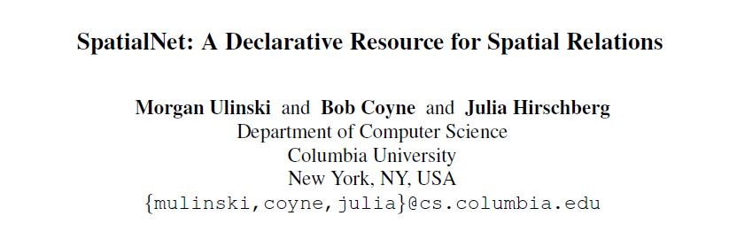

Slide 2
Main Work
This paper introduces SpatialNet, a novel resource which links linguistic expressions to actual spatial configurations.
SpatialNet is based on FrameNet and VigNet, two resources which use frame semantics to encode lexical
In this paper, we describe the structureof SpatialNet, with examples from English and German. We also show how SpatialNet can be combined with other existing NLP tools to create a text-to-scene system for a language.

Slide 3
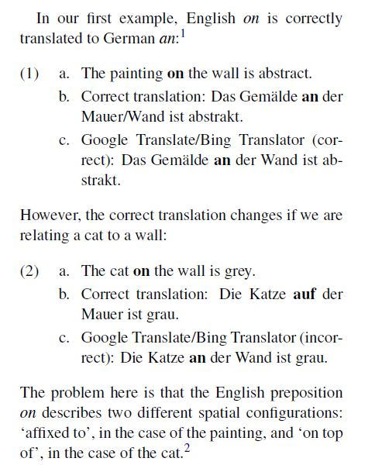
Case

Slide 4
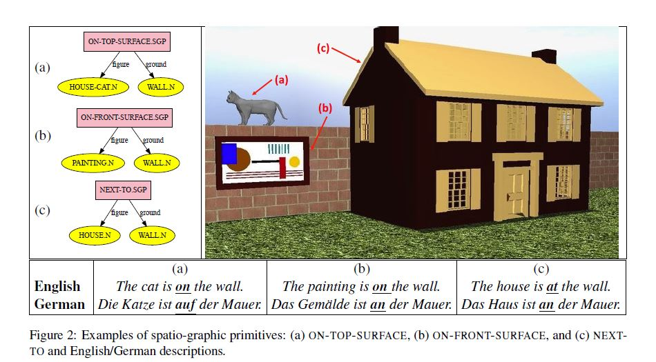
Case

Slide 5
SpatialNet
Spatio graphic primitives (SGPs)
Represent possible graphical (spatial) relations.
Ontology
Represents physical objects and their classification into semantic categories.

Slide 6
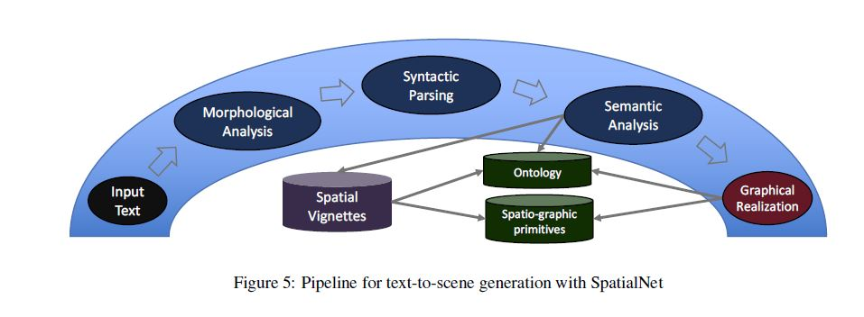
Case

Slide 7
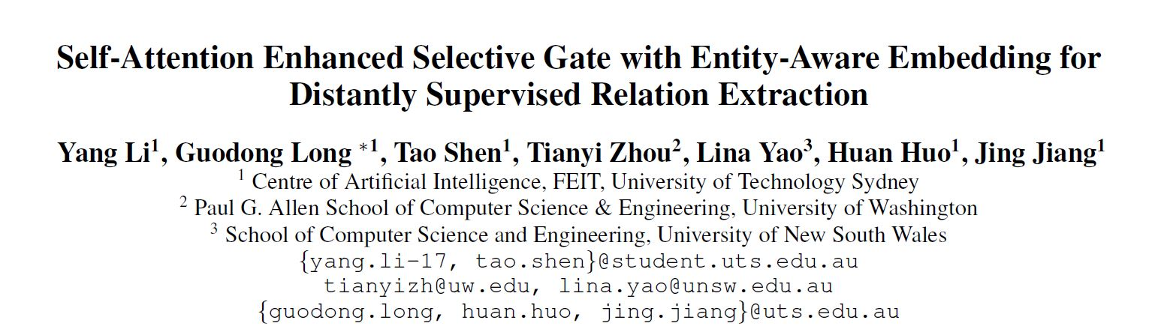
AAAI2020

Slide 8
Motivation
Distantly supervised relation extraction intrinsically suffers from noisy labels due to the strong assumption of distant supervision
Most prior works adopt a selective attention mechanism over sentences in a bag to denoise from wrongly labeled data, which however could be incompetent when there is only one sentence in a bag
we propose a brand-new light-weight neural framework to address the distantly supervised relation extraction problem and alleviate the defects in previous selective attention framework

Slide 9
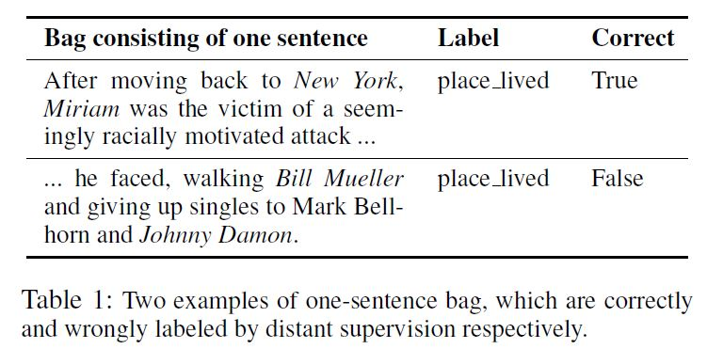
Case

Slide 10
NYT dataset
For NYT dataset (Riedel, Yao, and McCallum2010), up to 80% of its training examples (i.e., bags) are one-sentence bags
From our data inspection, we randomly sample 100 one-sentence bags and find 35% of them is incorrectly labeled
These results indicate that, in training phrase the selective attention module is enforced to output a single-valued scalar for 80% examples, leading to an illtrained attention module and thus hurting the performance

Slide 11
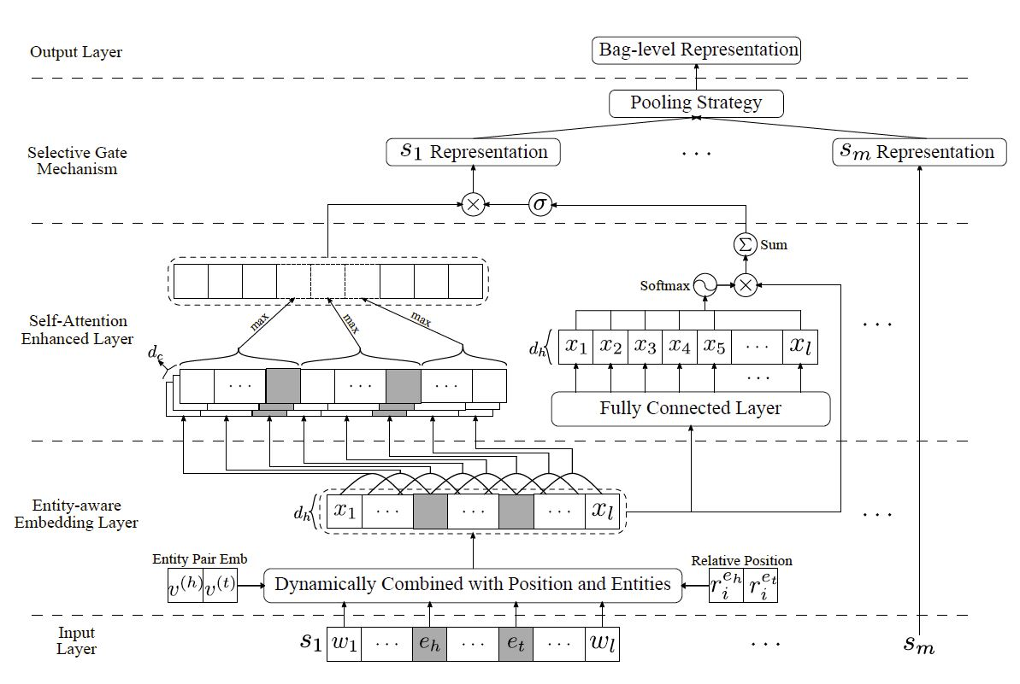
Model

Slide 12
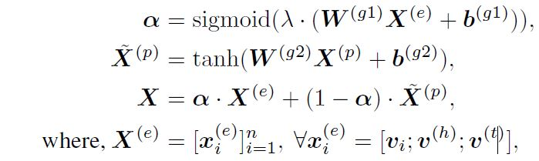

Entity-Aware Embedding

Slide 13
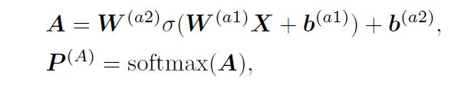
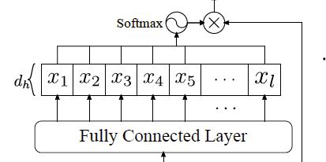

Self-Attention Mechanism

Slide 14


PCNN

Slide 15


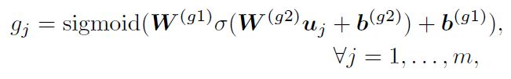
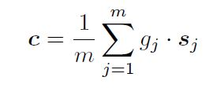

Selective Gate and Output

Slide 16
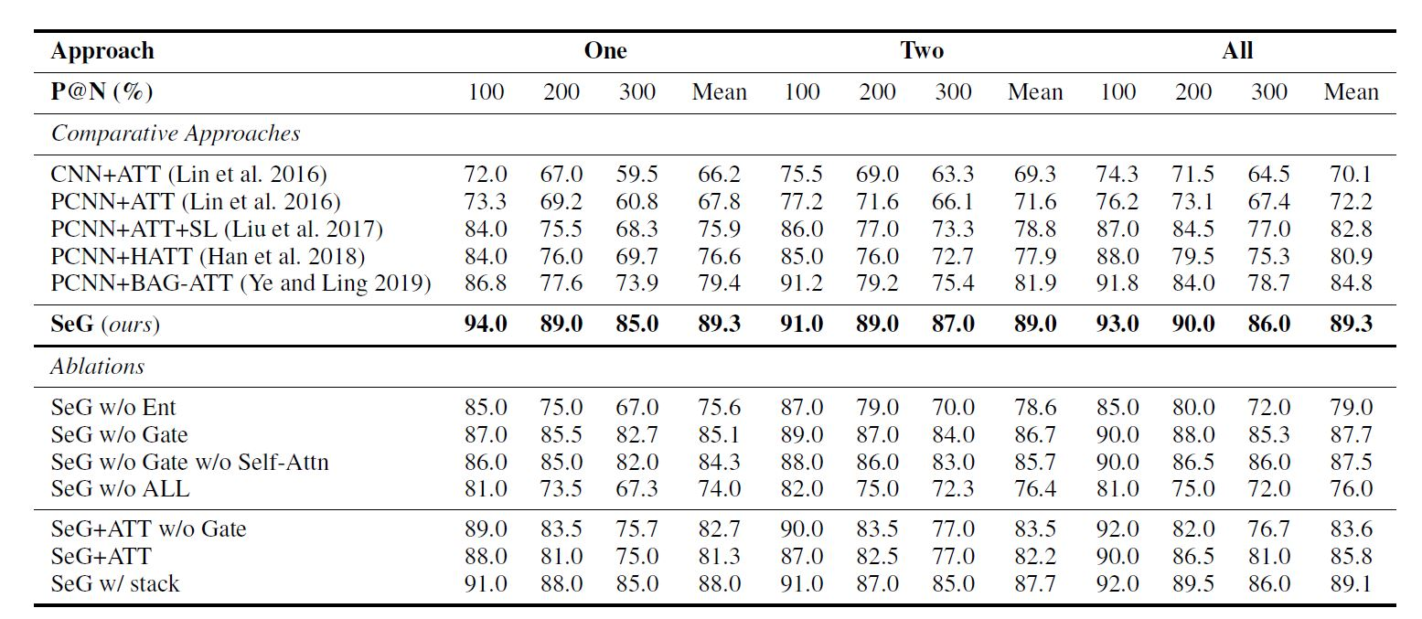
Result

Slide 17
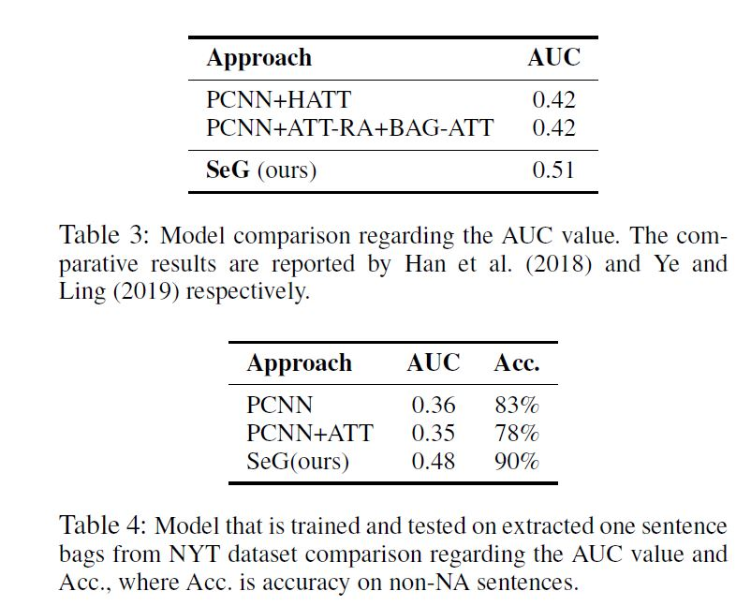
Result

Slide 18
Result

Slide 19
SRL-TASK
BiLSTM + Target self-attention+Pointer-network
BiLSTM + Local target attention+Pointer-network

