Slide 1
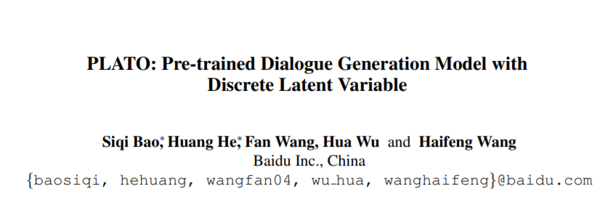

Slide 2
Motivation
Pre-training models have been proved effective for a wide range of natural language processing tasks
directly fine-tuning BERT on small conversation datasets has some problems:
➢the underlying pattern of dialogue generation is different from general text
➢training mode of unidirectional dialogue generation is distinct from bidirectional model
➢ there exists a one-to-many relationship in dialogue generation

Slide 3
framework
large-scale Reddit and Twitter conversations are utilized to further pre-train the generation model
to mitigate the difference in training mode, a flexible paradigm integrating unidirectional and bidirectional processing is employed in this work,
a discrete latent variable is introduced to model the one-to-many relationship among utterances in conversations.

Slide 4
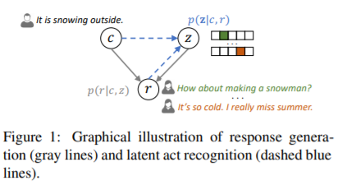
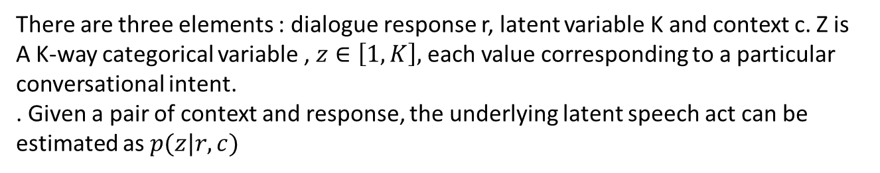
Framework
There are three elements : dialogue response r, latent variable K and context c. Z is
A K-way categorical variable , $z∈\left[1,K\right],$ each value corresponding to a particular conversational intent.
. Given a pair of context and response, the underlying latent speech act can be estimated as $p(z|r,c)$

Slide 5
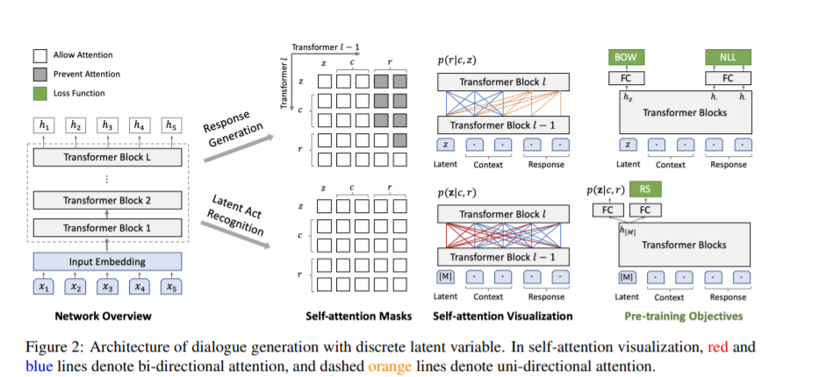
Framework

Slide 6
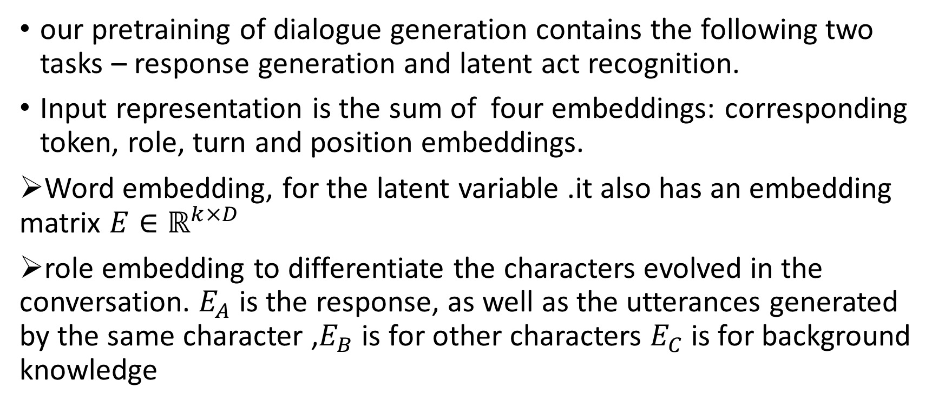
Model
our pretraining of dialogue generation contains the following two tasks – response generation and latent act recognition.
Input representation is the sum of four embeddings: corresponding token, role, turn and position embeddings.
➢Word embedding, for the latent variable .it also has an embedding matrix $E∈ℝ^{k×D}$
➢role embedding to differentiate the characters evolved in the conversation. $E_{A}$ is the response, as well as the utterances generated by the same character ,$E_{B}$ is for other characters $E_{C}$ is for background knowledge

Slide 7
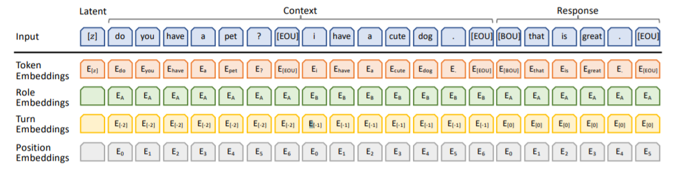
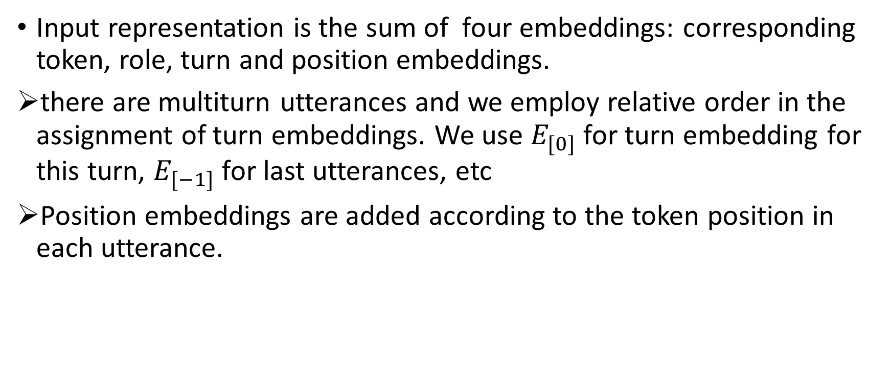
Model
Input representation is the sum of four embeddings: corresponding token, role, turn and position embeddings.
there are multiturn utterances and we employ relative order in the assignment of turn embeddings. We use $E_{[0]}$ for turn embedding for this turn, $E_{[−1]}$ for last utterances, etc
Position embeddings are added according to the token position in each utterance.

Slide 8
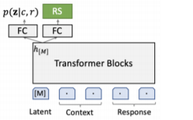

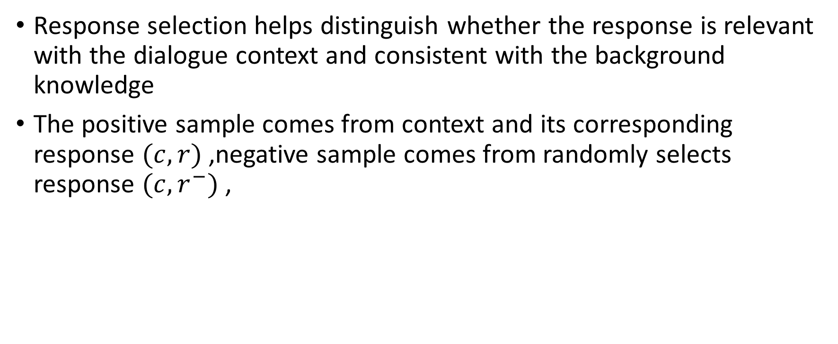
Response selection
Response selection helps distinguish whether the response is relevant with the dialogue context and consistent with the background knowledge
The positive sample comes from context and its corresponding response $(c,r)$ ,negative sample comes from randomly selects response $(c,r^{−})$ ,

Slide 9
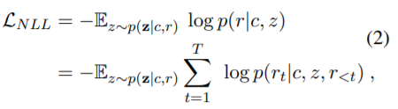
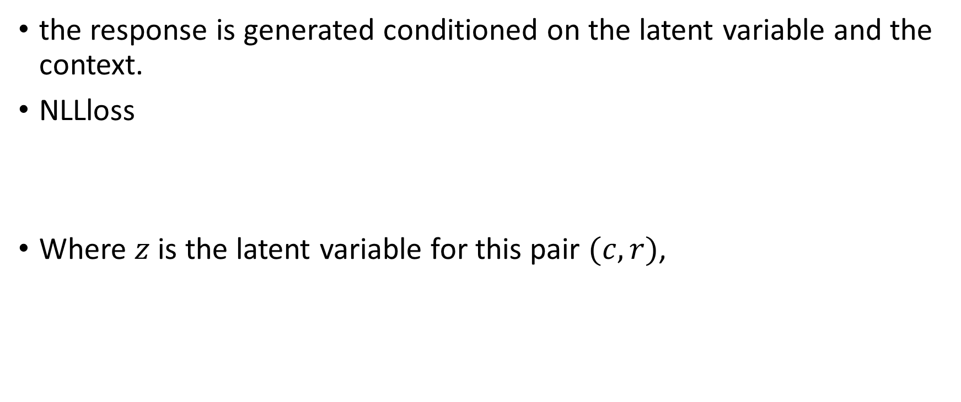
Response generation
the response is generated conditioned on the latent variable and the context.
NLLloss
Where $z$ is the latent variable for this pair $(c,r)$,

Slide 10
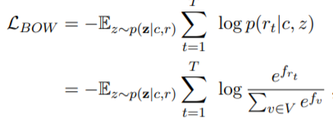

Response generation
Besides NLLloss ,we also use the bag-of-words loss
the BOW loss discards the order of words and forces the latent variable to capture the global information of the target response.

Slide 11
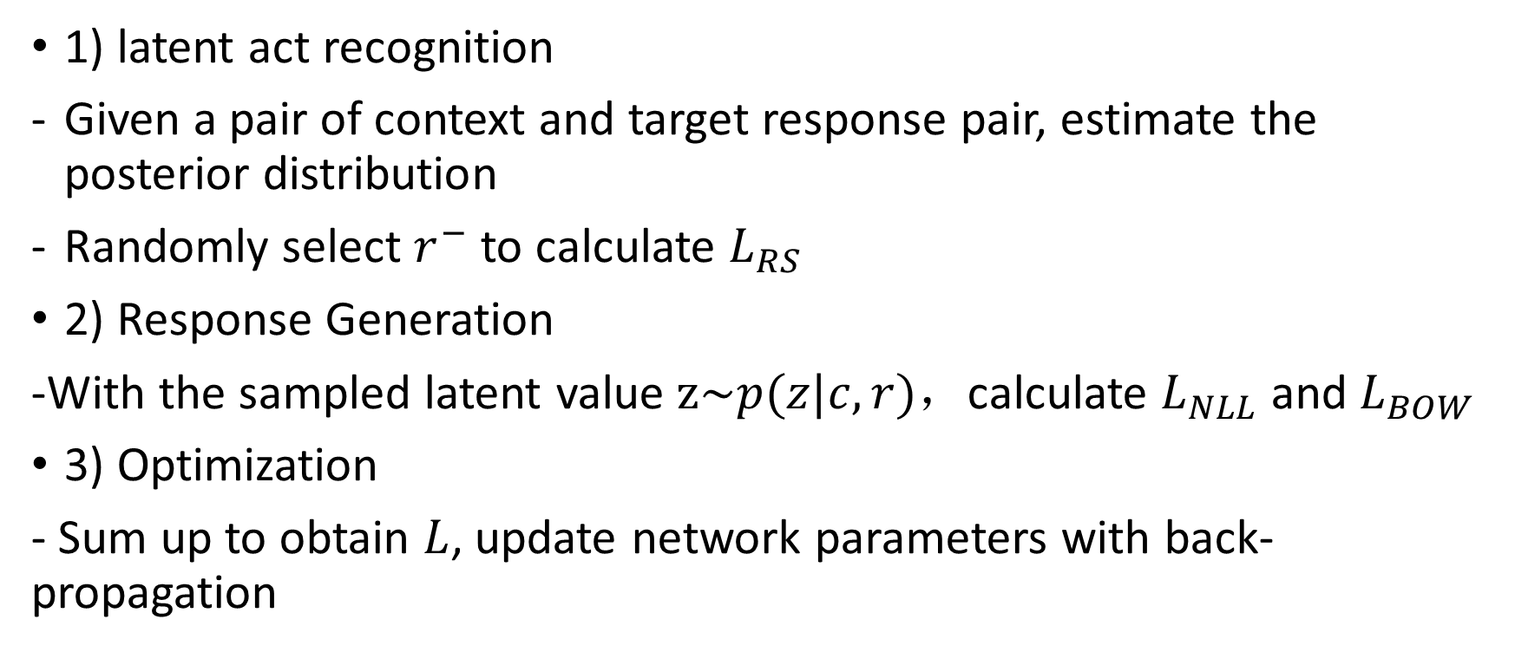
Pretraing steps
1) latent act recognition
Given a pair of context and target response pair, estimate the posterior distribution
Randomly select $r^{−}$ to calculate $L_{RS}$
2) Response Generation
-With the sampled latent value $z\sim p(z|c,r)$，calculate $L_{NLL}$ and $L_{BOW}$
3) Optimization
- Sum up to obtain $L$, update network parameters with back-propagation

Slide 12
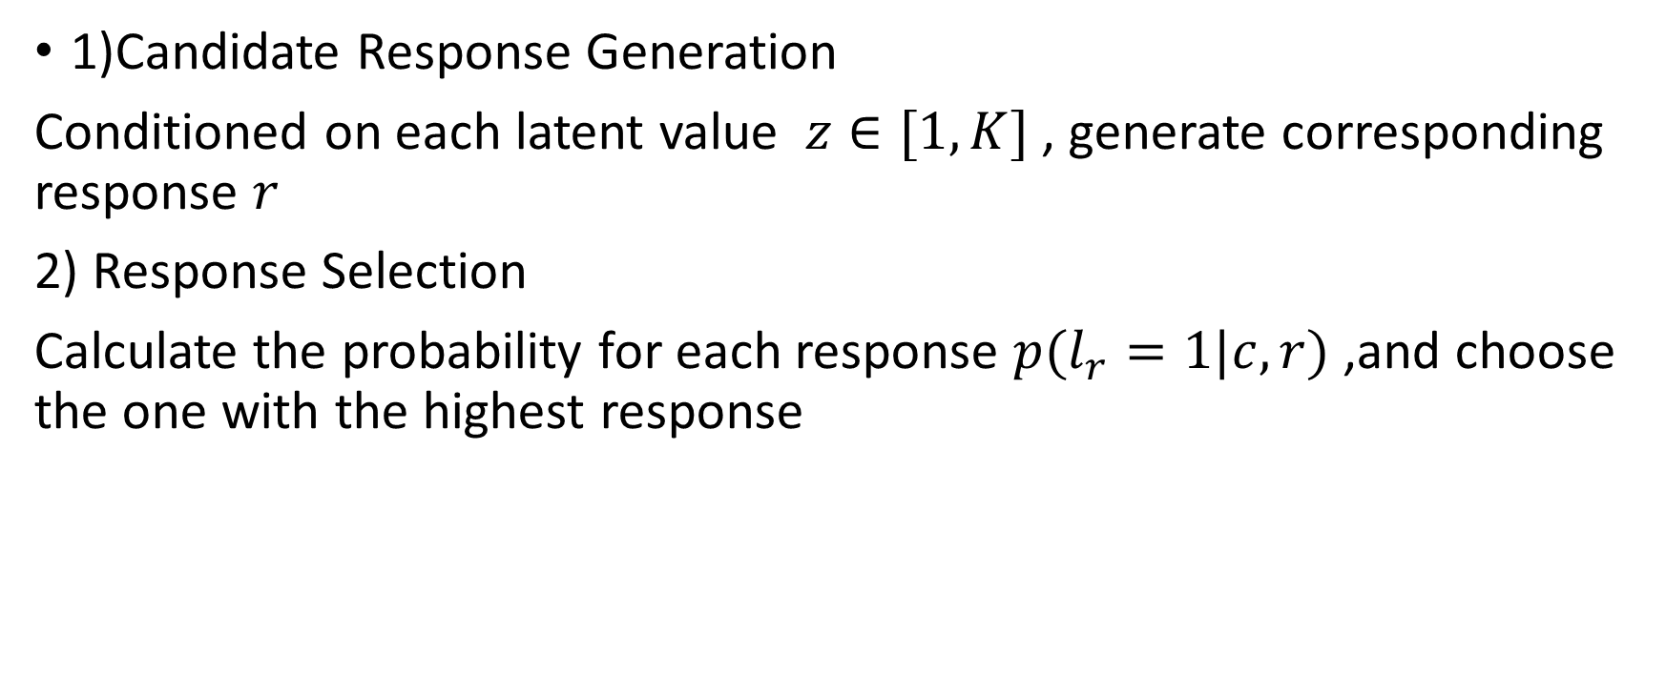
Fine-tuning and Inference
1)Candidate Response Generation
Conditioned on each latent value $z∈[1,K]$ , generate corresponding response $r$
2) Response Selection
Calculate the probability for each response $p(l_{r}=1|c,r)$ ,and choose the one with the highest response

Slide 13
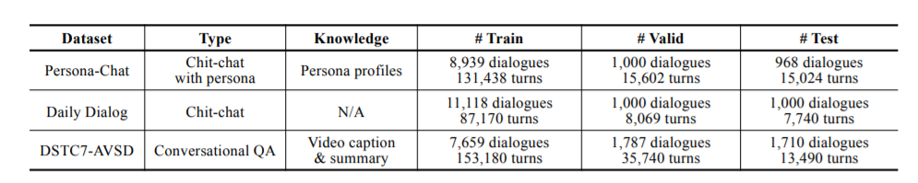
Dataset
Persona –chat a knowledge grounded conversation dataset.
Daily Dialog , which contains high-quality human conversations about daily life
DSTC7-AVSD, in which the system need to generate an answer given dialogue context and background knowledge.(with caption and summary as

Slide 14
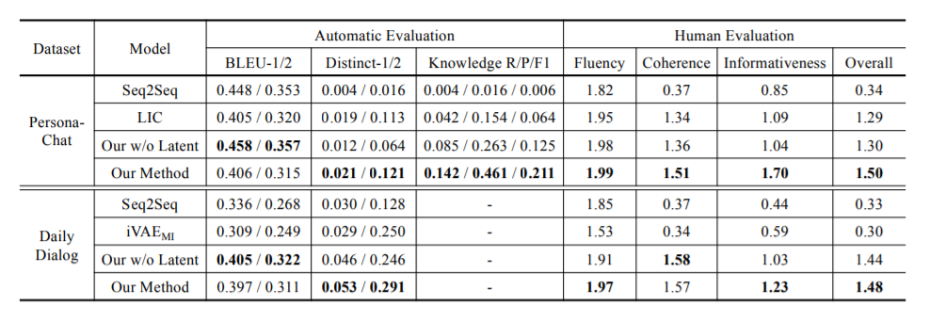
Experiment
Human evaluation:randomly chooses 100 sentences, score the response quality on a scale of [0,1,2], from four aspects – fluency, coherence, informativeness and overall.

Slide 15
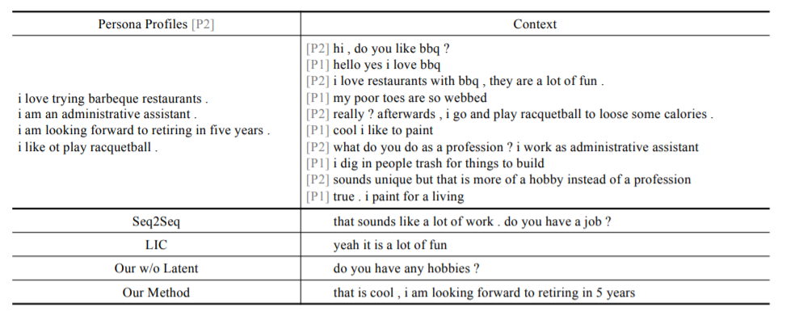
Experiment

