Slide 1
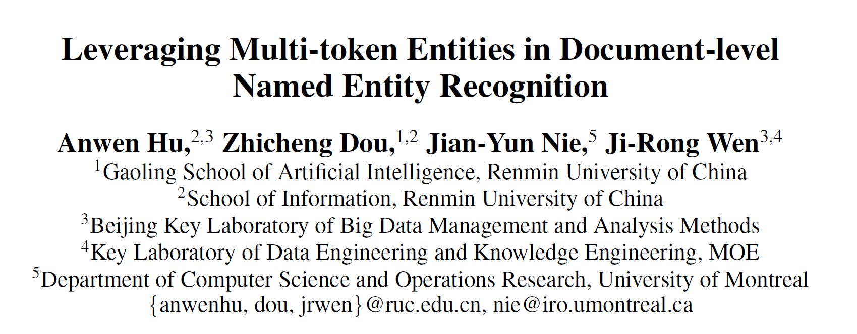
AAAI2020

Slide 2
Main Work
We propose a novel attention-based document-level NER model that leverages global context features across sentences as supplements to local context features.
We take advantage of multi-token entities in the document to guide NER. Multi-token entities are detected by an auxiliary sequence tagging task.
Experimental results confirm the effectiveness of the proposed method over the state-of-the-art sentence-level and document-level NER models.

Slide 3
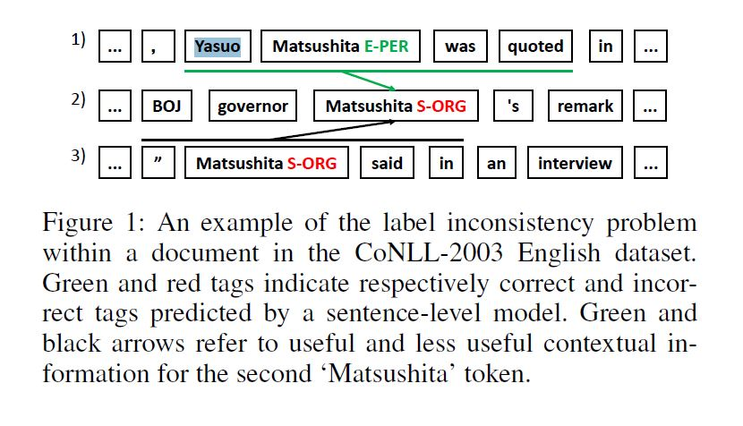

Slide 4
Motivation
it is common that a multi-token entity such as ‘Yasuo Matsushita’ is fully spelled out at the beginning of the article, and then referred to by one of its token (e.g ‘Matsushita’) later
we found 26.62% of the single-token entities are constituents of multi-token entities in the same document.
we propose to pay more attention to the token occurrences within multi-token entities

Slide 5
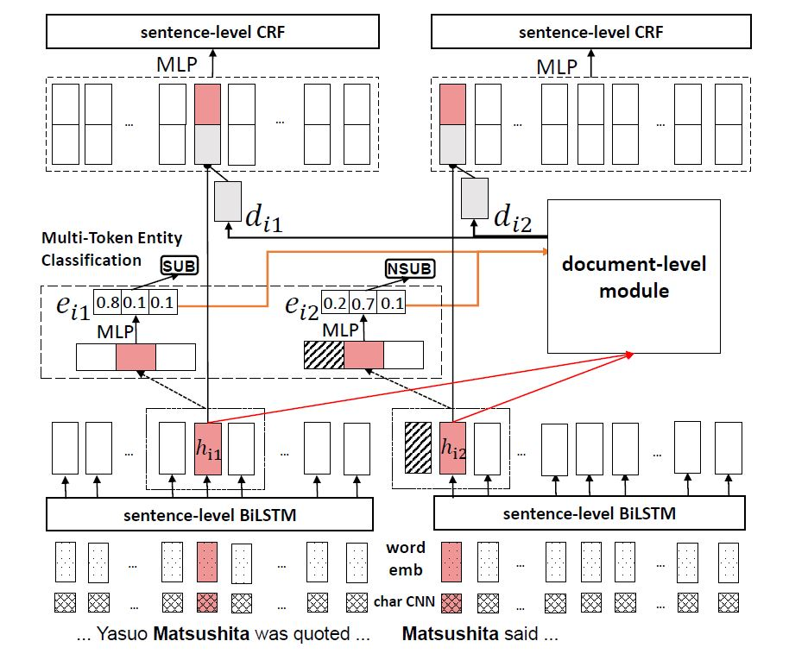
Model

Slide 6
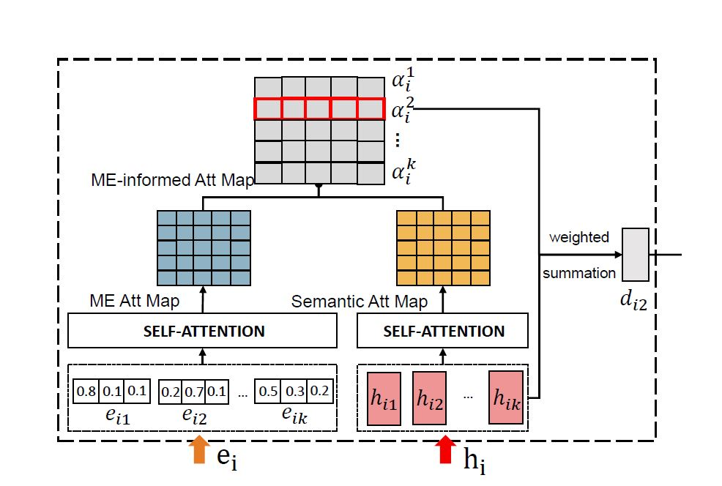
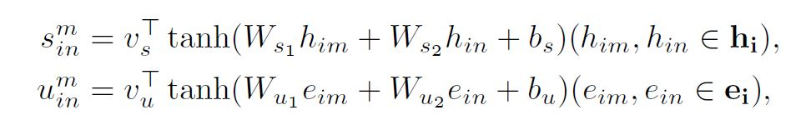
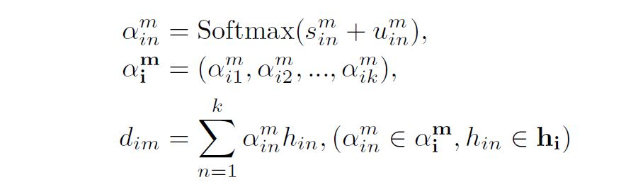


ME-informed Attention

Slide 7
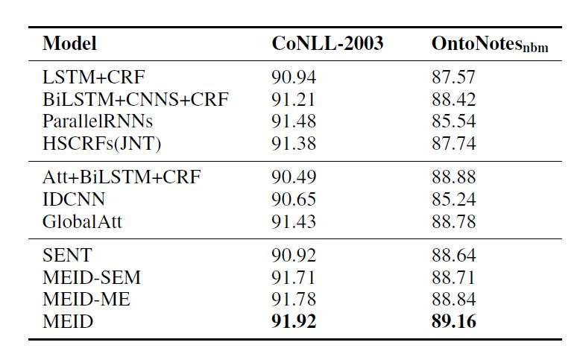
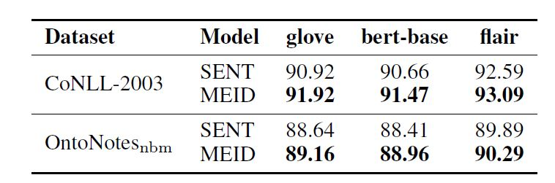
Result

Slide 8
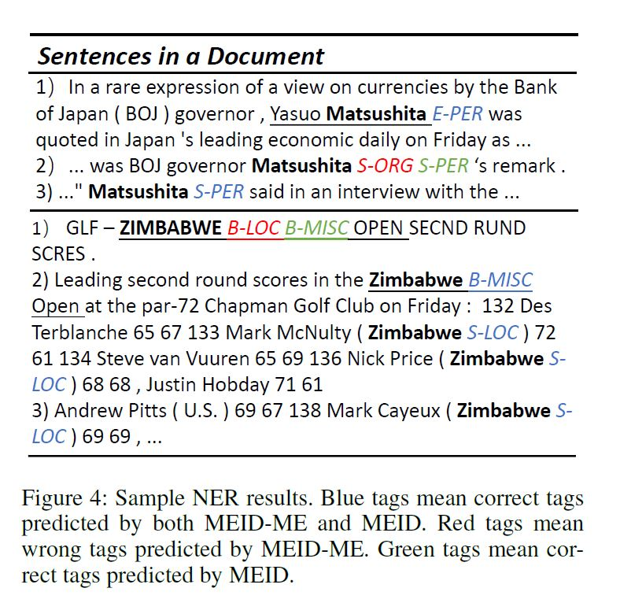
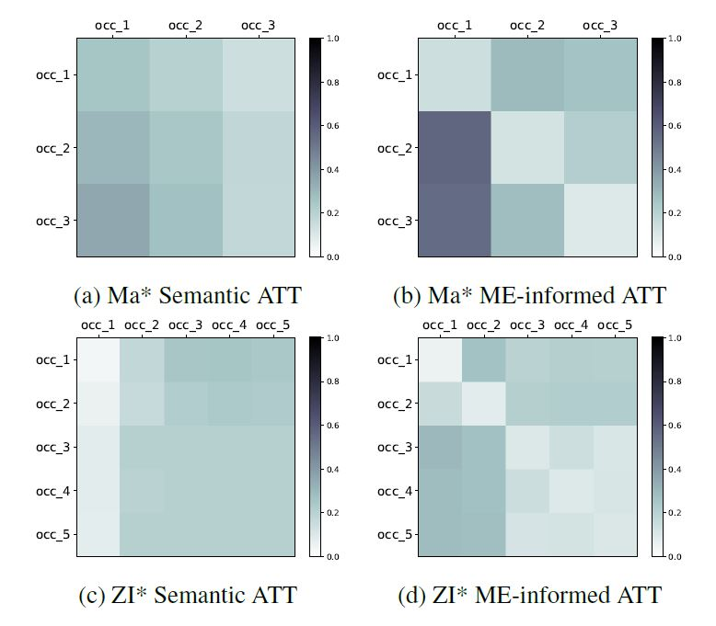
Case Analysis

