Slide 1


Dissertation
Partial fulfilment of passing of B.Sc (Computer Science) 6th Semester Final Exam 2023 of Bodoland University.

Slide 2
Project On Data Encryption Standard File Encryption
Submitted By : China Brahma
Roll No.: UG123S20041
Registration: 023993
Submitted to: Department Of Computer Science,
Kokrajhar Govt. College, Kokrajhar

Slide 3
Table Of Contents
Introduction & Problem Statement
Approach
Program Structure
Usage Screenshot
Future Scope Of Project
Conclusion

Slide 4
INTRODUCTION
With growing technology, sharing of files and information has become one click away.
The only thing that makes it dangerous is that anyone with good computer skills can intercept you files, information and messages you send to your friends, family, anyone whom we intend to.
Therefore, we have to figure out a way to protect it from people whom we don’t intend to.
It brings the need to encrypt our files, information and messages.
Over the years, Many encryption approach has been tried and tested.
This project of mine tries to replicate the encryption algorithm accepted as Encryption Standard in 1970s.
A Data Encryption Standard File Encryption Project.

Slide 5
APPROACH
I have used symmetric key encryption algorithm to encrypt text files. It converts each character of plain text into binary format which divides file content to a 64-Bit Block and a 56-bit key for Encryption.
It undergoes 16 rounds of XOR, Substitution, Permutation process for encryption and decryption.

Slide 6
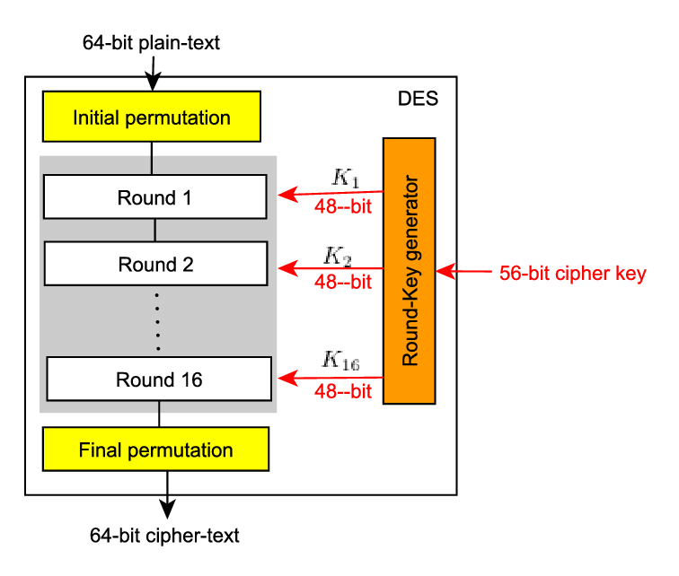
Program Structure

Slide 7
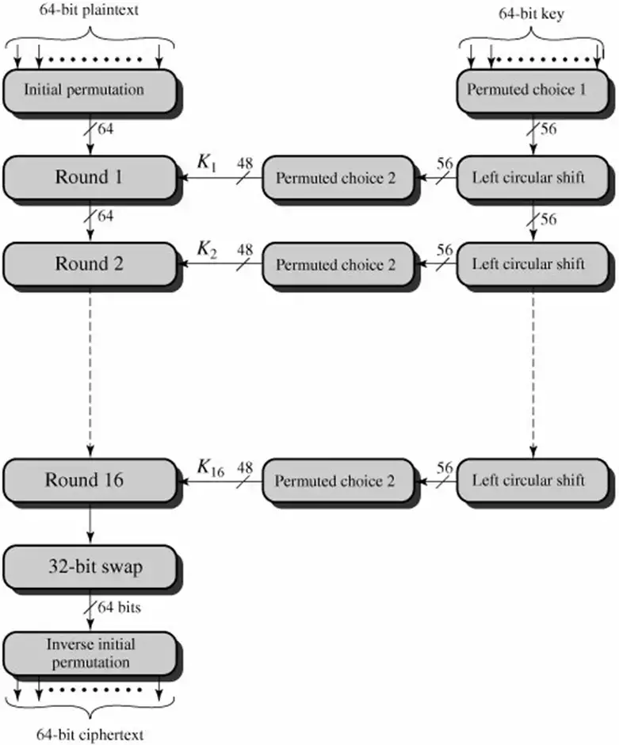

Slide 8
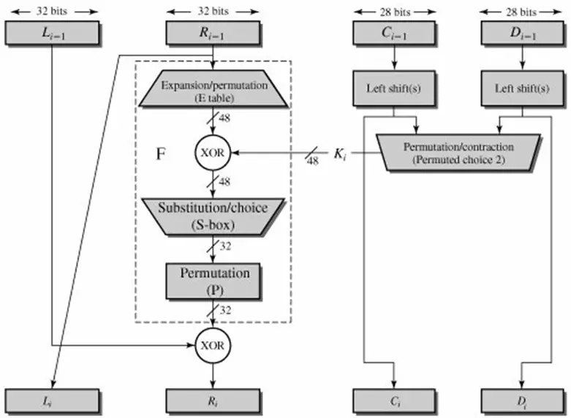
Single Round Of Encryption Algorithm

Slide 9
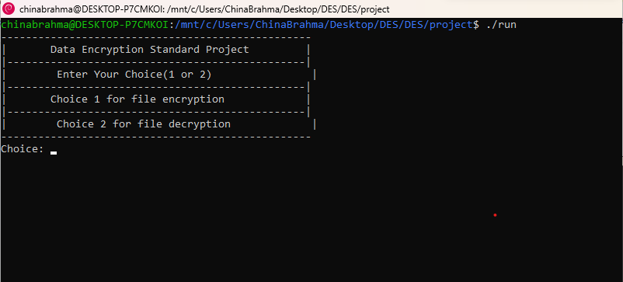
Usage Screenshots

Slide 10
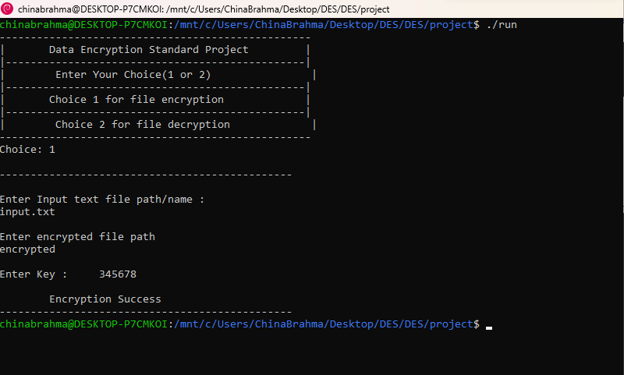

Slide 11
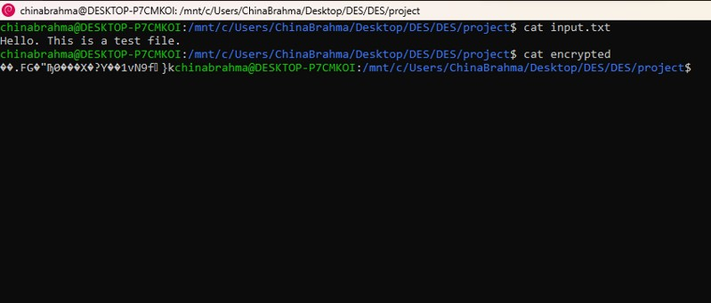

Slide 12
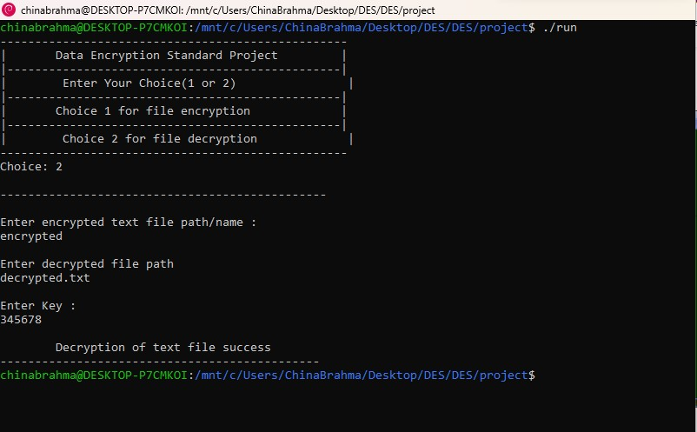

Slide 13
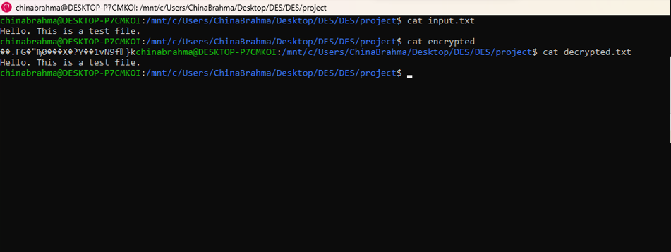

Slide 14
Future Scope
This project can farther be develop to encrypt image files.
It can be used to analyze use of encryption algorithm in a project.

Slide 15
Conclusion
In conclusion, the implementation of the DES (Data Encryption Standard) file encryption project has proven to be highly successful in enhancing data security and confidentiality. Throughout the project, we have achieved our primary goal of protecting sensitive information by encrypting files using the DES algorithm. By applying a strong encryption technique, we have ensured that unauthorized individuals cannot access or decipher the encrypted data, thus safeguarding the integrity and privacy of our files.

