Slide 1

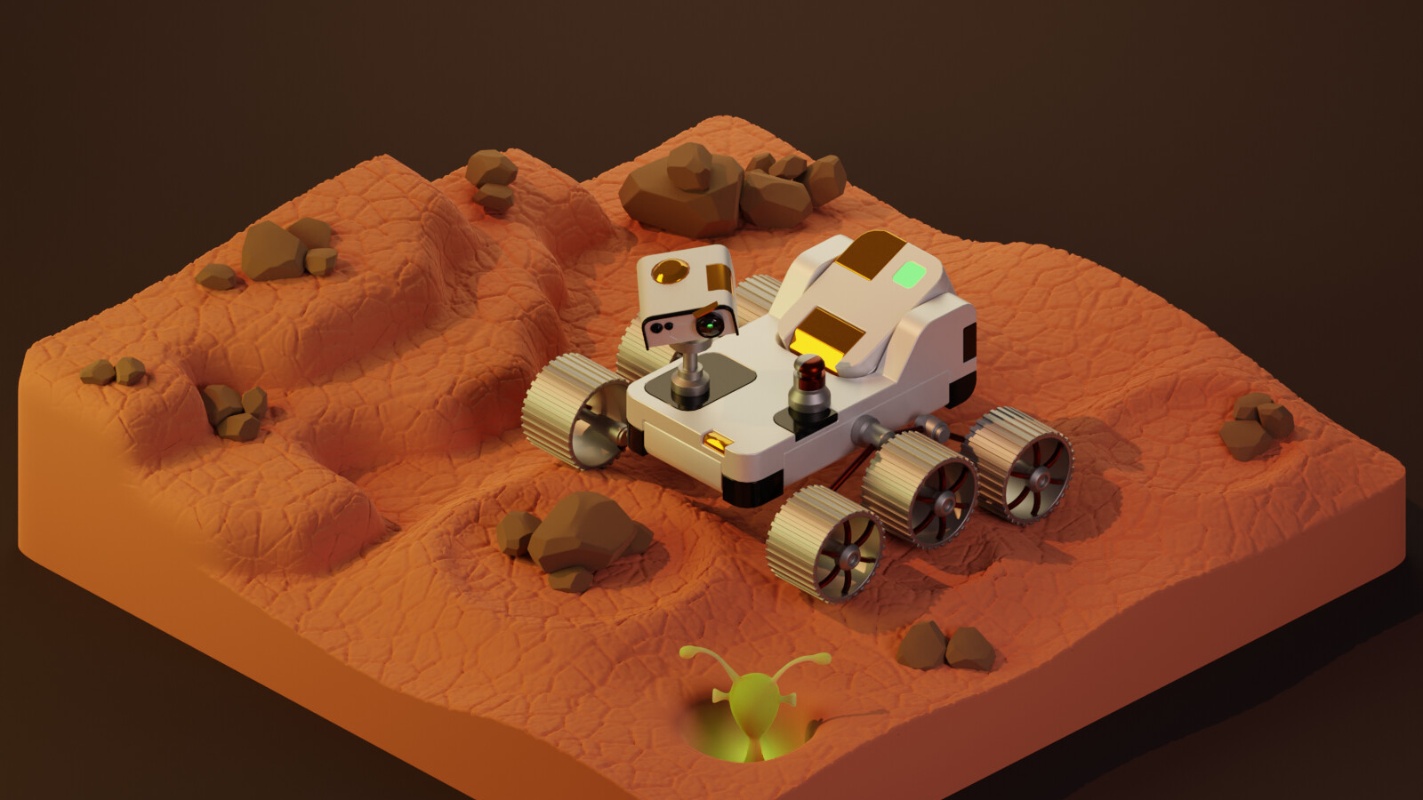
Rover Ready
Chirag Baviskar and Dhrumil Patel

Slide 2

Introduction
The player restores a damaged rover before deployment
Main tasks are inserting power modules and repairing damaged parts
The player interacts with the rover directly using the controllers
Notes:
Our project is called Rover Ready. It is a small VR repair experience set in a single garage bay. The basic goal is simple: get a damaged rover working again before it can leave.

Slide 3

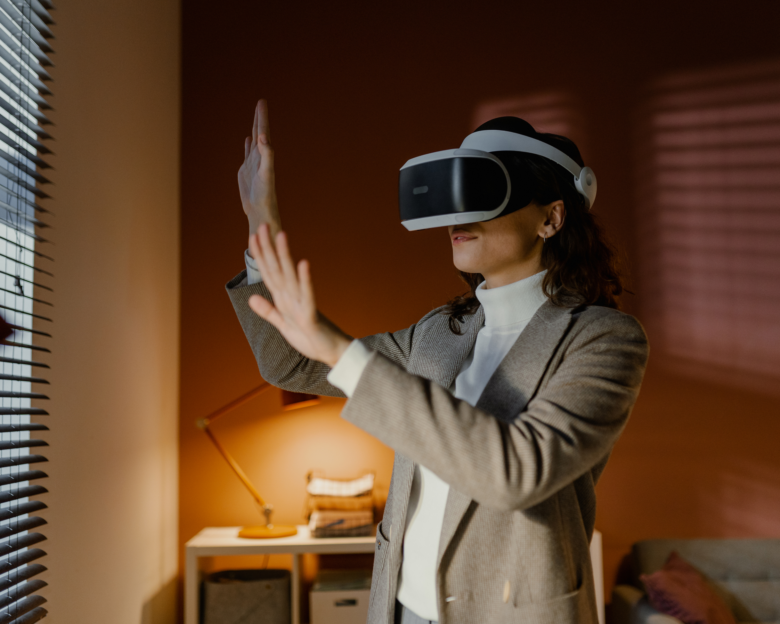
Why This Works in VR
Grabbing and inserting parts works better in VR than on a normal screen
Repairing rover parts feels more direct when the player uses hand motions
The player can see the rover change as each step is completed
A one-room project is realistic for a 2-person team and easier to finish well
Notes:
VR makes sense for this because the whole experience requires reaching out, grabbing parts, putting them in place, and using a tool on the rover. That feels a lot more natural in VR than it would on a normal screen. Since the whole project is one room with two main interactions, it is also something we can realistically finish.

Slide 4
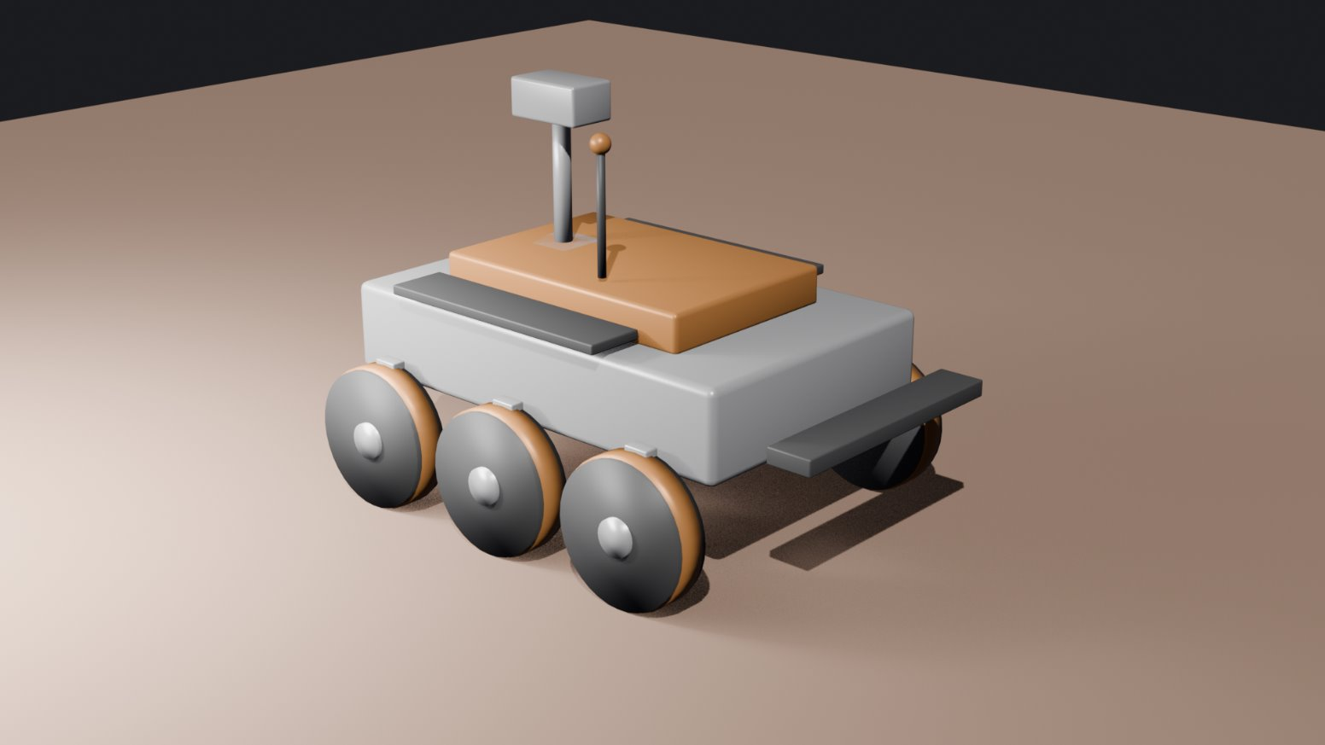
Scene and Art Direction
Scene Setup
Art Direction
One compact rover repair bay
Rover, charging rack, tool wall, floor markings
A few damaged rover parts placed around the main work area
All major objects stay within easy reach of the player
Low-poly industrial look
Simple materials and a limited color palette
Custom assets: power module and repair tool
Color contrast can help show powered, damaged, and repaired states
Notes:
The scene is a single repair bay, with the rover in the middle. Around it are the charging rack, the tool wall, and the damaged rover parts that the player has to work on. We are also using a low-poly industrial style, so the scene stays manageable to build and still looks consistent.

Slide 5


Interaction Loop
Pick up a power module from the rack
Insert it into the rover and power it on
Pick up the repair tool and fix damaged rover parts
The rover lights up and becomes ready to go
Later repair jobs get harder as the game continues
Notes:
The interaction loop starts fairly simply. First, the player grabs a power module and inserts it into the rover, which powers it on. After that, the player uses the repair tool on the damaged rover parts, and the rover changes visually as it gets fixed. We also want the later repairs to get harder over time, so the game doesn't feel like the same task repeated time and time again.

Slide 6
Requirement Fit and Tech Plan
Base Requirements
Advanced Features
Tools
Original theme: rover repair bay
Two custom Blender assets: power module and repair tool
Two meaningful VR interactions: insertion and repair
Physics
Multiple object types/tools
Blender, Three.js + WebXR, GLTFLoader, Cannon-ES
Backup option: procedural environment assets if needed
Notes:
For the assignment requirements, this project gives us an original theme, two custom Blender assets, and two meaningful VR interactions. For the advanced features, we are planning physics and different object or tool behaviors. The main tools we are using are Blender, Three.js, WebXR, GLTFLoader, and Cannon-ES.

Slide 7
Plan, Roles, and Timeline
Main Components
Team Roles
Timeline
Blender modeling and export
WebXR interaction logic for grabbing, insertion, and repair
Rover feedback, physics, and testing
Chirag: Bay layout, custom models, exports, and slide prep
Dhrumil: WebXR scene setup, grabbing, insertion, repair logic, and physics
By April 20: Lock the layout, finish the first custom asset, and get the main interaction loop working
Before the final presentation: Complete both interactions, improve feedback, test in the emulator, and clean up the experience
Notes:
For the work split, Chirag is mainly handling the bay layout, the custom models, and the exports, while Dhrumil is mainly handling the WebXR setup, grabbing, repair logic, and physics. By April 20, we want the layout locked, the first custom asset finished, and the main interaction loop working. After that, we can spend the rest of the time testing in the emulator and cleaning things up before the final presentation.

