Slide 1
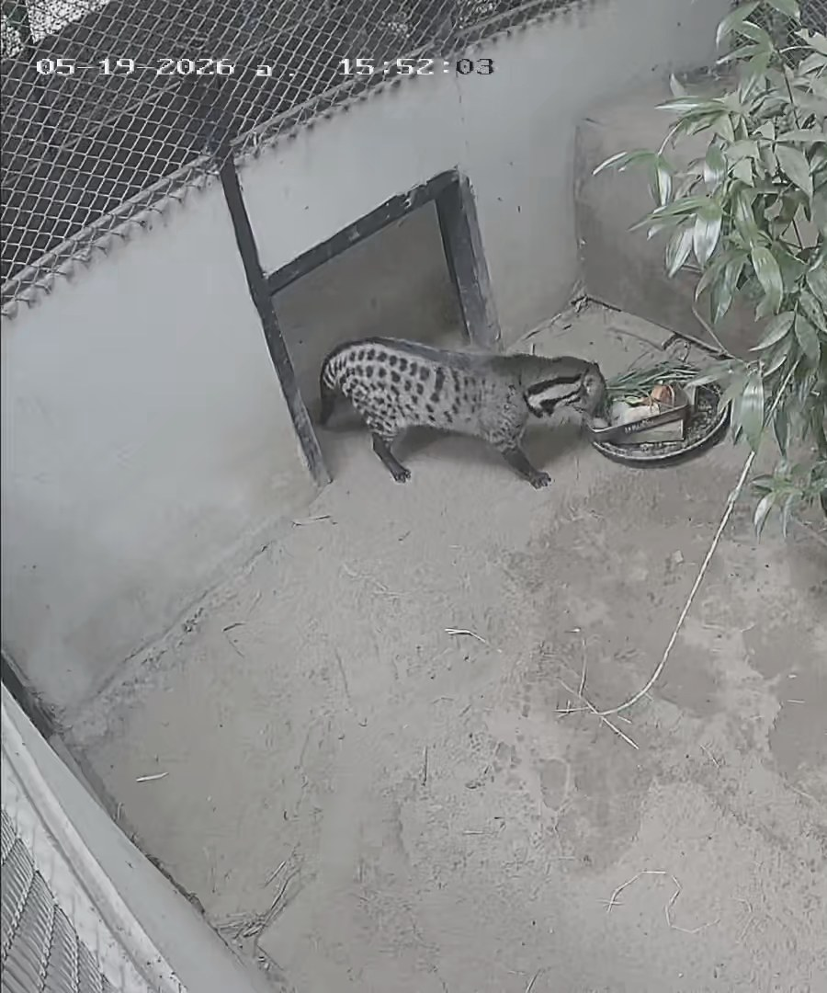
CMZ PROJECT · PHASE 2 · OCTOBER 2026
Three Tasks,
One Animal,
One Pipeline
Short-clip behavior classification, detection and feature analysis for a zoo civet
Project team, CMU
CAMERA 02 · 19 MAY 2026
01 / 10
Notes:
We built all three tasks of the brief on the same 22 clips, and everything you see comes from one pipeline. The scores are only half the story: the other half is what each score covers. I will take the tasks in order, then show the single command that produces all three at once.

Slide 2
02 / SCOPE
What the brief asked, what we delivered
TASK | BRIEF ASKED | WHAT WE BUILT | MEASURED RESULT
TASK 1 Image-based classification | Walking · Eating · Resting · Climbing | Five-second window CNN, three classes | Macro F1 0.949 on 15 held-out windows
TASK 2 YOLO-based detection | Video → frames → YOLO annotation → training → detection | Auto-labeled detector, no hand-drawn boxes | mAP50 0.537 on validation; animal found in 59% of held-out frames
TASK 3 Keypoint feature analysis | Body Angle · Head Angle · Movement Speed · Limb Distance | Silhouette geometry with the same four names | Macro F1 0.422 on 15 test windows
Climbing dropped with instructor confirmation (ADR 0007). Task 3 is a silhouette proxy, not keypoints (ADR 0009).
CMZ / PHASE 2
02 / 10
Notes:
This page is the whole brief and the whole delivery side by side. Task 1 is the strongest result, Task 2 works but does not survive a new recording day, and Task 3 is the honest weak one. The footnote matters: Climbing was dropped with the instructor's agreement, and Task 3 measures a silhouette rather than keypoints.

Slide 3
03 / TASK 1 · DATA
Task 1: the evidence base
22
201
138
93 · 30 · 15
source clips
five-second windows
labelled windows
train · val · test
01
02
03
04
Source clips
→
Verified intervals
→
Five-second windows
→
Split by whole clip
22 fixed-camera MP4s
one class per whole span
a fixed grid over each clip
no frame-level leakage
THE TEST SPLIT
The eight-clip gold set: two labeling passes, interval Dice 0.597, reconciled, and locked on 2026-10-20 before the test was read.
63 of 201 windows are dropped: 46 not covered completely by one interval, 17 touching a Transition or Uncertain span.
CMZ / PHASE 2
03 / 10
Notes:
Task 1 rests on 22 clips cut into 201 windows, of which 138 carry one verified label. The flow is deliberately boring: clips, verified intervals, five-second windows, then a split by whole clip. The test set is the eight-clip gold set, locked on the 20th before anyone read a test score.

Slide 4
04 / TASK 1 · RESULT
Task 1: 0.949 held-out macro F1
CONFUSION MATRIX · ROWS TRUE / COLUMNS PREDICTED
0.949
 | EATING | LOCOMOTION | RESTING | TOTAL
Eating | 6 | 0 | 1 | 7
Locomotion | 0 | 2 | 0 | 2
Resting | 0 | 0 | 6 | 6
TOTAL | 6 | 2 | 7 | 15
MACRO F1 · 15 HELD-OUT WINDOWS
ONE ERROR
Clip 25690519193808204, 40–45 s.
Labelled Eating; predicted Resting at 0.847.
Abstained: 0 of 15. Accuracy over decided windows: 0.933.
WHAT THIS NUMBER DOES NOT ESTABLISH
Fifteen windows: Locomotion has 2, Resting takes all 6 from one clip, and camera and class travel together. 0.949 is an upper bound on a new recording, not an estimate of it.
The one error may be a model miss on a partly hidden animal or an annotation error; the label was not changed after the test was read.
CMZ / PHASE 2
04 / 10
Notes:
0.949 is fifteen windows, so treat it as a headline rather than a property of the animal. There is one error: an Eating window predicted Resting at 0.847. Read the bottom line before you read the number, because camera and class travel together and that makes this an upper bound.

Slide 5
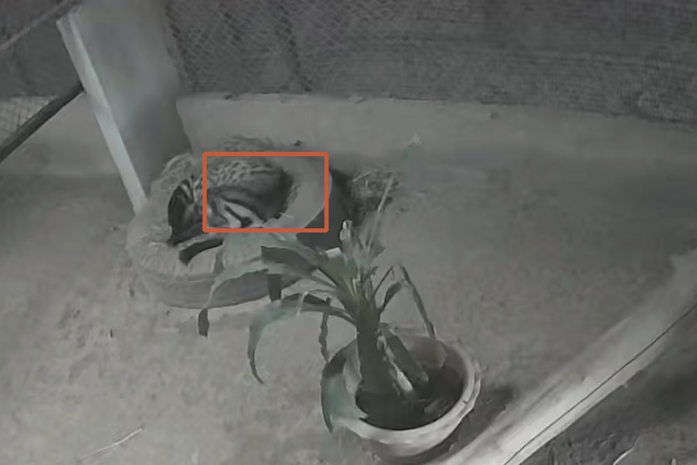
05 / TASK 2 · LABELS
Task 2: nobody drew a box
METHOD TRIED | WHAT IT RETURNED
COCO YOLO11n, full frame | Zero detections of the animal. One potted plant at 0.344.
Frame differencing, largest blob | Locks onto swaying foliage, not the animal.
Grounding DINO, open vocabulary | 40+ boxes at 0.12; top score 0.535 on empty floor.
Per-pixel median background | 408 boxes kept after a one-second persistence filter.
YOLO BOX 0.66 · CAMERA 03 · 19 MAY 2026
Source: outputs/detection/heldout.csv
The cameras never move, so each clip supplies its own background.
Median frame per clip · per-pixel noise threshold · components in an animal-size band · a box must persist for about a second.
CMZ / PHASE 2
05 / 10
Notes:
We tried four ways to get a box without a person drawing one, and three failed in instructive ways. A COCO model does not know what a civet is, differencing sees the plant, and Grounding DINO puts boxes on the floor. What worked is the fact that these cameras never move, so every clip carries its own background.

Slide 6
06 / TASK 2 · RESULTS
Task 2: the loop that learns its own labels
01
02
03
04
05
1061
470
408
116
0.537
frames sampled at 1 fps across 22 clips
candidate boxes from the background model
kept after the one-second persistence filter
boxes audited; 113 were on the animal
YOLO round 1 mAP50; round 2 self-trains
0.499
59%
5 / 10
mAP50 on untouched validation after self-training
of held-out frames fire at confidence 0.25
audited held-out boxes were on the animal
ROUND 2 ON ITS OWN VALIDATION: 0.774
That number is not comparable: 115 of round 2's validation labels were partly written by round 1.
No person drew a bounding box at any point.
CMZ / PHASE 2
06 / 10
Notes:
From 1061 frames the background model proposes 470 boxes, and persistence cuts that to 408. We audited 116 by eye and 113 were on the animal, which is what made training possible. Round 1 reached 0.537; round 2 looks better on its own split, but the comparable number is 0.499 on the untouched seed labels. No person drew a box at any point.

Slide 7
07 / TASK 3 · FEATURES
Task 3: four features from a silhouette
FEATURE · MEDIAN PER CLASS | EATING | LOCOMOTION | RESTING
Body angle (deg) | 115° | 88° | 154°
Head angle (deg) | 113° | 49° | 96°
Movement speed (px/s) | 17 | 134 | 2
Limb extent (px) | 56 | 148 | 98
VALIDATION MACRO F1
0.479
TEST MACRO F1
0.422
Medians over training and validation windows with at least one silhouette.
PROXY, NOT POSE ESTIMATION
No keypoints, no pose model. Resting is invisible: 58 of 93 training windows have no silhouette, so Resting scores 0 on test.
Per-class test F1: Eating 0.267 · Locomotion 1.000 · Resting 0.000. Locomotion separates by an order of magnitude in speed.
CMZ / PHASE 2
07 / 10
Notes:
The four names are the brief's four names, but the measurement is silhouette geometry. Locomotion separates by an order of magnitude in speed, which is why it scores 1.000 on test. Resting is the failure: a still animal becomes the background, so most training windows have no silhouette and Resting scores zero.

Slide 8
08 / ONE COMMAND
All three tasks in one command
$ python3 scripts/demo_all.py data/raw/Eating/25690519193422801.mp4
data/raw/Eating/25690519193422801.mp4 (50.0 s, 10 windows, abstain below 0.00)
start end T1 conf T2 box via conf crop body head speed limb
0.00 5.00 Eating 0.73 408,462,606,528 motion 0.00 Eating 6 161 1 63
5.00 10.00 Eating 0.69 606,510,674,564 motion 0.37 Eating 25 16 23 52
10.00 15.00 Eating 0.69 632,472,700,550 motion 0.00 Eating 43 24 20 68
15.00 20.00 Eating 0.67 341,365,624,534 yolo 0.58 Locomotion 119 19 24 51
detection: 10/10 windows found the animal directly (6 by the trained detector, 4 by the per-clip model)
full-frame and crop labels agree on 4/10 windows
Task 1 behavior, Task 2 detector box and crop, Task 3 features — same windows, same timecodes.
Validation clip. Output trimmed to the header, four data rows and the two summary lines; the per-class features are medians over the window's sampled frames.
CMZ / PHASE 2
08 / 10
Notes:
One command prints all three tasks for the same five-second windows, so nothing here is stitched together afterwards. Task 1 gives the behavior, Task 2 gives the box and the crop classifier, Task 3 gives the four features. On this clip it found the animal in all ten windows, six by the detector and four by the per-clip model.

Slide 9
09 / BOUNDARIES
What this does not prove
01
15 test windows from 5 clips
Locomotion has 2 and Resting takes 6 from one clip. A per-class score on that support is a baseline, not a stable estimate.
02
Camera and class travel together
Every Resting window is Camera 03 and nearly all Eating is Camera 02, so a score can come from the recording rather than the behavior.
03
The detector does not generalize
It fails on the 2026-05-20 recording day, absent from training, and fires on a bright plant.
04
Task 3 is a proxy
No keypoints and no pose model. A still animal joins the median background, so most Resting windows have no features at all.
05
One training seed
Seed 0 only. No run-to-run spread is reported, so the split between score and seed is unknown.
And no human ground truth for detection: its quality is a counted visual audit, not mAP against truth.
CMZ / PHASE 2
09 / 10
Notes:
These are the limits we would rather say ourselves. The test set is small and the camera tracks the class, the detector does not survive a new recording day, and Task 3 is a proxy. Detection has no human ground truth, so its quality is a counted audit, not a mAP against truth.

Slide 10
10 / NEXT
Next
Four changes that would turn these numbers into evidence.
01
Hold out a recording group
02
Widen per-class support
Collect footage from sessions absent from training and repeat the evaluation, so the upper bound becomes an estimate.
Add Locomotion and Resting test clips from more than one clip per class before reading per-class differences.
03
Calibrate abstention
04
Revisit Climbing and pose
Choose the abstain threshold on a larger validation set or a separate calibration set, never on the test windows.
Only if verified footage and keypoint labels exist. Until then, three classes and silhouette features are the scope.
A reproducible baseline that states what it measured and what it did not.
CMZ / PHASE 2
10 / 10
Notes:
The next version needs footage from recording sessions that are absent from training, because that is the only way to turn an upper bound into an estimate. Then more support per class and an abstain threshold chosen off the test set. Climbing and pose come back only if verified footage exists. What we have now is a baseline that is reproducible and honest about its coverage.

