Slide 1

LANGUAGE UNDERSTANDING IN NATURAL LANGUAGE PROCESS USING MICROSOFT AZURE
MICROPROJECTREPORT Submitted by
[C RANJITH KUMAR]
Register Number:[ 99220041651]
Inpartialfulfilmentfortheawardofthedegreeof
BACHELOROFENGINEERING
in
COMPUTERSCIENCEANDENGINEERING
[Month and Year '.October 2023]
i

Slide 2

BONAFIDE CERTIFICATE
SCHOOL OF COMPUTING
DEPARTMENT OF COMPUTER SCIENCE AND ENGINEERING
Bonafide record of the work done by C. RANJITH - 99220041651 in partial fulfillment of the requirements for the award of the degree of Bachelor of Technology in AIML of the Computer Science and Engineering, during the Academic Year Even Semester (2023-24)
Mr. C. SHIVAMURGAN
Mr. Akbar basha
Project Guide
Faculty Incharge
[associate professor
Associate Professor
[Department Name]
cse
CSE
Kalasalingam Academy of
Kalasalingam Academy of
Research and Education
Research and Education
Krishnan kovil - 626126
Krishnan kovil - 626126
Mr. B. Sakthi karthi durai
Evaluator
Associate Professor
CSE
Kalasalingam Academy of Research and Education Krishnan kovil - 626126
i

Slide 3
TABLE OF CONTENT
Sl. No. | Title | Page.No.
1 | Abstract
2 | Introduction
3 | System Study
4 | Existing work
5 | Proposed system
6 | Literature Survey
7 | Implementation
8 | About Software Tool
9 | Project Overview
10 | Result
11 | System specification
12. | Benefits And Capabilities
13. | Conclusion
14 . | References
2

Slide 4
1.ABSTRACT
Language understanding is a foundational concept in the field of Natural Language Processing (NLP), representing the ability of machines to comprehend and interpret human language. This abstract provides a concise overview of the key aspects and significance of language understanding in NLP.
Language understanding in NLP encompasses the extraction of meaning, context, and intent from text or speech data. It involves syntactical analysis to decode grammatical structure, semantic analysis to decipher word meanings in context, and pragmatic considerations to discern implied meanings and intentions. Furthermore, contextual understanding, Named Entity Recognition (NER), sentiment analysis, and intent recognition are vital components of language understanding, enabling applications like chatbots, virtual assistants, and language translation systems to operate effectively.
With advancements in machine learning, deep learning, and the development of transformative models like transformers and GPT (Generative Pre-trained Transformer), language understanding has made significant strides. These models learn from vast corpora of text data to capture intricate language patterns and relationships, allowing machines to grasp the nuances of human communication. This understanding is leveraged across diverse NLP applications, from question answering and text summarization to sentiment analysis and machine translation, enhancing human-computer interaction and information processing.
In summary, language understanding in NLP is a multifaceted field crucial to the development of intelligent language-based applications. It empowers machines to not only process and generate text but also to interpret and respond to human language in a manner that is contextually relevant and semantically accurate, driving the evolution of natural language interfaces and communication between humans and machines.
2.INTRODUCTION
Language understanding is a fundamental aspect of human communication and cognition, and it plays a pivotal role in the field of Natural Language Processing (NLP). In the context of NLP, language understanding refers to the capability of computers and artificial intelligence systems to comprehend and interpret human language, both in written and spoken forms. It is a critical step toward enabling machines to interact with humans more effectively and intelligently.
Humans effortlessly understand the meaning, nuances, and context of language. We can infer intentions, discern sarcasm, and resolve ambiguities based on our background knowledge and experiences. Language understanding in NLP seeks to impart a similar ability to machines,
3

Slide 5
allowing them to extract meaningful information, make informed decisions, and respond appropriately to human inputs.
Language understanding in NLP has evolved significantly with the advent of machine learning and deep learning techniques. Models like transformers and large-scale language models such as GPT-3 have demonstrated impressive language understanding capabilities by learning from vast amounts of text data. These models can handle a wide range of tasks, from translation and summarization to question answering and chatbot interactions, making human-computer communication more natural and accessible.
3. SYSTEM STUDY
A system study in language understanding involves a comprehensive examination of ,processes, and technologies used to enable machines to comprehend and process human language. This study aims to understand how various elements work together to achieve language understanding in a computational context. Here are the key aspects typically included in a system study of language understanding.
1.Text Processing: Analyzing and preprocessing text data, including tasks like tokenization, stemming, And stop-word removal.
2.Syntax Analysis: Parsing sentences to understand grammatical structure, including the identification of parts of speech and syntactic relationships.
3.Semantic Analysis: Extracting the meaning of words and phrases within context, including disambiguation and sense disentanglement.
4. Pragmatic Analysis: Interpreting implied meaning, speech acts, and discourse coherence. Contextual Understanding: Considering the context in which language is used to resolve ambiguity and improve comprehension.
5. Entity Recognition: Identifying and classifying named entities like names, dates, locations, and more.
6.Sentiment Analysis: Determining the emotional tone or sentiment expressed in text.
7.Intent Recognition: Recognizing the user's purpose or intention behind a query or request.
8.Coreference Resolution: Resolving pronouns and references to determine their referents.
4

Slide 6
9.Machine Learning Models: Utilizing machine learning algorithms and models for various language understanding tasks.
4. EXISTING WORK
Several existing systems and technologies have made significant advancements in language understanding within the field of Natural Language Processing (NLP). Please note that the landscape of NLP is rapidly evolving, and new systems may have emerged since then. Here are some prominent existing systems and technologies for language understanding: BERT (Bidirectional Encoder Representations from Transformers): BERT, developed by Google, is a transformer-based model that has had a profound impact on NLP. It can understand the context of words in a sentence and has been fine-tuned for various tasks, such as sentiment analysis, question answering, and language translation.GPT (Generative Pre-trained Transformer) Series: GPT models, like GPT-3, have shown remarkable language understanding capabilities. These models are pretrained on massive amounts of text data and can generate coherent and contextually relevant text, making them suitable for a wide range of NLP tasks. OpenAI's GPT-3: GPT-3, developed by OpenAI, is one of the largest language models with 175 billion parameters. It has been used for chatbots, content generation, code completion, and more, demonstrating a high level of language understanding. BERT-based Chatbots: Many conversational AI systems and chatbots leverage BERT or similar models for understanding user queries, interpreting intent, and providing relevant responses. Examples include Dialogflow and Rasa.
5. PROPOSED WORK
In this language understanding by using Microsoft Azure , this is going to train the model i.e.. machine in which the way it can understand our language . It also gives the training data and testing data and stores the data which is helpful for humans to acknowledge that model. It also gives the accuracy and also precision which is helpful for human.this machne model will understand what we arre trying to say by storing data in its database.
Here are the other proposed works in different research papers:
1.Cross-Lingual Understanding: Develop models and techniques that enable language understanding systems to work across multiple languages effectively. This can involve
5

Slide 7
improving translation, cross-lingual sentiment analysis, and multilingual chatbots.
2. Explainable AI (XAI) for Language Understanding: Investigate methods for making language understanding models more interpretable and explainable, especially in high-stakes applications like healthcare and legal contexts.
3. Multimodal Language Understanding: Explore the integration of text, images, and audio for more comprehensive language understanding, enabling systems to understand and respond to content in various modalities.
4. Low-Resource Language Understanding: Focus on improving language understanding capabilities for languages with limited data and resources, making NLP more inclusive and globally accessible.
5. Bias Mitigation: Develop techniques to identify and mitigate biases in language understanding models to ensure fairness and reduce potential harm in AI applications.
6.LITERATURE SURVEY
1. "Attention Is All You Need" by Vaswani et al. (2017)
This paper introduced the transformer model, which has become the foundation for many state-of-the-art NLP models, revolutionizing the field.
2. "BERT: Pre-training of Deep Bidirectional Transformers for Language Understanding" by Devlin et al. (2018)
This paper presents BERT (Bidirectional Encoder Representations from Transformers), a highly influential model that achieved state-of-the-art results on a wide range of NLP tasks by pretraining on a massive amount of text data.
3. "GPT-3: Language Models are Few-Shot Learners" by Brown et al. (2020)
This paper describes GPT-3, one of the largest and most powerful language models to date. It demonstrated the capabilities of large-scale pretrained models in language understanding and generation.
4. "XLNet: Generalized Autoregressive Pretraining for Language Understanding" by Yang et al. (2019)
XLNet introduced a permutation-based training approach that improves upon the bidirectional nature of BERT, leading to better results on various NLP tasks.
5. "ERNIE: Enhanced Language Representation with Informative Entities" by Zhang et al.
6

Slide 8
(2019)
ERNIE focuses on improving language understanding by incorporating informative entities into pretrained models, enhancing their contextual understanding.
6. "RoBERTa: A Robustly Optimized BERT Pretraining Approach" by Liu et al. (2019) RoBERTa is a variant of BERT that optimizes the pretraining process, achieving better
performance on a range of NLP benchmarks.
7. "T5: Text-to-Text Transfer Transformer" by Raffel et al. (2019)
T5 introduces a text-to-text framework, demonstrating the ability to cast various NLP tasks as a text generation problem, unifying language understanding and generation tasks.
8. "BART: Denoising Sequence-to-Sequence Pre-training for Natural Language Understanding" by Lewis et al. (2019)
BART is a model for sequence-to-sequence pretraining and showcases its effectiveness in various NLP tasks, including text generation and understanding.
9. "ELECTRA: Pre-training Text Encoders as Discriminators Rather Than Generators" by Clark et al. (2020)
ELECTRA proposes a novel training approach by having models predict missing words using a discriminator network. This method has shown efficiency in pretraining.
10. "ALBERT: A Lite BERT for Self-supervised Learning of Language Representations" by Lan et al. (2019)
ALBERT is designed to reduce model size and training time while maintaining or even improving the performance of BERT, making it more efficient for language understanding tasks.
7.IMPLEMENTATION
1.Schema definition :Add intents and entities to your schema. Intents are tasks or actions the user wants to perform. Entities are terms relevant to the user's intent and can be extracted to help fulfill the user’s intent.
2. Data labeling :To add an utterance, first select an intent that your user intends to accomplish. Then provide an example of what they’d say in that situation and label the information to extract as entities. After labeling the utterances, you'll be ready to create a model with this data in Training . For example, for an intent of Order Pizza, an utterance might be “I’d like to get a large pizza.” The word “large” might then be labeled as a Pizza Size entity.
3. Training jobs : After labeling your data, start a training job to create a model that understands
7

Slide 9
conversational utterances. Select the trained model from a successful job to view its performance results. Jobs from the last 7 days are displayed here.
4. Model performance : Select a model to view details about how it performed. Review the precision and recall scores for each intent and entity type as well as the confusion matrix which Compares predictions against labeled testing data.
5. Deploying a model : Choose which model to deploy or get the prediction URL for a deployed model. To view pricing for endpoint hosting and service requests after deployment . Deploy your project to different regions by assigning language resources with different regions.
8.ABOUT SOFTWARE TOOL
In this language understanding we used Microsoft Azure tool.
Microsoft Azure is a cloud computing platform and service created by Microsoft. It provides a wide range of cloud-based services, including infrastructure as a service (IaaS), platform as a service (PaaS), and software as a service (SaaS) offerings.
Azure is designed to help organizations build, deploy, and manage applications and services through Microsoft-managed data centers worldwide.
Microsoft Azure, commonly referred to as Azure, is a cloud computing platform and a comprehensive set of cloud services offered by Microsoft. Azure provides a wide range of tools, services, and resources that enable organizations to build, deploy, and manage applications and services in the cloud. Here are key aspects of Azure as a software tool:
Cloud Services: Azure offers a vast array of cloud services, including computing, networking, databases, storage, artificial intelligence, machine learning, analytics, DevOps, Internet of Things (IoT), and more. These services are designed to cater to a wide variety of
IT needs.
Infrastructure as a Service (IaaS): Azure provides virtual machines (VMs) that allow you to run Windows or Linux-based workloads in the cloud. You have full control over the VM's configuration and can use it to host applications, websites, and services.
Platform as a Service (PaaS): Azure offers platform services that abstract away infrastructure management, allowing developers to focus on building and deploying applications. Azure App Service is an example of a PaaS offering for web applications.
Software as a Service (SaaS): Azure includes a variety of SaaS applications and services like Microsoft 365 (formerly Office 365) and Dynamics 365, which enable users to access software
8

Slide 10
applications over the internet without the need for installation or maintenance.
Azure DevOps: Azure DevOps is a set of development tools and services that help teams plan, develop, test, and deliver software. It includes features for version control, continuous integration, continuous delivery (CI/CD), and project management.
Azure AI and Machine Learning: Azure provides AI and machine learning services, including Azure Machine Learning, Cognitive Services, and Bot Service, which enable developers to build intelligent applications with natural language understanding, computer vision, and more.
Data and Analytics: Azure offers a range of data and analytics services, including Azure SQL Database, Azure Cosmos DB, Azure Data Lake Storage, and Azure Databricks, for storing, processing, and analyzing data.
Security and Identity: Azure provides robust security and identity management solutions, including Azure Active Directory (Azure AD), Azure Security Center, and Azure Key Vault, to protect applications and data in the cloud.
Integration and Messaging: Azure offers services like Azure Logic Apps, Azure Service Bus, and Azure Event Grid for building scalable and reliable integration and messaging solutions.
Monitoring and Management: Azure Monitor and Azure Management provide tools for
monitoring the performance and health of Azure resources, enabling proactive troubleshooting and optimization.
Development Tools: Azure supports a wide range of programming languages, frameworks, and development tools, including .NET, Python, Java, Visual Studio, and VS Code.
9

Slide 11
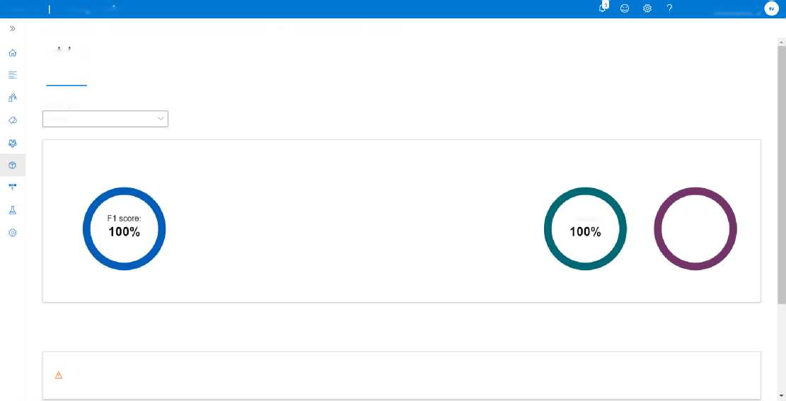
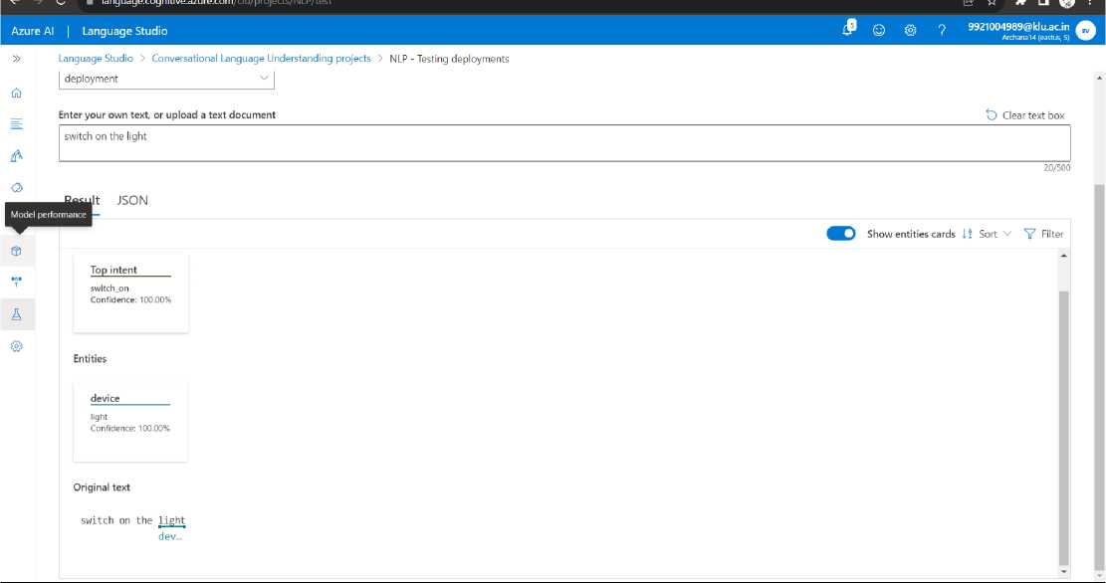
9. PROJECT OVERVIEW
Azure Al Language Studio
9921004989@klu.ac.in
Archanal4 (eastus, S)
Language Studio > Conversational Language Understanding projects > NLP - Model performance > training
training
Overview Model Performance Test set details Dataset distribution
Confusion matrix
Model Type
Intents
Status: © Trained successfully
F1 score: © Precision: © Recall: ©
100%
100%
100%
Finished training on: 10/7/2023, 9:39:36 PM
Total training time: 0 hour(s), 1 minute(s), 11 second(s)
Precision:
Recall:
100%
Training data splitting type: Number of training utterances: Number of testing utterances:
Percentage 8 (80%) 2 (20%)
Learn more about how to improve your model
Guidance
To improve your model's performance, review these issues and follow any recommendations.
Not enough intents labels in training set
We recommend a minimum of 15 utterances per intent in your training data.
2 intents with low data.
View Details
10.RESULT
10

Slide 12
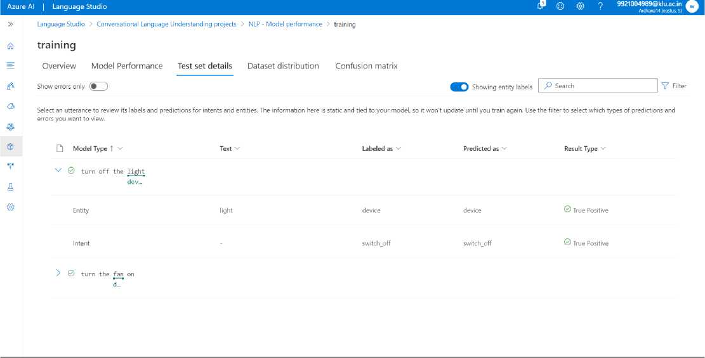
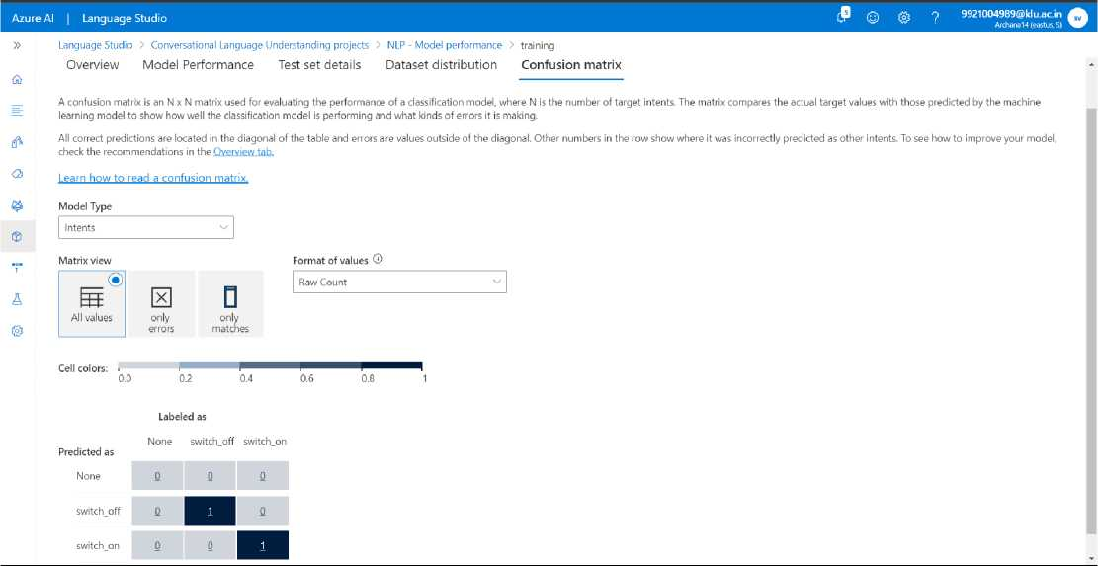
11

Slide 13
11.SYSTEM SPECIFICATION
Azure Services and Tools:
Identify the Azure services and tools you plan to use for language understanding, such as Azure Cognitive Services, Azure Bot Service, Azure Machine Learning, etc.
Hardware and Infrastructure:
Specify the hardware and infrastructure requirements, including the type and size of virtual machines (if using Azure VMs), storage, and networking configurations.
Data Sources:
Describe the sources of data your system will utilize for language understanding, whether it's text data from websites, user-generated content, or other sources.
Data Preprocessing:
Outline the preprocessing steps for your data, including tasks like data cleaning, tokenization, and data augmentation if necessary.
Training Data:
Specify the size and characteristics of your training dataset, including any labeling or annotation requirements.
Model Selection and Architecture:
Define the machine learning or deep learning model(s) you plan to use for language understanding, specifying the architecture and hyperparameters.
Training Process:
Detail the training process, including how data will be split into training, validation, and test sets, as well as the training schedule, batch sizes, and optimization algorithms.
Evaluation Metrics:
Specify the evaluation metrics you will use to assess the performance of your language understanding system. Common metrics include accuracy, F1 score, precision, and recall. Deployment Environment:
Describe the Azure environment where your language understanding system will be deployed, whether it's Azure App Service, Azure Kubernetes Service (AKS), or another service
12

Slide 14
12. BENEFITS AND CAPABILITIES
Here are some key points to summarize the benefits and capabilities of language understanding using Azure:
Comprehensive Suite of Services: Azure offers a comprehensive suite of services for natural language understanding, including Azure Cognitive Services, Azure Bot Service, Azure Machine Learning, and more. These services cover a broad spectrum of language-related tasks and enable developers to quickly integrate language understanding capabilities into their applications.
Pretrained Models: Azure Cognitive Services provides pretrained models for common language understanding tasks such as text analytics, sentiment analysis, and language translation. These models can be easily accessed and customized to suit specific application needs.
Customization and Training: Azure Machine Learning allows developers and data scientists to build and train custom language understanding models using their own datasets. This enables fine-tuning models for domain-specific tasks and achieving higher accuracy.
Scalability: Azure's cloud infrastructure ensures that language understanding systems can scale seamlessly to handle growing workloads and user interactions. Azure Kubernetes Service (AKS) and Azure Functions enable efficient scaling and resource allocation.
Integration: Azure services are designed for easy integration with other Azure services and external systems. This facilitates the creation of end-to-end solutions that leverage language understanding across various aspects of an application.
Security and Compliance: Azure offers robust security and compliance features, ensuring that sensitive data and user interactions are protected. Azure Active Directory (Azure AD) and Azure Security Center provide essential identity and security controls.
Monitoring and Analytics: Azure Monitor and Azure Log Analytics enable real-time monitoring and analytics of language understanding systems, helping organizations proactively identify and address issues.
13

Slide 15
Flexibility and Choice: Azure allows developers to choose from a variety of programming languages, frameworks, and tools, making it accessible to a broad developer community.
Cost Management: Azure provides tools for cost monitoring, budgeting, and optimization, allowing organizations to manage their cloud expenses effectively.
Global Reach: Azure's global network of data centers ensures low-latency access to language understanding services for users around the world, supporting global applications.
13. CONCLUSION
In conclusion, language understanding using Microsoft Azure offers a powerful and flexible framework for developing intelligent applications that can comprehend and interact with human language. Azure provides a rich ecosystem of services and tools that can be harnessed to build a wide range of language understanding applications, from chatbots and sentiment analysis to translation and speech recognition.
14.REFERENCES
"ERNIE: Enhanced Language Representation with Informative Entities" by Zhang et al. (2019)
ERNIE focuses on improving language understanding by incorporating informative entities into pretrained models, enhancing their contextual understanding.
"RoBERTa: A Robustly Optimized BERT Pretraining Approach" by Liu et al. (2019) RoBERTa is a variant of BERT that optimizes the pretraining process, achieving better performance on a range of NLP benchmarks.
"T5: Text-to-Text Transfer Transformer" by Raffel et al. (2019)
T5 introduces a text-to-text framework, demonstrating the ability to cast various NLP tasks as a text generation problem, unifying language understanding and generation tasks.
"BART: Denoising Sequence-to-Sequence Pre-training for Natural Language Understanding" by Lewis et al. (2019)
14

Slide 16
BART is a model for sequence-to-sequence pretraining and showcases its effectiveness in various NLP tasks, including text generation and understanding.
"ELECTRA: Pre-training Text Encoders as Discriminators Rather Than Generators" by Clark et al. (2020)
ELECTRA proposes a novel training approach by having models predict missing words using a discriminator network. This method has shown efficiency in pretraining.
"ALBERT: A Lite BERT for Self-supervised Learning of Language Representations" by Lan et al. (2019)
ALBERT is designed to reduce model size and training time while maintaining or even improving the performance of BERT, making it more efficient for language understanding task
15

Slide 17

COURSE CERTIFICATE
16

