Slide 1
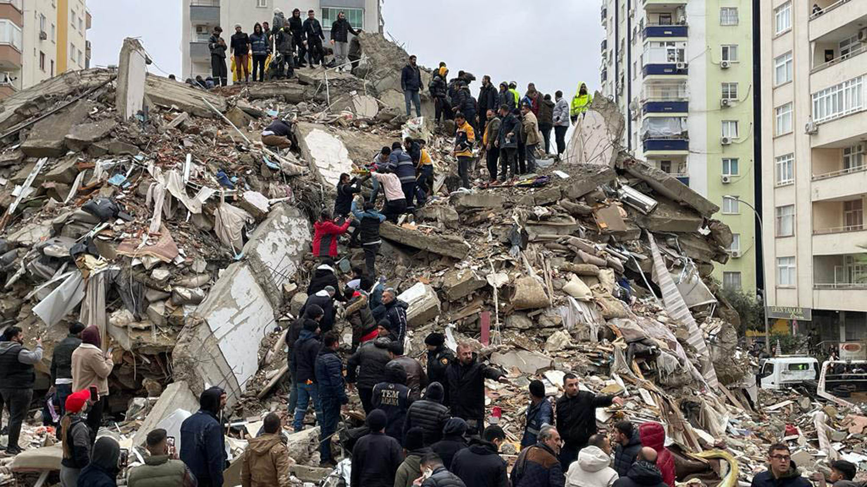
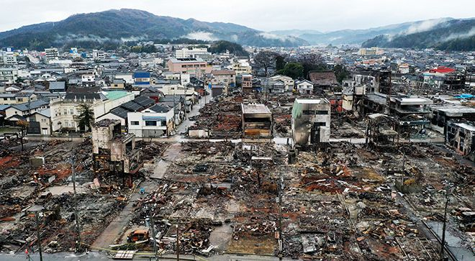
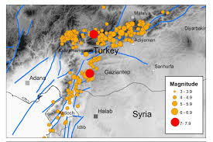
Turkey-Syria and Noto earthquake comparison
Impacts of the Turkey-Syria earthquake:
There were around 60,000 deaths in total with tens of thousands injured in both countries. The earthquake caused approximately 1.5 million people to become
homeless in Turkey alone. 240,000 buildings in Turkey and Syria were damaged or destroyed. Many of these included hospitals and schools further increasing trauma for the people. Also, lots of infrastructure was destroyed such as roads, bridges and communications suffered heavy damage which further impacts the speed of which help could arrive. It caused $148.8 billion worth of damage to Turkey and $9 billion worth in Syria. The earthquake also affected the heritage of the areas affected because of the mass damage done to historic sites such a s mosques, churches and monuments. In addition, the debris included hazardous materials like asbestos, lead, and other dangerous chemicals which posed long term health risks to the population. Many schools were destroyed which impacted lots of children's education.
Impacts of Noto earthquake:
Due to it being a magnitude 7.6 earthquake it caused over 60,000 houses to collapse. And because there are many older wooden houses of majority of the houses damaged were of that kind. Also at least 241 people were killed and over a thousand injured. There was also significant liquefaction making the ground unstable and greatly hindering rescue services from reaching Noto. In addition, roughly 3-6 billion dollars of damage was caused by the earthquake.
Reasons for differences in the impacts of responses of the Turkey-Syria earthquake and the Noto Earthquake:
The reason that there were a lot more deaths in the Turkey-Syria earthquake is because the earthquake in Turkey hit the very well populated areas of Ganziantep, Kahramanmaras and Hatay which cause the earthquake to be more fatal. Also, the buildings were not as prepared for earthquakes as they were in Japan, which contributed to why so many more people died in the Turkey-Syria earthquake. In addition, because the GDP per capita and HDI is much lower in Turkey the government and people did not have enough money and resources to be adequately prepared for an earthquake compared to Japan who have a GDP per capita of 32.475.89 USD vs Turkey’s of 16,709 USD and Syria’s 847 USD. So even though not all of Japan’s building were of suitable building standards they were more stable than the generally low quality of building in Syria and Turkey.
Another point is that the earthquake in Turkey was significantly longer at around 60 seconds and had thousands of aftershocks compared to the earthquake in Japan which only lasted 15 seconds with some low magnitude after shocks. This resulted in more destruction Turkey and Syria with 240,000 building getting compared to Noto’s 60,000 buildings.
A reason for why the Turkey-Syria earthquake received a large amount of international aid compared to the Noto earthquake is because the earthquakes hit very populated areas so a lot more people were affected also because Japan is a HIC country and it wasn’t a vast amount of people affected it had more internal resources to manage the earthquake by itself with minimal international assistance. Also, in Japan they are trying to be more well prepared by implementing technology to improve response speed and prevent more unnecessary deaths however in Turkey and Syria the sheer amount of destruction causes is such a massive problem that attempts to try and reduce the impacts of future earthquakes is going very slowly as seen in the Turkish governments plan to build 650,000 earthquake proof houses which currently has not made significant progress. This is because of the differences is in GDP with Japan having a higher GDP than Turkey and Syria at 4.3 trillion USD, Turkey being at 1.32 trillion USD and Syria being significantly lower at 12.1 billion USD.
Responses of the Noto earthquake:
The immediate responses to the earthquake was the Japan Self-Defense Forces were quickly deployed to the affected regions. Local volunteer organizations took part in the search and rescue, setting up mobile clinics to help those injured by the earthquake. Also, water, sanitation and hygiene facilities were set up in evacuation centers. Tens of thousands of people were evacuated into temporary shelters. The Japanese government put funds from reserve into relief for the people of Noto. They also received donations in the form of money, clothes and supplies from the Private and public sector. To rebuild the government s made a 9-year reconstruction plan to rebuild the areas affected. Old houses that vulnerable to earthquakes were demolished to keep the citizens safe. For the future there will be a greater focus on using technology to help the response speed and to prevent secondary deaths(illness, cold) and to better support the elderly.
Responses of the Turkey-Syria earthquake:
Turkey deployed a large-scale search and rescue operation consisting of 60,000 health workers and many volunteers. And there were over 141,000 international rescuers from 94 different countries to assist Turkey and Syria. This was heavily supported by the United Nations who delivered food, medical aid, blankets and supplies to the victims of the earthquake. Temporary shelters and camps were made to help the many homeless people because of the earthquake. The Turkish government promised to build 650,000 homes with only little progress made as of today. This is due to the high costs to demolish unsafe houses and debris. Aid and relief from the Turkish Red Crescent and the Syrian Arab Red Crescent is used to support those in Turkey and Syria. As of now many people remain in temporary houses facing poor sanitation and health risks.

