Slide 1

Supply Management
Supply Management Analytics: Supplier Pricing in Caterpillar Supply Chain
Group 4:
Mohammad Sharif Azimy
Antonios Stefanakis
Chinelo Lydia Nweke
Takal Ebrahimkhel

Slide 2
Table of Contents
Introduction (Slides )
Ideas, Scope, and Objectives
Tasks and Milestones
Deliverables
Business Case (Slides )
Theoretical Background (Slides )
Business Understanding (Slides )
Dataset (Slides
Source(s)
Description (Columns, Scales etc.) / Data Understanding / Exploration (Quality)
Data Preparation
Descriptive Data Analytics
Machine Learning Algorithms (Overview) (Slides
Next Steps (Slides

Slide 3
Introduction

Slide 4
Forecasting Caterpillar tube assembly Price
- Predict supplier quote prices for Caterpillar tube assemblies. (Caterpillar manufactures mining and construction equipment)
- Use engineering and pricing data together to improve procurement decisions.
- Reduce cost uncertainty by forecasting likely supplier quotes.

Slide 5
Project domain / scope and focus
Procurement & Supplier Pricing
Manufacturing + Supply Chain / Procurement Quoting
What happens in reality:
Multiple suppliers provide quotes for tube assemblies (custom manufactured parts).
Quote price depends on: supplier, date, requested quantity, commercial constraints, and tube design + components.
- Combine tube assembly, supplier quote, bill of materials, and component data.
- Focus on predicting quoted price, not manufacturing design.
- Handle both bracket pricing and minimum-order pricing.

Slide 6
Project objectives
Team roles
- Forecast supplier quote price at the assembly level.
- Identify the most important cost drivers in the quote data.
- Support faster, better-informed supplier negotiation.
Mohammad Sharif Azimy: Project Manager and Data Engineer
Antonios Stefanakis: Data Analyst
Chinelo Lydia Nweke: Data Engineer
Takal Ebrahimkhel: Data Scientist

Slide 7
Tasks and milestones - CRISP-DM
Timeline
Business Understanding
Data Understanding
Data Preparation
Modeling
Evaluation
Deployment / Finalization
mm/dd – mm/dd/yyyy | mm/dd – mm/dd/yyyy | mm/dd – mm/dd/yyyy | mm/dd – mm/dd/yyyy | mm/dd – mm/dd/yyyy | mm/dd – mm/dd/yyyy
•Determine Business Objectives •Assess Situation •Determine Data Mining Goals •Produce Project Plan | •Collect Initial Data •Describe Data •Explore Data •Verify Data Quality | •Select Data •Clean Data •Construct Data •Integrate Data •Format Data Result: Preprocessed Data | •Select Modelling Techniques •Generate Test Design •Build Model •Assess Model | •Evaluate Results •Review Process •Determine Next Steps | •Plan Deployment •Plan Monitoring and Maintenance •Produce Final Report •Review Project
Milestone
05/07/2026
Milestone Presentation
06/25/2026
Final Presentation
mm/dd/yyyy
Submit PDF

Slide 8
Deliverables
Constraints
- A cleaned, merged dataset for tube assembly pricing.
- Visual analysis of pricing drivers.
- A predictive model and feature importance results.
- Business recommendations for procurement.
- Final presentation + documentation including codes in Jupyter Notebook (method, results, limitations).
Limitations in dataset such as specificaiton dataset which is relational table but the other table is missing.
Time constraints (semester timeline).
Less familiarity with online platforms to integrate codes produced in group , the compilation requires extensive efforts by Project Manager

Slide 9
Business Case

Slide 10
Supply Management Context
Supply management involves sourcing materials from suppliers
Companies rely on suppliers for components and parts
Pricing decisions directly impact procurement costs
Theoretical Background

Slide 11
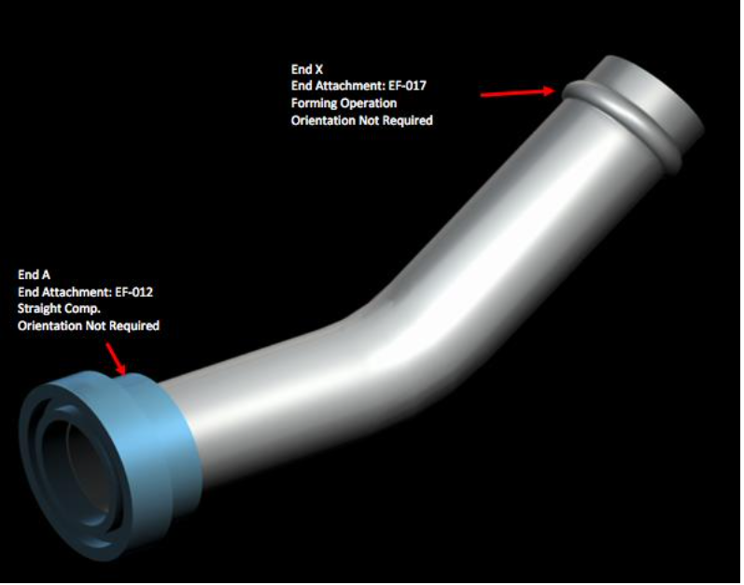
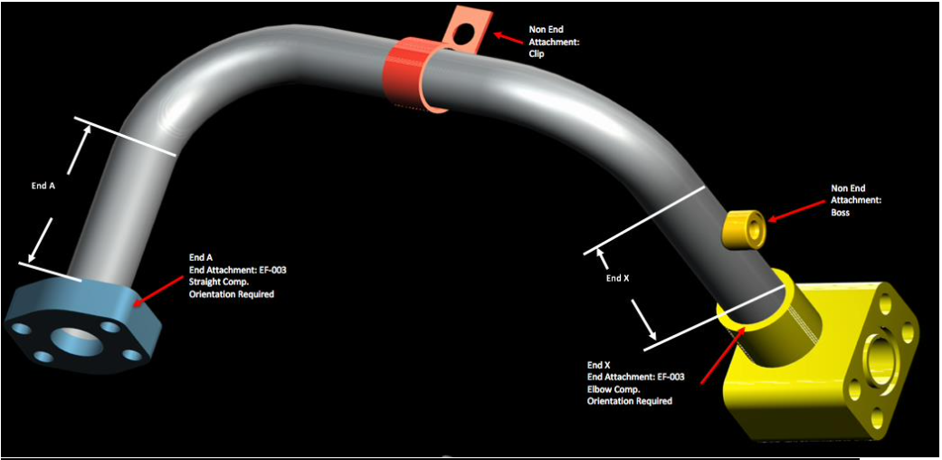
What are tube assemblies?
- Multi-component products used in pneumatic systems.
- Comprised of bends, fittings, bosses, brackets, and end connections.
- Complexity causes large variation in supplier pricing.

Slide 12
Why pricing is difficult
- Price depends on geometry, materials, components, and supplier strategy.
- Short end lengths and special connectors often need extra tooling.
- Quotes include both fixed and variable cost elements.

Slide 13
Supplier quote process
- Suppliers price each assembly based on volume, quantity, and complexity.
- Bracket pricing changes with quantity tiers.
- Non-bracket pricing applies once minimum order quantity is reached.

Slide 14
Pricing structure
- Quoted price = fixed cost + variable cost + margin.
- Fixed cost examples: tooling, setup, special processes.
- Variable cost examples: material, labor, machining.
- Margin depends on supplier relationship and risk.

Slide 15
Business Context
Companies rely on suppliers for industrial components
Each product requires a price quotation
Pricing affects procurement and overall costs
Business Understanding

Slide 16
Business problem
- Predict the supplier quote price for a tube assembly.
- Help Caterpillar procurement reduce quote uncertainty.
- Use the model to compare suppliers and bids objectively.

Slide 17
Business impact
Business challenge
- Accurate forecasts expose outlier quotes and negotiation opportunities.
- Insight into cost drivers reduces price variability.
- The model supports pricing validation and supplier strategy.
Risk of overpaying suppliers
Lack of standard pricing benchmarks
Slow decision-making process

Slide 18
Success criteria
- Strong prediction accuracy across pricing regimes.
- Interpretable feature importance and cost drivers.
- Clean data joins, consistent quantity handling, robust features.

Slide 19

Dataset Exploration

Slide 20
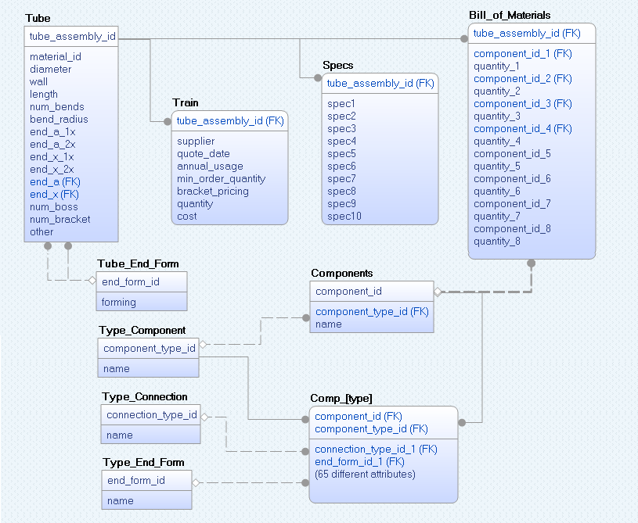
Key tables and relationship model
Prepared by : Group work

Slide 21
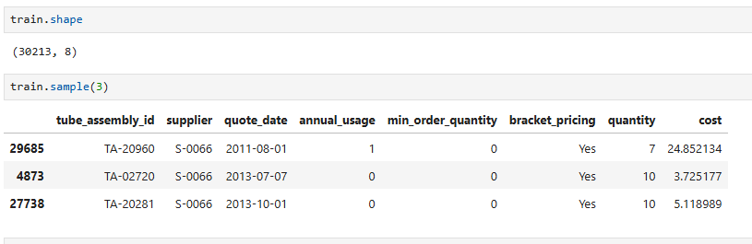
Train Dataset-Number of column and rows
Prepared by : Group work

Slide 22
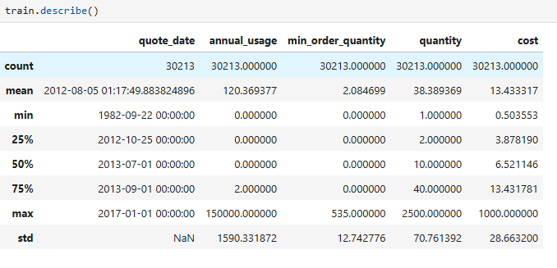
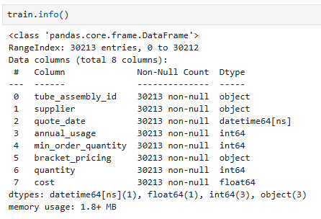
Train Dataset- Key statistics and data types
Prepared by : Group work

Slide 23
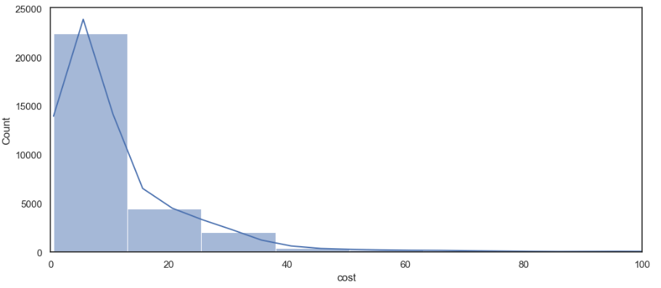
Tube Assembly – Cost Distribution(Train Dataset)
Prepared by : Takal Ebrahimkhel

Slide 24
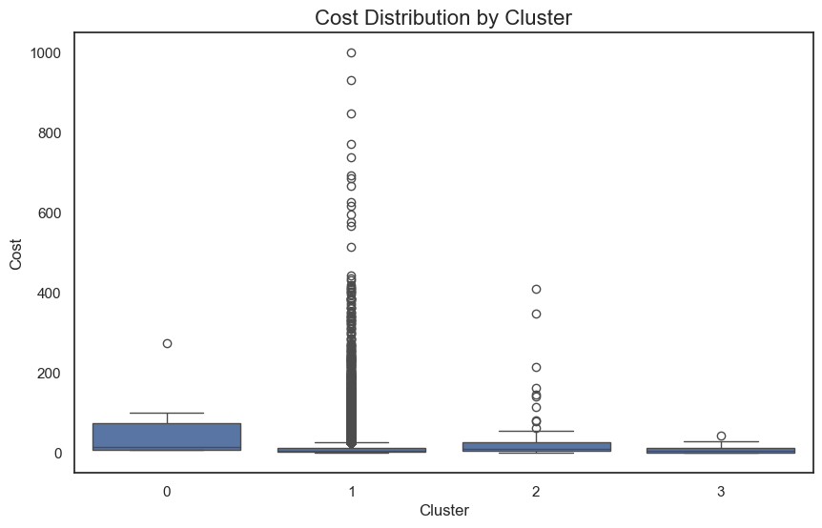
Cost clusters
Cluster | Pattern | Interpretation
Cluster 0 | Medium spread, highest median among the low-cost groups | Relatively consistent costs, mostly between ~10 to ~100. Some high outliers up to ~280.
Cluster 1 | Very wide spread + many extreme outliers | Most interesting cluster. Huge variation in cost — from very cheap to extremely expensive (up to ~1000). Lots of outliers above 400–900. This cluster likely contains complex or highly customized tubes.
Cluster 2 | Moderate spread, some high outliers | Similar to cluster 0 but slightly higher variation. Many points between 0–50 with outliers up to ~400.
Cluster 3 | Very tight and low cost | Cheapest and most consistent cluster. Almost all tubes are low cost with very little variation. Looks like a "standard/simple" group.
Prepared by : Takal Ebrahimkhel

Slide 25
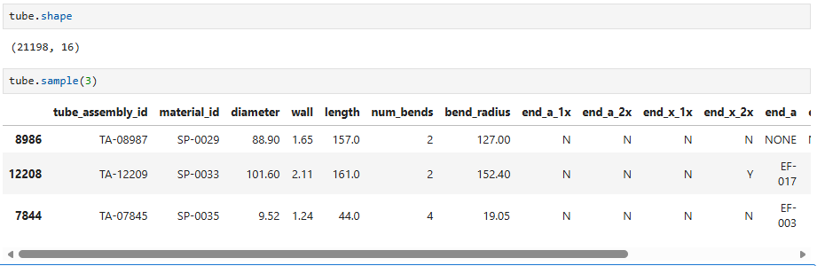
Tube Dataset-Number of column and rows
Prepared by : Group work

Slide 26
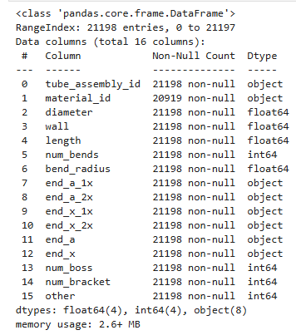
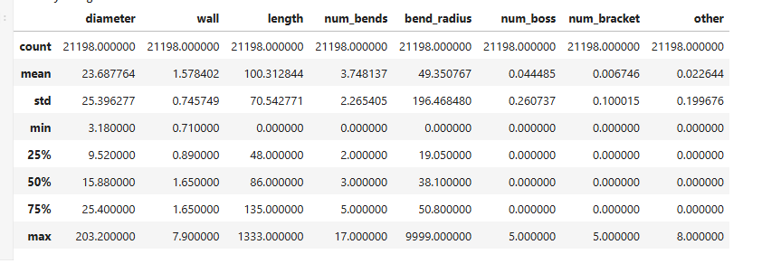
Tube Dataset- Key statistics and data types
Prepared by : Group work

Slide 27
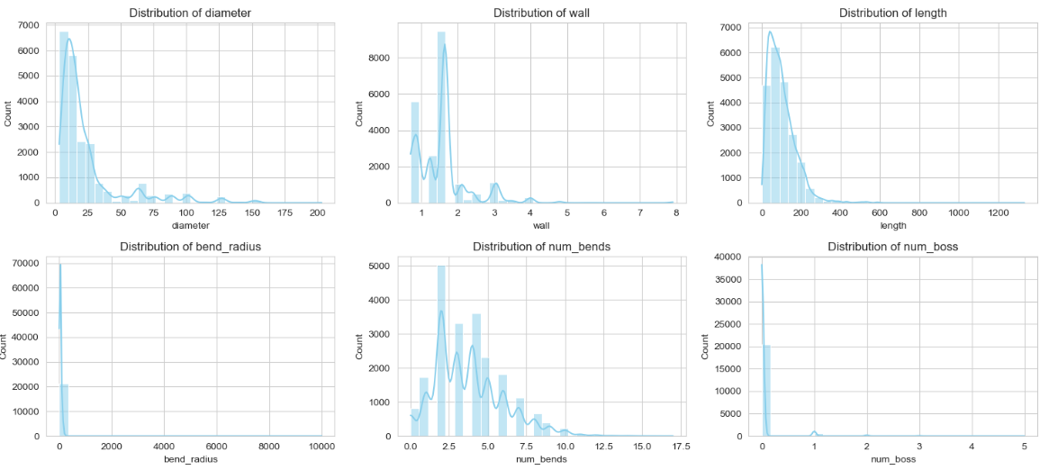
Tube Dataset- Numeric Features Distribution
Prepared by : Takal Ebrahimkhel

Slide 28
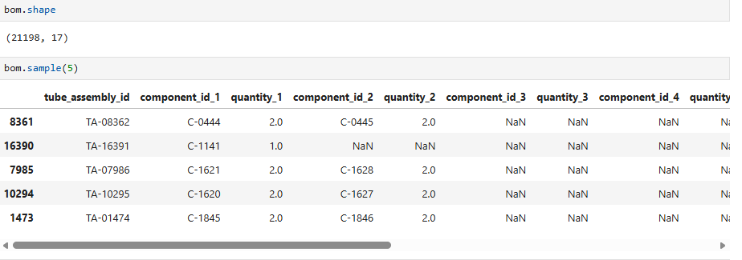
Bill of Material Dataset-Number of column and rows
Prepared by : Group work

Slide 29
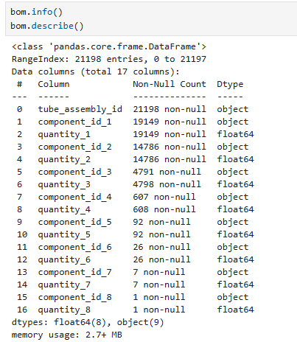
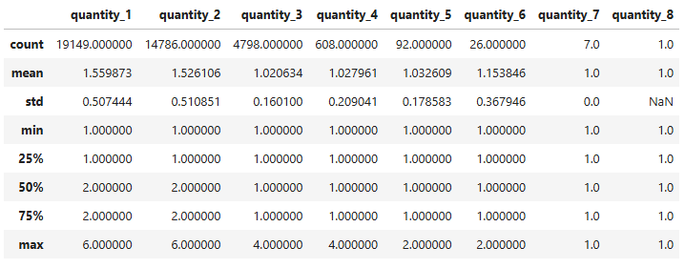
Bill of Material Dataset- Key statistics and data types
Prepared by : Group work

Slide 30
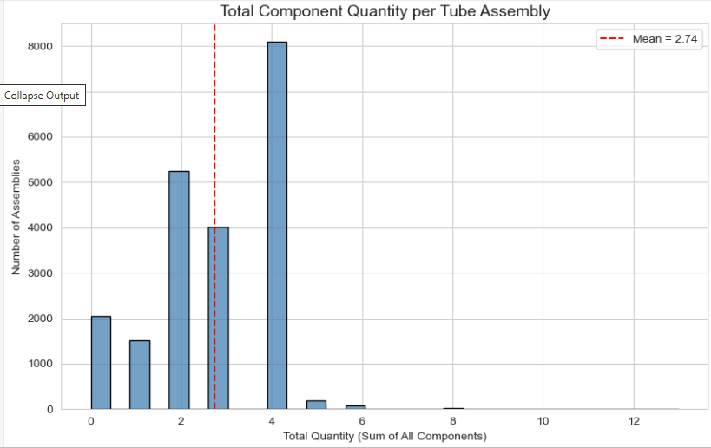
Bill of Material Dataset- Key statistics and data types
Prepared by : Mohammad Sharif Azimy

Slide 31
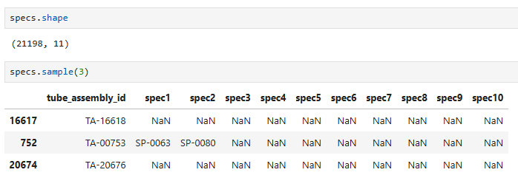
Specification Dataset-Number of column and rows
Prepared by : Group work

Slide 32
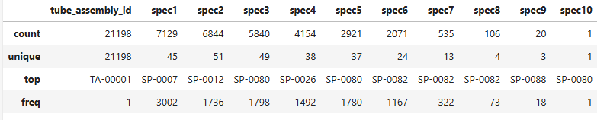
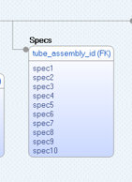
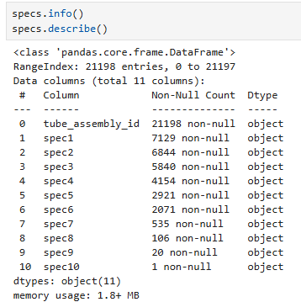
Specification Dataset- Key statistics and data types
Limitation : no look up table to explain us specifications entries which are in form of and ID
Prepared by : Group work

Slide 33
Verify Data Quality

Slide 34
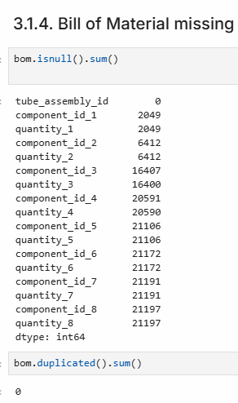
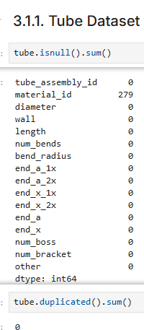
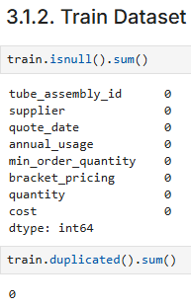
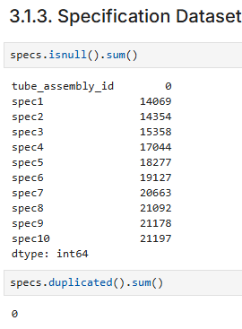
Missing Value and Duplicates
Prepared by : Group work

Slide 35
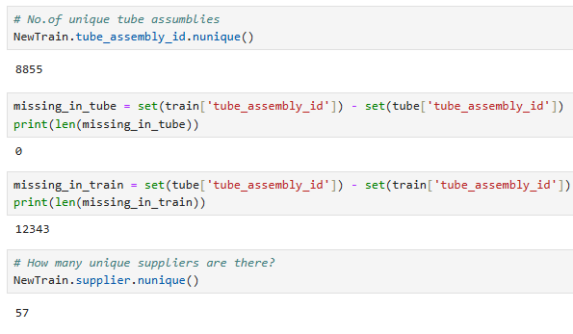
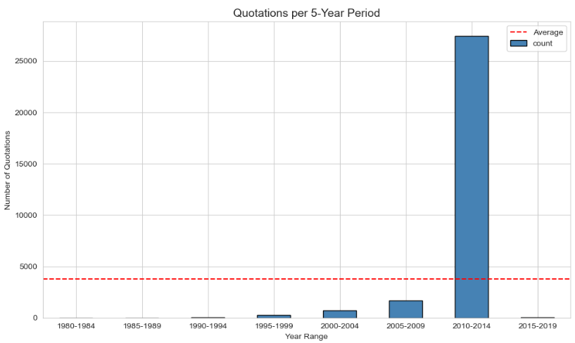
Additional quality checks
Prepared by : Chinelo

Slide 36
Feature Engineering

Slide 37
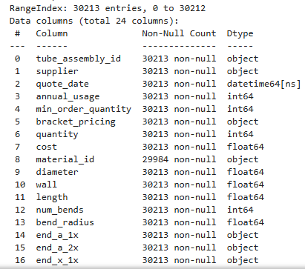
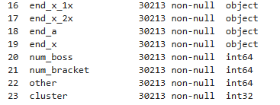
1) Merging Relational Datasets: Combined multiple datasets using tube_assembly_id as the primary key to create a unified dataset.
NewTrain = pd.merge(train, tube, on ='tube_assembly_id')
Prepared by : Group work

Slide 38
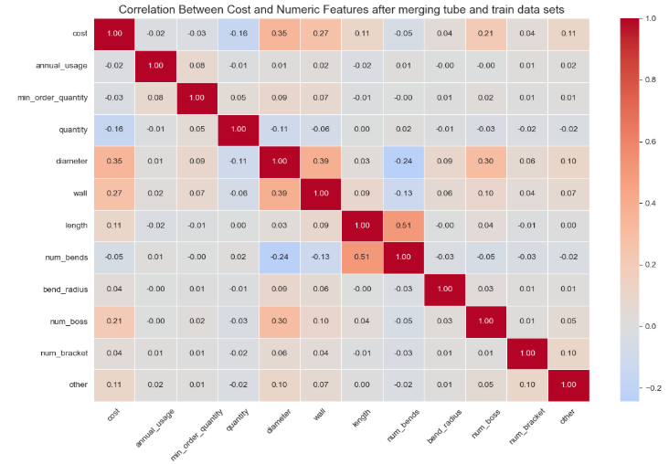
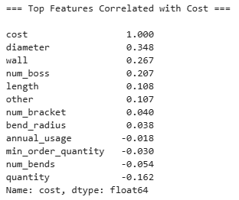
Correlation Between Cost and Numeric Features after merging tube and train data sets'
This highlights the importance of calculation of additional features such as total weight and total quantity based on available data
Prepared by : Mohammad Sharif Azimy & Takal Ebrahimkhel

Slide 39

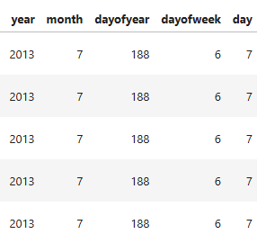
2) Date Feature Extraction: Created new columns by splitting quote_date into day, month, and year for better time-based analysis.
Captures Seasonal & Monthly Patterns
Improves Machine Learning Model Performance
Better feature Interaction
Prepared by : Mohammad Sharif Azimy

Slide 40
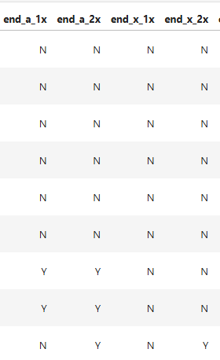
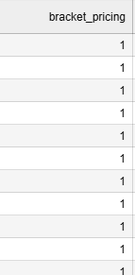
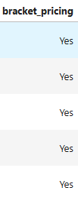
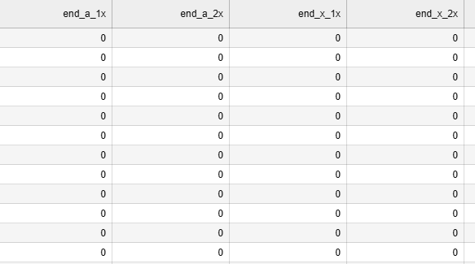
3) Categorical Encoding: Converted categorical/text variables into numerical format to make them suitable for machine learning models.
Prepared by : Mohammad Sharif Azimy

Slide 41
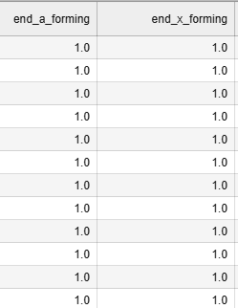

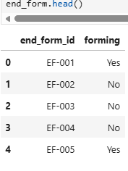
4) End Forming Features: Used lookup table (tube_end_form) to extract forming information from end_a and end_x columns. Created new relevant forming features and removed missing values.
Prepared by : Mohammad Sharif Azimy

Slide 42
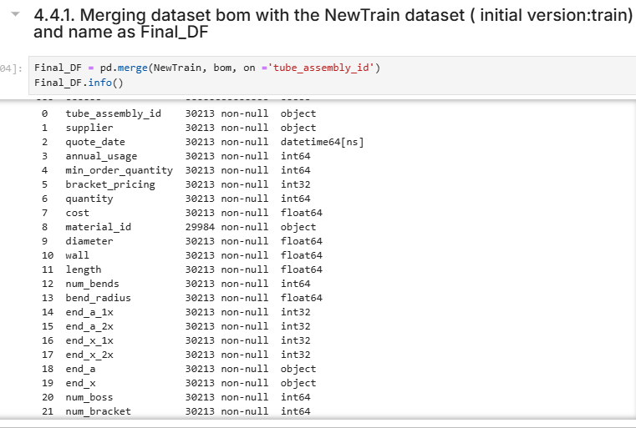
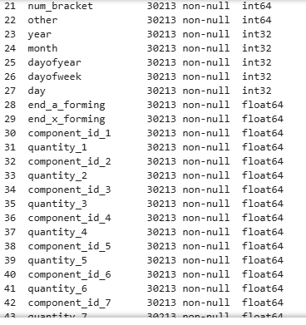
5) Bill of Materials (BOM) Aggregation
Prepared by : Mohammad Sharif Azimy

Slide 43
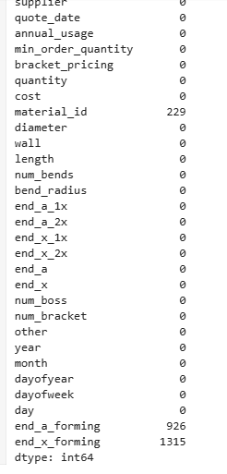
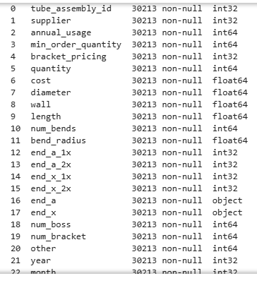
6) Data Cleaning
Replacing missing values in forming with 0
Remove date as it is now extracted to new features
Material ID , not much useful information
Prepared by : Mohammad Sharif Azimy

Slide 44
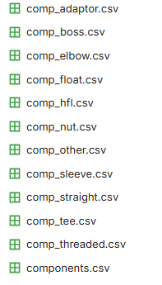
6) Bill of Materials (BOM) Aggregation with Component type to import weight feature for each component
There are a total of 11 comp_[name] files, which contains the details for each component including weight.
In general, the heavier a tube is, the more expensive it can be. In addition, the more quantity required, the more expensive a tube can be.
Thus, we'll try to extract the total quantity and total weight features for each tube.
Prepared by : Mohammad Sharif Azimy

Slide 45
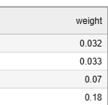
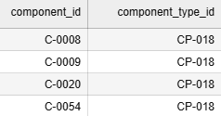
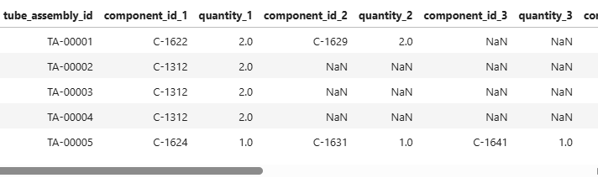
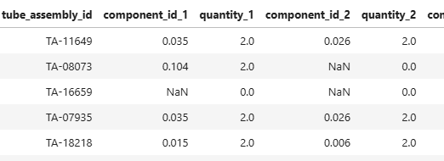
6) Bill of Materials (BOM) Aggregation with Component type to import weight feature for each component
(this table is 3 col of com_boss)we have 10 othe comp as listed in last slide
Prepared by : Mohammad Sharif Azimy

Slide 46
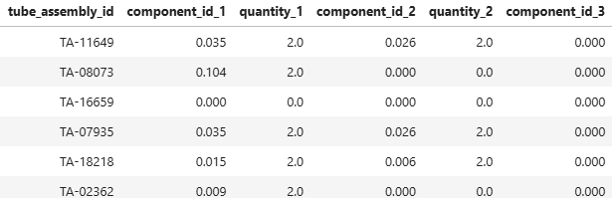
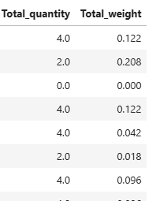
7) Determining Total quantity and weight of tube from Dataset bill of material
Prepared by : Mohammad Sharif Azimy

Slide 47
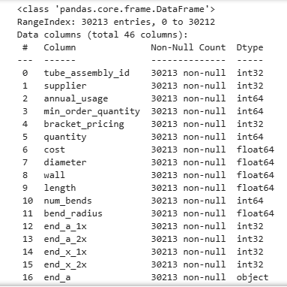
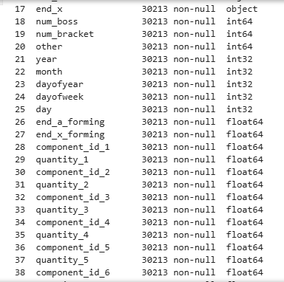

Final Clean , merged and Dataset including added new columns/features
Prepared by : Mohammad Sharif Azimy

Slide 48

Correlation matrix
Prepared by : Mohammad Sharif Azimy

Slide 49
Machine Learning Algorithms (Overview)

Slide 50

Linear Regression
/
Cross-Validation
Used to predict price (continuous value)
Finds relationship between features and cost
Splits data into multiple parts
Tests model several times
Gives more reliable results
Why Used?
Suitable for pricing prediction
Simple and easy to interpret
Chinelo Lydia Nweke

Slide 51
Extreme Gradient Boosting (XGBoost) for quote forecasting
- XGBoost is a gradient boosting library that builds many decision trees sequentially to improve predictions.
- Plan: Use XGBoost to model the supplier quote price with strong predictive accuracy.
- Benefit from gradient boosted trees that handle nonlinear relationships and feature interactions.
- Apply it to the merged dataset with tube geometry, component counts, and pricing regime indicators.
- Leverage built-in regularization and tree-based feature importance for model stability and interpretability.
Takal Ebrahimkhel

Slide 52
CatBoost(Decision Tree)
Features
Native categorical handling works directly with categorical features (no manual encoding)
Ordered boosting: reduces overfitting and improves generalization
Symmetric decision trees: faster training and more stable predictions
Minimal preprocessing: handles missing values and mixed data types automatically
High performance: strong accuracy on tabular datasets with little tuning
Applications
Structured/tabular data problems (
Regression & classification tasks
Industry use cases: demand forecasting, risk modeling, recommendation systems
Datasets with many categorical variables where traditional models struggle
Mohammad Sharif Azimy

Slide 53

Thank you for your attention
Q&A

Slide 54
References
Literature:
Liu, Yang (2022): Supply chain analytics. Concepts, Techniques and Applications. Cham: Palgrave Macmillan.
Code: Joint Group Jupyter

