Slide 1
FINAL PRESENTATION
Chandra X-ray luminosity and halo-mass scaling relations
Weak-lensing calibrated CLASH + LoCuSS cluster analysis
18
1.08
0.48
main clusters
L_X-M500 slope
T_X-M500 slope
exclude_bad sample
full-R500 baseline
full-R500 baseline
Mass-based X-ray scaling relations are stable to core excision within current uncertainties.
Advanced Observational Astrophysics final project
01

Slide 2
CONTENTS
Scientific structure of the project
A Chandra measurement chain from cluster physics to weak-lensing calibrated scaling relations.
01
Scientific background
02
Sample selection
03
Chandra reduction
why X-ray emission traces halo mass
lensing masses, morphology, and quality cuts
imaging products, masks, and R500 apertures
04
Spectral modeling
05
Scaling inference
06
Results
ICM model, backgrounds, WSTAT, ACCEPT check
fixed-evolution linmix fits
mass-based relations and scientific conclusion
Contents revised for final academic presentation
02

Slide 7
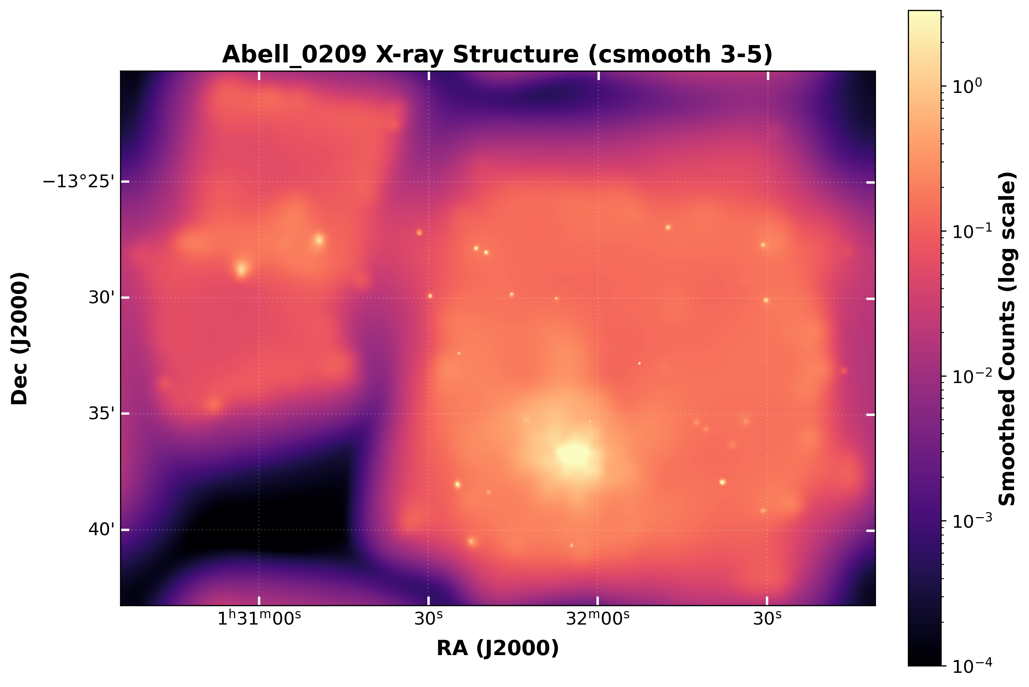
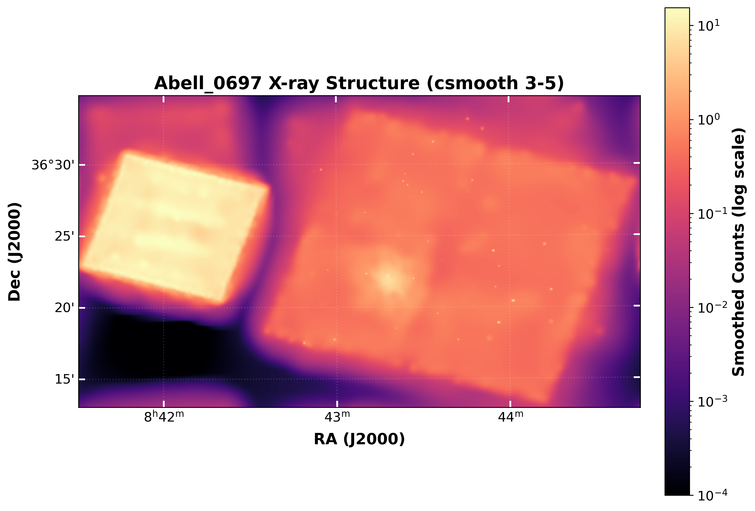
SAMPLE DEFINITION
Sample selection combines weak-lensing masses with image-level quality control.
The main analysis uses the 18-cluster exclude_bad sample after morphology and spectral QA cuts.
30
parent sample
-7
visual cut
23
processed
-5
spectral QA
18
main sample
->
->
->
->
CLASH + LoCuSS with Chandra coverage
aspheric/morphology screen
CIAO imaging and spectral branch
unstable or failed fits
baseline scaling relation fit
Retained example: Abell 0209
Processed but excluded by spectral QA: Abell 0697
Sources: memory/pipeline_status.csv; output_heatmaps
07

Slide 8
CHANDRA REDUCTION
The reduction workflow separates imaging products from per-ObsID spectra.
Merged maps support morphology, peak finding, and masks; spectral fitting preserves each observation response.
1
Chandra archive
2
chandra_repro
3
merge_obs / wavdetect
->
->
secondary data
calibrated event files
merged maps and point-source masks
4
region construction
5
specextract
6
Sherpa and linmix
->
->
R500 aperture centered on X-ray peak
per-ObsID spectra and ARF/RMF
T_X, L_X, slopes, and scatter
Spectral-response requirement
Final spectra are not fitted from merged event files. Each ObsID keeps its own ARF/RMF response and contributes to the joint Sherpa fit.
Sources: final report; Xray_Luminosity_Halo_Scaling_Relations_Final_Presentation.pptx
08

Slide 9
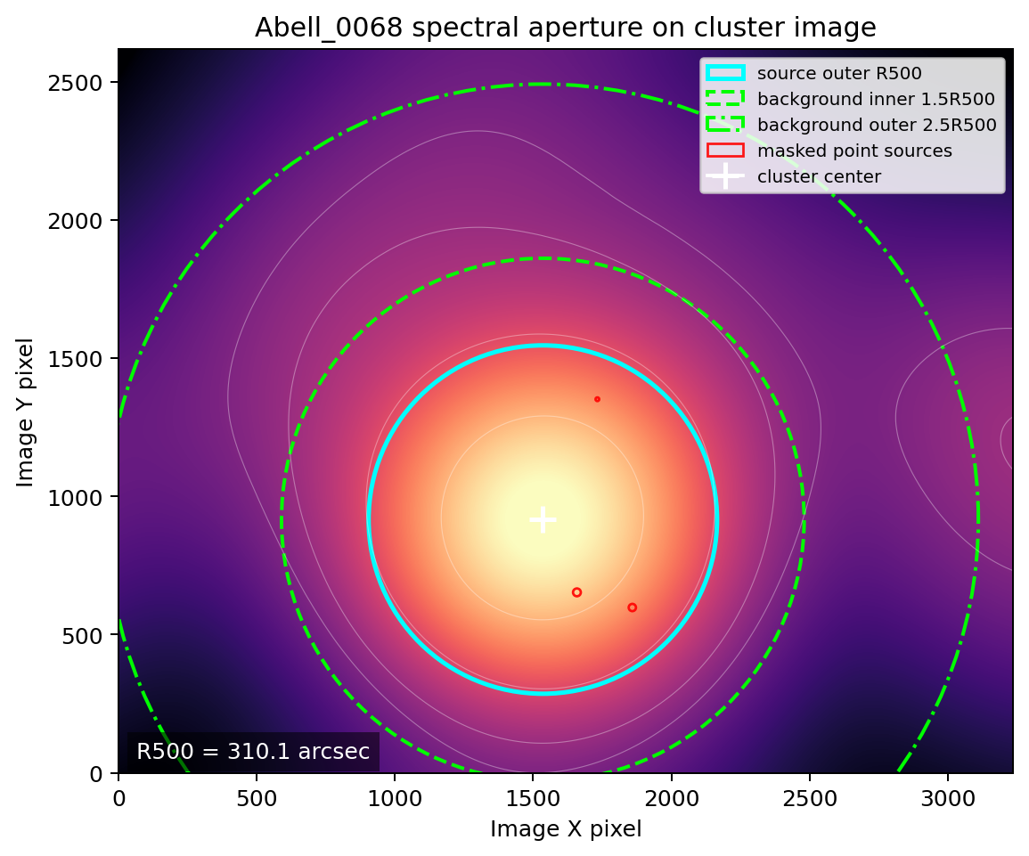
APERTURE CONSTRUCTION
R500 coverage defines the X-ray extraction region and quality-control geometry.
The aperture is centered on the X-ray peak and combined with point-source masking before spectral extraction.
Displayed quantities
The overlay shows the smoothed X-ray image, X-ray peak, point-source masks, and R500-scale source/background aperture geometry used for spectral products.
Role in the analysis
This step connects the image-level morphology screen to the spectral measurement: aperture choices determine which ICM photons enter L_X and T_X.
Figure: output/figures/spectral/Abell_0068_r500_xray_peak_psmask_aperture_overlay.png
09

Slide 10
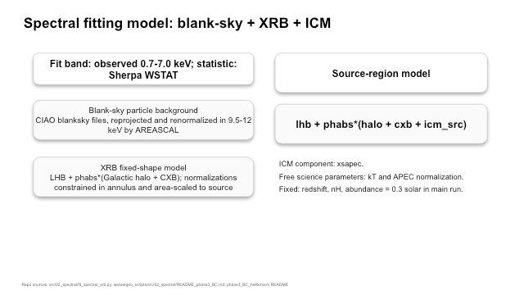

Slide 11
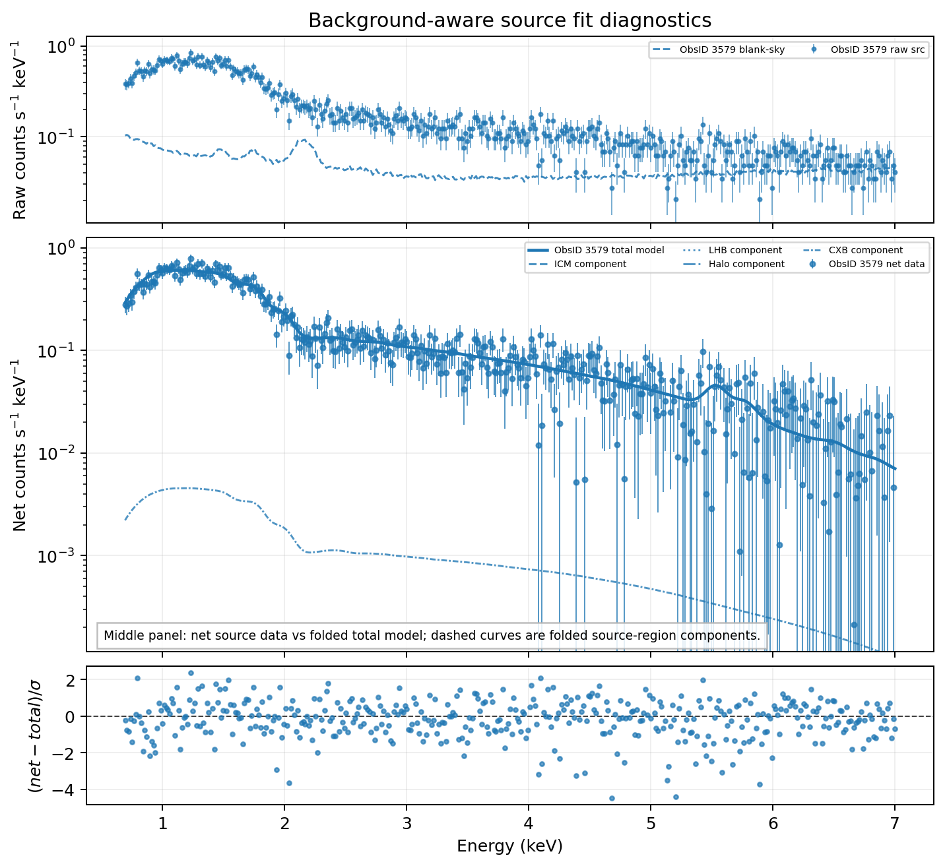
SPECTRAL QA
Spectral QA separates raw background behavior from the net source model.
The adopted WSTAT diagnostic compares source-region model components after background treatment.
Model components
Absorbed APEC ICM plus source-region sky components: local hot bubble, Galactic halo, and cosmic X-ray background.
Background handling
Blank-sky particle background is renormalized in 9.5-12 keV, where cluster thermal emission is weak and the particle background dominates.
Figure: output/figures/spectral/Abell_0209_fit.png
11

Slide 12
EXTERNAL SANITY CHECK
ACCEPT temperatures provide an external diagnostic for spectral-fit plausibility.
The reference values are used for QA interpretation, not as calibration priors in the scaling fit.
Cluster
Project T_X
ACCEPT T_X
ratio
Interpretation
Abell 0209
8.05
8.28
0.97x
Near-unity ratios support the spectral solution. Large deviations trigger inspection of fit statistics, ObsID coverage, backgrounds, and aperture/reference mismatches.
Abell 0611
12.87
6.69
1.92x
MACSJ0647.7+7015
16.74
9.07
1.85x
ZwCl 0857.9+2107
4.68
12.10
0.39x
Example outcome
ZwCl 0857.9+2107 is excluded from the main relation because the ACCEPT comparison appears affected by a reference/aperture mismatch.
Sources: memory/pipeline_status.csv; ACCEPT used as QA reference only
12

Slide 13
SCALING INFERENCE
Scaling relations are fitted with fixed evolution and intrinsic scatter.
The main-flow analysis focuses on the two mass-based observables.
Headline relations
log10[Y / E(z)^gamma] = alpha + beta log10[X / X_piv]
L_X-M500
T_X-M500
linmix handles measurement errors in both axes and reports intrinsic scatter in dex.
Pivot convention
M500 pivot = 3e14 Msun and T_X pivot = 5 keV. Slopes are the primary scientific comparison; normalization is pivot-dependent.
Sources: final report; output/products/final_scaling_table.csv; Kelly 2007
13

Slide 14
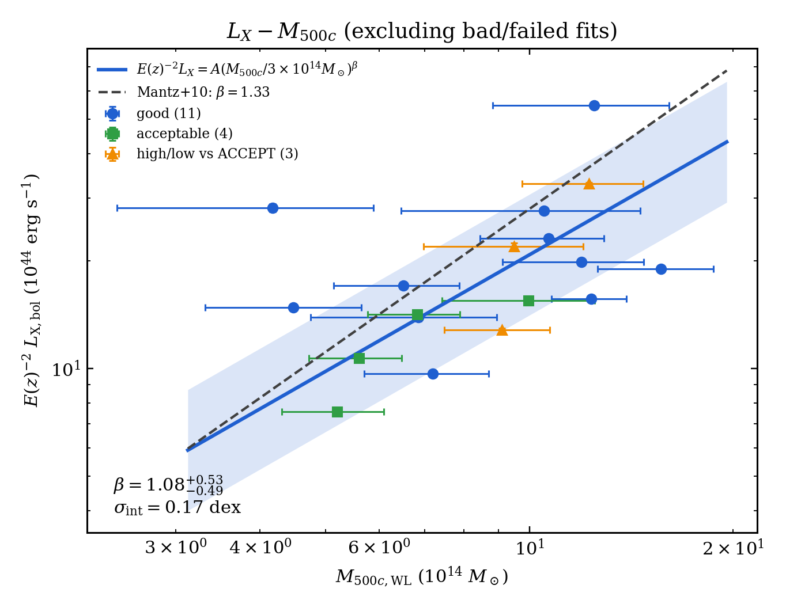
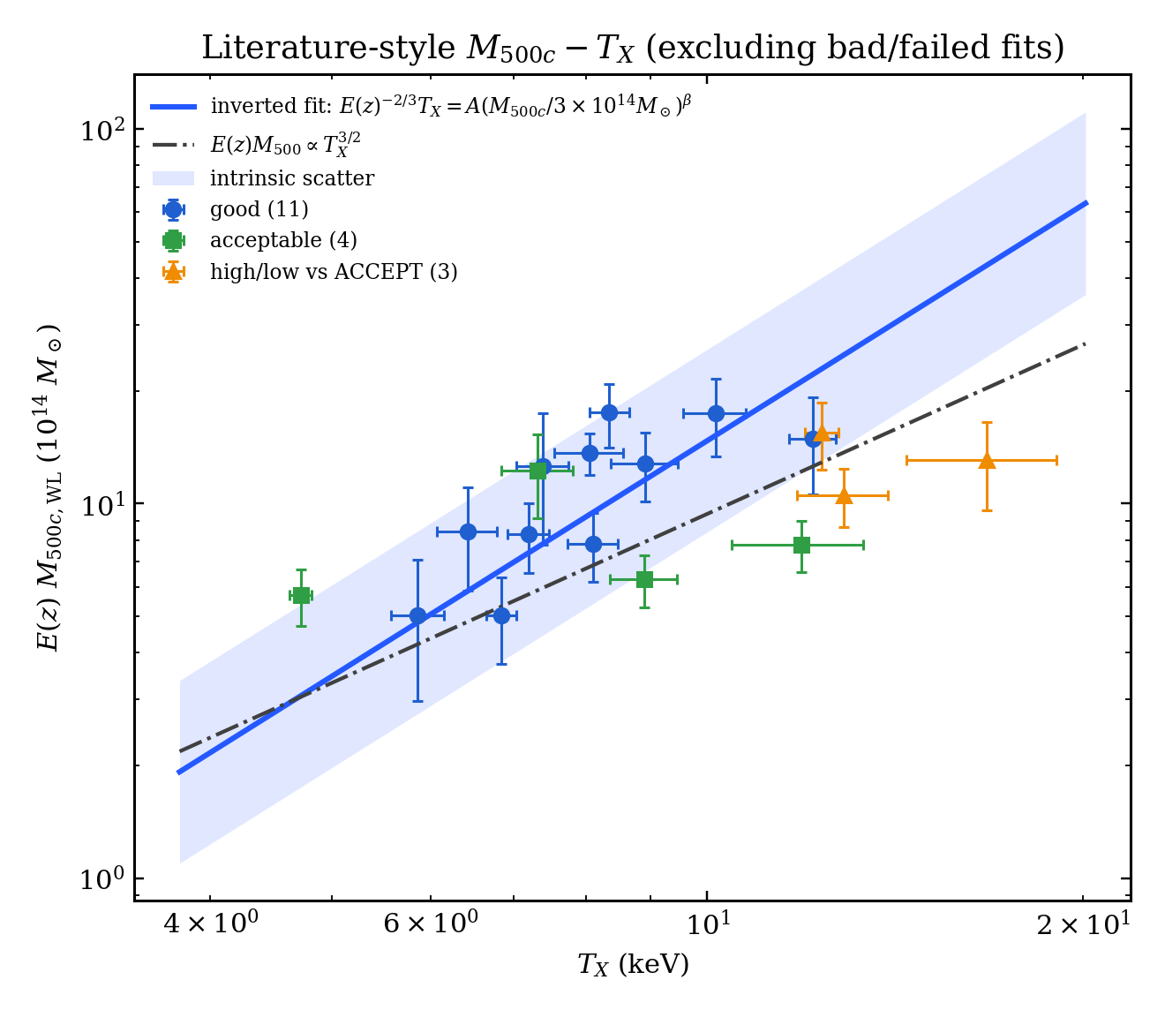
MASS-BASED RESULTS
Full-R500 scaling shows stable mass trends in luminosity and temperature.
Baseline sample: 18-cluster exclude_bad; fixed self-similar redshift evolution.
L_X-M500
slope beta
T_X-M500
slope beta
1.08 -0.49/+0.53
0.48 -0.25/+0.26
intrinsic scatter
intrinsic scatter
0.169 dex
0.117 dex
Figures: output/figures/scaling/lx_m500_linmix_exclude_bad.png; m500_tx_literature_style_exclude_bad.png
14

Slide 15
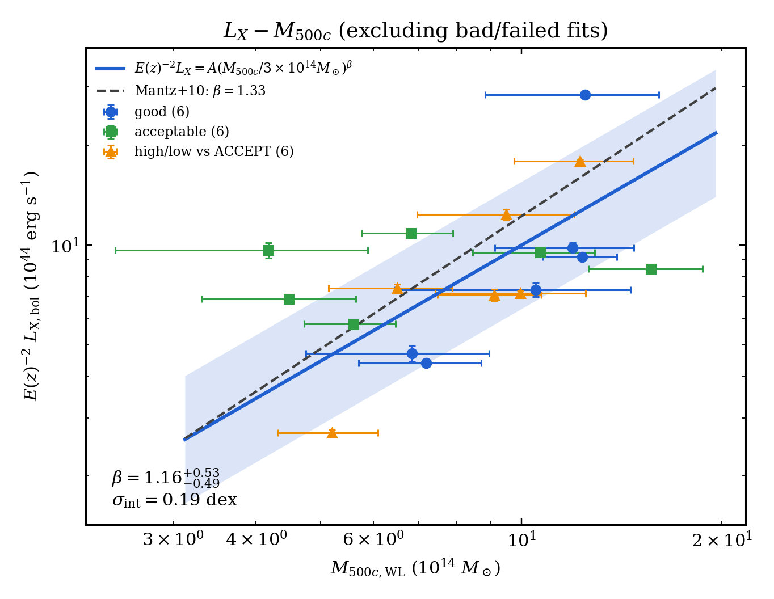
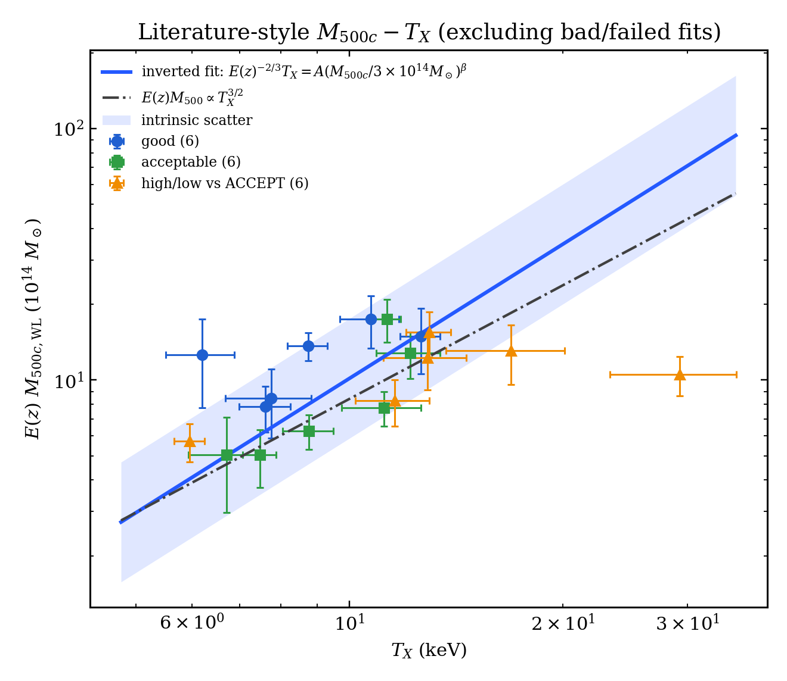
CORE EXCISION
Core excision preserves the mass-based slopes within current uncertainties.
The comparison uses the same 18-cluster sample over 0.15-1.0 R500.
Scientific reading
The result is a stability check: removing the central 0.15 R500 does not overturn the mass-based relations at this precision.
Relation
full beta
core beta
scatter
L_X-M500
1.08
1.16
0.169 -> 0.192
T_X-M500
0.48
0.56
0.117 -> 0.134
Sources: final_scaling_table.csv; full_vs_core_excised_comparison.md
15

Slide 16
QUALITY CONTROL
Quality control limits the impact of failed spectra and small-sample sensitivity.
Excluded systems are retained in the archive but not used for the headline scaling relations.
Excluded from headline fit
Sensitivity tests
Remaining limitation
Abell 0697
Leave-one-out tests for retained high/suspect systems shift L_X-M500 and T_X-M500 slopes by less than the current statistical errors.
The sample is small and heterogeneous, so precision is limited by statistical leverage, background treatment, and high-temperature objects.
Abell 0750
MS2137-2353
RXJ1347.5-1145
Mass-based slopes remain the stable headline result.
ZwCl 0857.9+2107
Sources: scaling sensitivity report; memory/pivot_normalization_analysis.md
16

Slide 17
SCIENTIFIC CONCLUSION
Chandra hot-gas observables broadly trace weak-lensing halo mass.
Mass relations
Full-R500 L_X-M500 beta = 1.08 and T_X-M500 beta = 0.48 for the 18-cluster main sample.
Core excision
The corresponding core-excised slopes, 1.16 and 0.56, agree within current statistical uncertainties.
Physical meaning
T_X-M500 is the cleaner gravitational proxy; L_X-M500 remains more sensitive to gas density and core/background physics.
Precision limit
The final uncertainty is set by sample size, heterogeneous Chandra coverage, background modeling, and a few high-T_X systems.
Final report and refreshed scaling products, May 2026
17

Slide 18
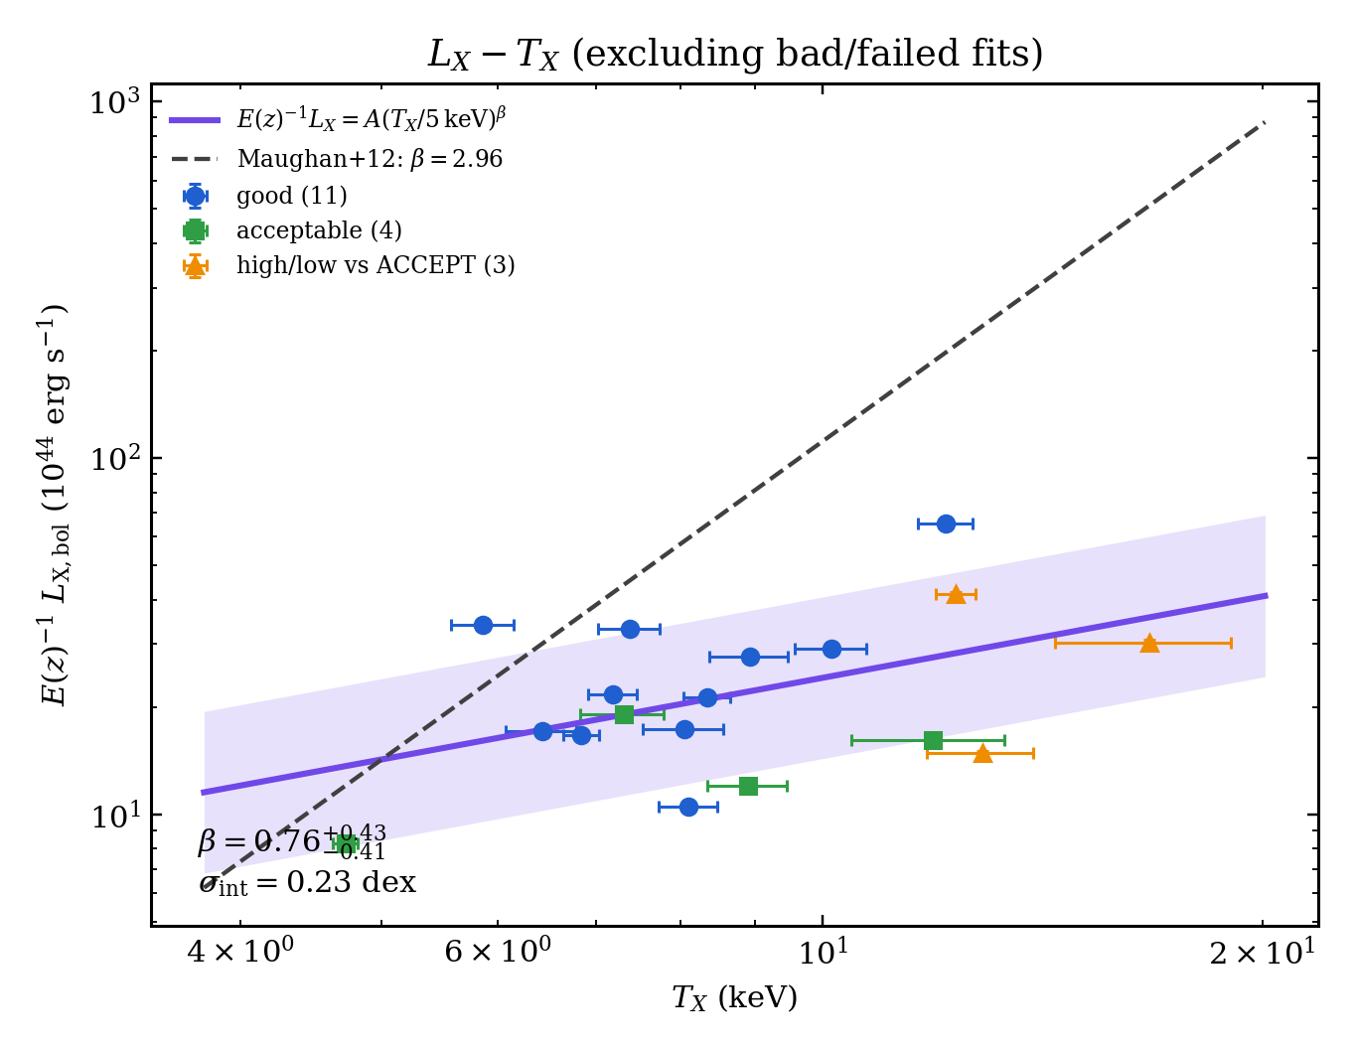
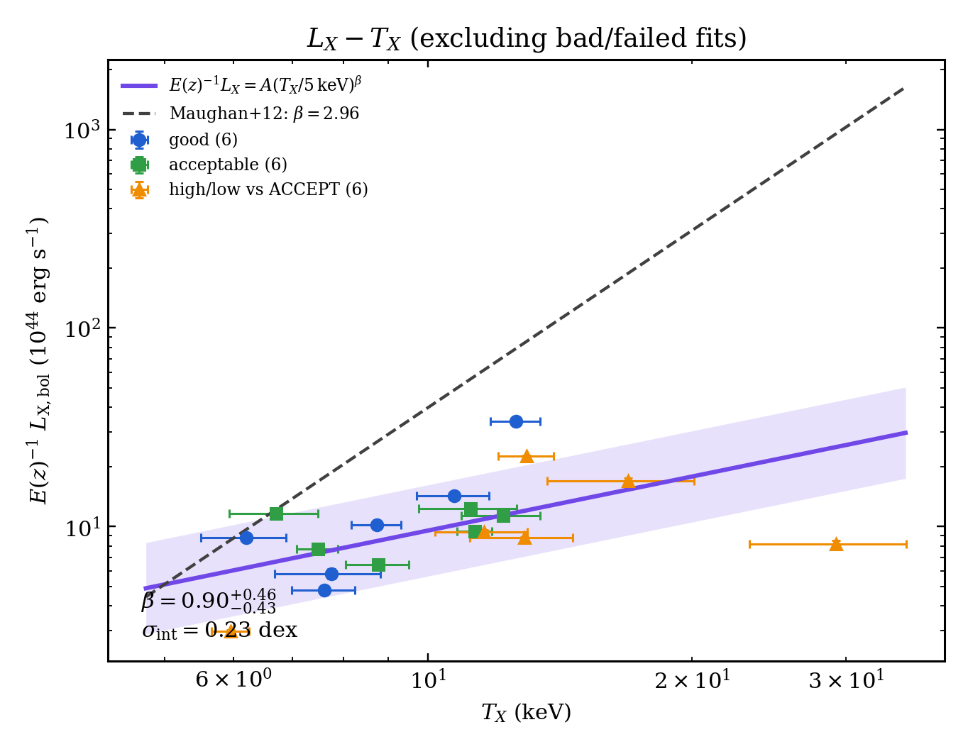
BACKUP: CONSISTENCY RELATION
The L_X-T_X relation is retained as a non-headline consistency check.
It is the noisiest relation and is not used as the primary scientific conclusion.
Full R500
slope beta
Core excised
slope beta
0.76 -0.41/+0.43
0.90 -0.43/+0.46
intrinsic scatter
intrinsic scatter
0.227 dex
0.230 dex
Backup figures: output/figures/scaling/*lx_tx*exclude_bad.png
18

