Slide 1


Slide 2
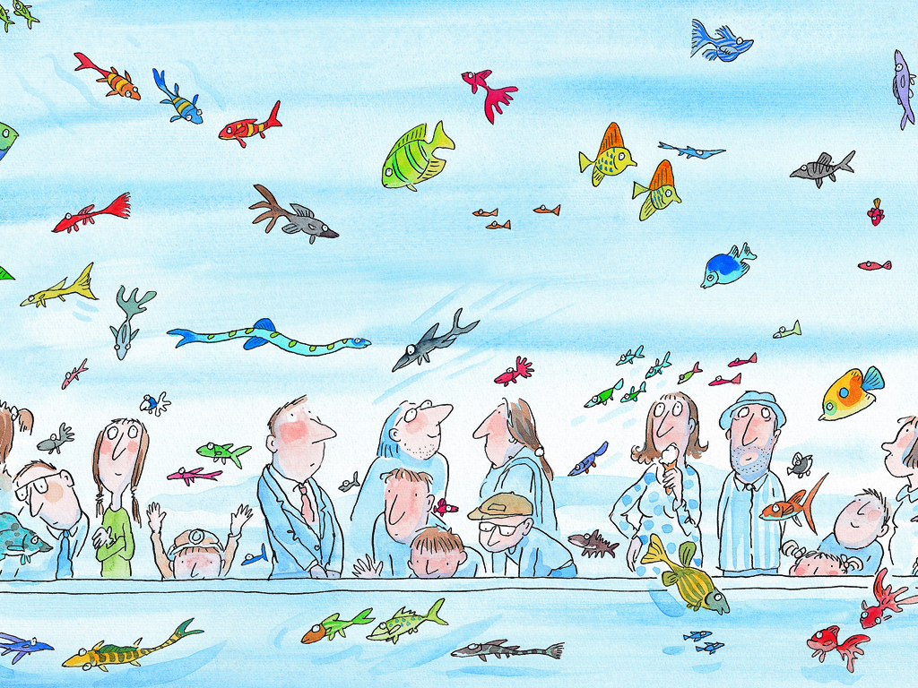
我看見一隻魚，一隻對我微笑的魚。
Notes:
我看見一隻魚
I see a fish.
一隻對我微笑的魚
A fish smiling at me.

Slide 3
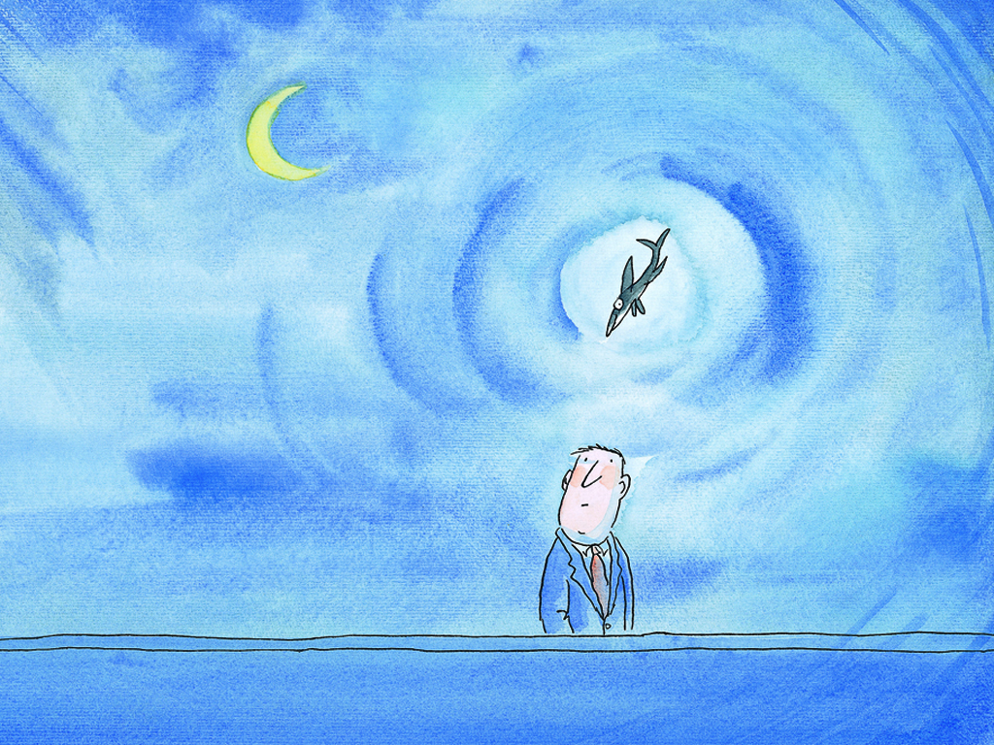
不管白天、夜晚，每當我經過時，
他總是搖搖擺擺地游向我，對我微笑。
Notes:
不管白天
No matter if it's daytime,
夜晚
or nighttime.
每當我經過時
Whenever I pass by.
他總是搖搖擺擺地游向我
She always sways to and fro as She swims towards me,
對我微笑
and smiles at me.

Slide 4
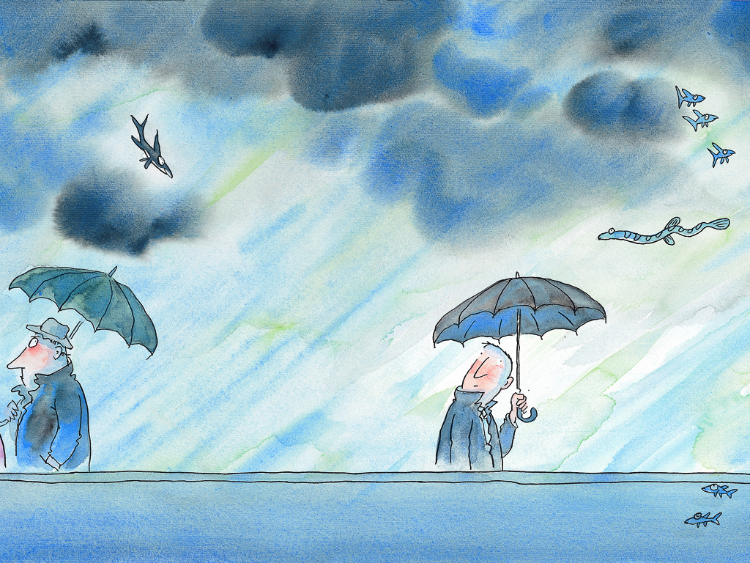
不論天晴、天雨，她似乎都在等著我，
等著我給她一個深情的眼神。
Notes:
不論天晴
No matter if it's a clear day,
天雨
rainy day.
她似乎都在等著我
It seems like she's always waiting for me.
等著我給她一個深情的眼神
Waiting for me to give her an affectionate look.

Slide 5
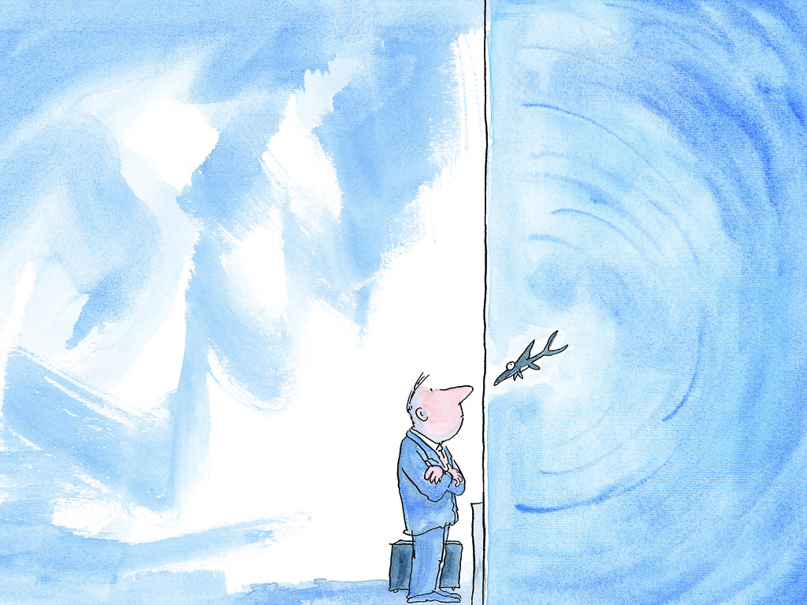
我想擁有這隻魚。
Notes:
我想擁有這隻魚
I want to have this fish for my own.

Slide 6
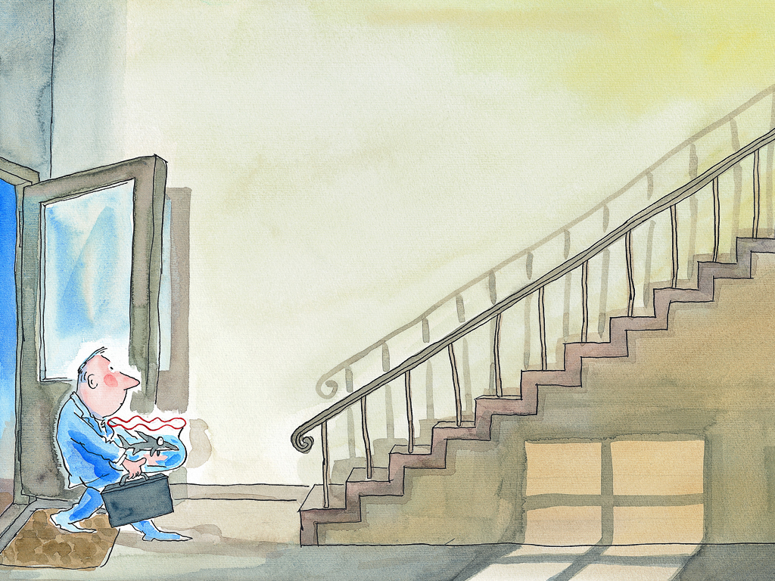
我帶著一隻魚，一隻對我微笑的魚回家。
Notes:
我帶著一隻魚
I brought a fish.
一隻對我微笑的魚回家
A fish that smiles at me back home.

