Slide 1
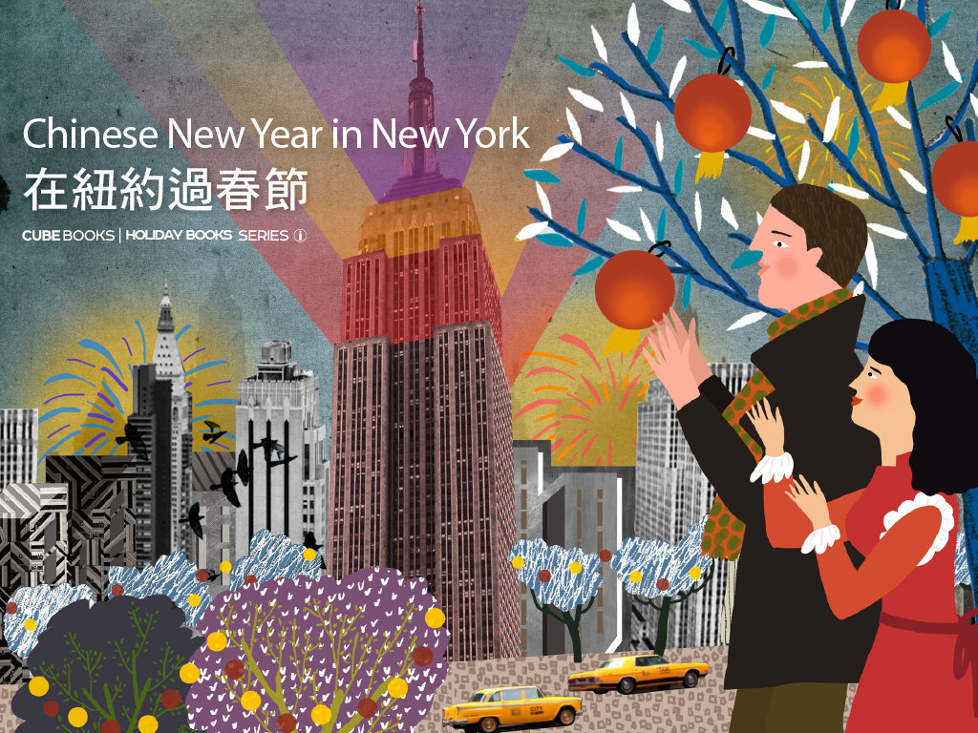

Slide 2
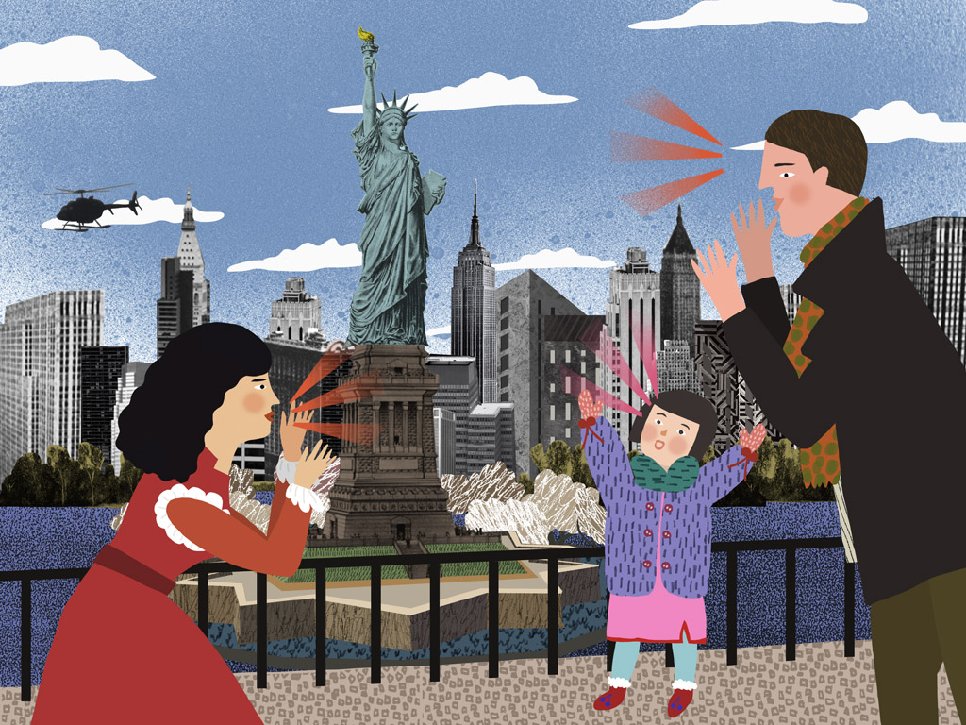
新年到了，我們說：「新年好」！
Notes:
It's New Year, we say: Happy New Year!

Slide 3
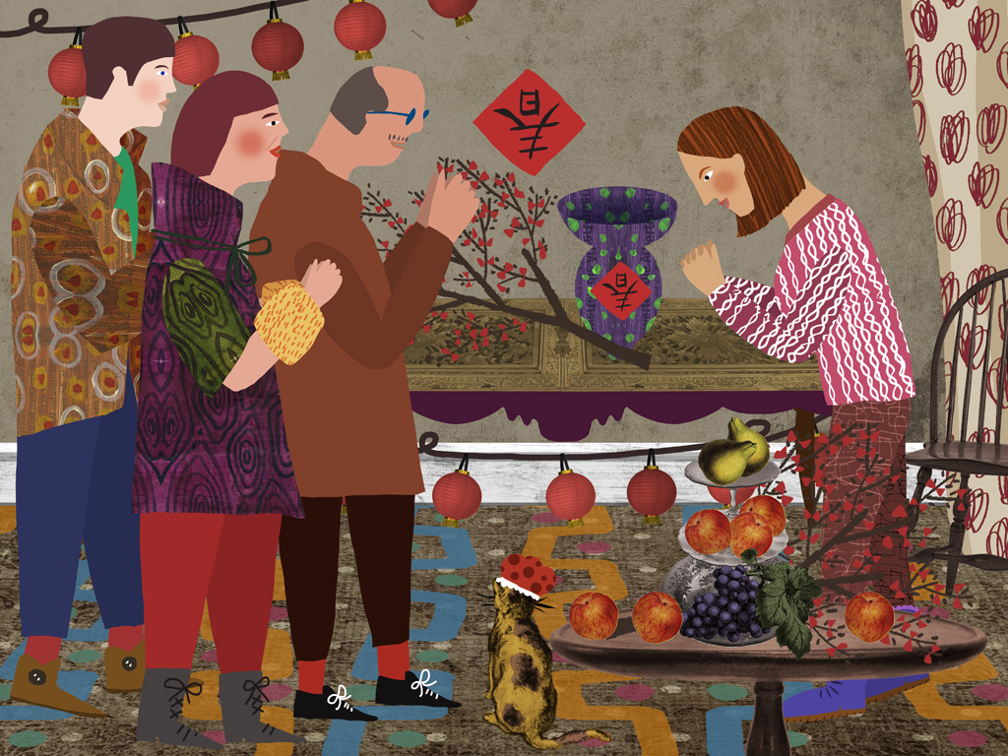
我們也說：「恭喜發財」！
Notes:
We also say: Gonxi Facai! (Wish You a Great Fortune! )

Slide 4
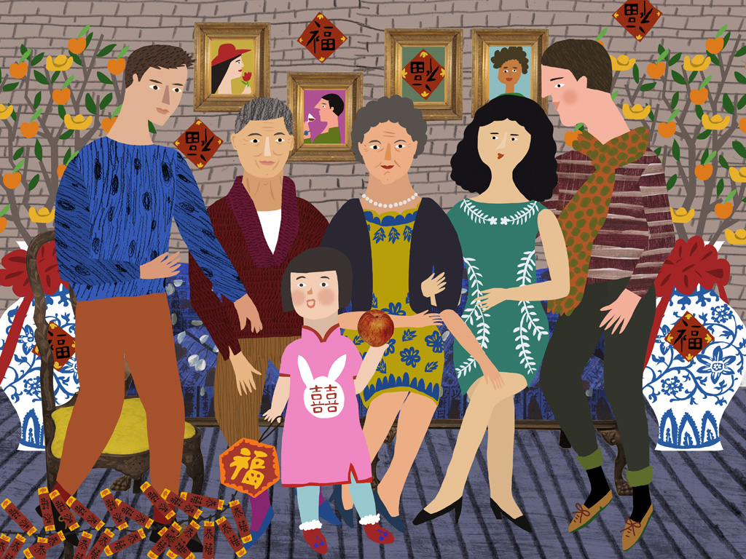
我們全家人團聚。
Notes:
We have family reunion.

Slide 5
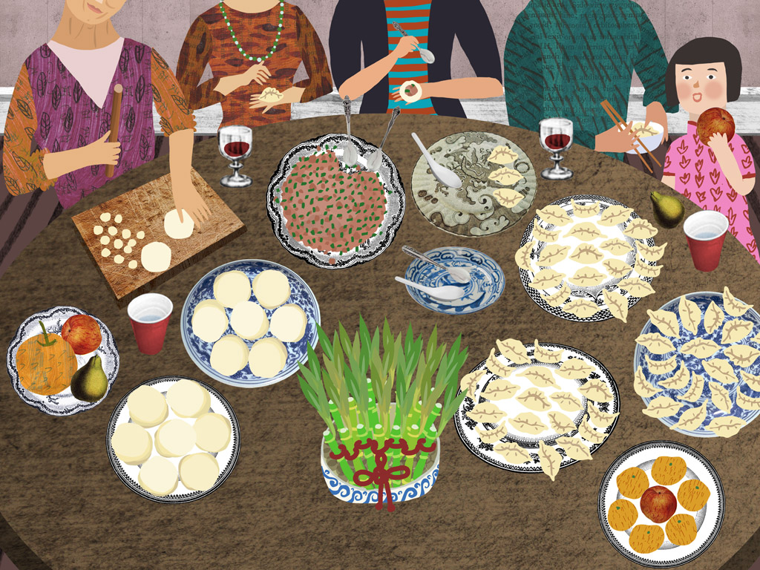
我們包餃子吃。
Notes:
We make dumplings to eat.

Slide 6

我們剪頭髮。我們穿新衣。
Notes:
We have new haircuts. We wear new clothes.

Slide 7
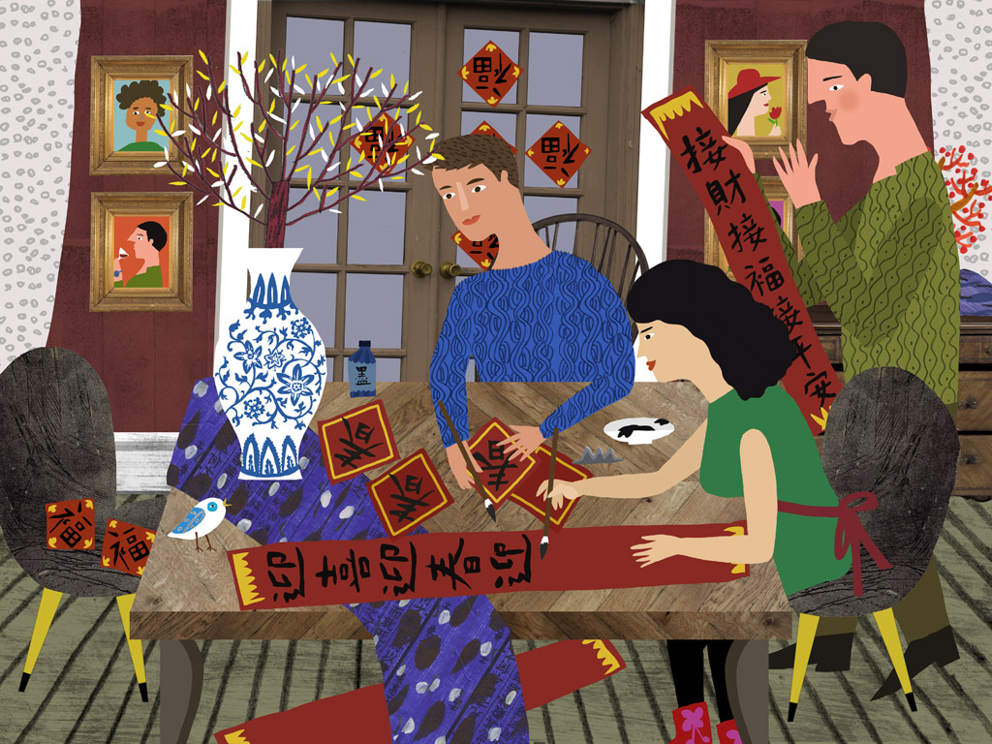
中國新年又叫春節。我們寫春聯。
Notes:
Chinese New Year is also called Spring Festival. We write Spring Idioms.

Slide 8
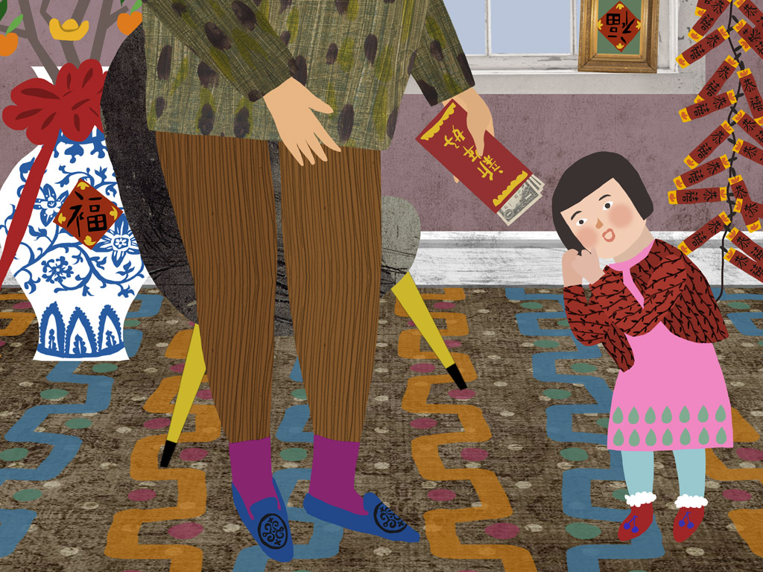
大人給孩子紅包當壓歲錢。
Notes:
Adults give kids red enveloped money to wish them grow healthily.

Slide 9
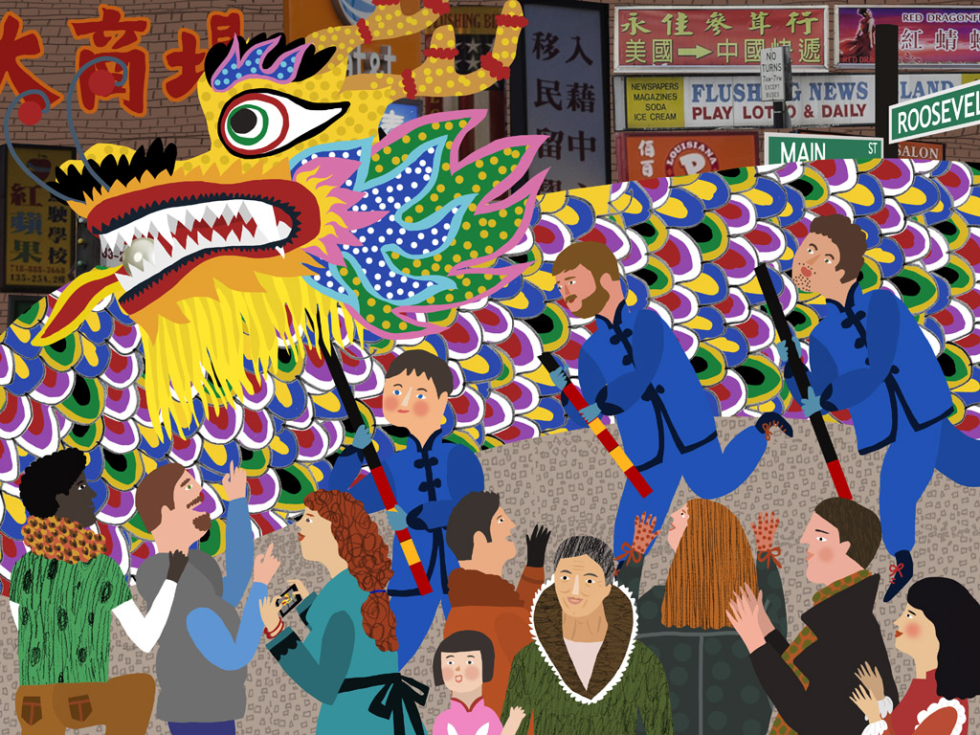
我們去唐人街看舞龍舞獅。
Notes:
We go to watch dragon dancing in China Town.

Slide 10
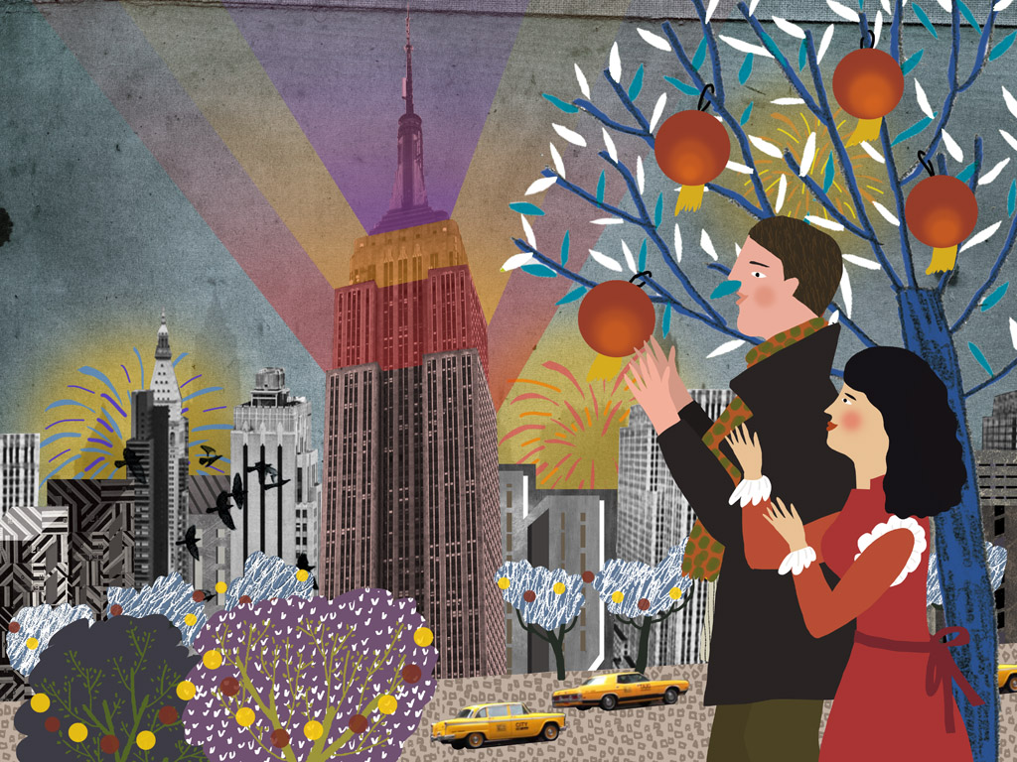
我們去看帝國大廈的燈，它會變換顏色慶祝中國新年。
Notes:
We go to watch Empire State's changing lights which are to celebrate Chinese New Year.

Slide 11

希望明年紐約的春節也放假，這樣紐約就有兩個新年了！
Notes:
We hope it will be a holiday for the next Spring Festival, then we have two New Years in New York!

