Slide 1


Slide 2
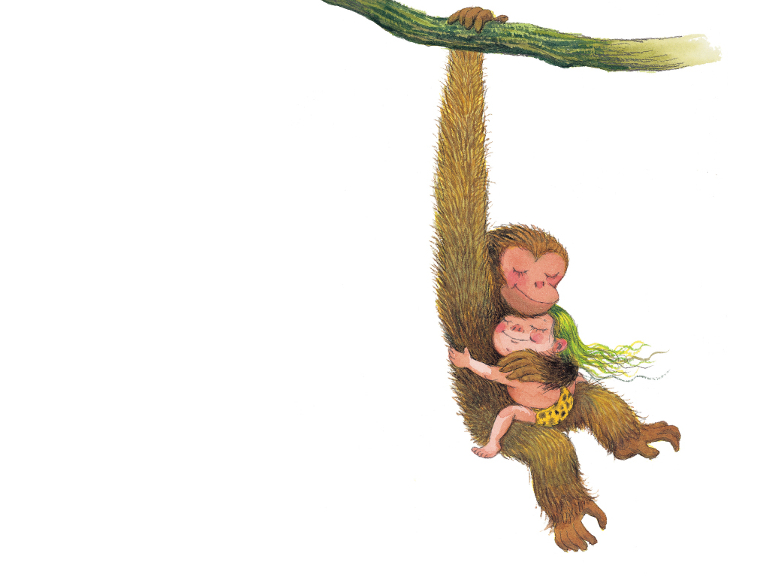
我想擁抱頑皮的猴子
Notes:
I want to hug a naughty monkey.

Slide 3
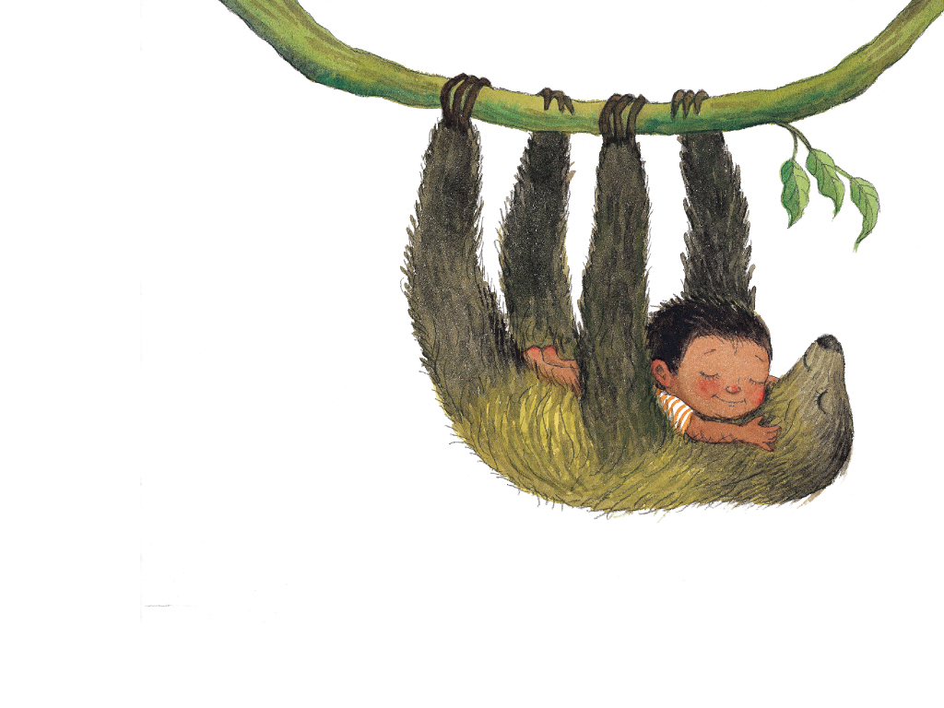
我想擁抱懶惰的樹懶
Notes:
I want to hug a lazy sloth.

Slide 4
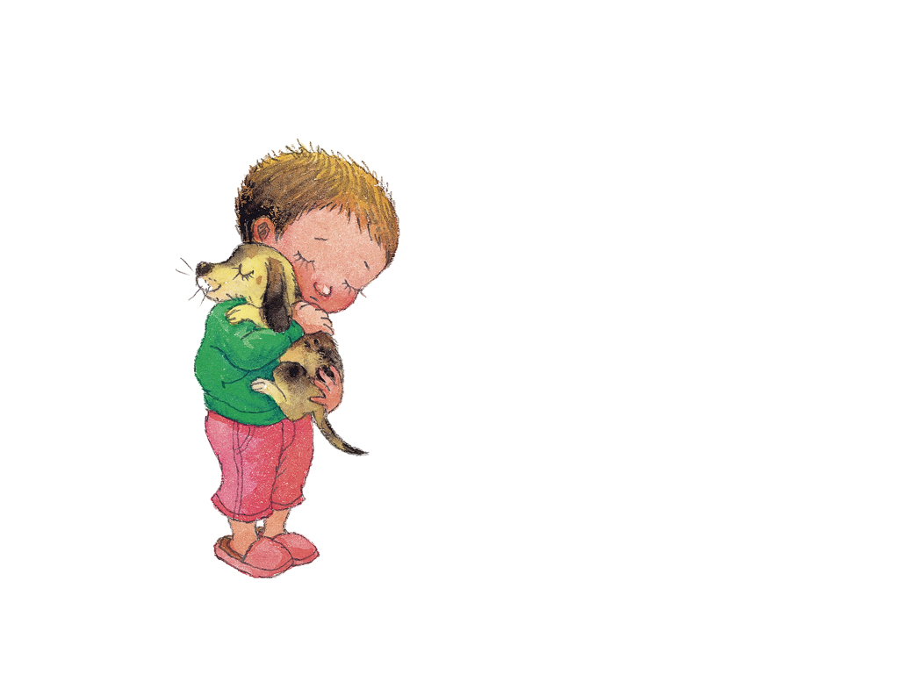
我想擁抱可愛的小狗
Notes:
I want to hug a lovely puppy.

Slide 5
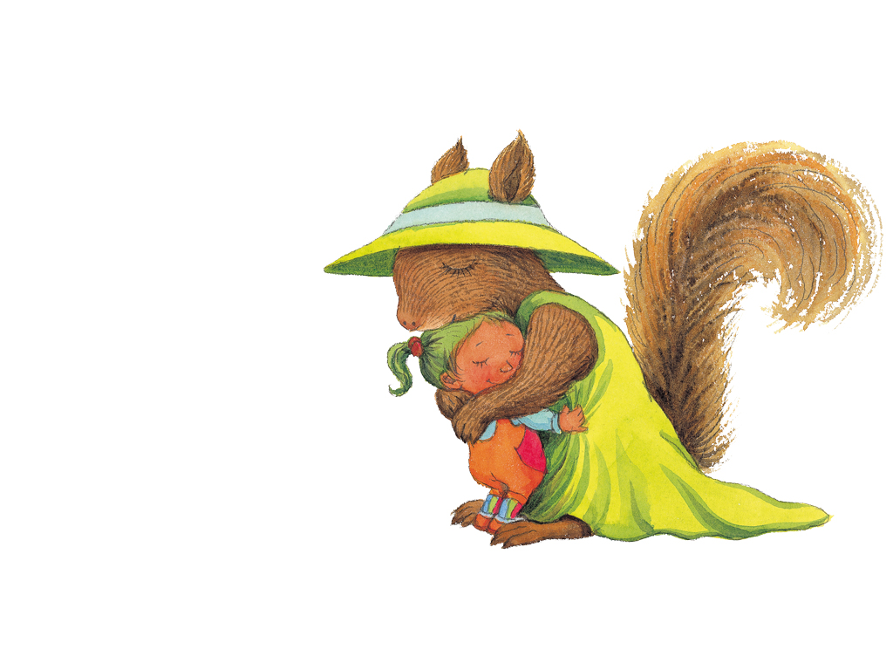
我想擁抱活潑的松鼠
Notes:
I want to hug a lively squirrel.

Slide 6
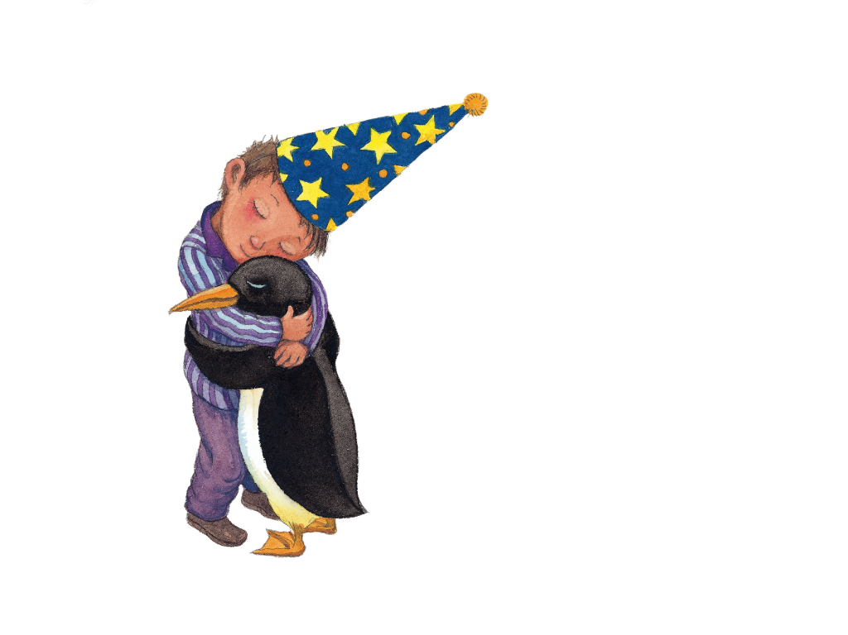
我想擁抱愛跳舞的企鵝
Notes:
I want to hug a penguin that loves to dance.

Slide 7
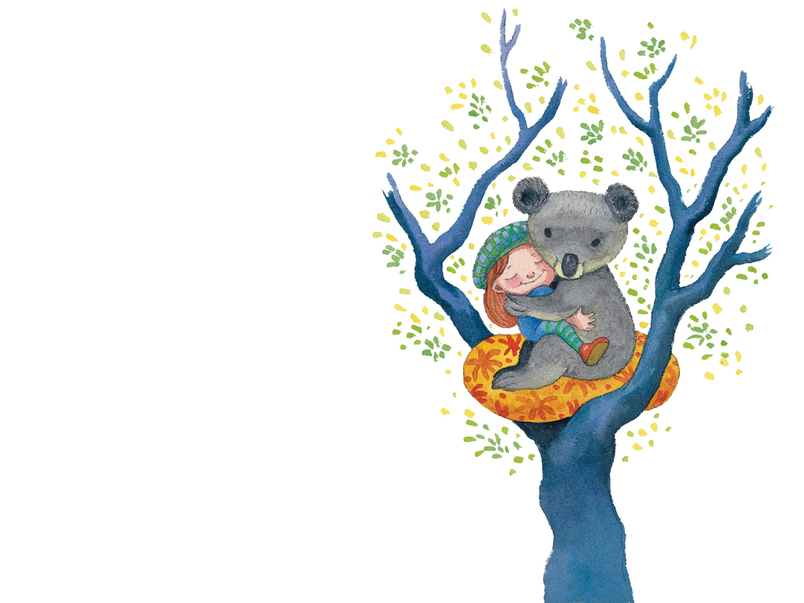
我想擁抱愛睡覺的無尾熊
Notes:
I want to hug a koala that loves to sleep.

Slide 8
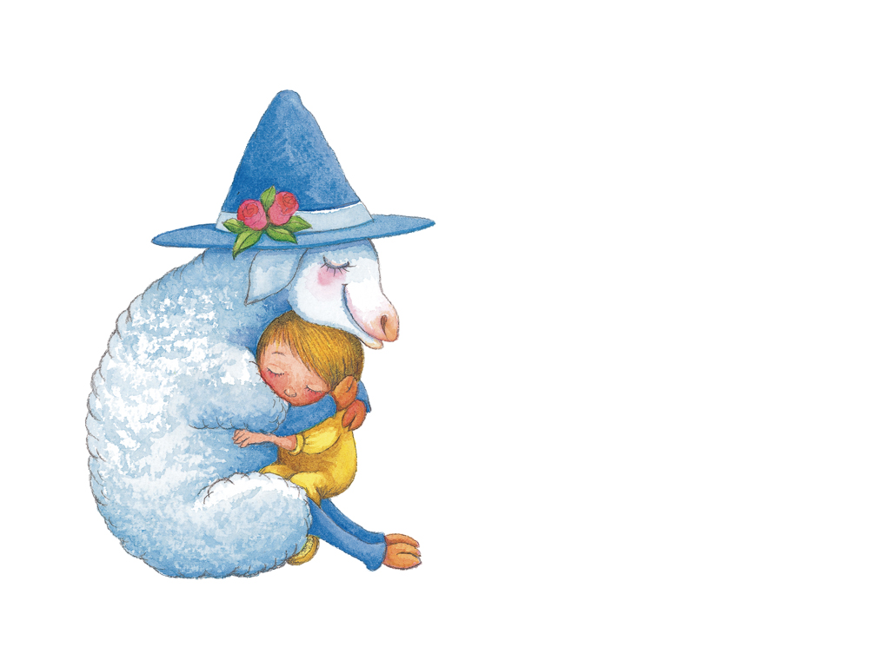
我想擁抱安靜的綿羊
Notes:
I want to hug a peaceful sheep.

Slide 9
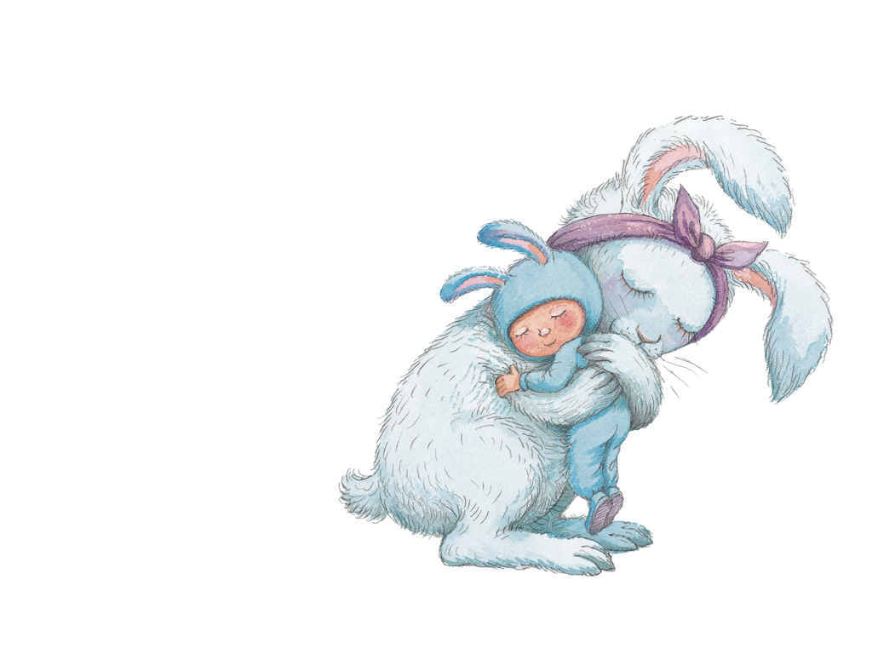
我想擁抱毛茸茸的兔子
Notes:
I want to hug a furry rabbit.

Slide 10
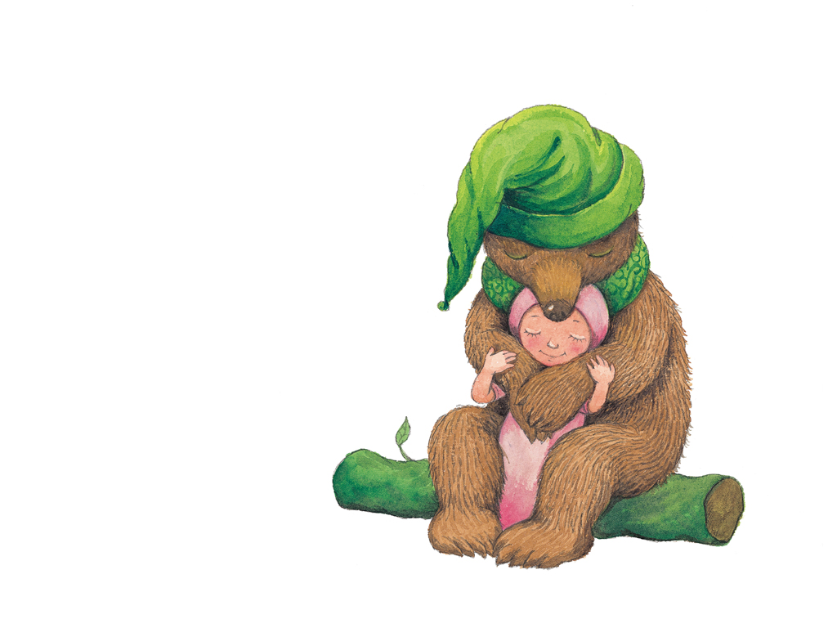
我想擁抱強壯的熊
Notes:
I want to hug a powerful bear.

Slide 11
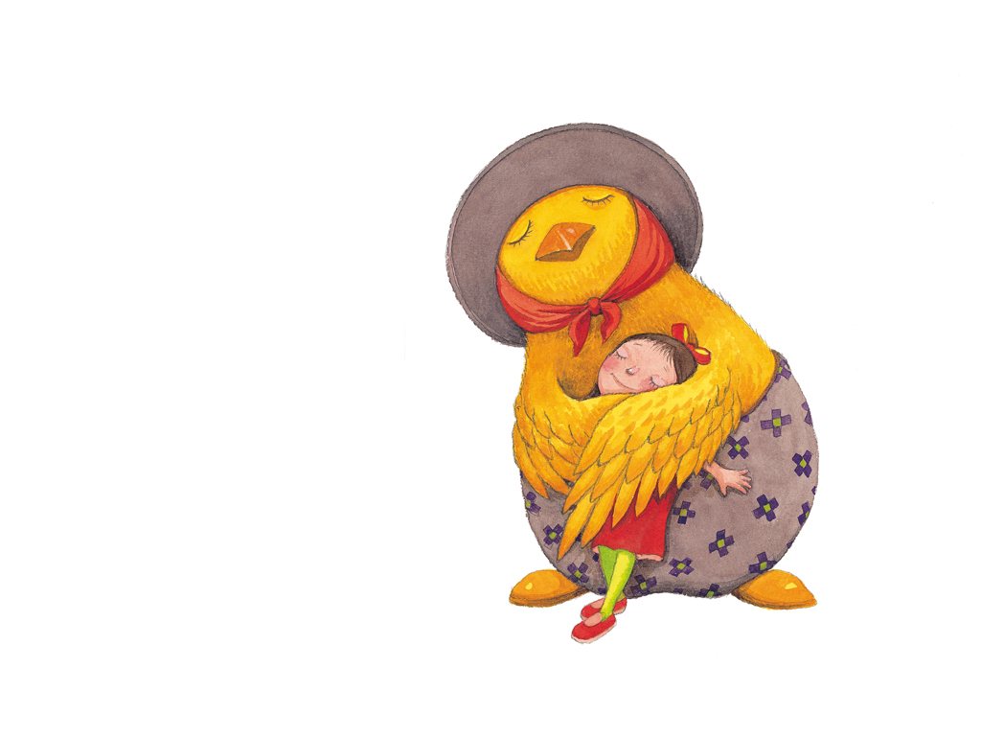
我想擁抱溫柔的母雞
Notes:
I want to hug a gentle hen.

Slide 12
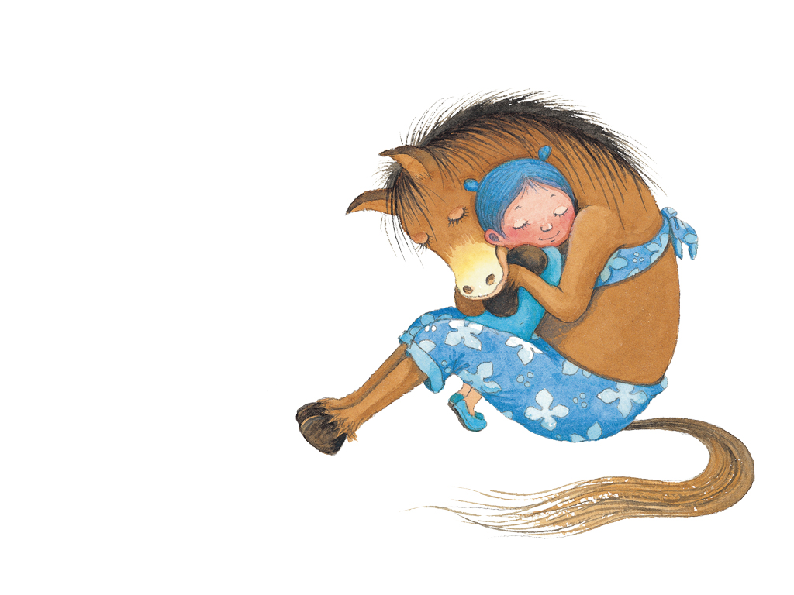
我想擁抱帥氣的馬
Notes:
I want to hug a handsome horse.

Slide 13
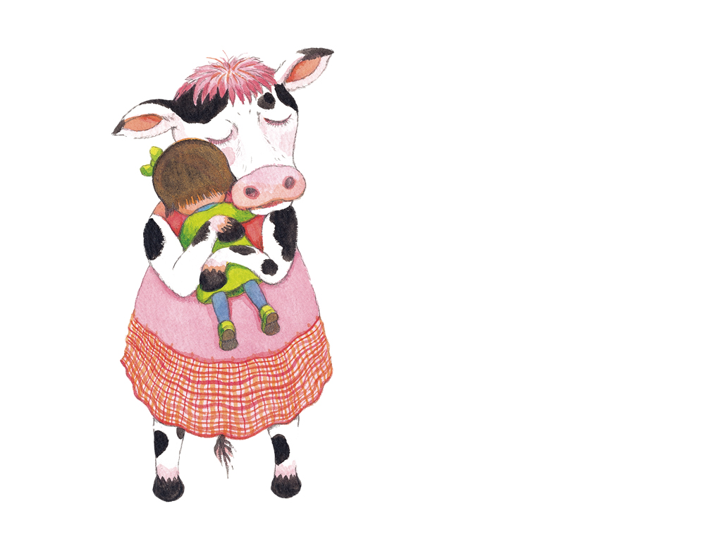
我想擁抱溫馴的乳牛
Notes:
I want to hug a meek milk cow.

Slide 14
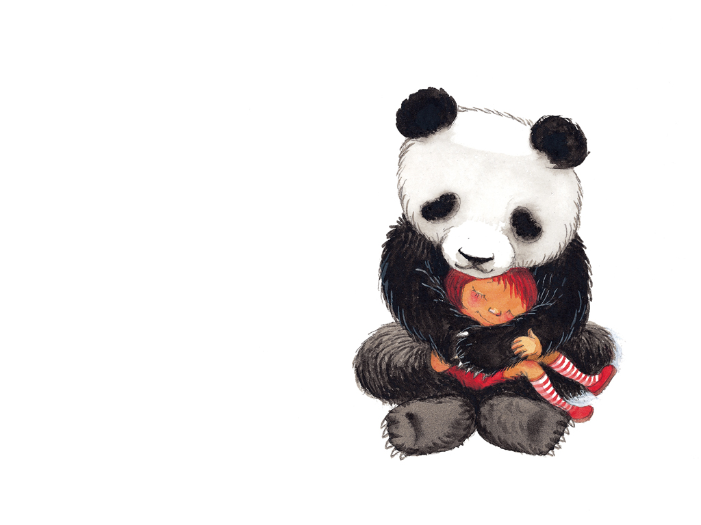
我想擁抱圓滾滾的貓熊
Notes:
I want to hug a plump panda.

Slide 15
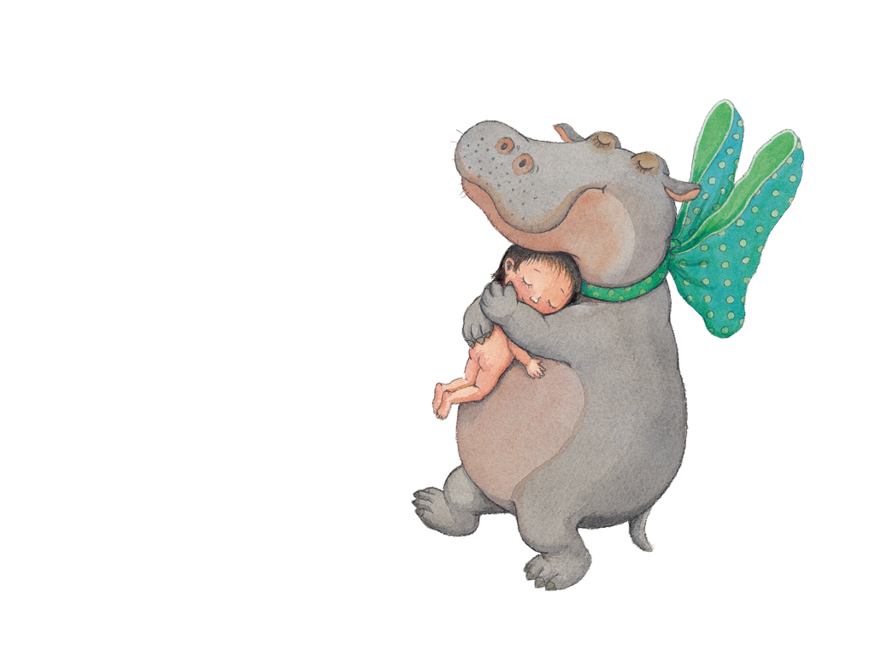
我想擁抱胖胖的河馬
Notes:
I want to hug a very fat hippo.

Slide 16
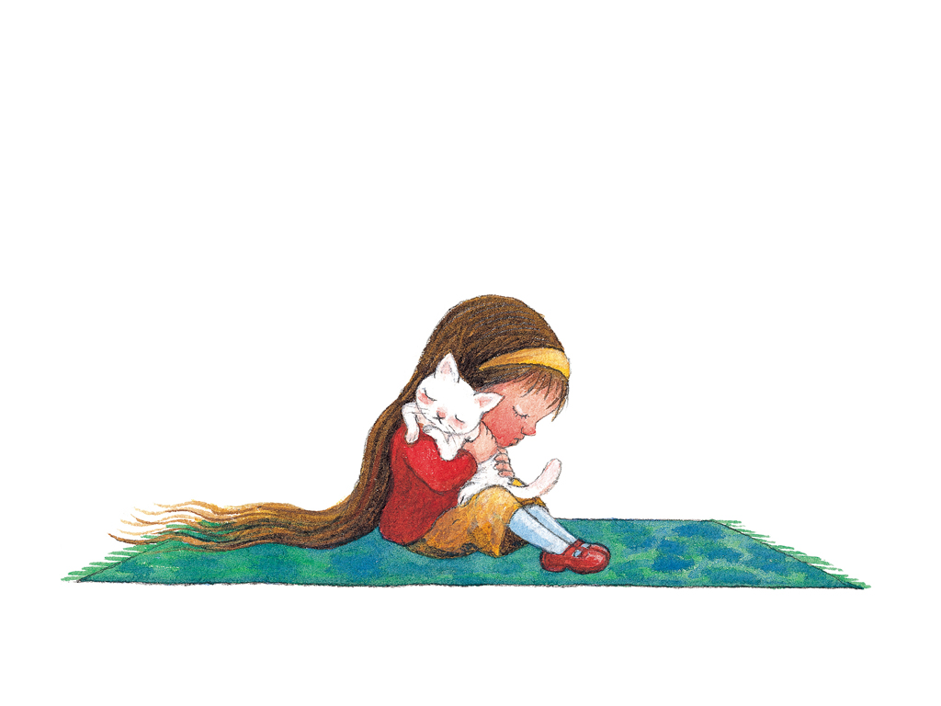
我想擁抱乖巧的小貓
Notes:
I want to hug a clever kitten.

Slide 17
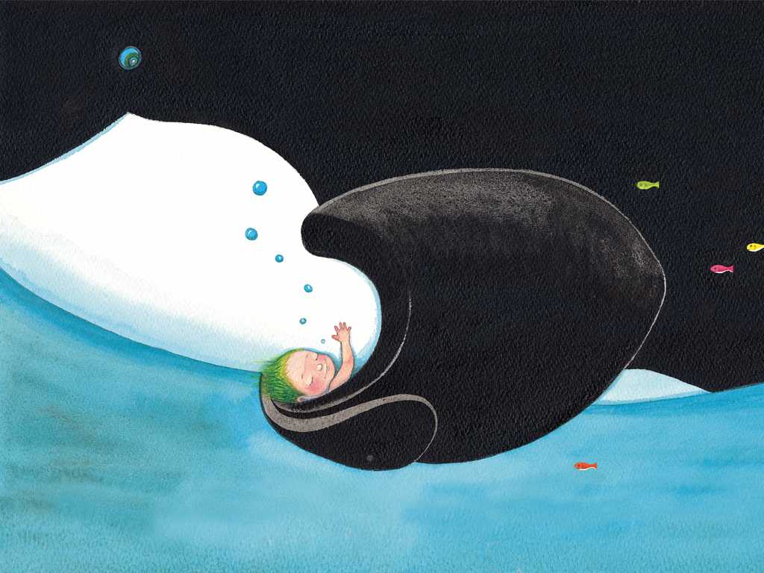
我想擁抱巨大的藍鯨
Notes:
I want to hug a huge blue whale.

Slide 18
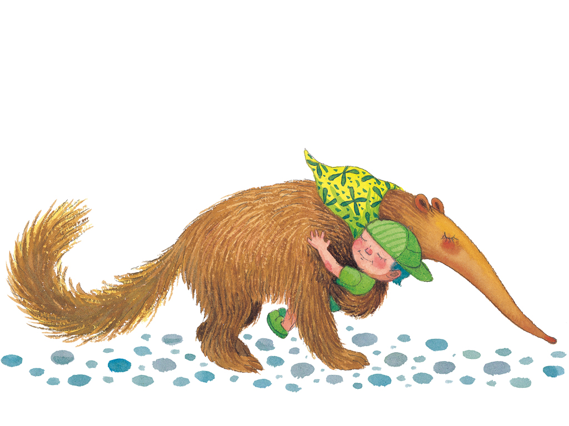
我想擁抱愛吃的食蟻獸
Notes:
I want to hug an anteater that loves to eat.

Slide 19
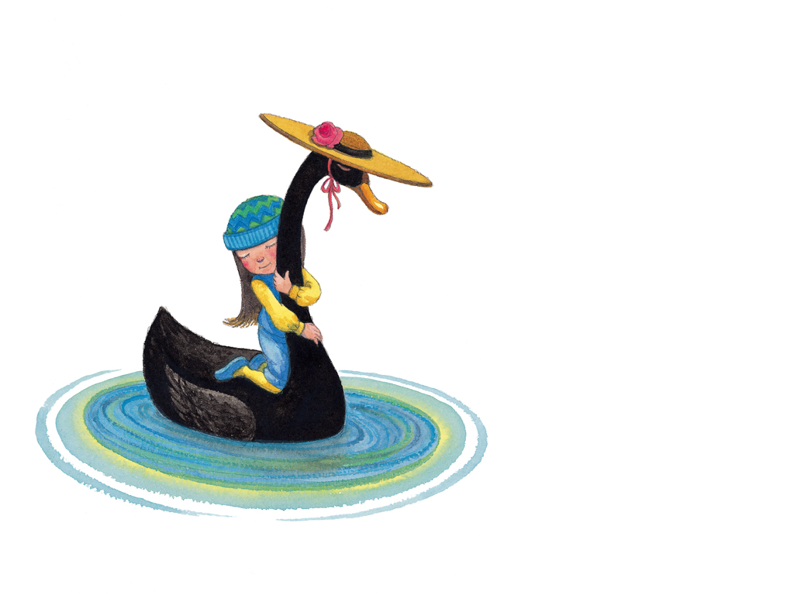
我想擁抱優雅的黑天鵝
Notes:
I want to hug an elegant black swan.

Slide 20
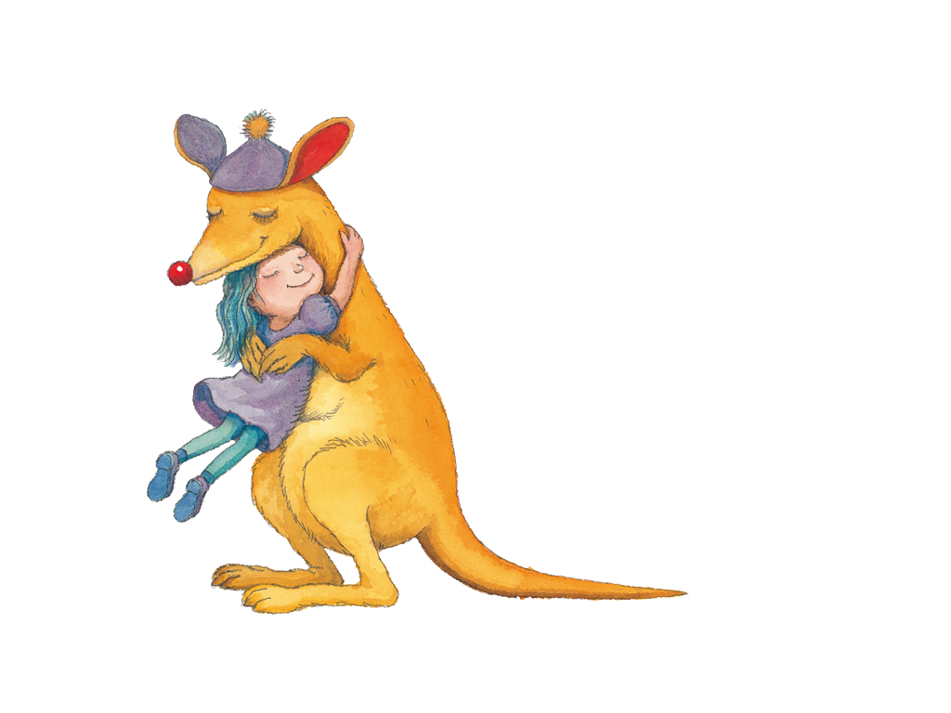
我想擁抱蹦蹦跳的袋鼠
Notes:
I want to hug a wildly hopping kangaroo.

Slide 21
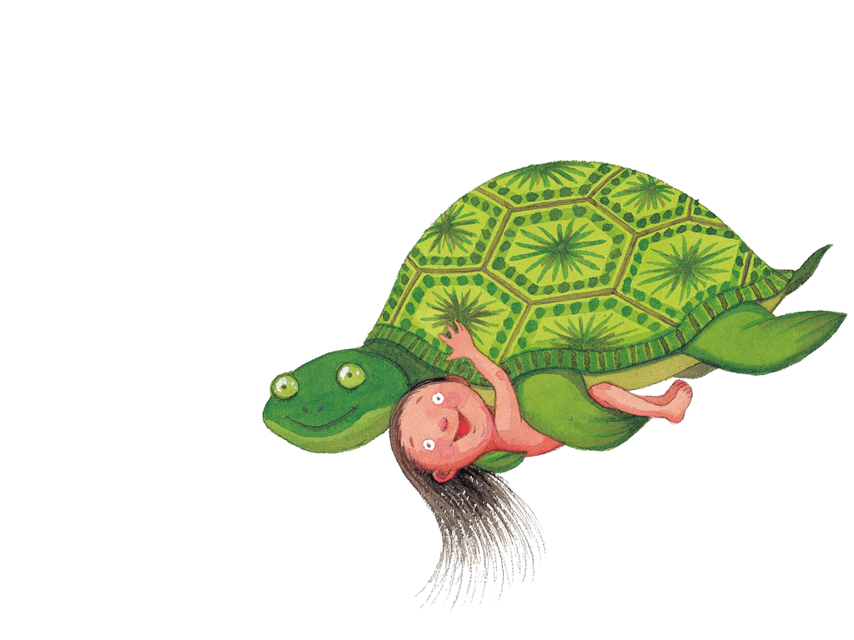
我想擁抱長壽的烏龜
Notes:
I want to hug a long-living turtle.

