Slide 1
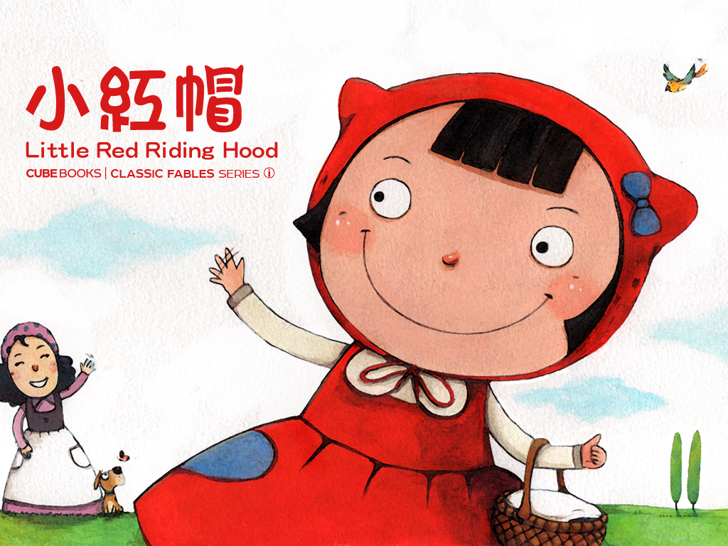

Slide 2
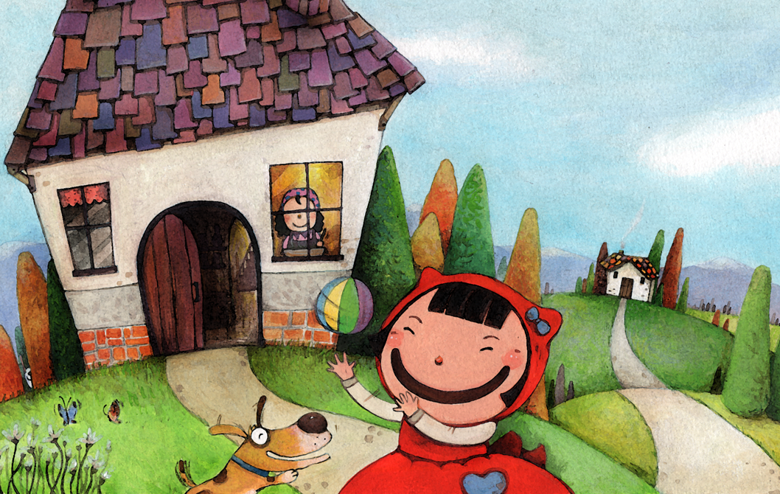
小紅帽住在森林邊的房子裡。
她的奶奶住在森林的另一邊。
Notes:
小紅帽住在森林邊的房子裡
Little Red-Cap lived in a cottage on the edge of the forest.
她的奶奶住在森林的另一邊
Her grandmother lived on the other side of the forest.

Slide 3
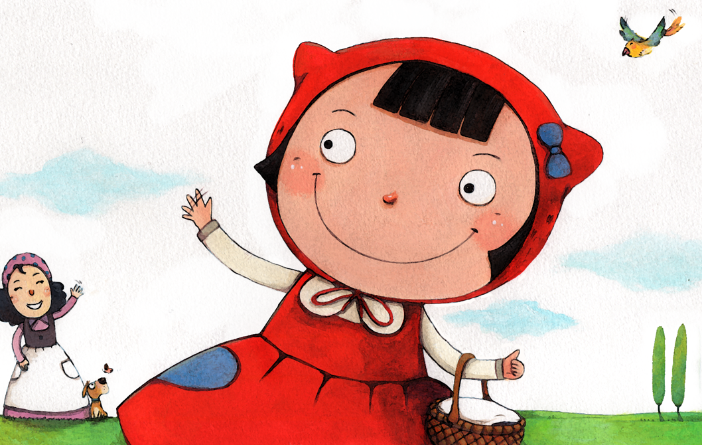
有一天，奶奶生病了，
媽媽叫她帶食物去看奶奶。
Notes:
有一天
One day,
奶奶生病了
her grandmother was not feeling well.
媽媽叫她帶食物去看奶奶
Mom told her to go take Grandmother something to eat.

Slide 4
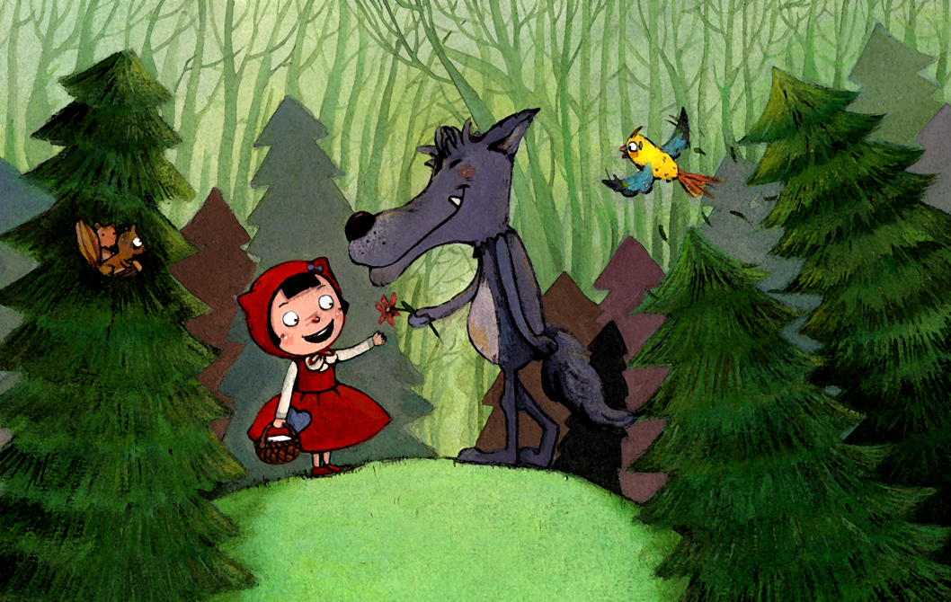
小紅帽經過森林。
在路上，她遇到一隻狼。
Notes:
小紅帽經過森林
Little Red-Cap passed through the forest.
在路上
Alone the way.
她遇到一隻狼
She ran into a wolf.

Slide 5
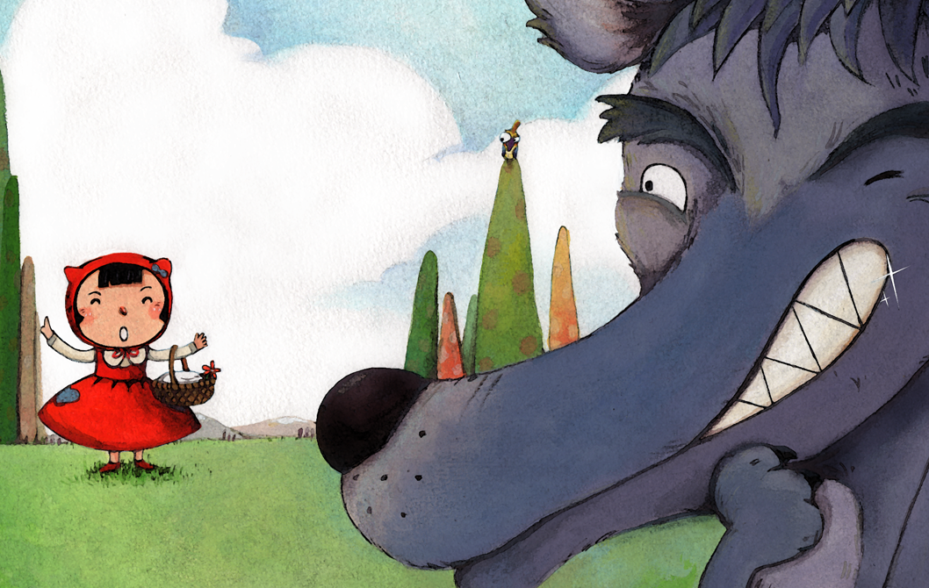
「小女孩，小女孩，妳要去哪裡？」
「我要帶食物去給生病的奶奶。」
Notes:
小女孩
Little girl,
小女孩
little girl,
妳要去哪裡
where are you going?
我要帶食物去給生病的奶奶
I'm bringing some food to my ill grandmother.

Slide 6
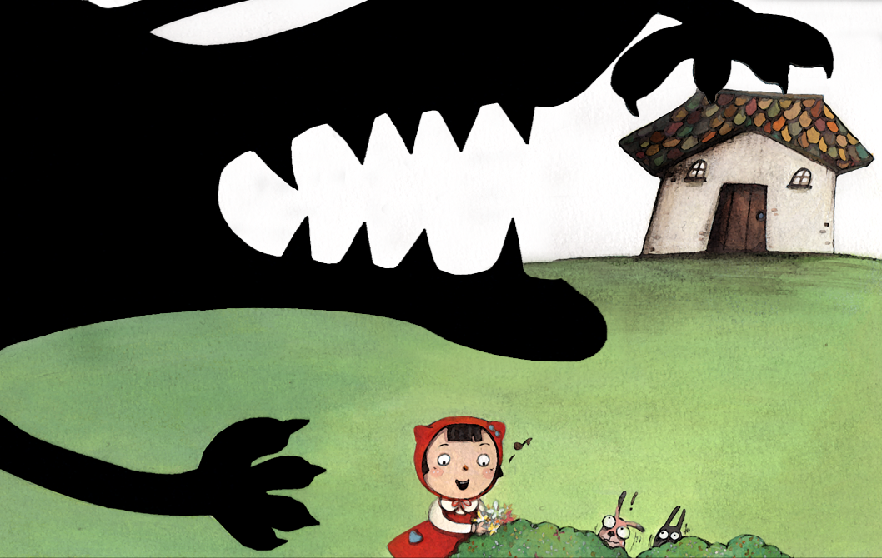
狼有了一個主意。
「我要去奶奶家，然後吃了她們兩個！」
Notes:
狼有了一個主意
The wolf had an idea.
我要去奶奶家
I'm going to her grandmother's home,
然後吃了她們兩個
and eat both of them!

Slide 7
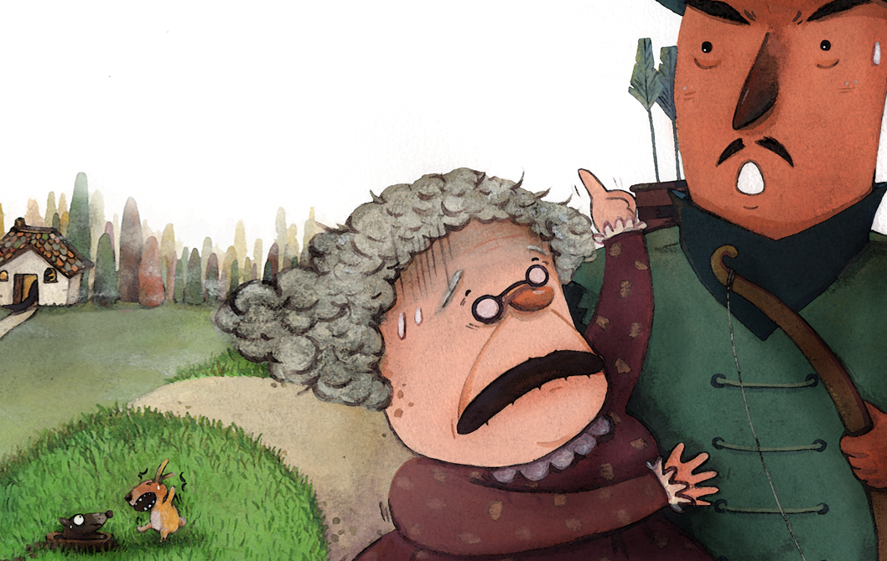
奶奶從屋子裡看見了狼。
她趕快起床去找獵人幫忙。
Notes:
奶奶從屋子裡看見了狼
Grandma saw the wolf from the house.
她趕快起床去找獵人幫忙
She quickly got out of bed to seek the hunter's help.

Slide 8
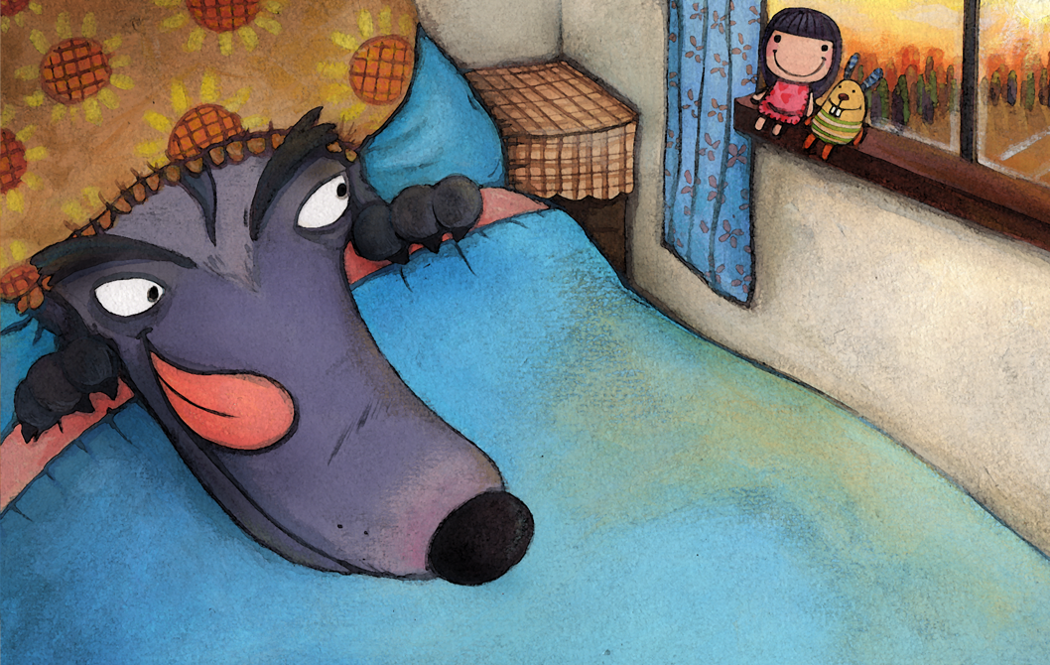
狼到了奶奶家，可是屋子裡沒有人。
於是，他穿上奶奶的衣服，躺在床上等小紅帽。
Notes:
狼到了奶奶家
The wolf came to Grandmother's house,
可是屋子裡沒有人
but no one was home.
於是
So
他穿上了奶奶的衣服
he put on Grandmother's bedclothes
躺在床上等小紅帽
and got into bed to wait for Little Red Riding Hood.

Slide 9
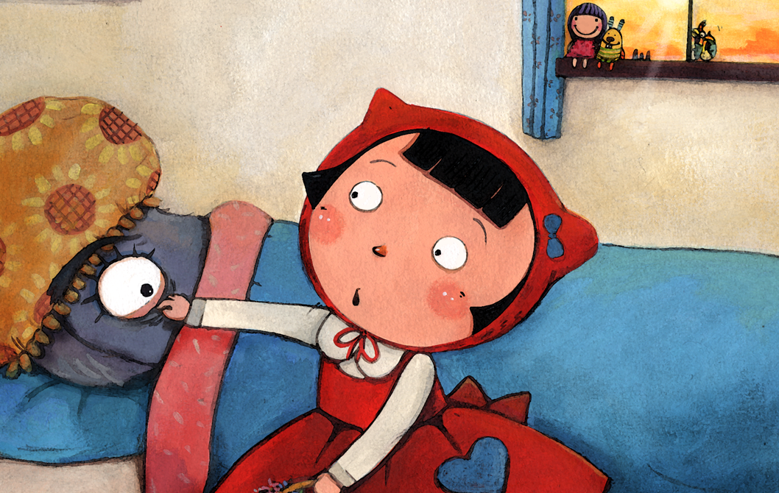
「奶奶，奶奶，我來看妳了！妳的眼睛好大呀！」
「因為我想看清楚妳的樣子！」
Notes:
奶奶
Grandma,
奶奶
Grandma,
我來看妳了
I've come to visit you!
妳的眼睛好大呀
What big eyes you have!
因為我想看清楚妳的樣子
The better to see you with, my dear!

Slide 10
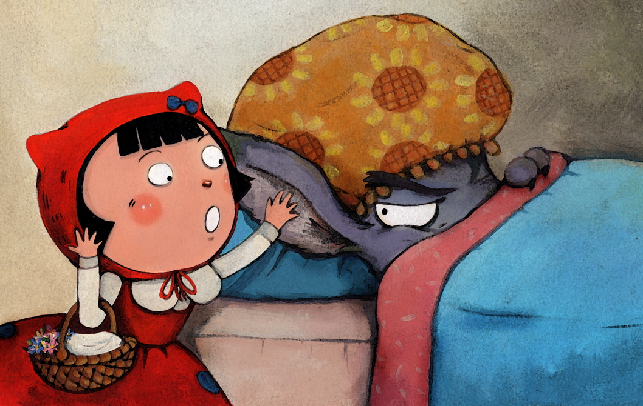
「奶奶，妳的耳朵好大呀！」
「因為我想聽清楚妳的聲音！」
Notes:
奶奶
Grandmother,
妳的耳朵好大呀
what big ears you have!
因為我想聽清楚妳的聲音
The better to hear you with, my dear!

Slide 11
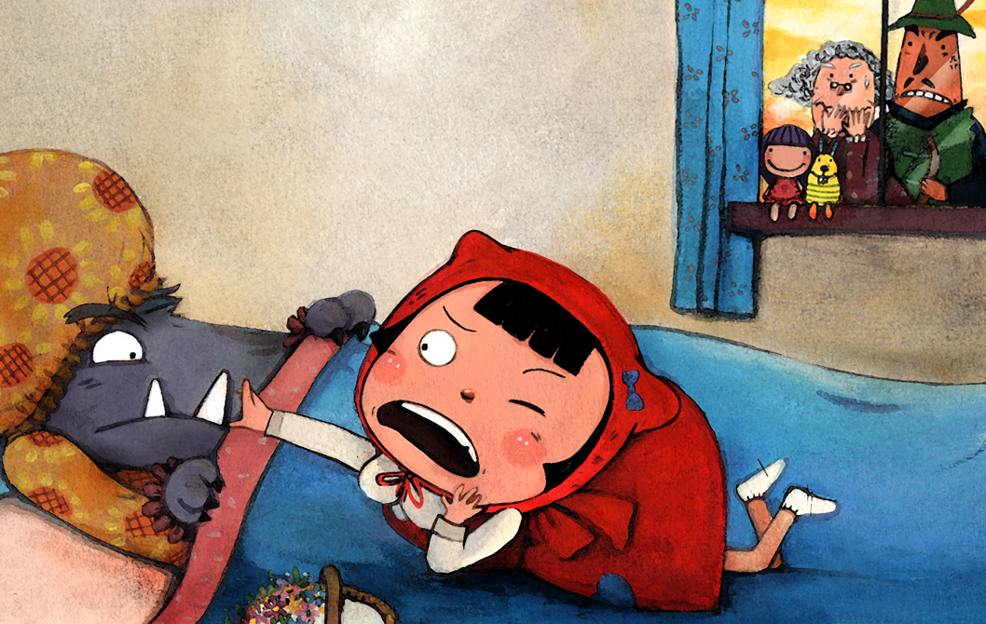
「奶奶，妳的牙齒好大呀！」
「因為…我想吃了妳！」
Notes:
奶奶
Grandmother,
妳的牙齒好大呀
what big teeth you have!
因為
Because
我想吃了妳
The better to… eat you with!

Slide 12
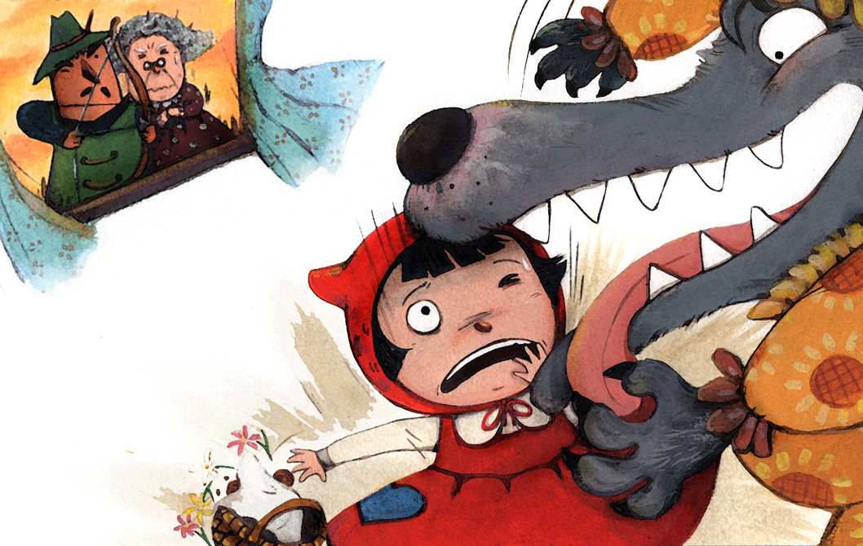
小紅帽趕快逃離那隻狼。
這時候，獵人和奶奶也趕來了。
Notes:
小紅帽趕快逃離那隻狼
Little Red-Cap quickly escaped from the wolf.
這時候
At that moment,
獵人和奶奶也趕來了
the hunter and Grandmother showed up.

Slide 13
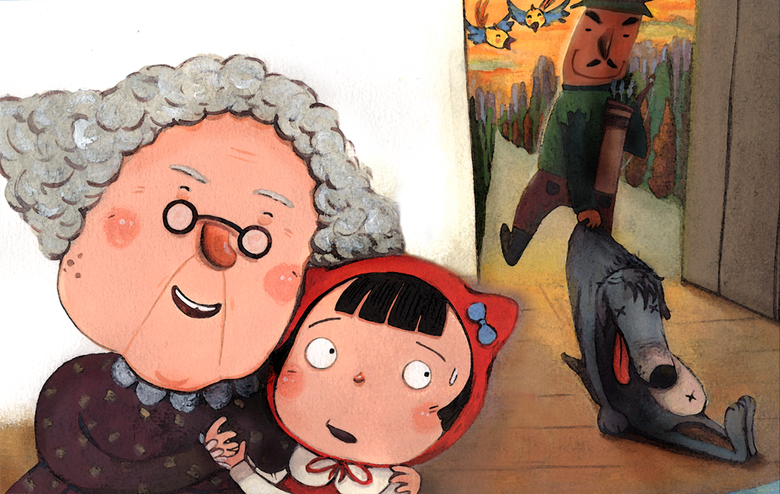
「奶奶，我好害怕！」
「別怕，已經沒事了。」
Notes:
奶奶
Grandmother,
我好害怕
I'm so frightened!
別怕
Don't be afraid.
已經沒事了
Everything will be all right.

