Slide 1
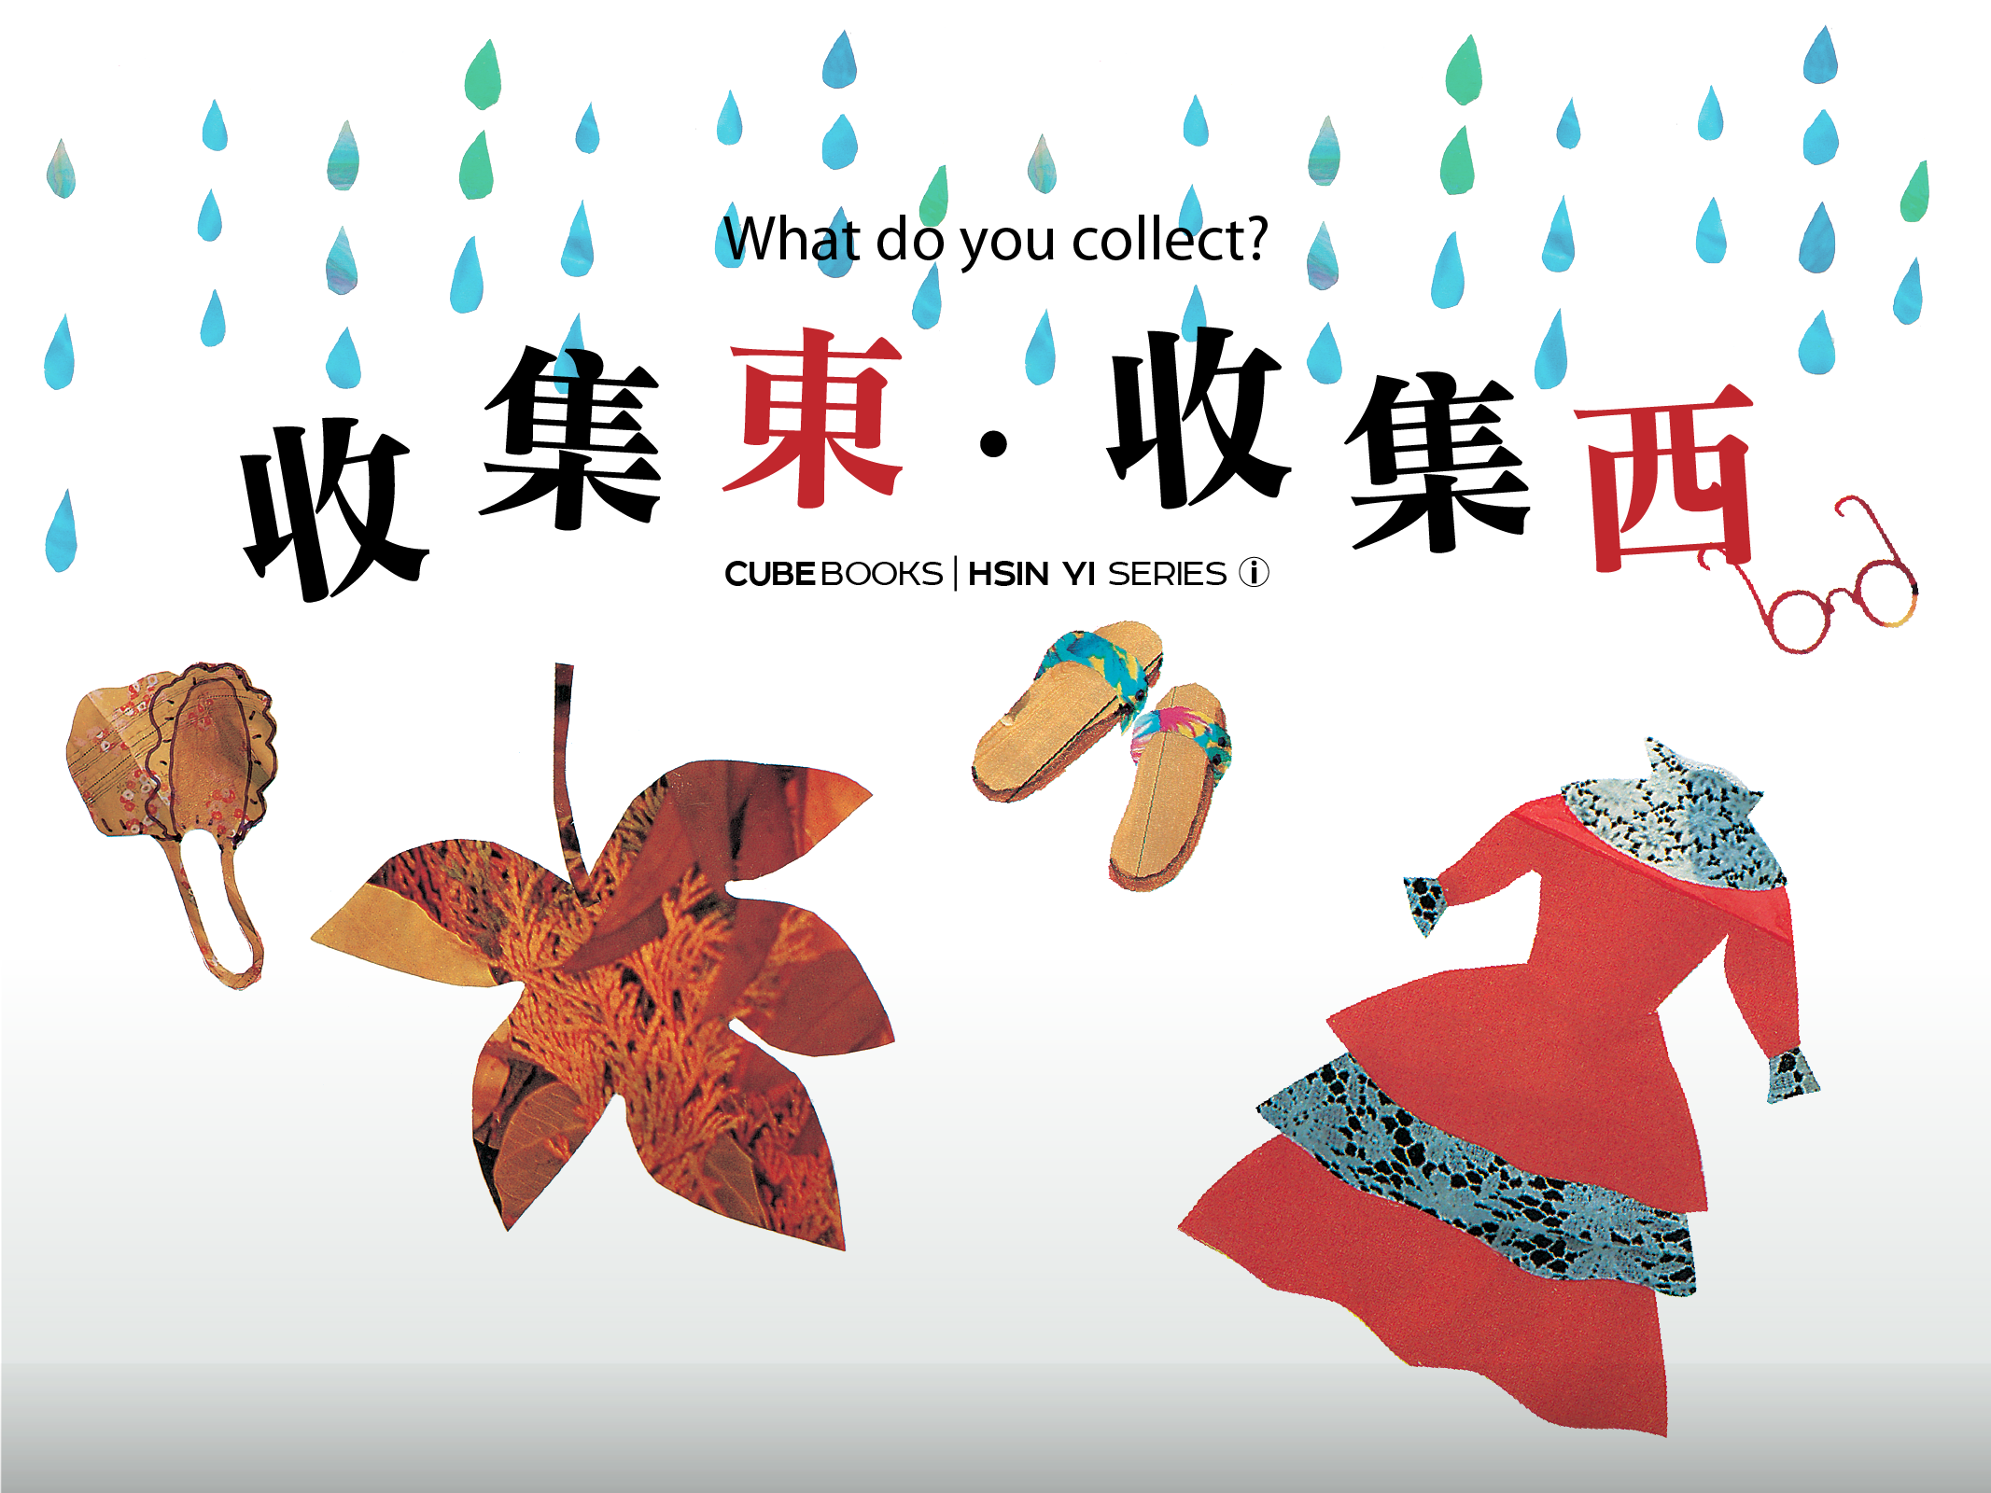

Slide 2
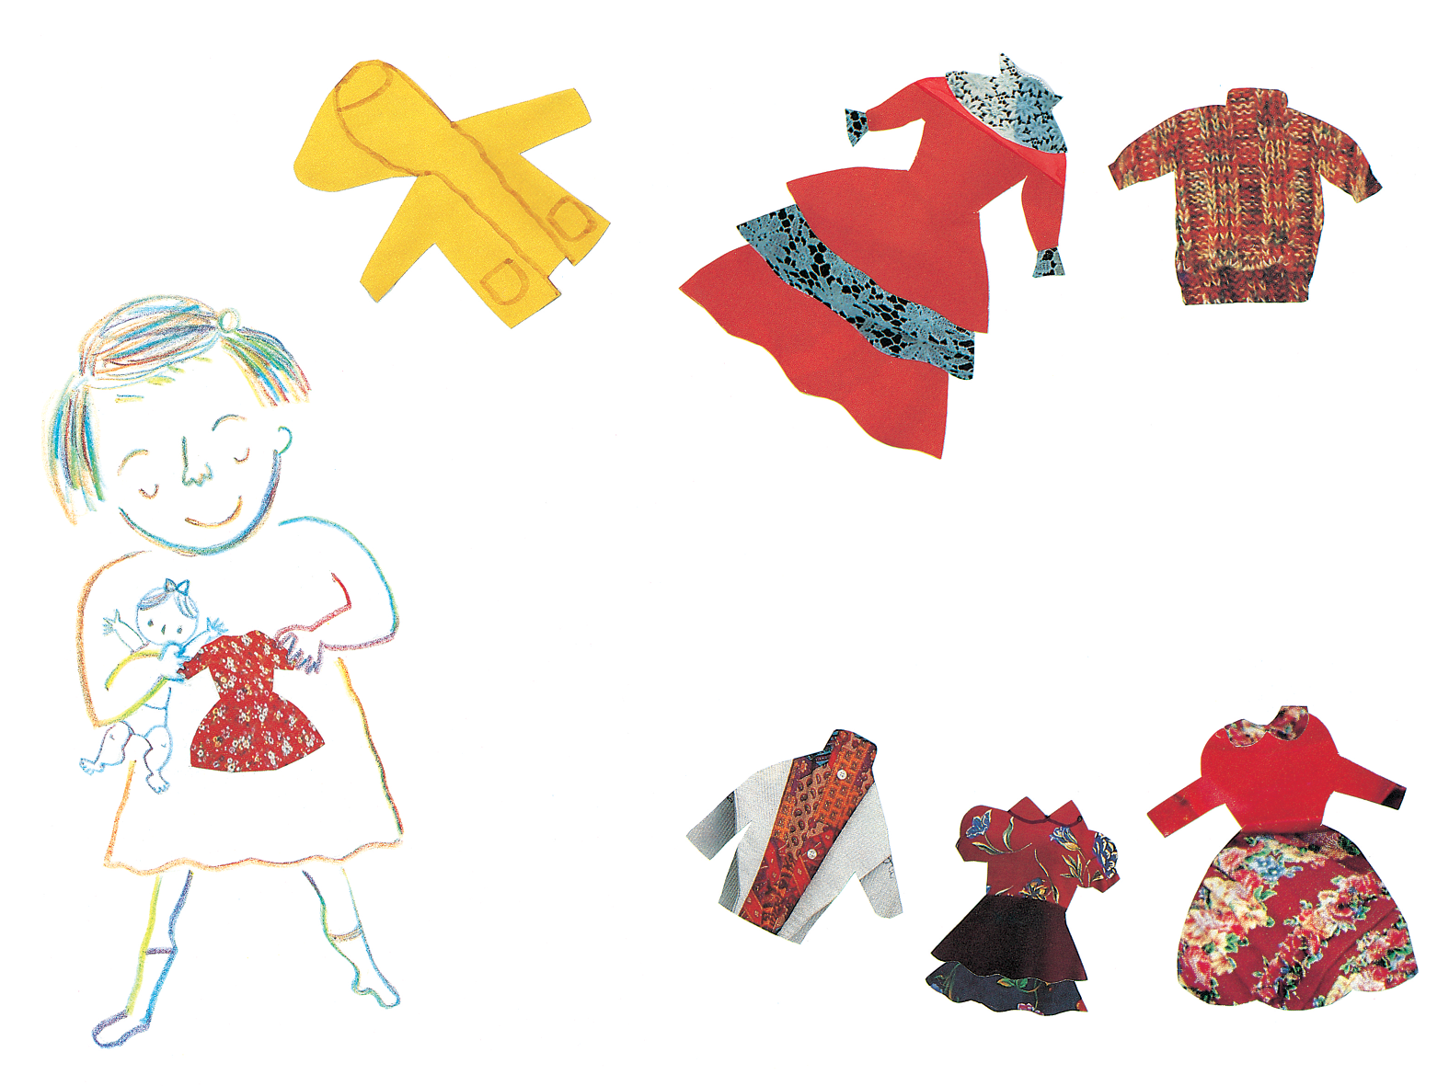
收集東，收集西，
你喜歡收集什麼東西？
我喜歡收集娃娃衣
Notes:
To collect things from one side, to collect from the other side.
What kind of things do you like to collect?
I like to collect dolls' clothing.

Slide 3
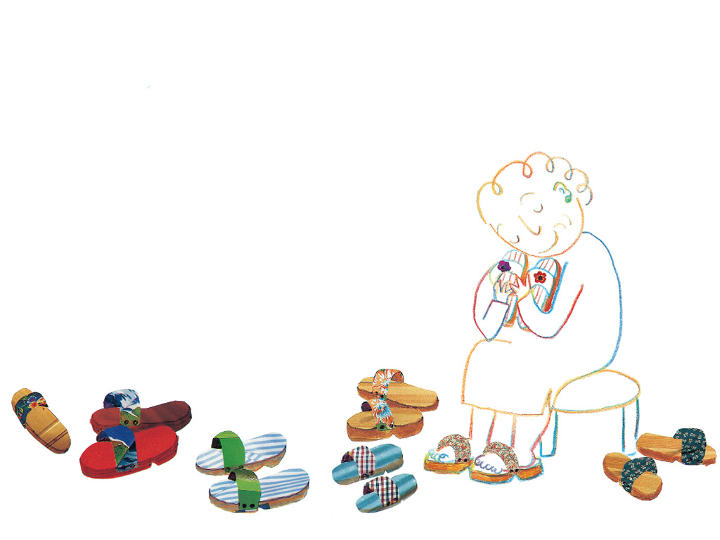
奶奶喜歡收集木屐
Notes:
Grandmother likes to collect wooden clogs.

Slide 4
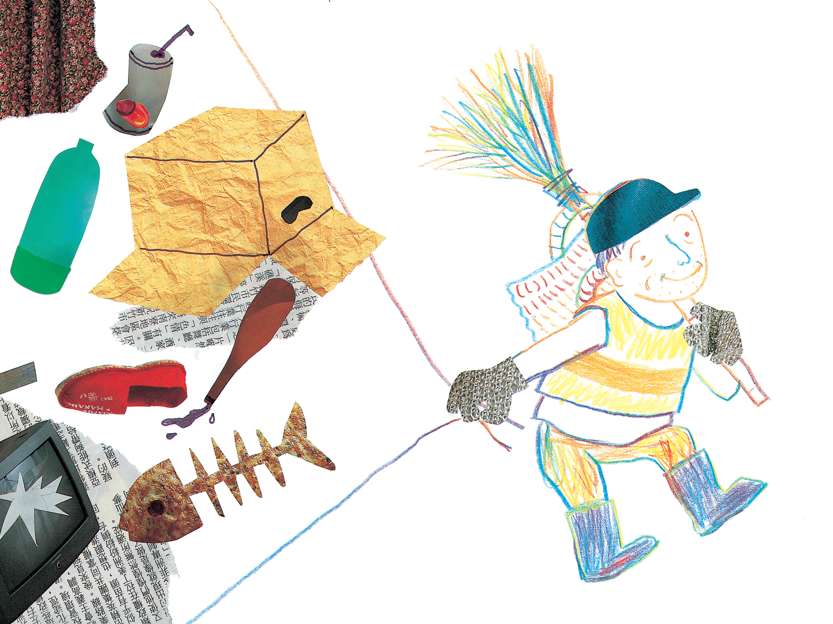
清潔伯伯收集很多很多垃圾。
Notes:
The garbage man collects lots and lots of garbage.

Slide 5
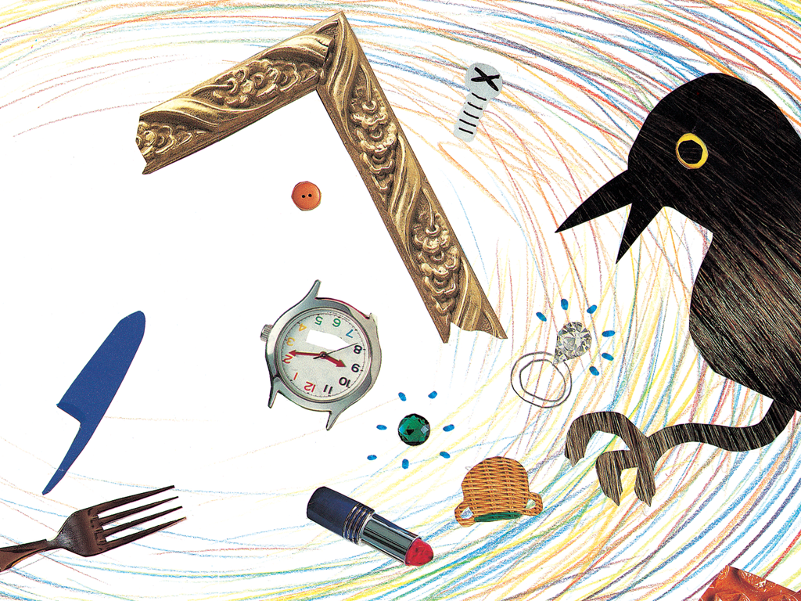
樹上的烏鴉
收集了一堆怪東西。
Notes:
The crow on the tree collects a pile of strange things.

Slide 6
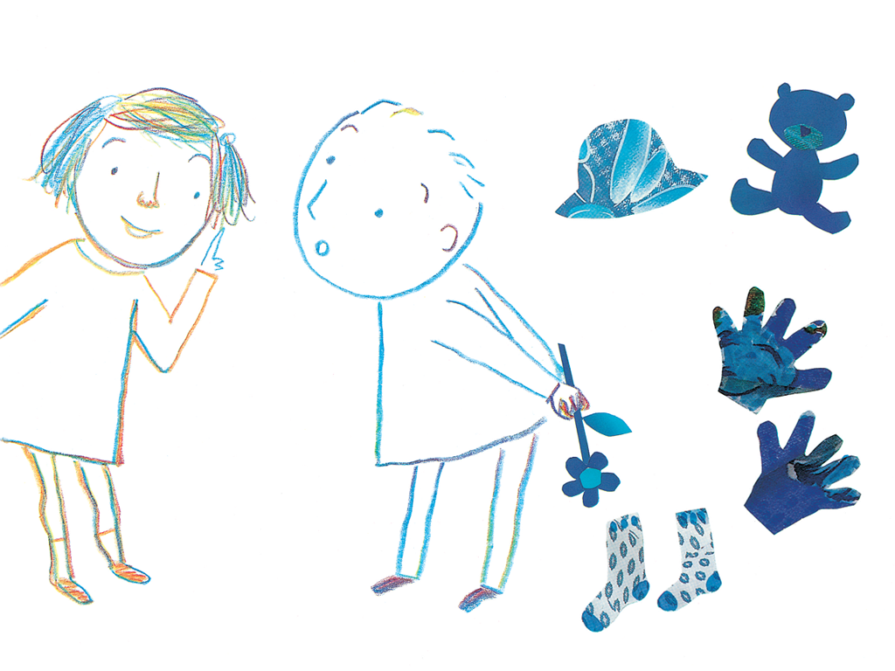
我問隔壁的圓圓：
「你喜歡收集什麼東西？」
圓圓問我：
「『藍色』算不算是東西？」
Notes:
I asked the next door's child named Yuan Yuan.
“What kinds of things do you like to collect?”
Yuan Yuan asked me,
“Does the color blue be considered as a theme?”

Slide 7
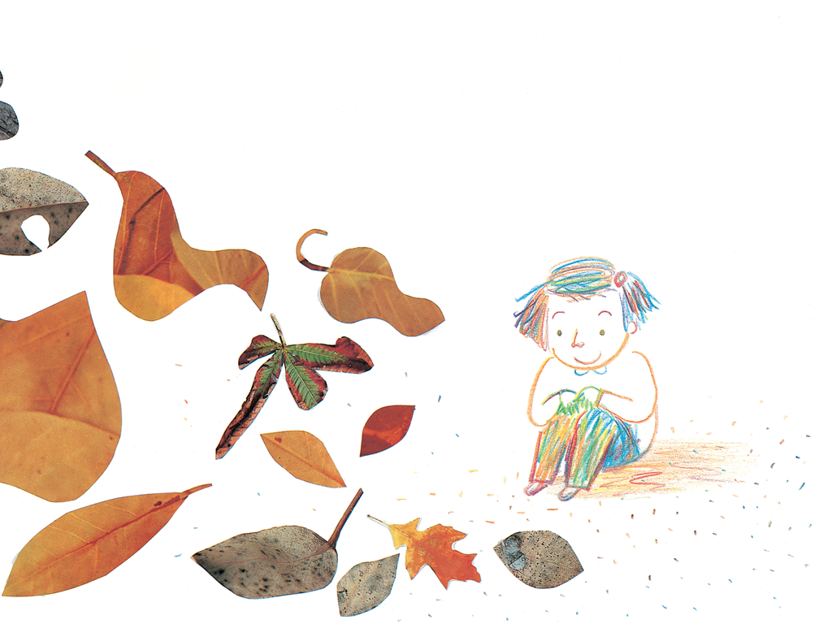
奶奶喜歡收集木屐
Notes:
Autumn likes to collect falling leaves.

Slide 8
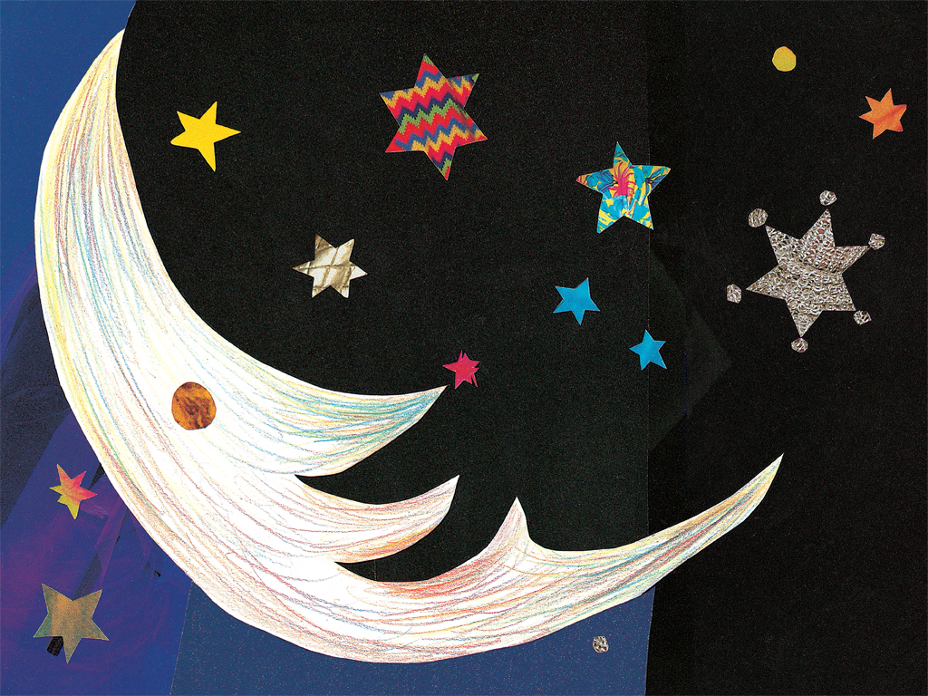
月亮喜歡收集星星
Notes:
The moon likes to collect stars.

Slide 9
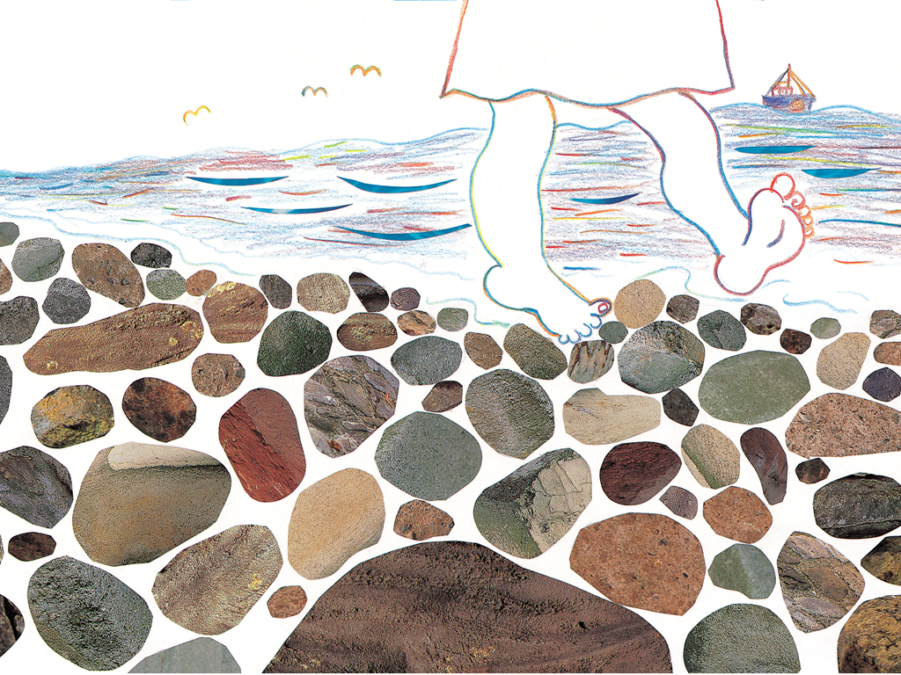
海邊收集了很多很多石頭。
Notes:
The seaside collected many, many stones.

Slide 10
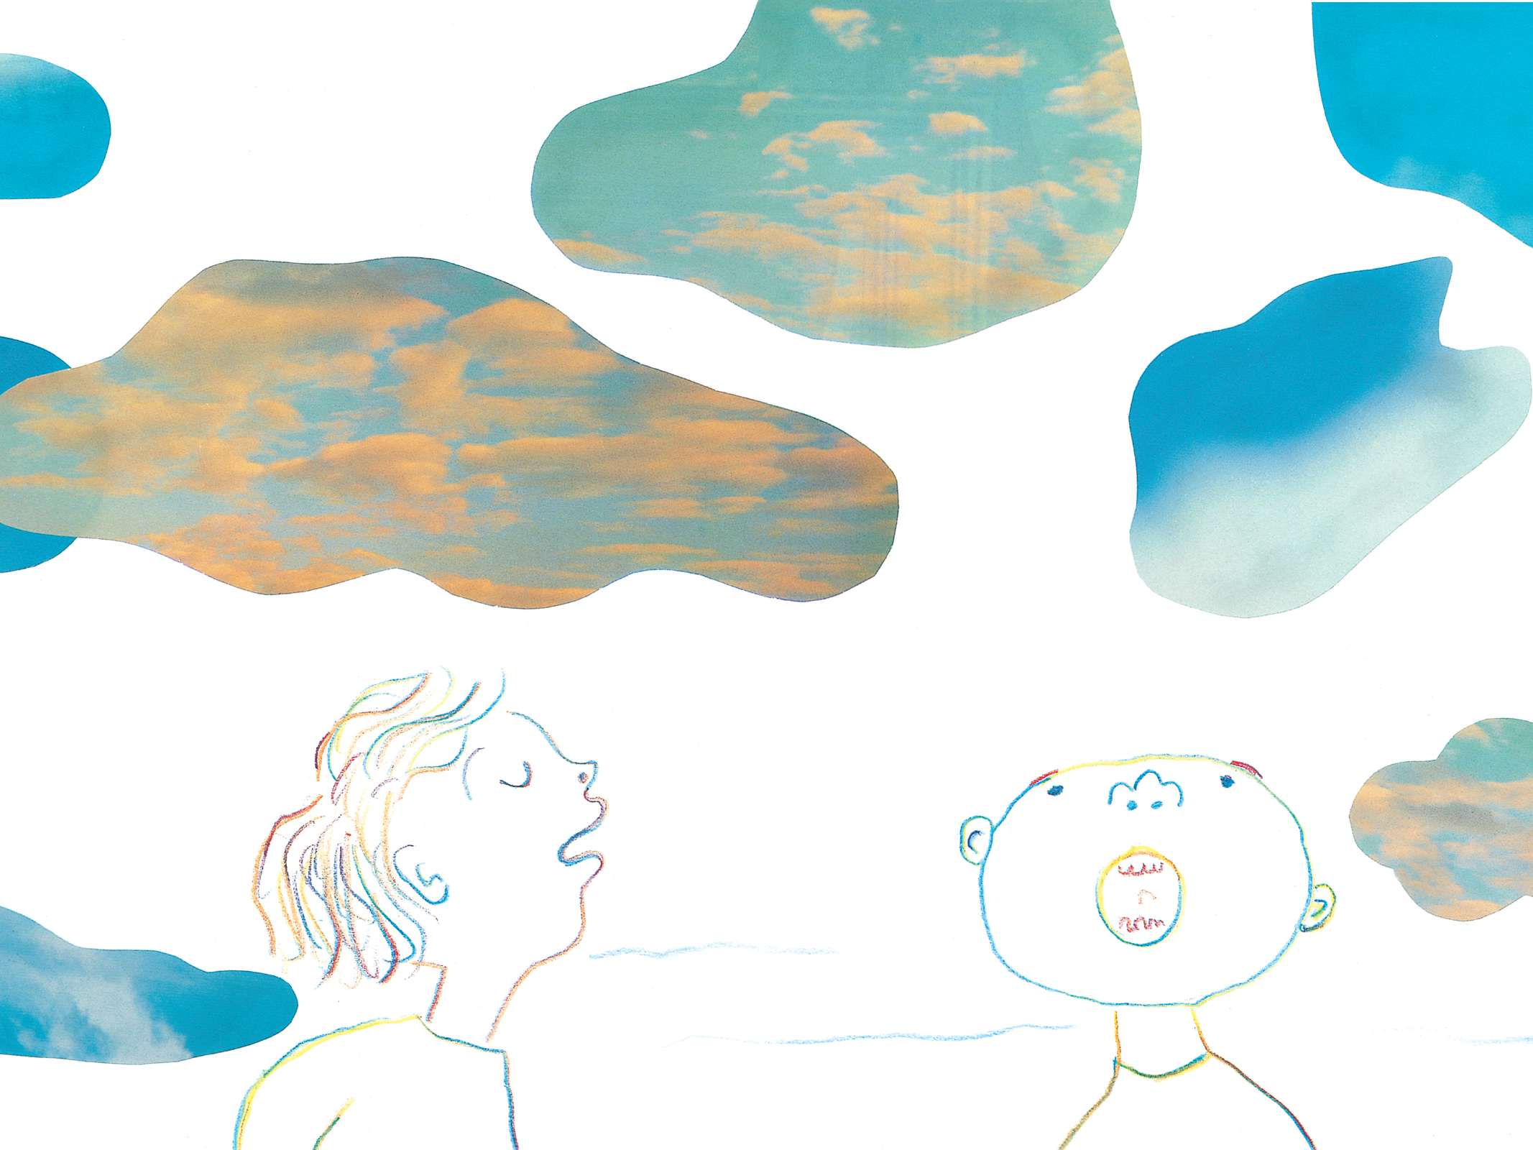
天空喜歡收集雲。
Notes:
The sky collects clouds.

Slide 11
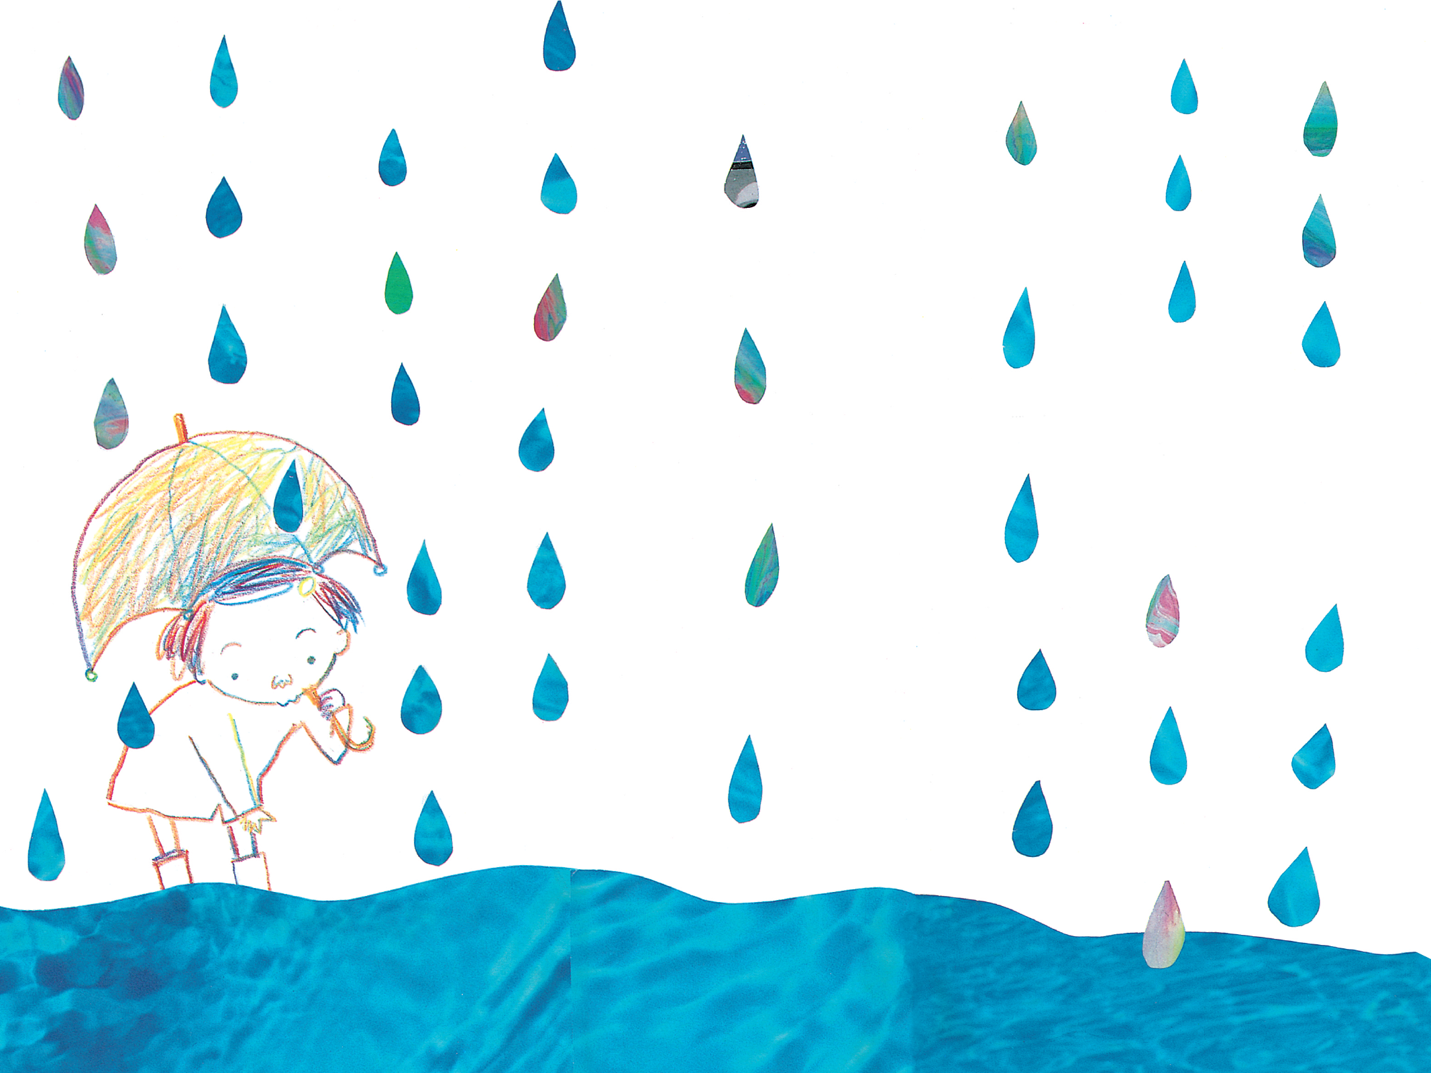
小溪喜歡收集雨滴。
Notes:
The little creek likes to collect raindrops.

Slide 12
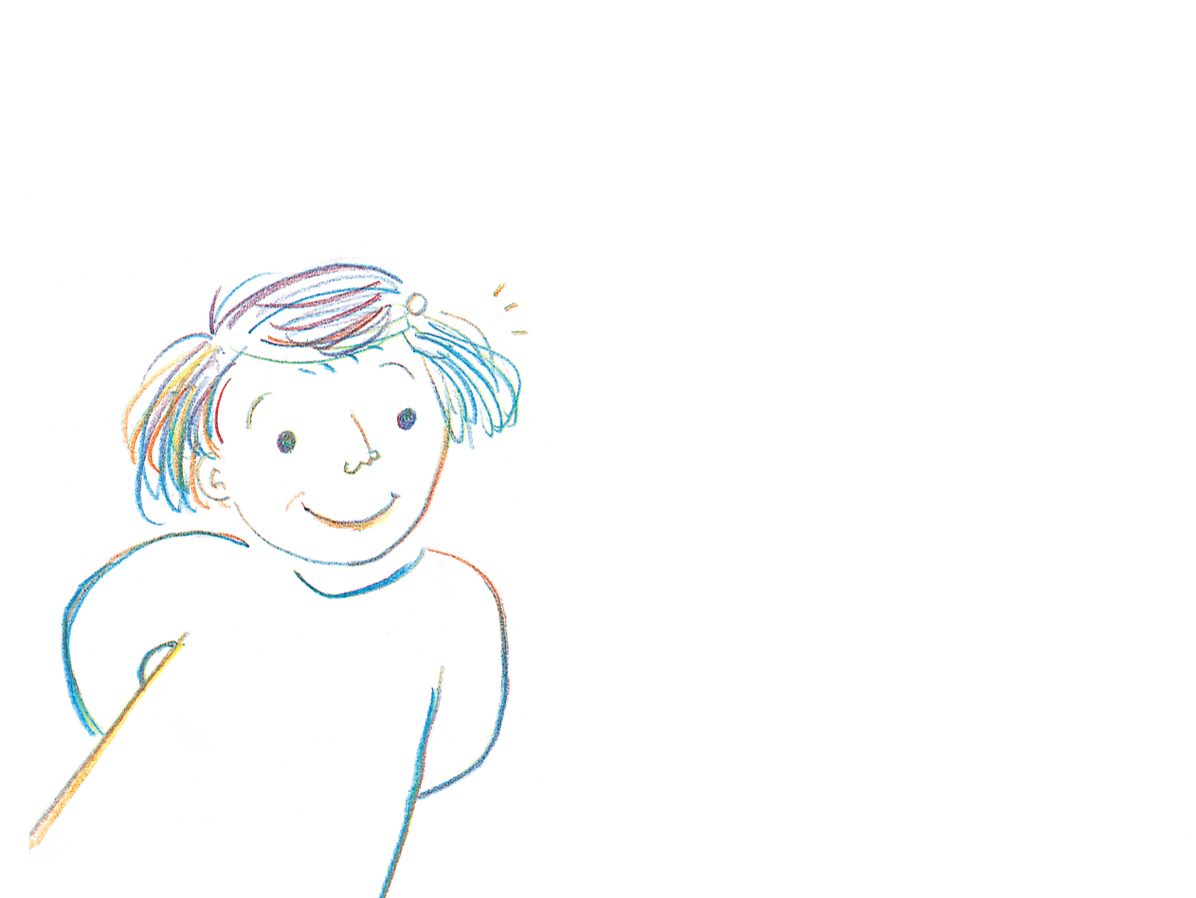
我問媽媽：
「你喜歡收集什麼東西？」
Notes:
I asked my mother
'What do you like to collect?'

Slide 13
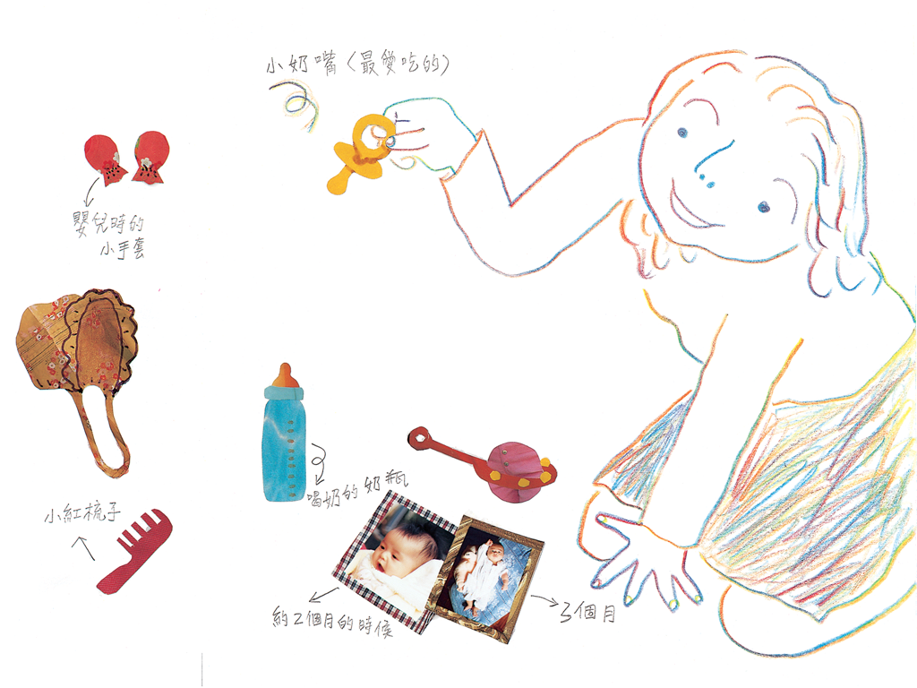
媽媽說：
「我收集的都是
『你的』東西阿！」
Notes:
Mother said
'I collected all
your things.'

