Slide 1


Slide 2
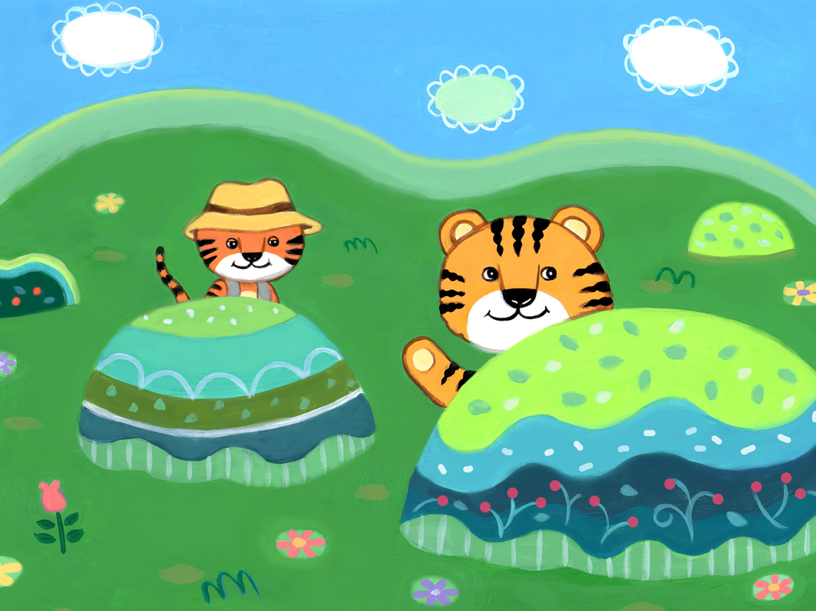
兩隻老虎
Notes:
two tigers

Slide 3
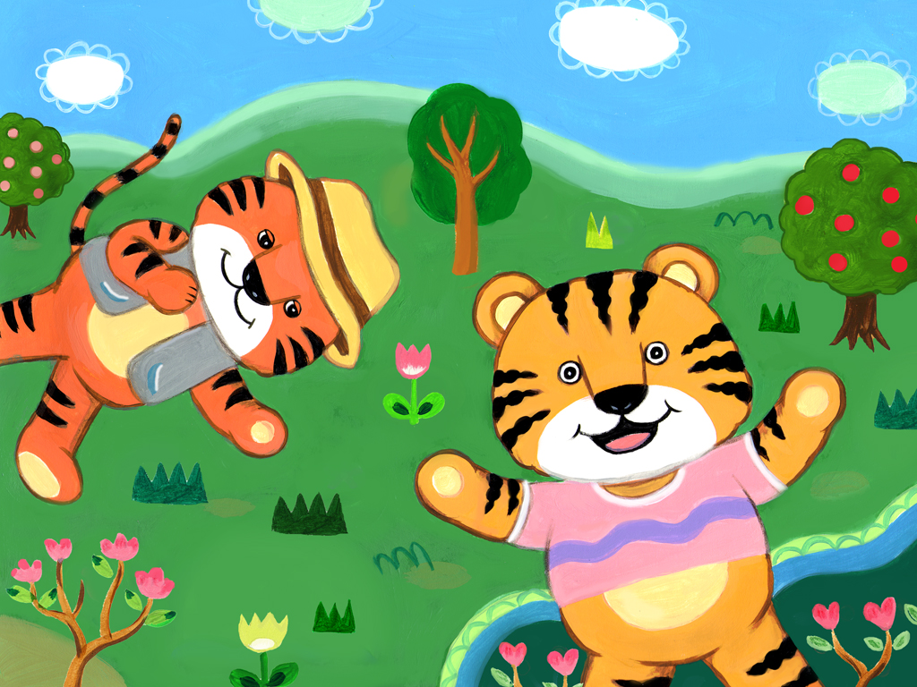
兩隻老虎
Notes:
two tigers

Slide 4
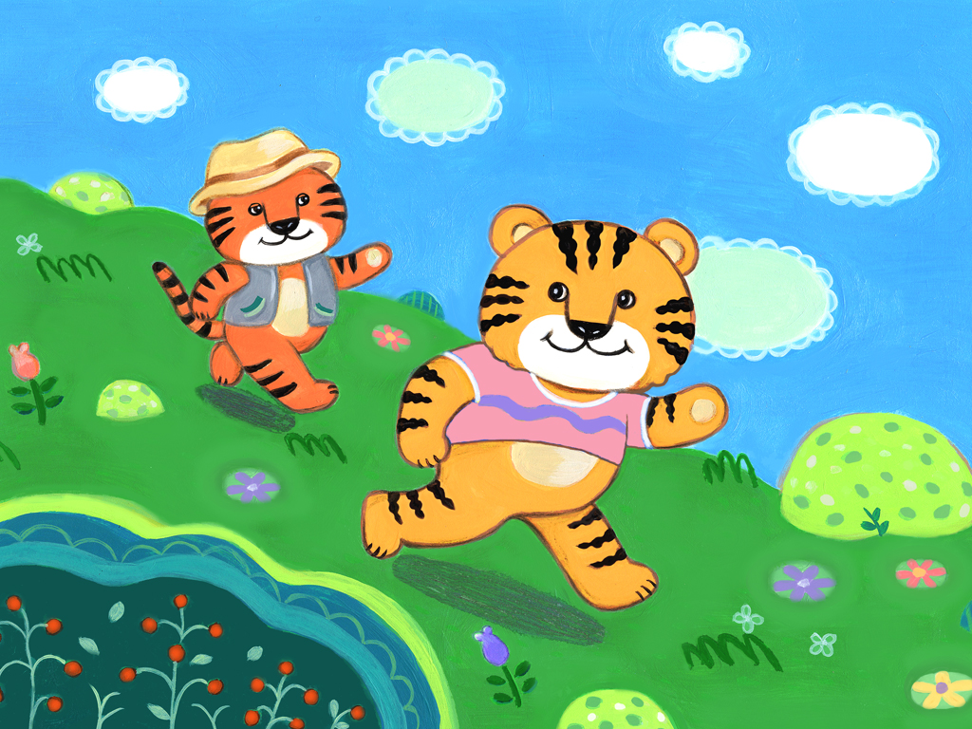
跑得快，跑得快。
Notes:
running fast,running fast

Slide 5
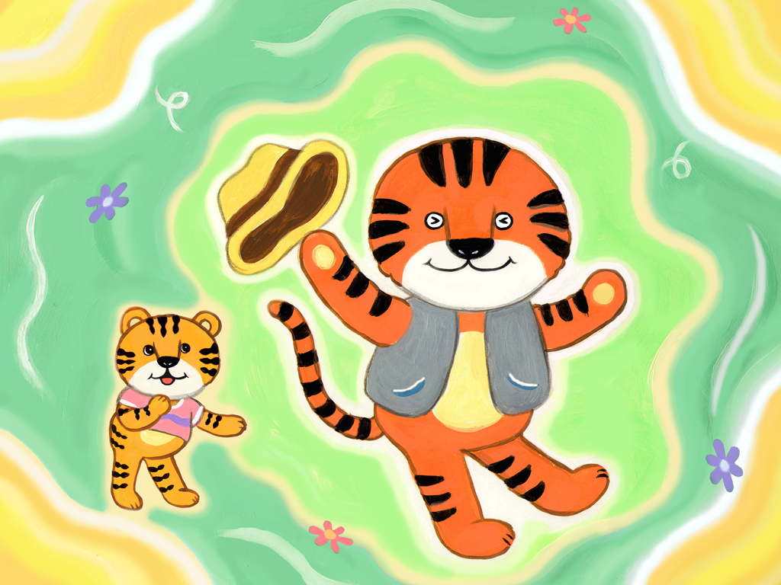
一隻沒有耳朵
Notes:
one doesn't have ears

Slide 6
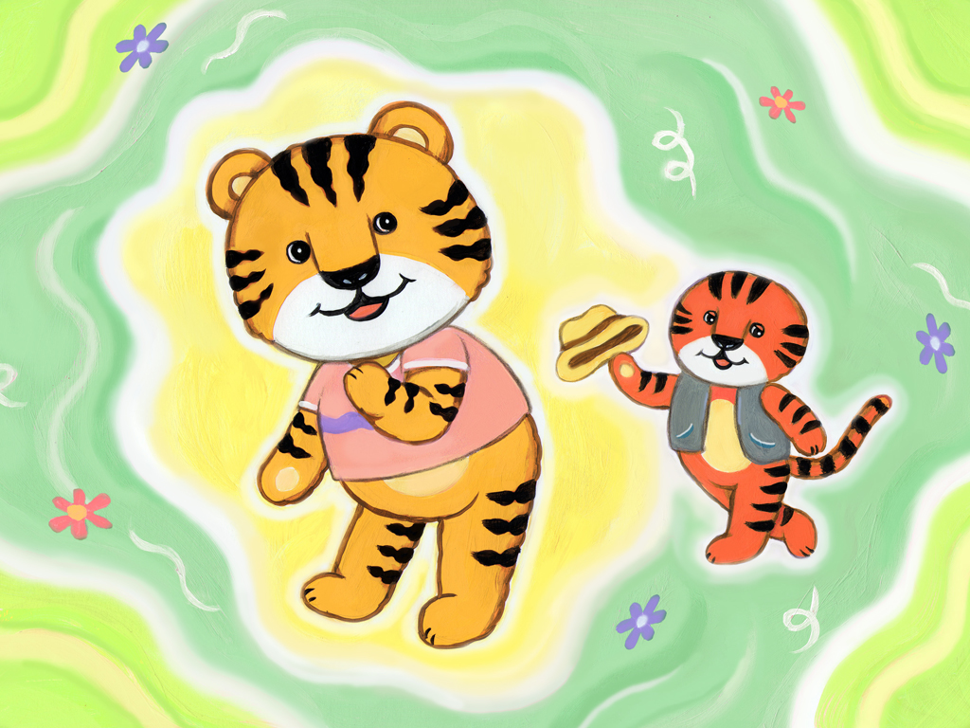
一隻沒有尾巴
Notes:
one doesn't have a tail

Slide 7
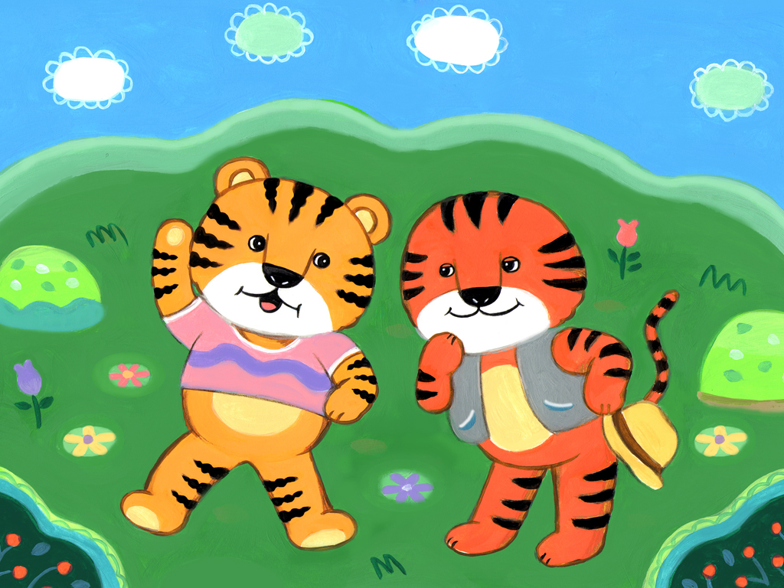
真奇怪，真奇怪。
Notes:
really strange,really strange.

