Slide 1


Slide 2
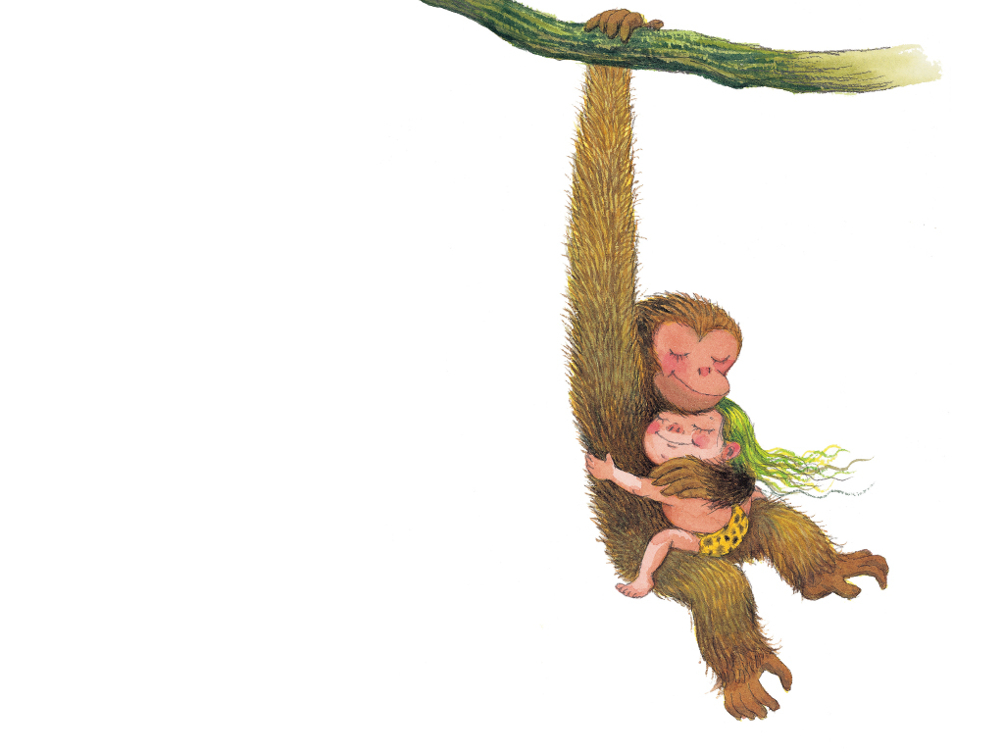
我想擁抱頑皮的猴子
Notes:
I want to hug a naughty monkey.

Slide 3
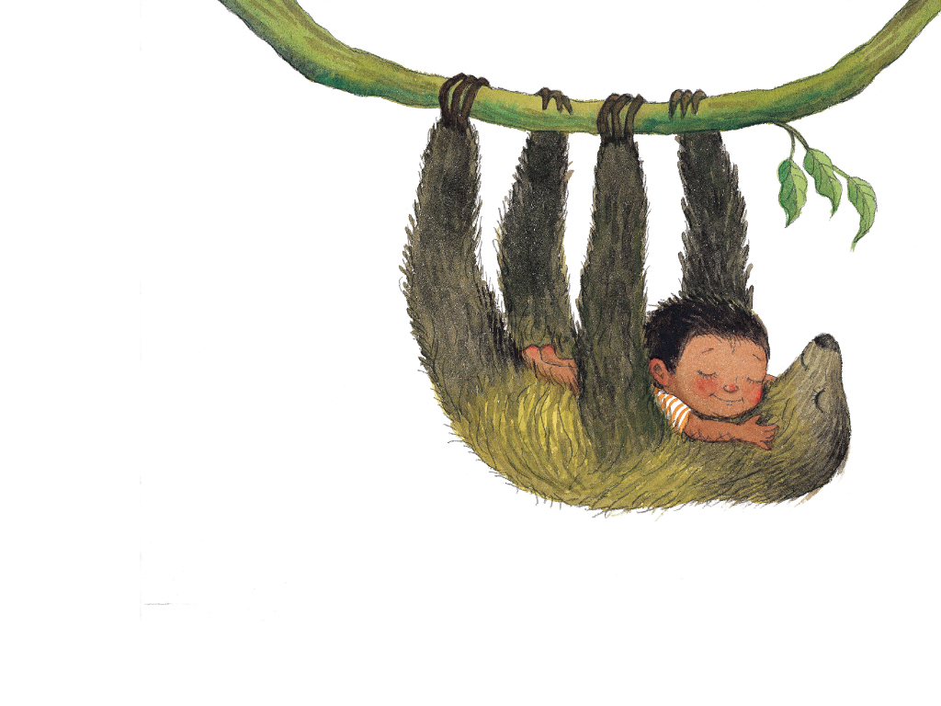
我想擁抱懶惰的樹懶
Notes:
I want to hug a lazy sloth.

