Slide 1


Slide 2

一個人
Notes:
One person

Slide 3

一位老師
Notes:
A teacher

Slide 4

一隻狗
Notes:
A dog

Slide 5

一本書
Notes:
A book

Slide 6
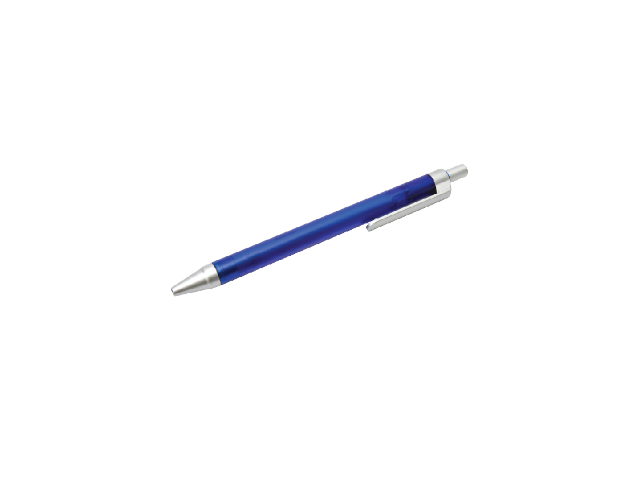
一枝筆
Notes:
A pen

Slide 7

一張紙
Notes:
A piece of paper

Slide 8
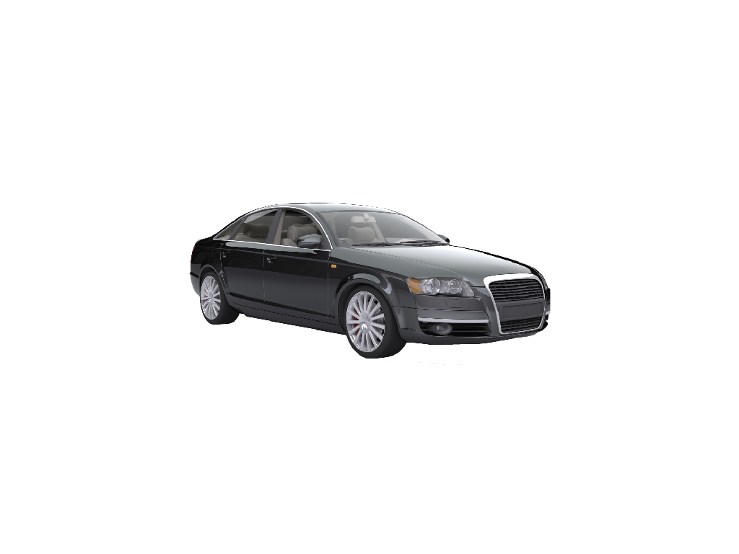
一臺車
Notes:
A car

Slide 9

一杯水
Notes:
A glass of water

Slide 10
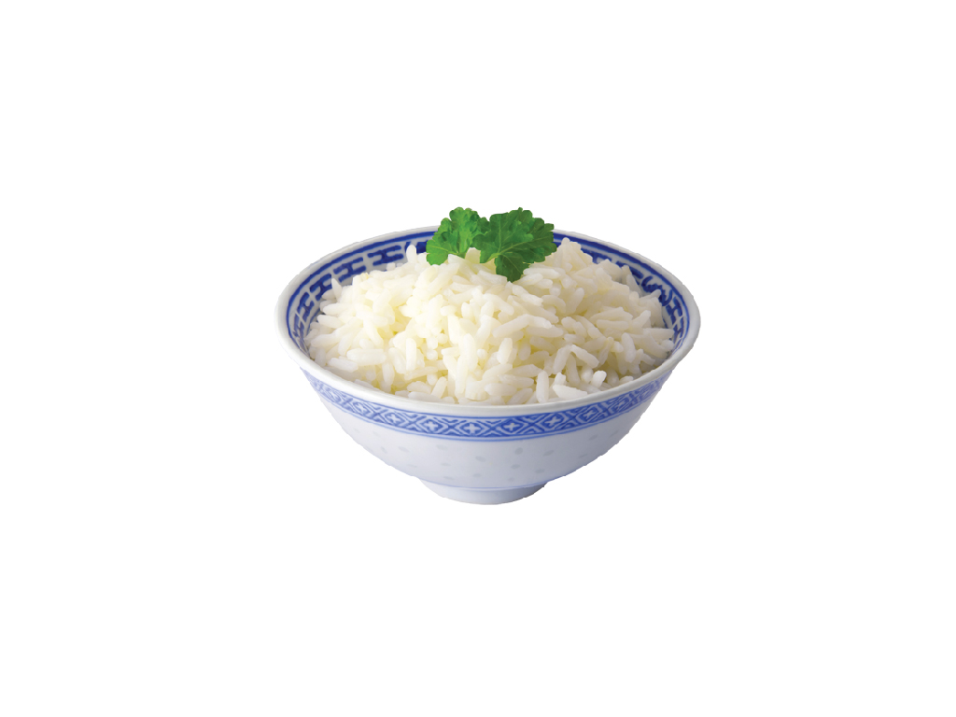
一碗飯
Notes:
A bowl of rice

Slide 11
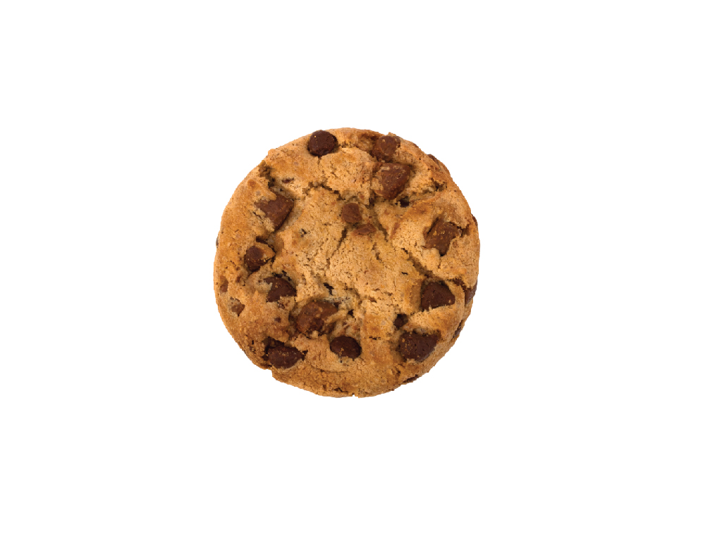
一片餅乾
Notes:
A cookie

