Slide 1
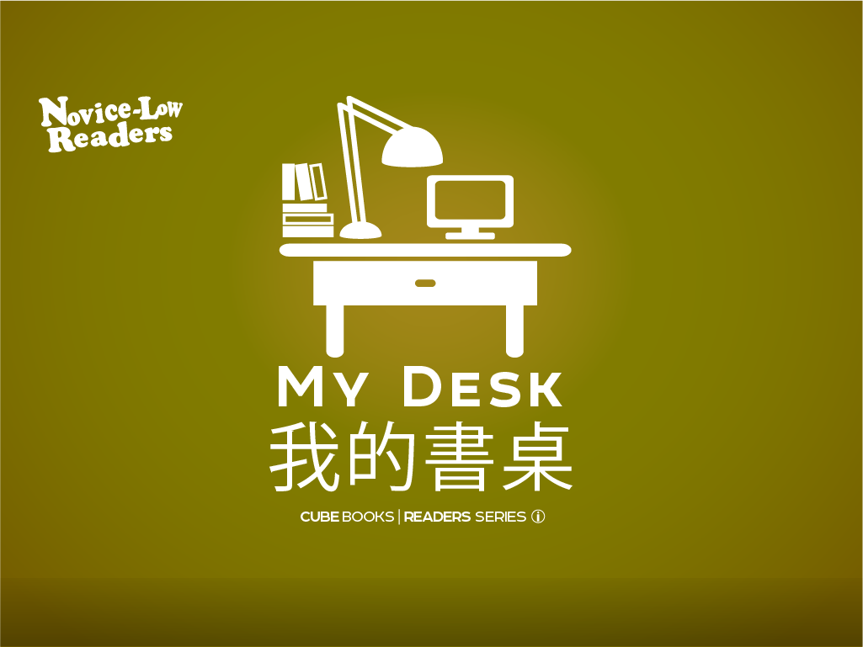

Slide 2
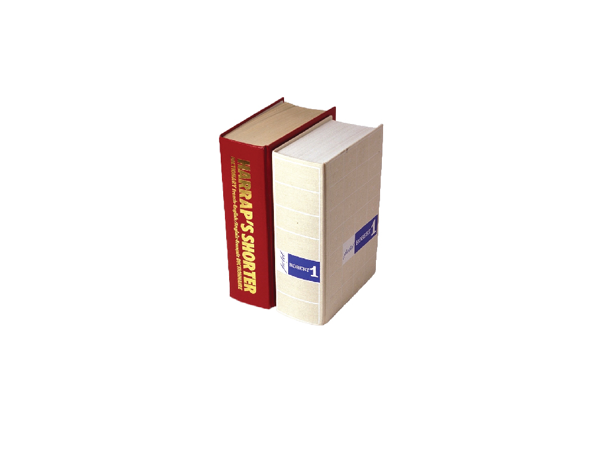
書
Notes:
book

Slide 3
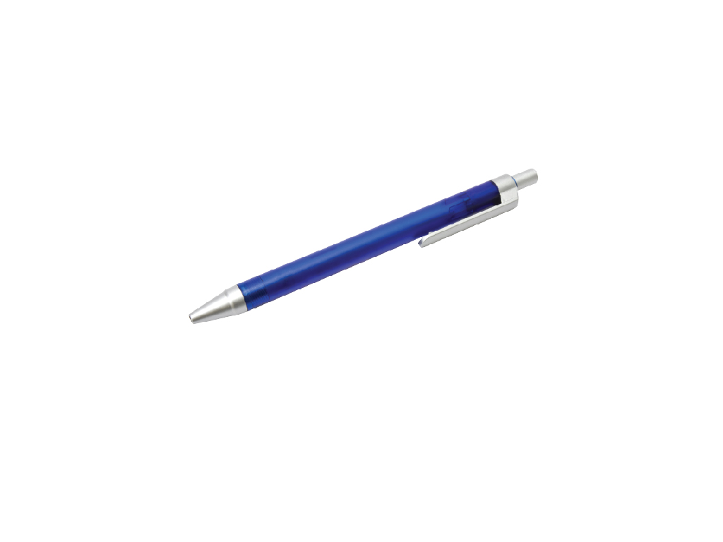
筆
Notes:
pen

Slide 4
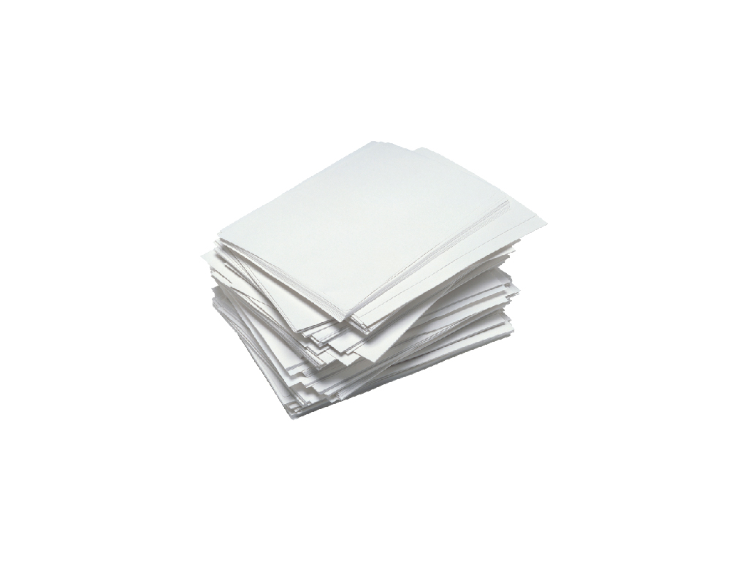
紙
Notes:
paper

Slide 5
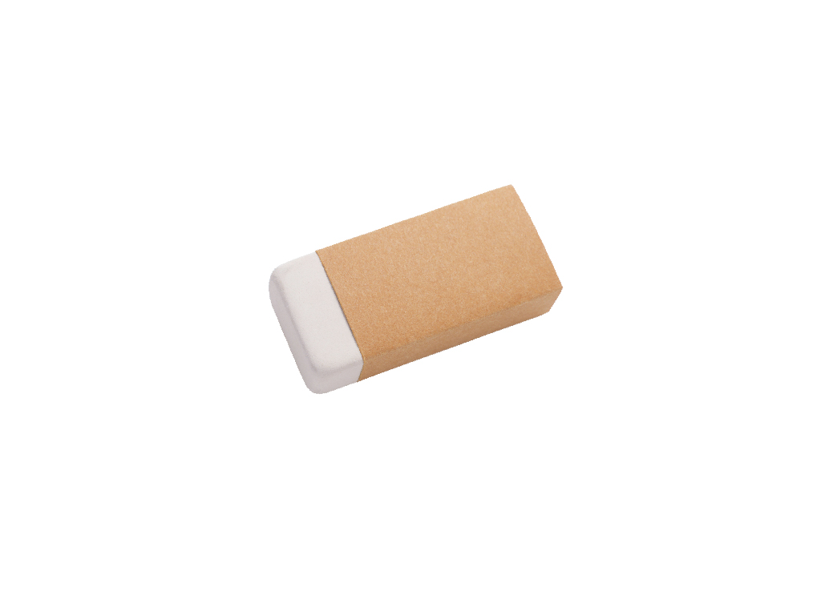
橡皮擦
Notes:
eraser

Slide 6
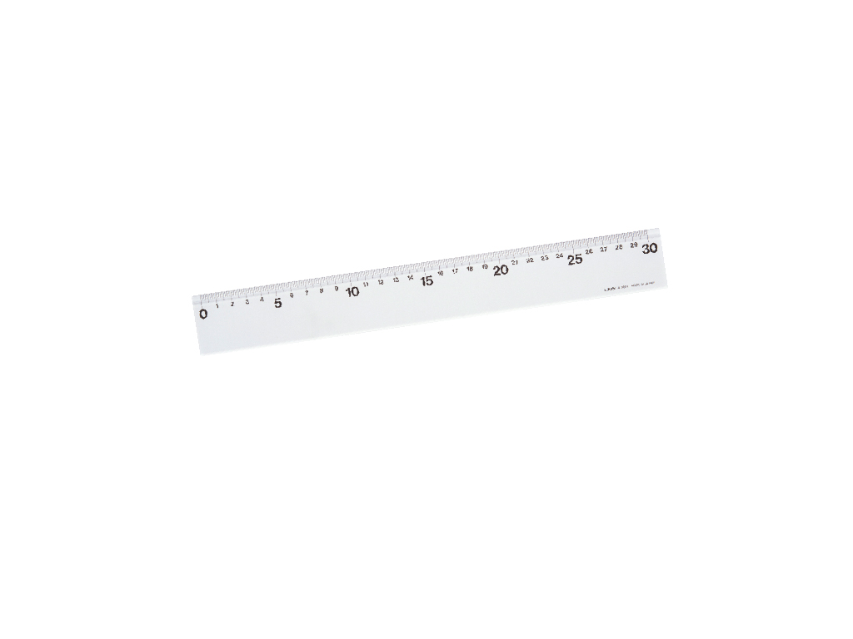
尺
Notes:
ruler

Slide 7
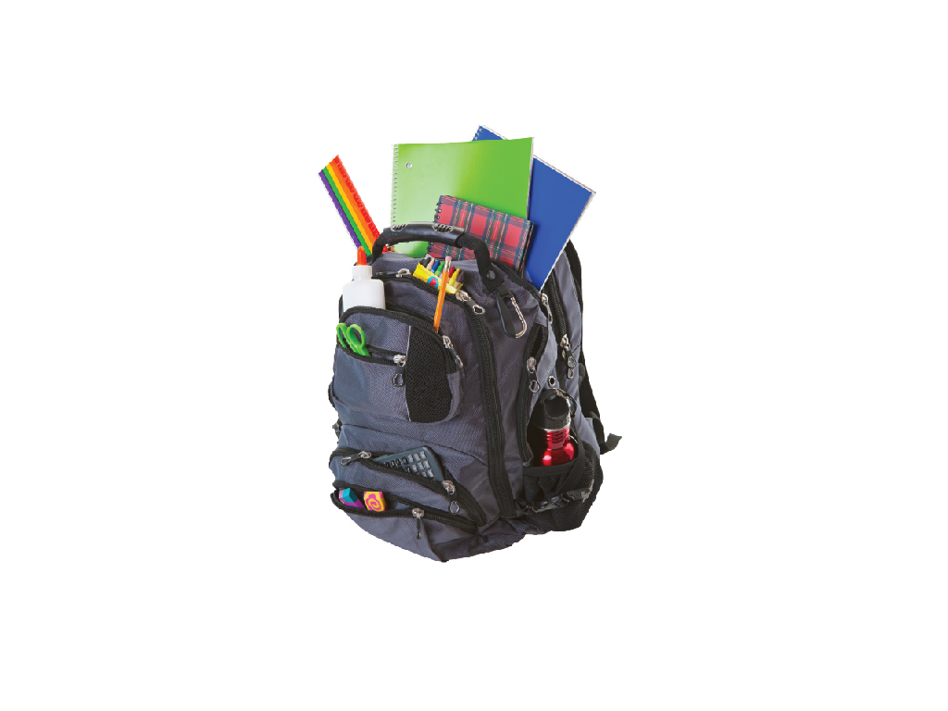
書包
Notes:
backpack

Slide 8

書架
Notes:
bookshelf

Slide 9
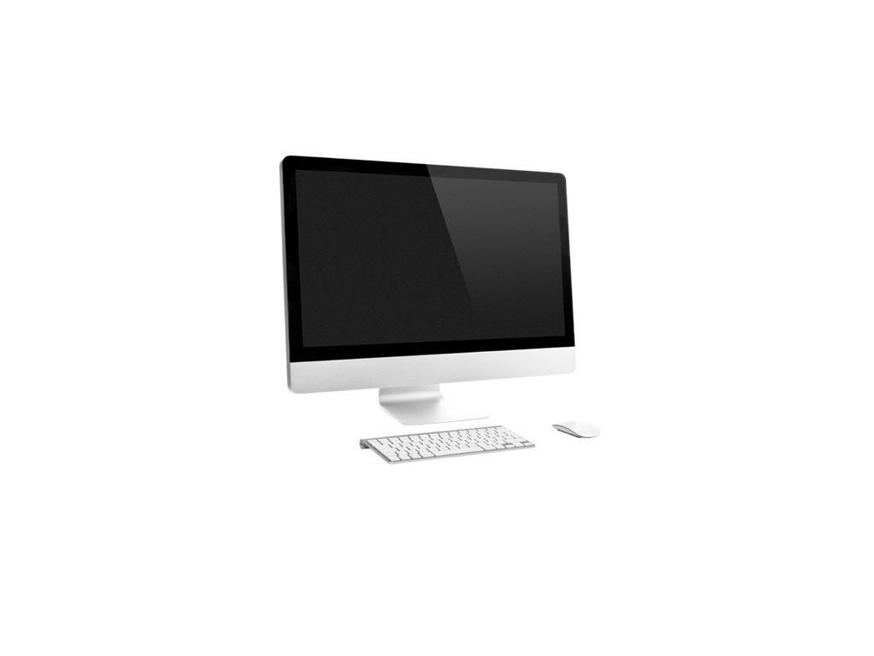
電腦
Notes:
computer

Slide 10
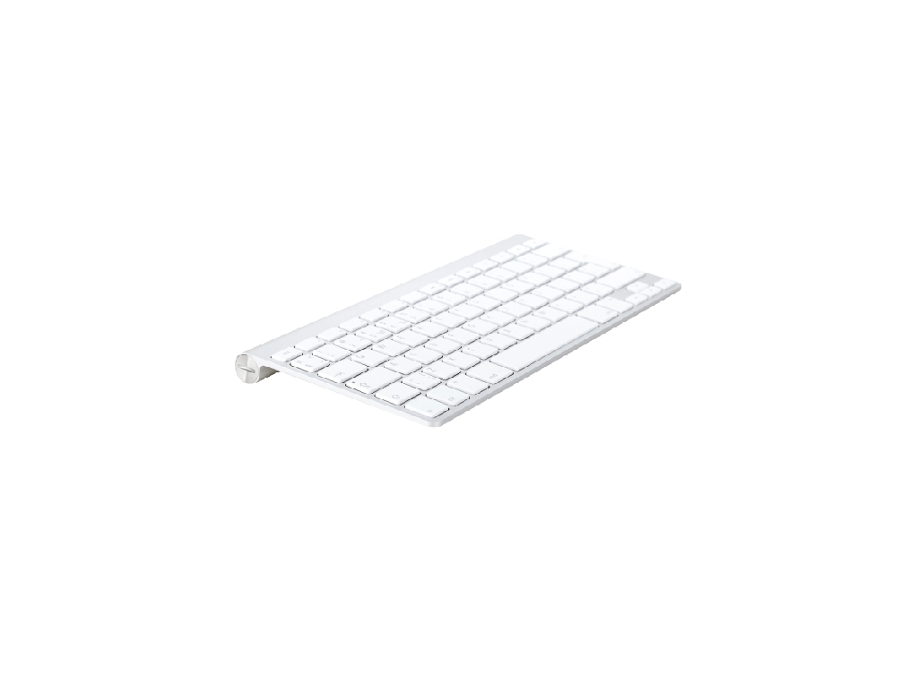
鍵盤
Notes:
keyboard

Slide 11
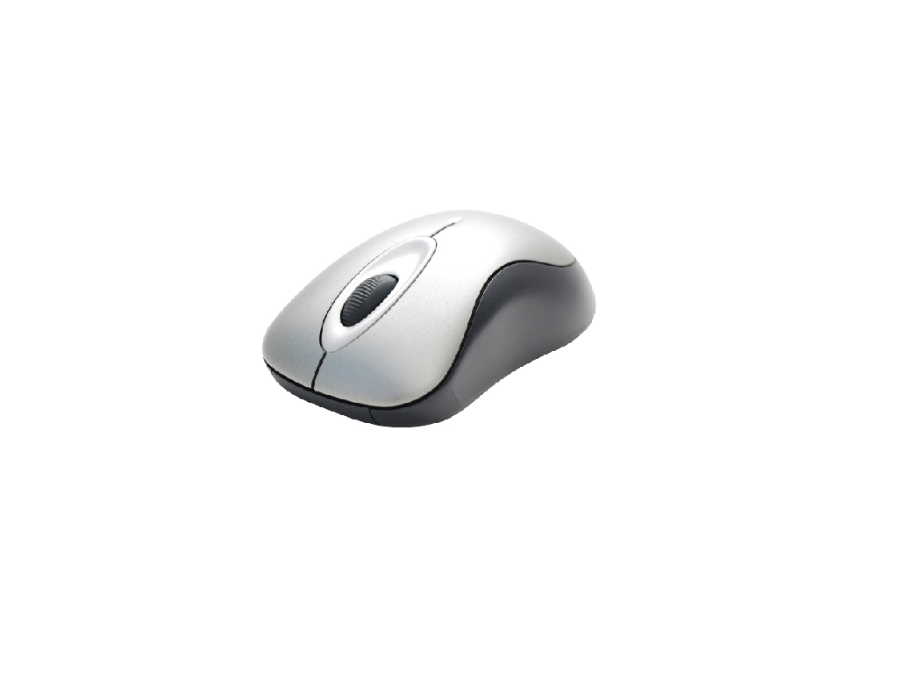
滑鼠
Notes:
computer mouse

Slide 12
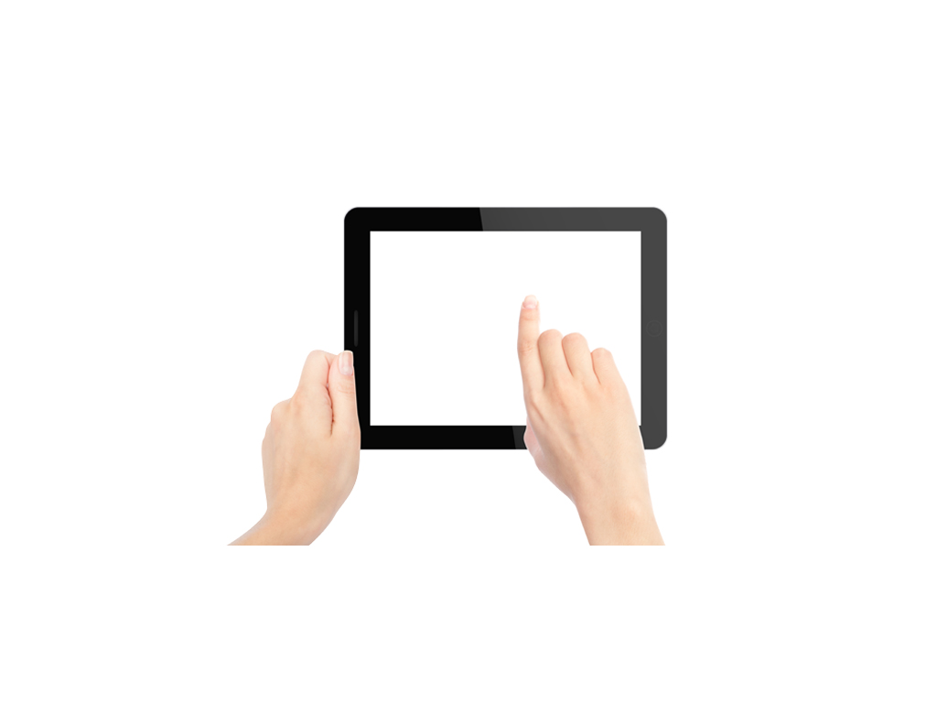
平板電腦
Notes:
tablet computer

Slide 13
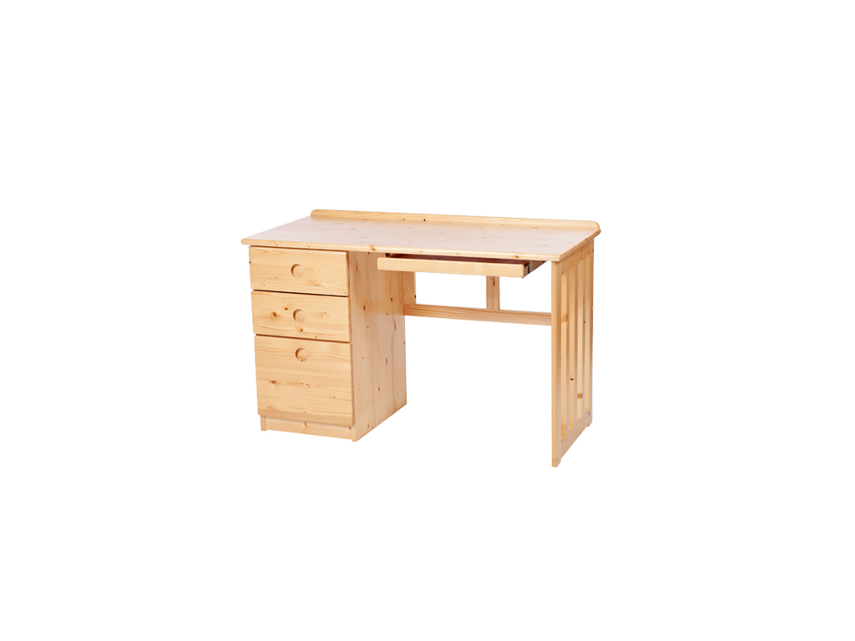
我的書桌
Notes:
My desk

