Slide 1
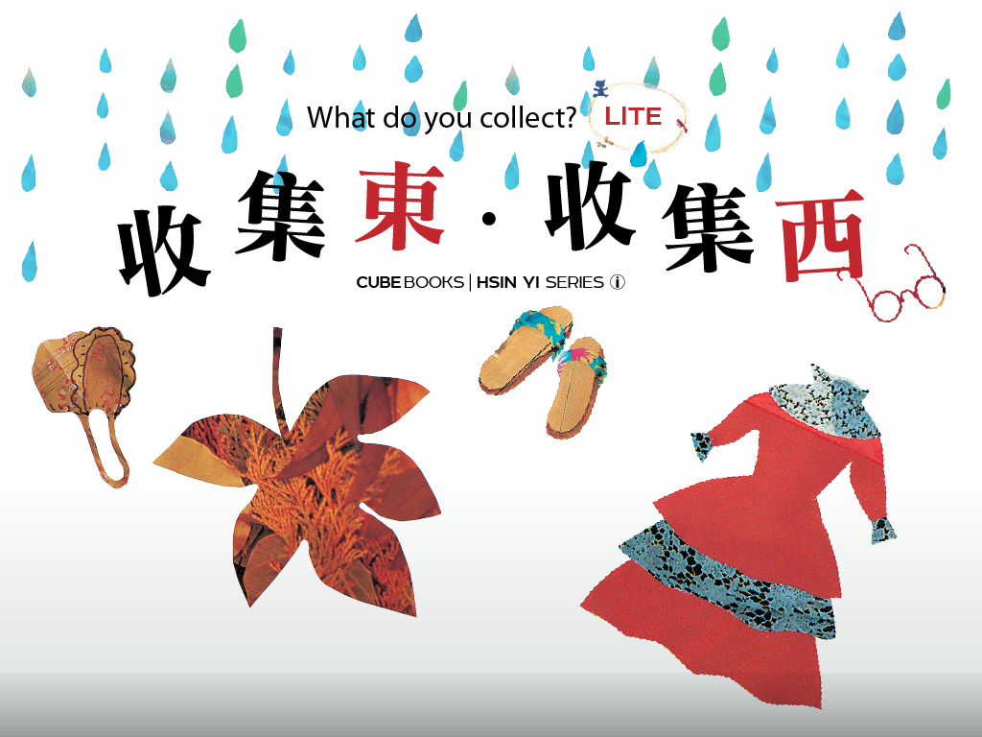

Slide 2
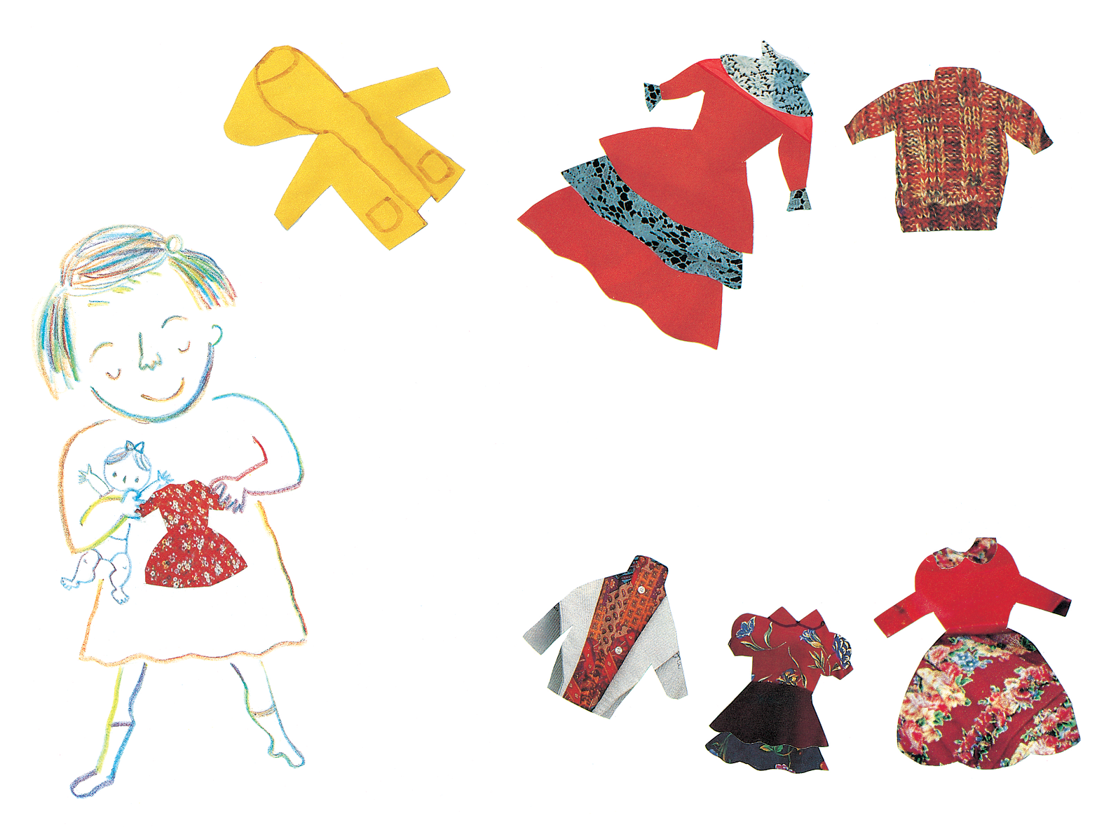
收集東，收集西，
你喜歡收集什麼東西？
我喜歡收集娃娃衣
Notes:
To collect things from one side, to collect from the other side.
What kind of things do you like to collect?
I like to collect dolls' clothing.

Slide 3
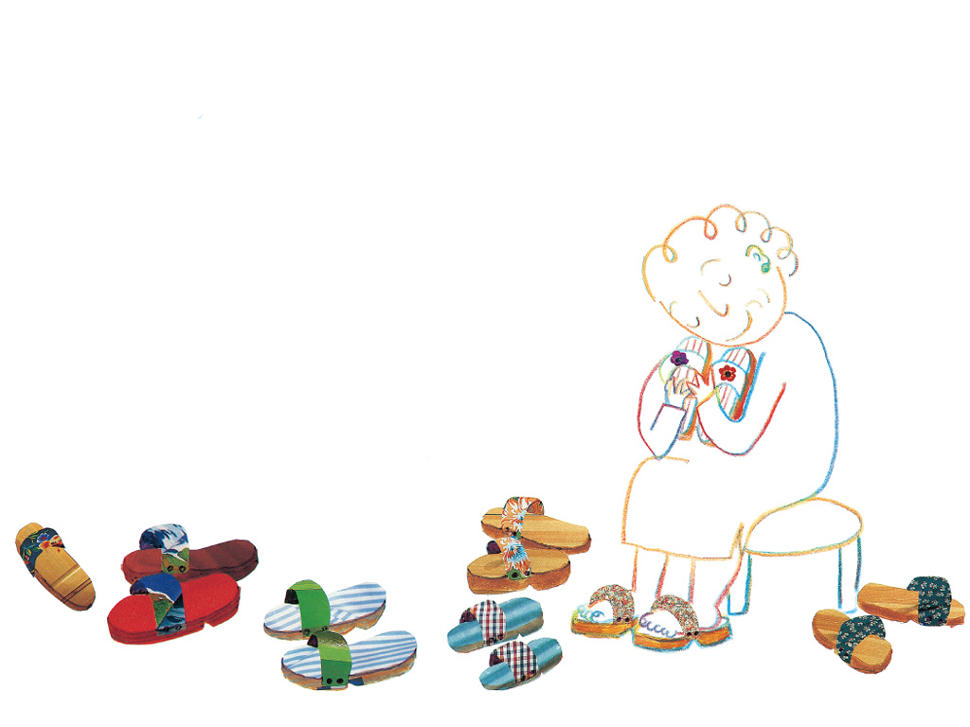
奶奶喜歡收集木屐
Notes:
Grandmother likes to collect wooden clogs.

