Slide 1
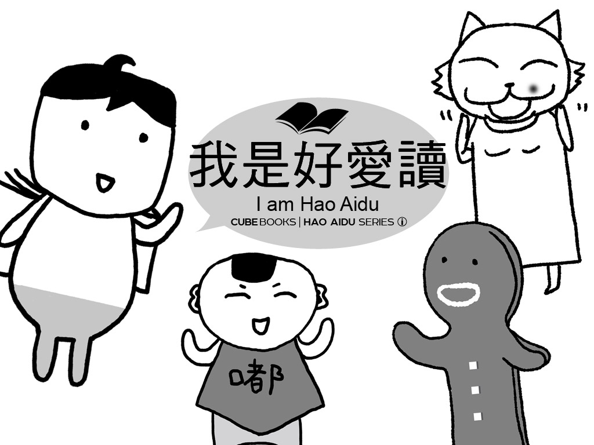

Slide 2
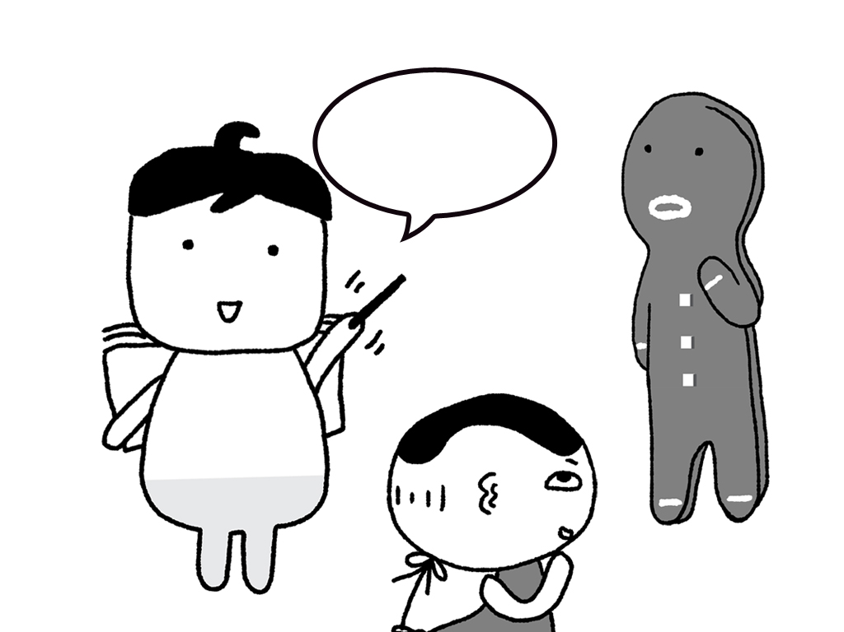
大家好。
我是好愛讀。
Notes:
Hello everyone.
My name is Hao ai du.

Slide 3
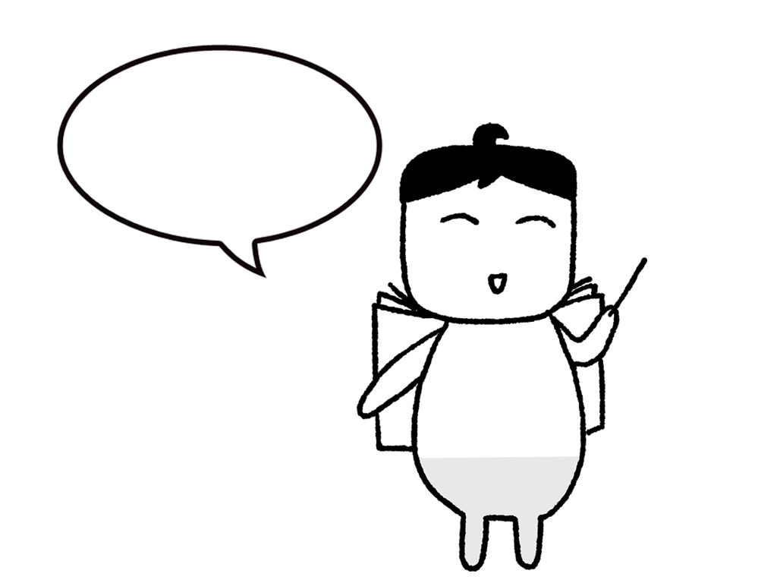
好愛讀，
就是很愛讀書的意思。
Notes:
Hao ai du.
It means I love to read books very much.

Slide 4
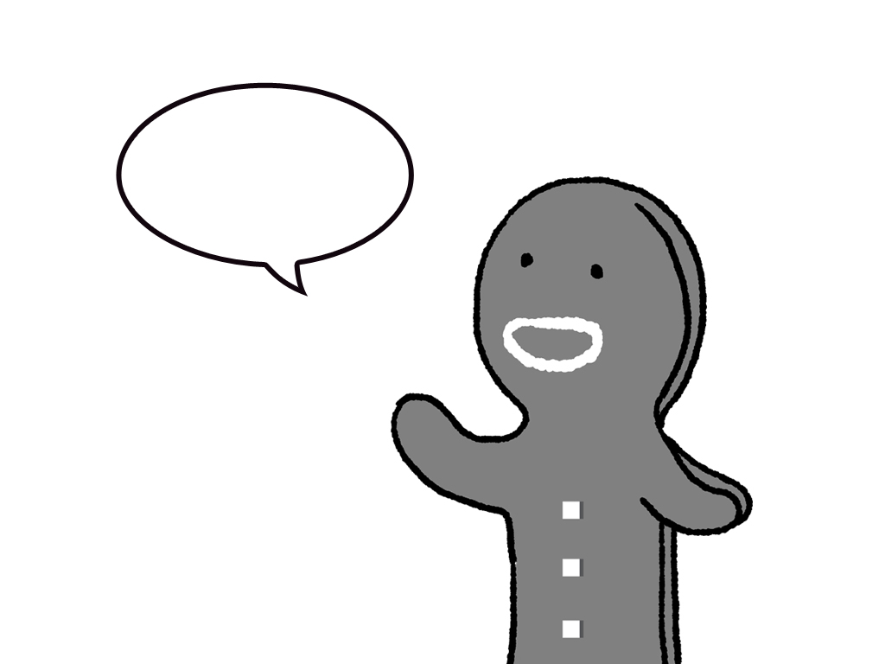
我也是。
Notes:
Me, too.

Slide 5
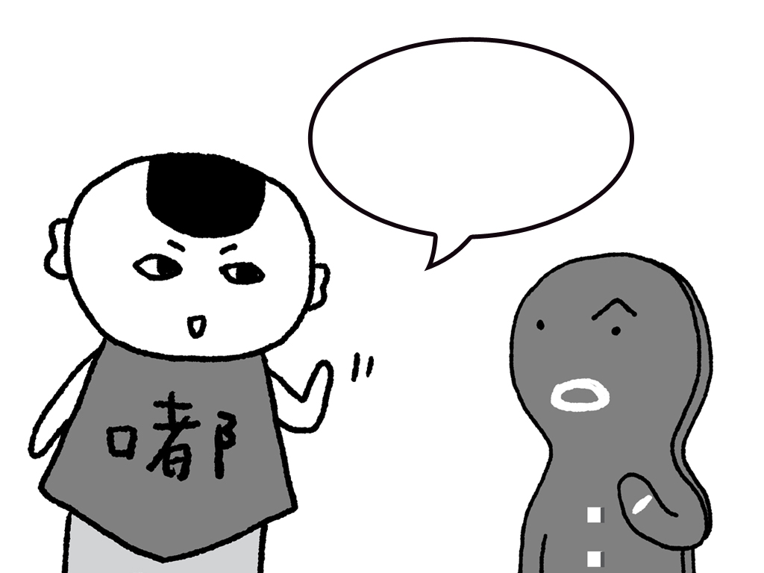
哈哈，我不相信。
你最愛吃，
你應該叫好愛吃。
Notes:
Ha ha, I don't believe it.
You love to eat the most.
You should be called, "The Food Lover."

Slide 6
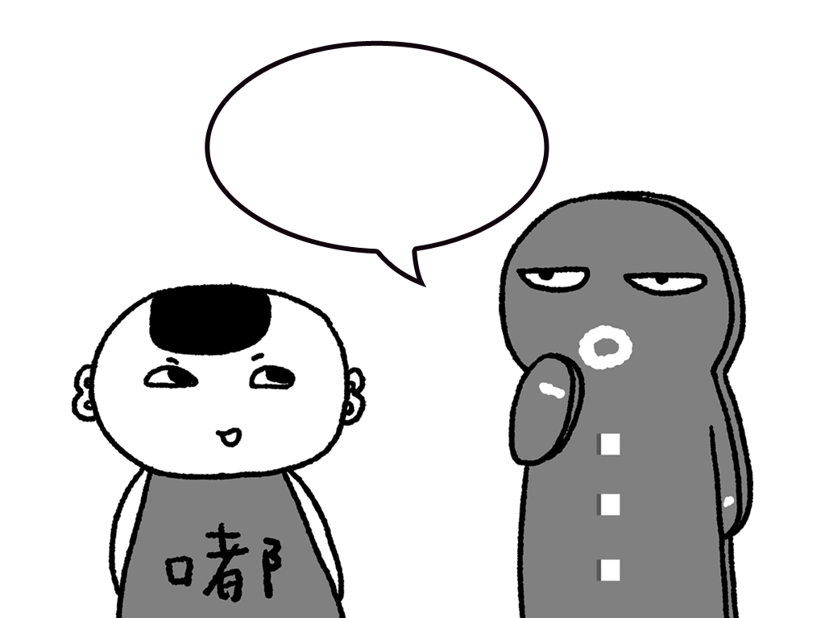
嘿，嘟嘟！
不要這麼說，
我的名字是薑餅人。
Notes:
Roly!
Don't say that.
My name is Gingerbread Man.

Slide 7
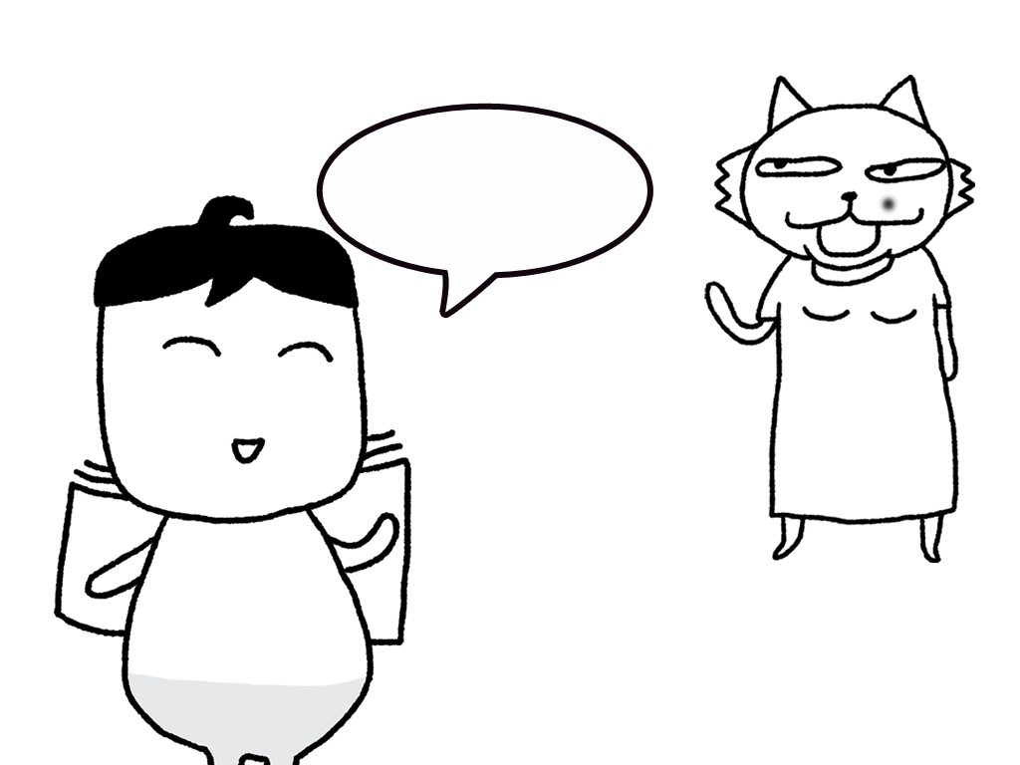
那一位是貓小姐。
Notes:
Other there is Miss Cat.

Slide 8
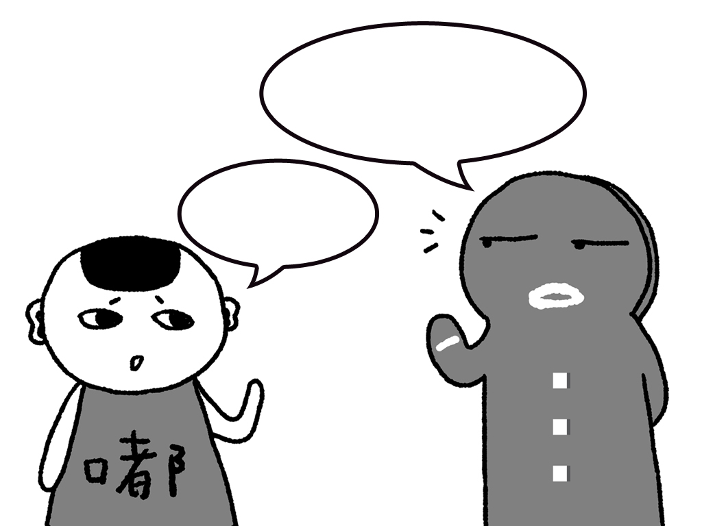
小心！
千萬不要說成「毛小姐」！
她會生氣的。
她很兇。
Notes:
Be careful!
Don't call her Miss Mao
She will get angry.
She is very mean.

Slide 9
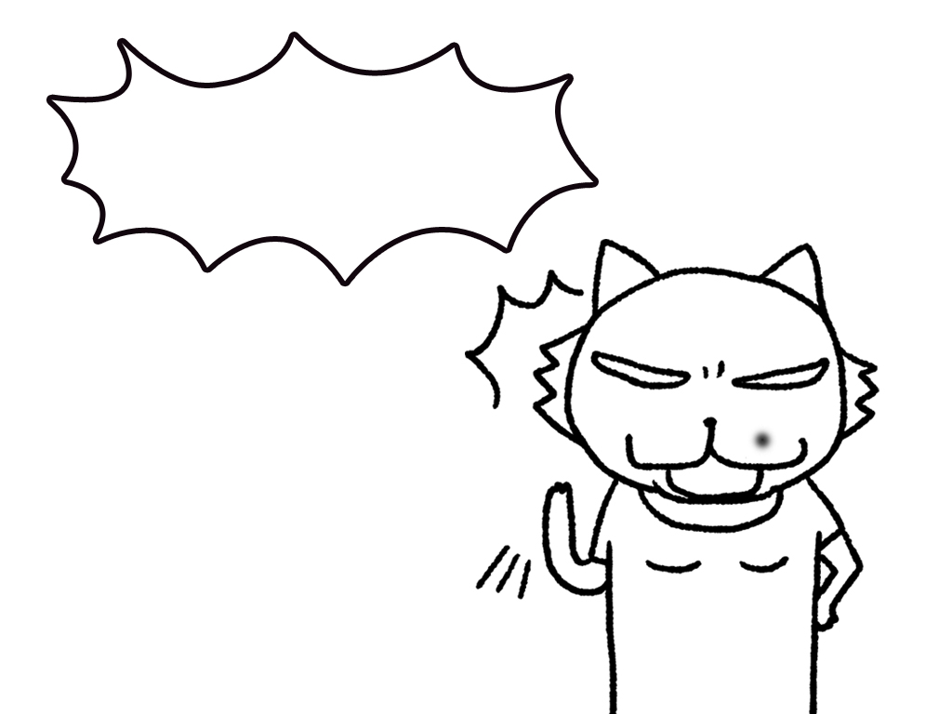
嘟嘟！你在說什麼？
Notes:
Roly!What are you talking about?

Slide 10
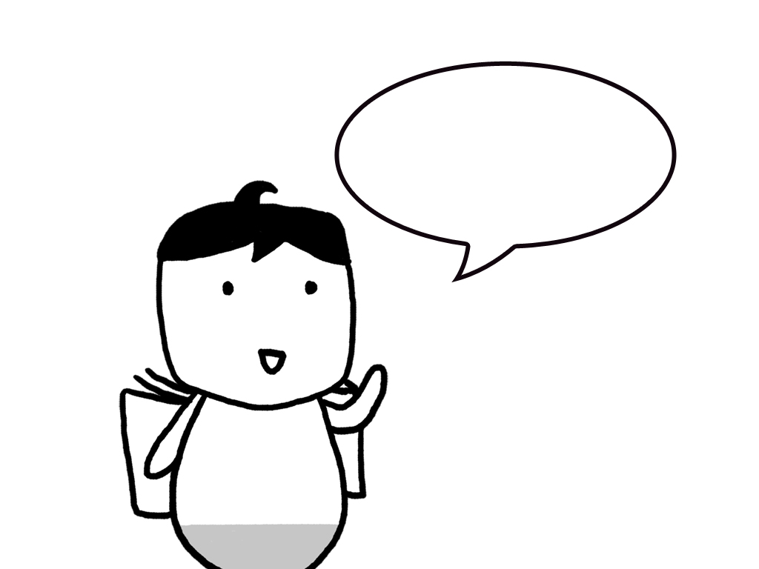
他們都想學中文。
所以我來教他們。
Notes:
They all want to learn Chinese.
So I come to teach them.

Slide 11
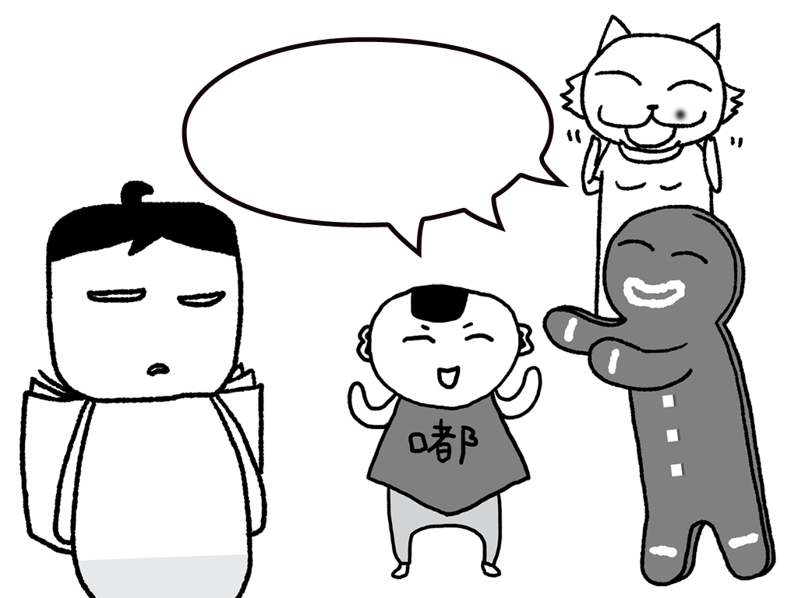
老師！
你應該準備好吃的點心！
Notes:
Teacher!
You should prepare some delicious snacks.

