Slide 1


Slide 2
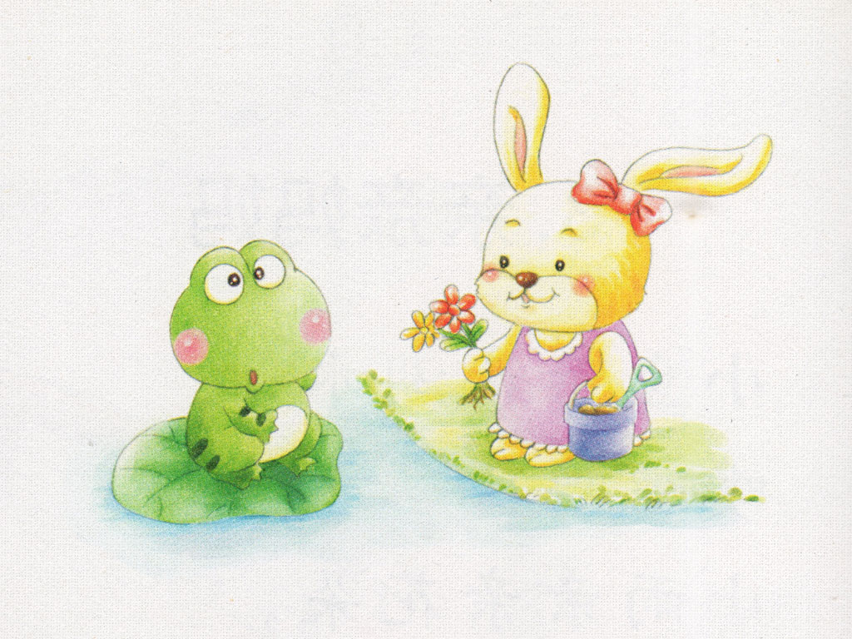
小白兔，去种花，
路上遇见小青蛙。
Notes:
The little rabbit went to plant a flower,
and met a little frog on the road.

Slide 3
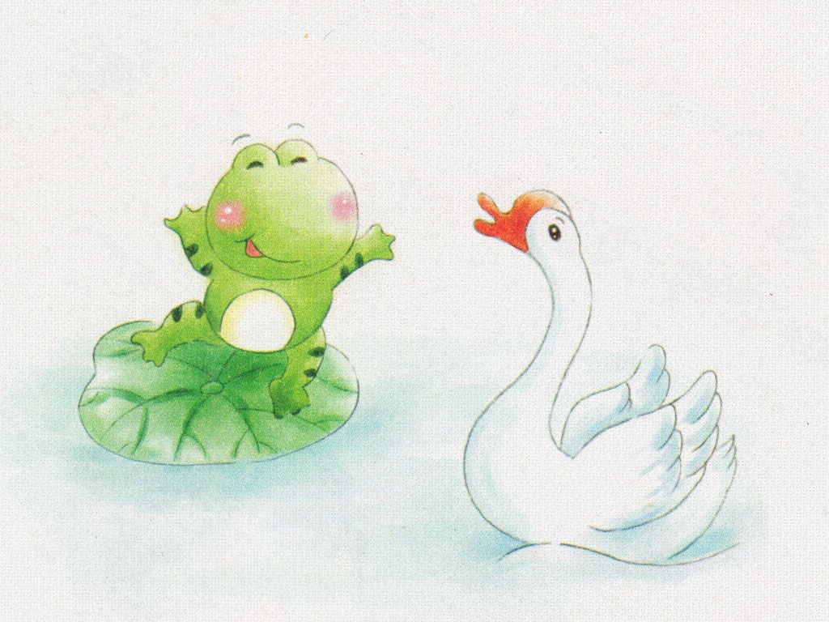
小青蛙，跳下河，
叫来一只大白鹅。
Notes:
The little frog jumped in to the river,
and called over a big white goose.

Slide 4
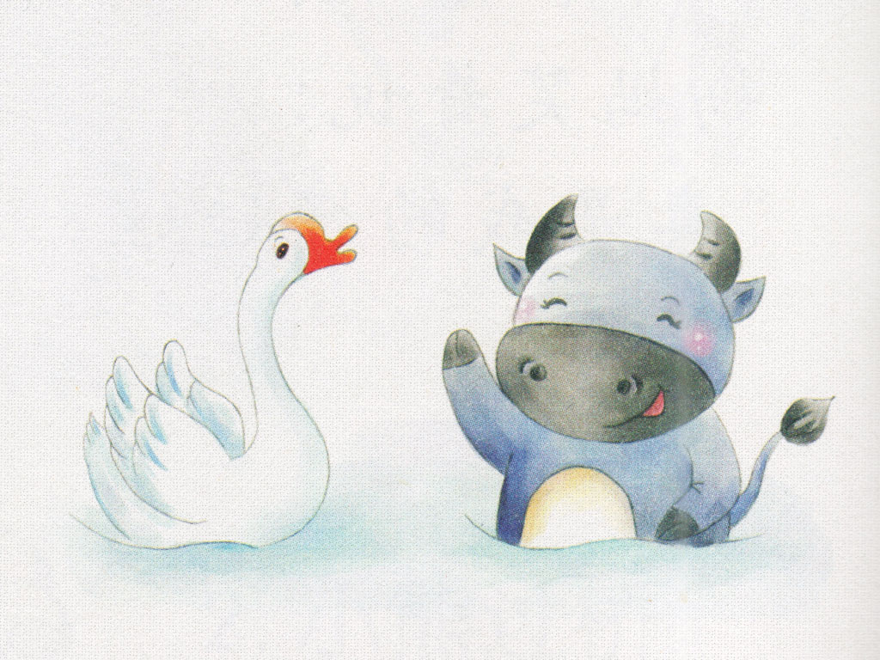
大白鹅，水里游，
请来一头老水牛。
Notes:
The big white goose swam in the water,
and invited over an old water buffalo.

Slide 5
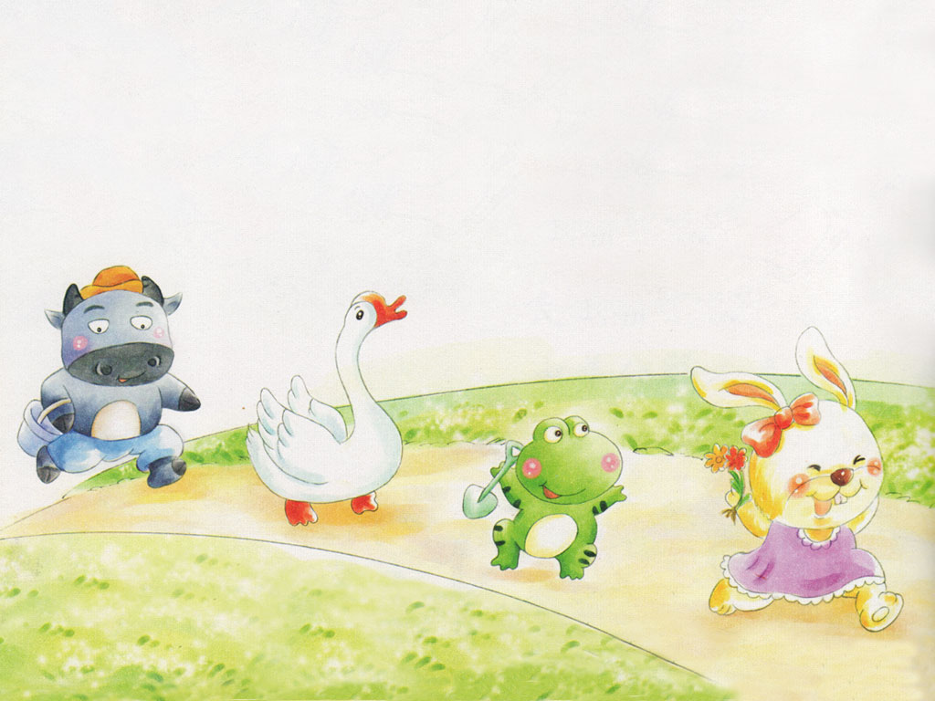
排好队，一起走，
他们都是好朋友。
Notes:
Walking in a line.
They were all good friends.

