Slide 1
Boolean Matching
R12921038 王瀞桓
B08901192 楊登堡

Slide 2
Outline
boolean matching intro
algorithm flow diagram
data structure
constraint
solved case
problem and discussion

Slide 3
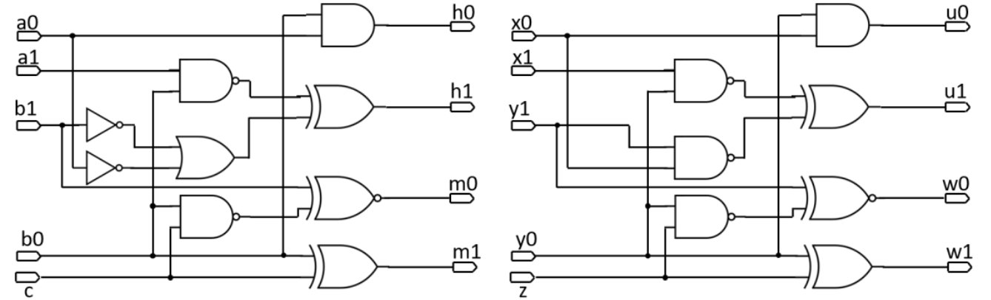
boolean matching intro
input matching pair : {(a0, a1), (x0, x1)}, {(b0, b1), (y0, y1)}, {(c), (z)}}
output matching pair: {(h0, h1), (u0, u1)}, {(m0, m1), (w0, w1)}

Slide 4
algorithm flow diagram
.v to .aag by ABC & yosys
read .aag by our cirMgr
define I/O solver class
add aig cnf and constraints for I/O solver to solve sat
O solver finds potential matching pair
iterate
I solver finds learned clause for outputsolver
If I solver unsat, case solved

Slide 5
data structure
define our aig data structure
aig member and method
pi, po, and, inv gate
topological order
dfs traversal
func/struc supp
unateness
symmetry

Slide 6
data structure
BDD (ABC package)
not suitable for large case
time and memory consuming
hard to encode into CNF

Slide 7
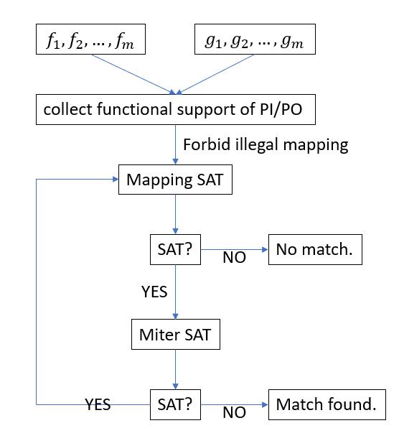
Constraint
[1] Boolean Matching of Function Vectors with Strengthened Learning
[2] A Two-Step Search Engine For Large Scale Boolean Matching Under NP3 Equivalence

Slide 8
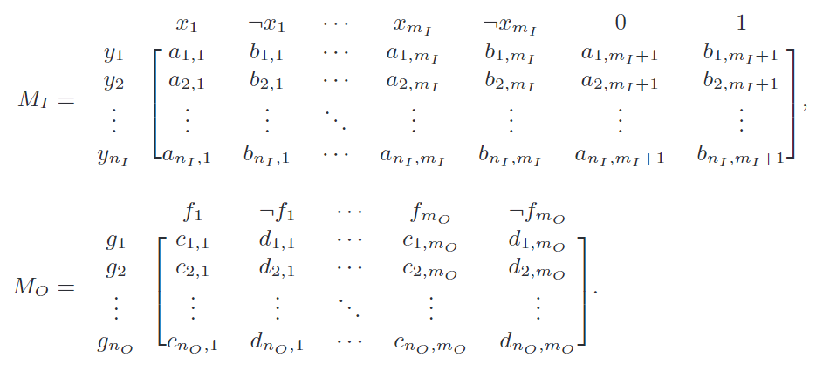
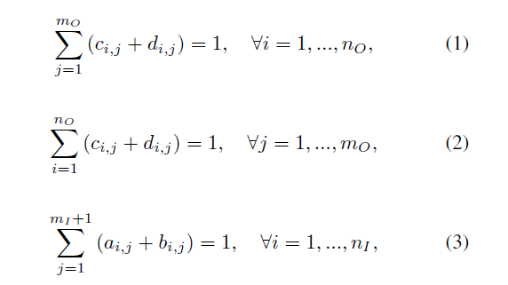
Constraint - mapping SAT
Basic constraints to require PI/PO mapping matrix:
[2] A Two-Step Search Engine For Large Scale Boolean Matching Under NP3 Equivalence

Slide 9
Constraint - mapping SAT
From Lemma 2 in [3], two inputs(outputs) can match only if they have the same degree.
Under the given problem, there is a weaker lemma:
Let FuncSupp(f) be the functional support of a Boolean function f.
If |FuncSupp(fi)| > |FuncSupp(gj)|, then gj cannot map to fi.
Let FuncSupp(x) be the set of Boolean functions where x is one of their functional supports.
If |FuncSupp(xi)| > |FuncSupp(yj)|, then xi cannot map to yj.
[2] A Two-Step Search Engine For Large Scale Boolean Matching Under NP3 Equivalence
[3] Large-scale Boolean Matching

Slide 10
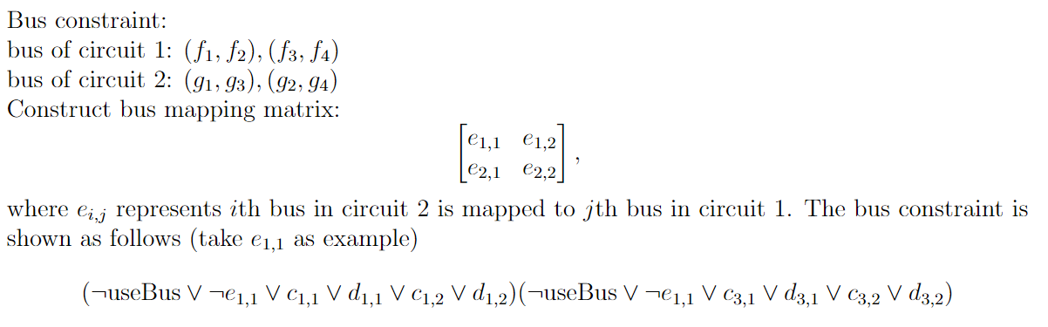
Constraint - mapping SAT
[2] A Two-Step Search Engine For Large Scale Boolean Matching Under NP3 Equivalence

Slide 11
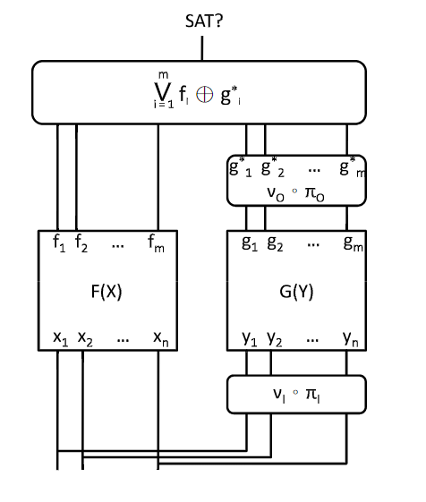
Constraint - miter SAT
[1] Boolean Matching of Function Vectors with Strengthened Learning
[2] A Two-Step Search Engine For Large Scale Boolean Matching Under NP3 Equivalence

Slide 12
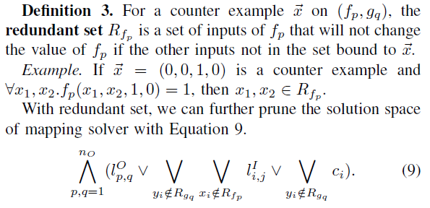
Constraint - learned clauses
[1] Boolean Matching of Function Vectors with Strengthened Learning

Slide 13
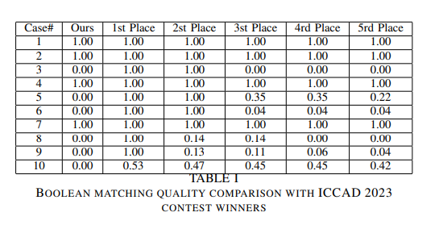
Experimental result - cases

Slide 14
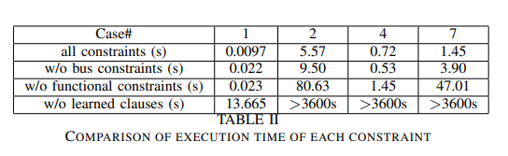
Experimental result - constraints

Slide 15
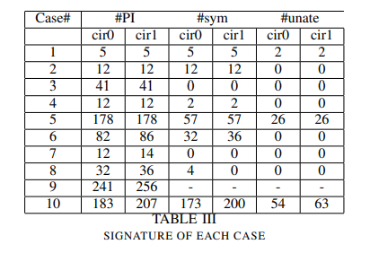
Experimental result - other potential signatures

Slide 16
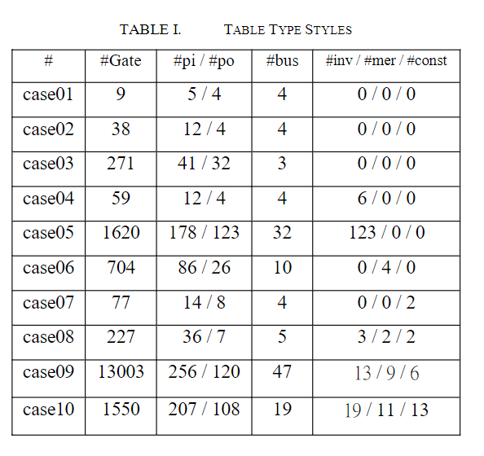
Expermental Result
For the current model, it only can solve smaller cases.
Simplifing AIG only have little improvement
sweep, strash, fraig, rewrite
Performance overhead
how to find better candidate matching pair
[4] Invited Paper: 2023 ICCAD CAD Contest Problem A: Multi-bit Large-scale Boolean Matching

