Slide 1
Image Caption Generation Model
Clip+GPT-2
Siyuan Jing and Haonan Wu

Slide 2
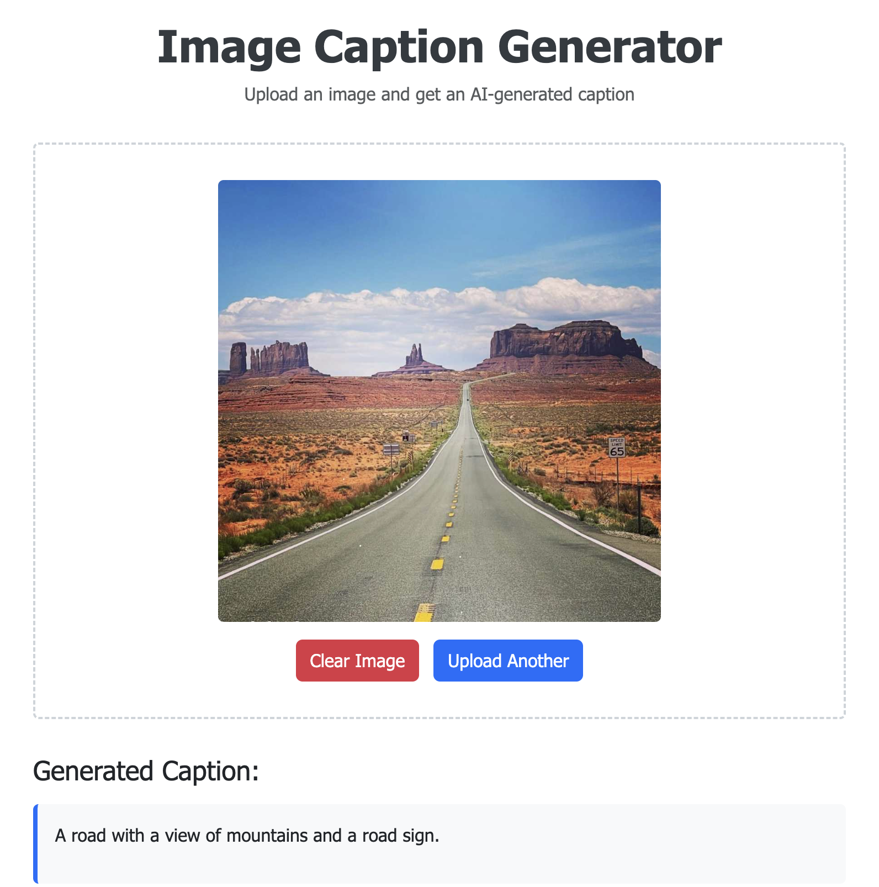
Combine 2 powerful model: CLIP and GPT-2
We use multiple ML algorithms from class and beyond:
Gradient Descent
Maximum Likelihood Estimation
We are going to introduce our model structure, loss function and show our progress by demo!
Our goal: generate captions from images

Slide 3
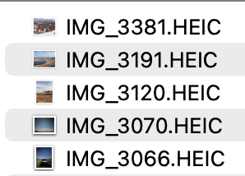
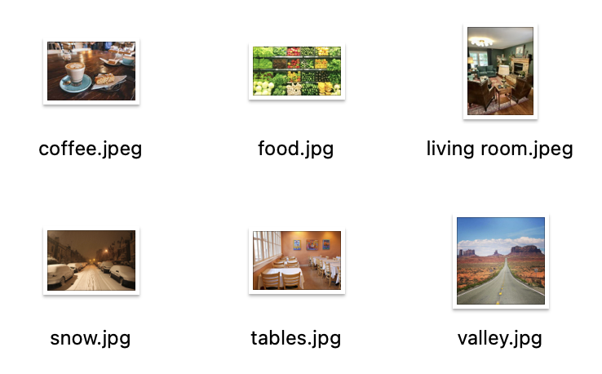
The Problem of Unlabeled Images
On modern digital platforms like AirDrop, images are constantly shared.
These images usually lack simple filenames — often just numbers or codes.
As these unlabeled images pile up, managing them becomes time-consuming
This reduces productivity and makes information search difficult for individuals and organizations.

Slide 4
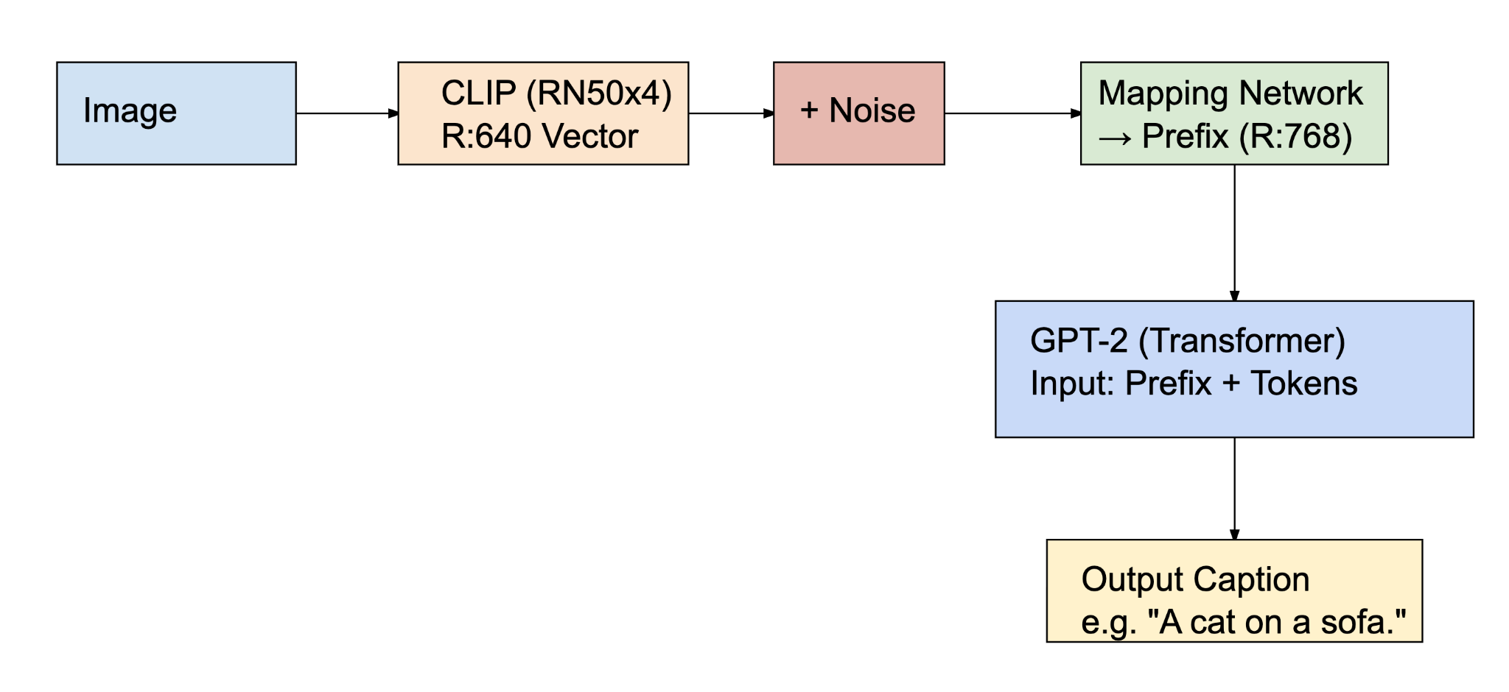
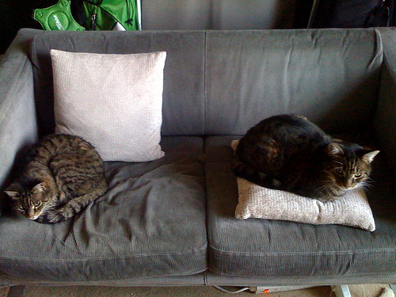
Core Principle
1.Bridging Visual and Linguistic Spaces with Noisy Mapping
More robust and reduce overfitting
The Equation:
Better Captions = CLIP Features + Noise → Mapping Network → GPT-2
Encoder
Decoder
Two cats are sleeping on a couch

Slide 5
Core Principle
2.Multi-Head Attention as a Cross-Modal Connector
The Equation:
Better Captions = CLIP Features + Noise → Mapping Network → GPT-2
Rather than using a simple linear projection to convert CLIP image features into GPT-2's embedding space, multi-head attention allows our model to learn complex relationships between different aspects of the visual representation.
Multi-head Attention Network allows the model to learn how different regions in the image affect language production.

Slide 6
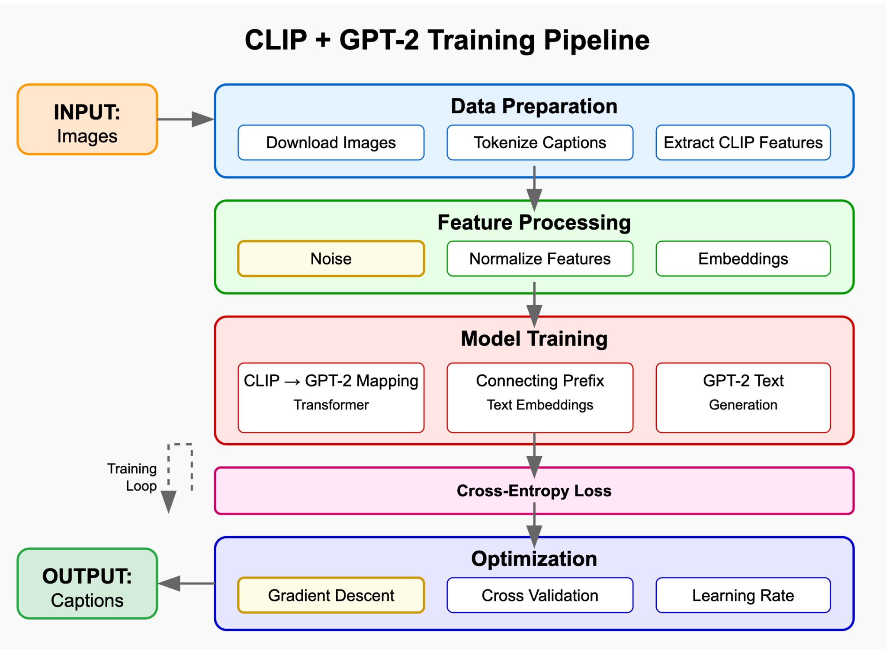
Our Project Pipeline

Slide 7
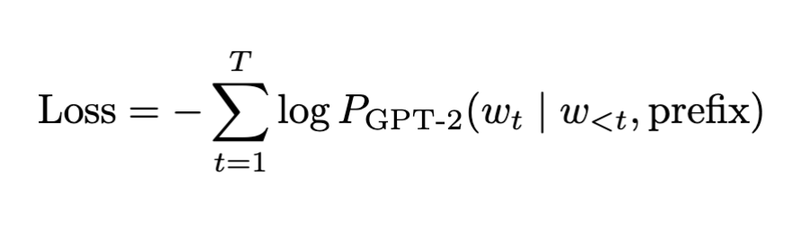
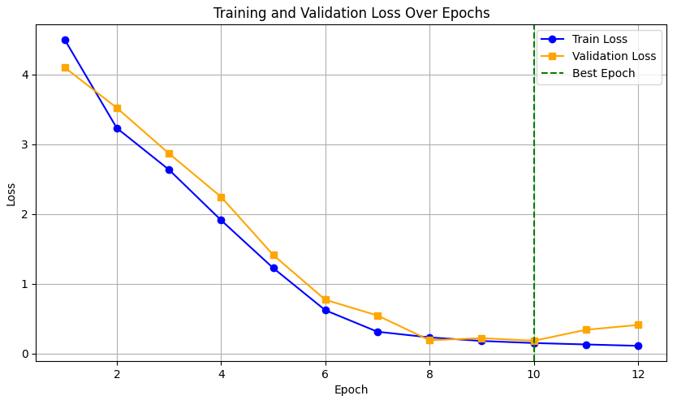
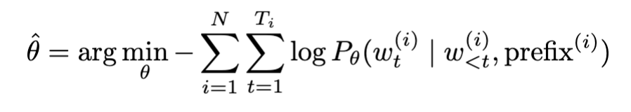
Loss and performance evaluation
Training: cross-entropy loss
Goal: Maximize the conditional probability that each correct token occurs
Cross Entropy Loss
Predict the probability of the t-th token conditional on the prefix and the history of the token before
Validation Loss
Best model ouput
（Maximum Likelihood Estimate）

Slide 8
Loss and performance evaluation
Predicting: BLEU + CIDEr
 | What It Measures | Typical Range
BLEU-1 | single word overlap between generated caption and reference | 0-1
BLEU-2 | two-word sequence overlap | 0-1
BLEU-3 | three-word sequence overlap | 0-1
BLEU-4 | Four-word sequence overlap | 0-1
CIDEr | Consensus-based evaluation using TF-IDF weighting | 0-2
BLEU-n:Higher means that the caption is closer to the reference, above 0.6 is better.
CIDEr: >1 indicates that the generated content is highly consistent with the reference; >1.5 very good

Slide 9
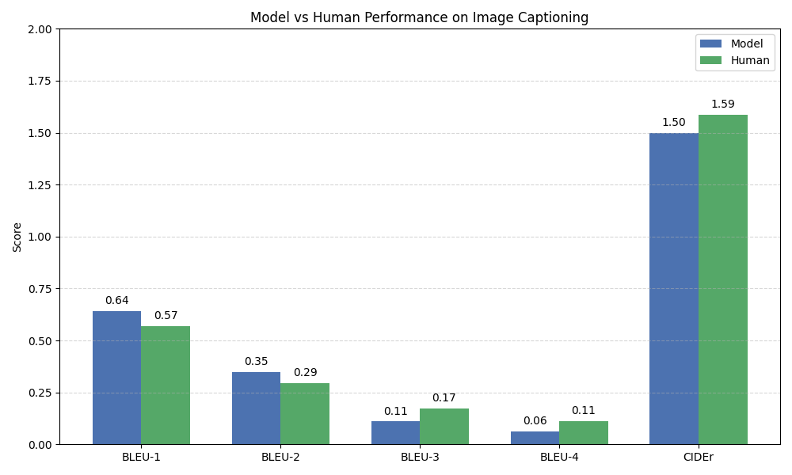
Prediction scores:
Model Parameter:
Transformer Layers: 8
Learning rate: 5e-5
Prefix length: 40
Noise rate: 10%
Dataset: COCO Image
Training set: 80, 000 images with 5 captions per image.
Validation set: 2,000 images
Human captions show better performance on longer word sequences, indicating more natural grammatical structure.
The CIDEr score shows our model can achieve 94.4% of human-level consensus quality.

Slide 10
Demo

Slide 11
Why Our Findings Matter
1.Automated organization of visual content:
Our model efficiently manages unlabeled images, reducing the need for manual effort.
2.Effective CLIP-to-GPT-2 Mapping： Our multi-head attention mechanism bridges visual and textual modalities for high-quality captions.
3.Noise Injection Boosts Generalization：
Introducing noise during training boosts generalization and helps create diverse, accurate captions.

Slide 12
Thank you

