Slide 1
Multigrid Poisson Solver
陳煒淮、邱懷萱、湯景堯
2020/06/30

Slide 2
Outlines
Model Problems
2D Poisson equation
Motivation
Limitation of exact solvers
Algorithms of Multigrid methods
V cycle
W cycle
F cycle
Full multigrid(FMG)
Method of GPU parallelism
Results
Conclusion

Slide 3
Model Problems

Slide 4
Poisson equation
We choose the following two 2D equations for the test of multigrid method.
Both of them have homogeneous BC and are confined within [0, 1].
Typically, multigrid method is used for solving elliptic PDEs.
Notes:
覺得這頁可以拿掉(?

Slide 5

Equation A
2D Fourier mode:
Test the performence of different Fourier modes independently

Slide 6
Equation B
Test the performence of multigrid method of an arbitrary problem

Slide 7
Motivation

Slide 8
Exact solvers
Here we introduce 2 kinds of exact solver:
Inverse Matrix
Successive Over-Relaxation (SOR)
There are other exact solvers, such as FFT, tridiagonal matrix algorithm, and etc., for solving discrete Poisson equation.

Slide 9
Limitation of Inverse matrix
1) Inverse matrix
For sin test with k = 𝛑/L,
N = 5 takes 2.269 sec to solve,
N = 9 takes >30 min to solve,
It is not realistic to solve the problem by inverse matrix generally
Notes:
最後一行可刪(?

Slide 10
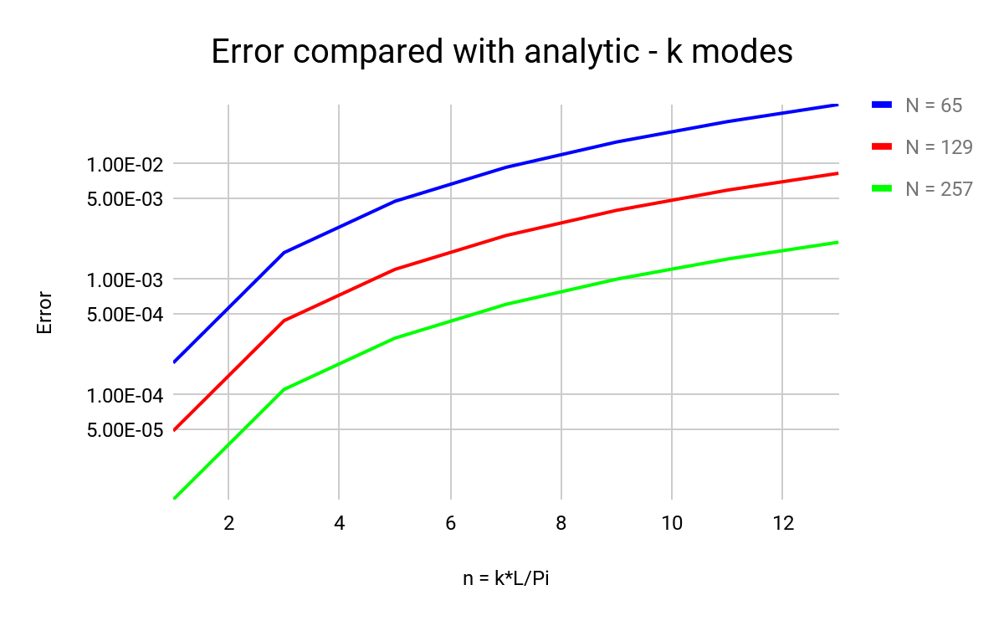
Limitation of SOR
2) SOR
Convergance rate is defined as 1e-15. 𝛚 = 1.
For sin test with different k modes in defferent resolutions,

Slide 11
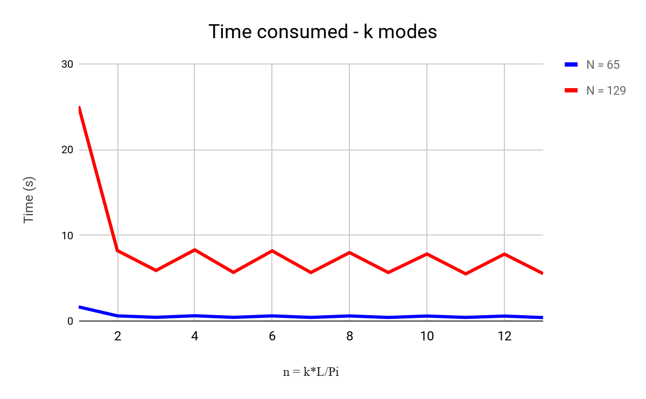
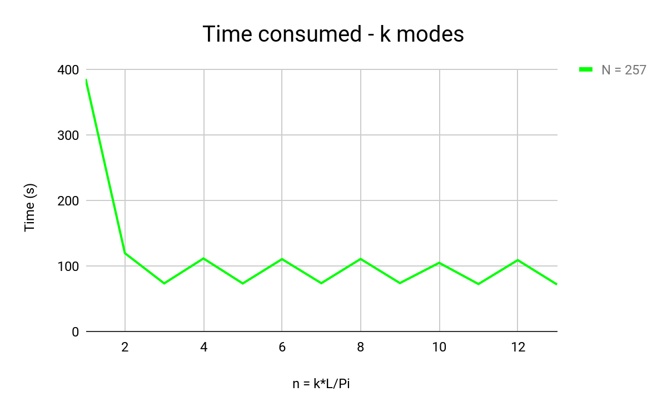
Limitation of SOR

Slide 12
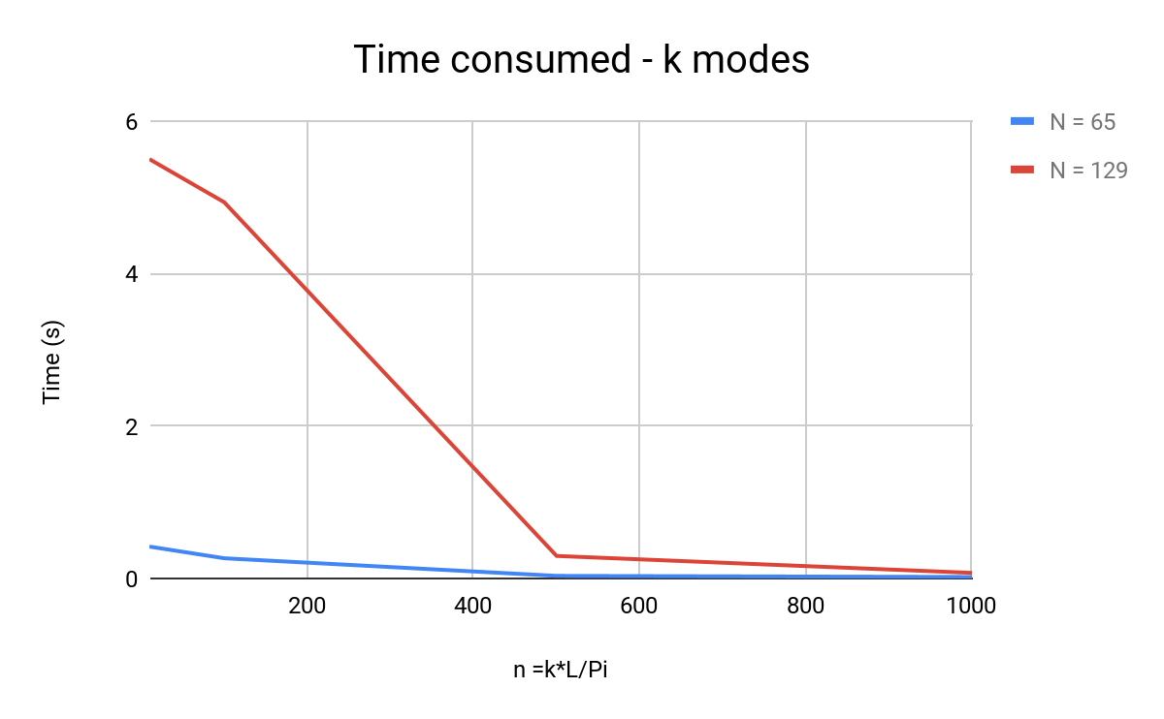
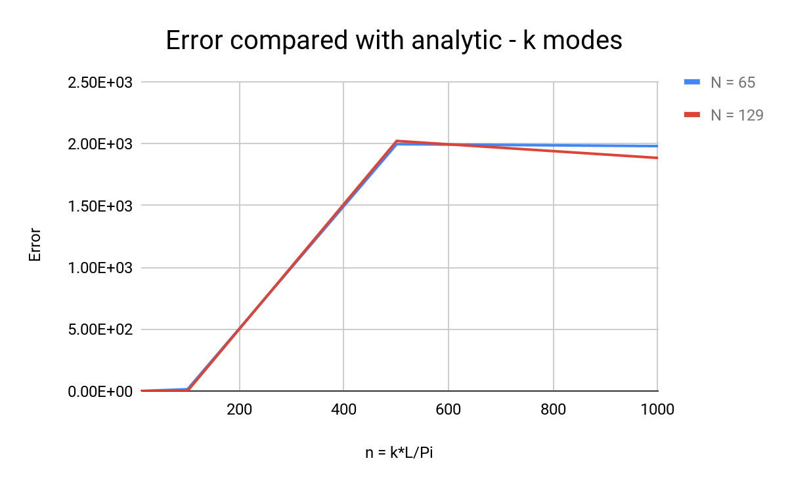
Limitation of SOR

Slide 13
Limitation of SOR
Higher resolution solves the problem with lower error.
Error increases as k increases.
Higher resolution takes more time to solve.
Higher k mode spends less time to solve.
High resolution gives better result but more time consuming.
High k modes have greater error but less time consuming.

Slide 14
Limitation of SOR
For a general problem which has low k modes, it could be very expensive for solving.
N>257, it takes more than 1 min in general. Low resolution can solve the problem more quickly.
Using low resolution to solve the low k modes could be a better way of solving general problem.
Multigrid method

Slide 15
Algorithms of Multigrid Methods

Slide 16





Residual & Correction
Target equation
Define residual
Define correction ,
Rewrite equation
Instead of solving target equation, we solve the equivalent residual equation, which is easier to be solved if we have a good enough guess.
(If the exact solver is inverse matrix, it does not matter which equation you are solving.)

Slide 17
Residual & Correction
For two-grid scheme with exact solver SOR, it is better to restrict residual to coarser level.
Because the solution of the residual equation at coarser level is expected to be fluctuated around zero, we can simply choose the initial guess as zero, which is a good enough guess as we expected.
By introducing even coarser level, we have the multigrid method.

Slide 18
V cycle (𝞬 = 1)
Level 0 (h)
S
S
𝞬 = 1
Level 1 (2h)
S
S
𝞬 = 1
Level 2 (4h)
S
S
𝞬 = 1
Level 3 (8h)
E
* m

Slide 19
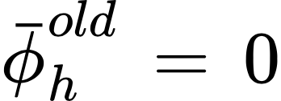
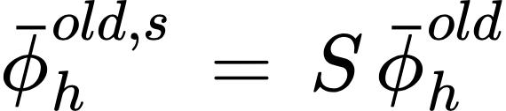
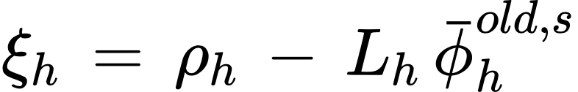

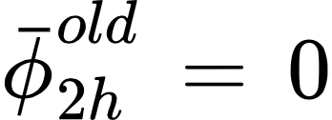
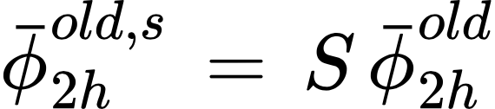
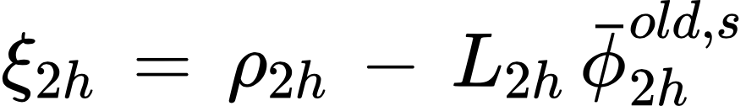

V cycle (𝞬 = 1)
Level 0
Initialization
Smoothing
Residual
Restriction
Level 1
Initialization
Smoothing
Residual
Restriction

Slide 20

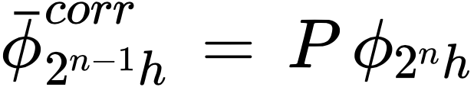

V cycle (𝞬 = 1)
Restriction
Prolongation
Level n
Exact solver

Slide 21
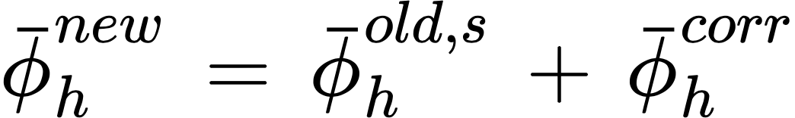
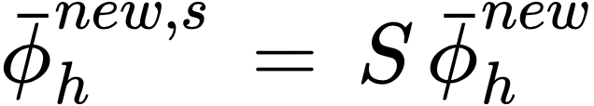
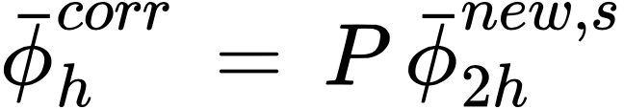
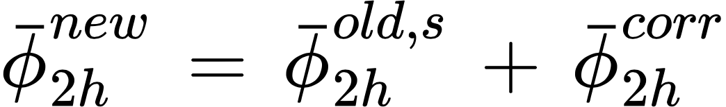
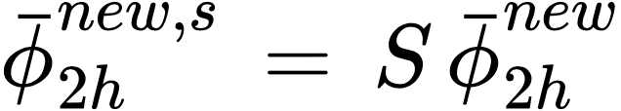
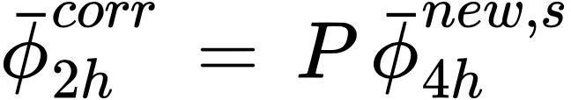
V cycle (𝞬 = 1)
Level 0
Updating
Smoothing
Prolongation
Level 1
Updating
Smoothing
Prolongation

Slide 22
W cycle (𝞬 = 2)
Level 0 (h)
S
S
𝞬 = 2
𝞬 = 1
Level 1 (2h)
S
S
S
𝞬 = 1
𝞬 = 2
Level 2 (4h)
S
S
S
S
S
S
𝞬 = 2
𝞬 = 1
Level 3 (8h)
E
E
E
E
* m

Slide 23
F cycle
Level 0 (h)
S
S
S
Level 1 (2h)
S
S
S
S
S
Level 2 (4h)
S
S
S
S
S
S
S
Level 3 (8h)
E
E
E
E
* m

Slide 24
FMG
An independent V cycle starts with an initial guess from the result of previous stage
Level 0 (h)
S
S
Level 1 (2h)
S
S
S
S
Level 2 (4h)
S
S
S
S
S
S
Level 3 (8h)
E
E
E
E
Exact solver for Poisson equation at coarsest level
* m
* m
* m

Slide 25
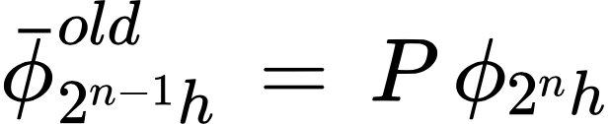
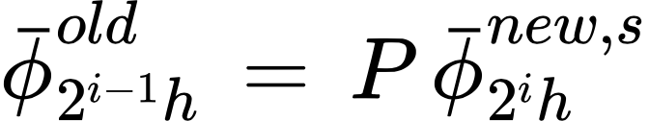
FMG
{
Prolongation
=
Prolongation for i ≠ n
Primary difference between Multigrid method & FMG:
“FMG starts from exact solution at coarsest level rather than an arbitrary initial guess”

Slide 26
Results

Slide 27
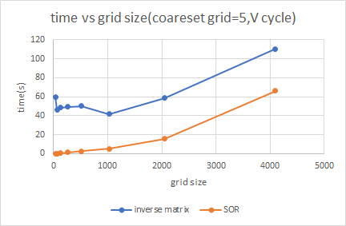
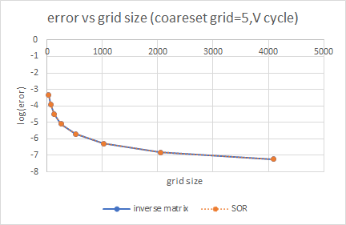
Why using inverse matrix as exact solver is stupid

Slide 28
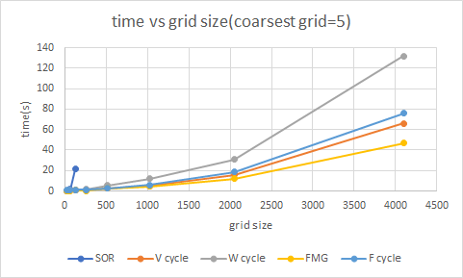
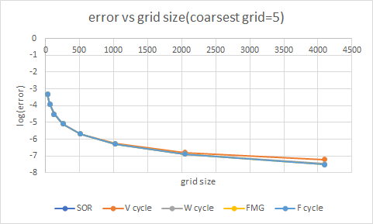
Compare different types of cycle (with certain conv_rate)
Since we fix the conv_rate, the errors of different methods are roughly the same at certain grid size.
W cycle is the slowest one among these method.

Slide 29
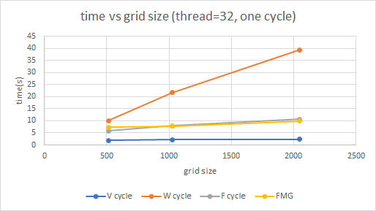
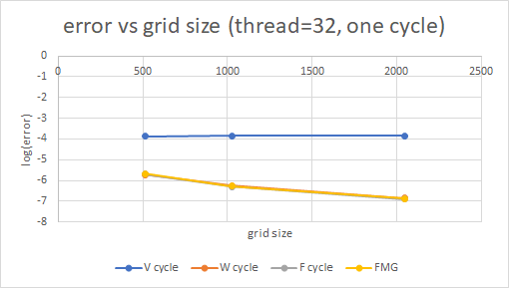
Compare different types of cycle (with one cycle)
For a single cycle, W cycle is also the most time consuming one.
V cycle has the greatest error.

Slide 30
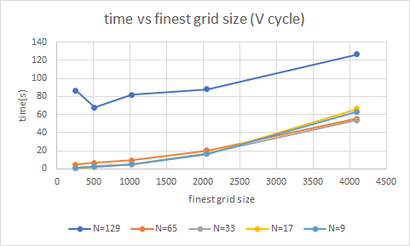
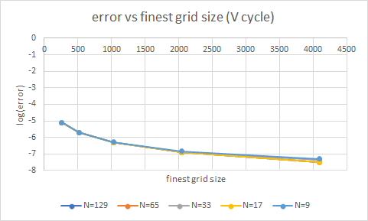
Down sample to different coarsest level
For the same finest level, the error does not depend on the coarsest level it reached heavily.

Slide 31
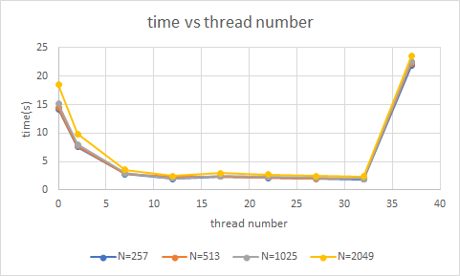
OMP parallel efficiency
Efficiency depends on how many physical threads the computer has.

Slide 32
Method of GPU parallelism
Parallel all the for-loop you see.
Reduce time of passing data.
Notice the maximum number of thread in hardware.

Slide 33
Conclusion

Slide 34
Conclusion
Error wrt analytic solution is only affected by test problem and total number of cells.
We seek for a way with the least consumed time for high efficiency. There are two ways:
choose the right cycle
go to the coarestest grid possible
minimize smoothing times at fine grids, since it doesn’t make much difference to error wrt analytic solution.

Slide 35
Thanks for your attention

