Slide 1
Side Chain Torsion Angle Prediction
Qingyuan Liu
Yang Zhang Lab
04/14/20

Slide 2
Outline
Background and Motivation
Method and results
New Progress since last presentation
Future Plan

Slide 3
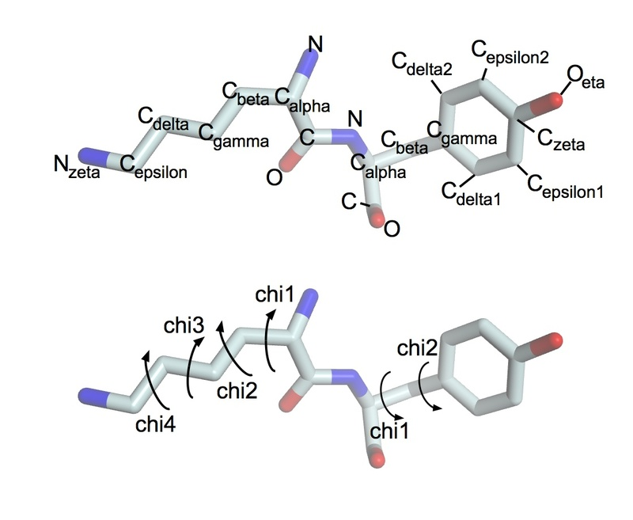
Background
Dihedral angle (torsion angle): hedral means plane, the angle between two planes.
C-C_{alpha}-C_{beta}-C_{gamma}
C-C_{alpha}-C_{beta} vs. C_{alpha}-C_{beta}-C_{gamma}

Slide 4
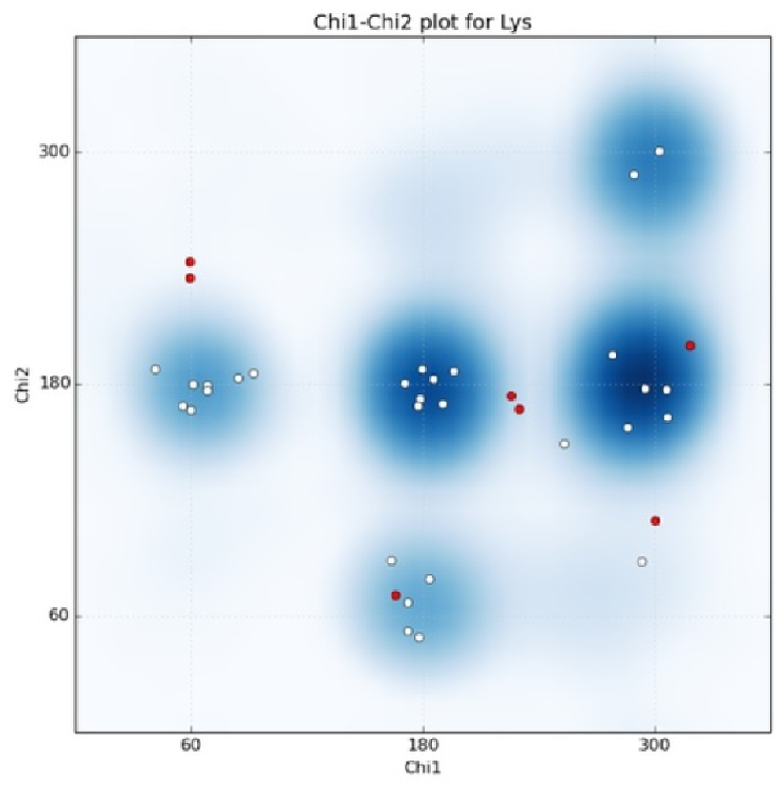
Background
There’s a discrete number of low-energy rotamers => Libraries (Dunbrack, Karplus 1993)
This project will utilize a backbone-independent Chi1 rotamer library
Three discreet defintions
(0,120]Gauche⁻, (120, 240] Trans, (240, 360]Gauche⁺
55 rotamers total
https://swissmodel.expasy.org/course/text/chapter3.htm

Slide 5
Objective
Given only amino acid sequence can we predict the rotamer sequence (rotamer configuration)?
Can we also predict the true value torsion angle?

Slide 6
From Last time
Problems:
Encounter not enough memory issue.
Future Direction
Write more blocks to the ResNet
Extend the prediction from 3 bin to multi-bin
Adding a co-loss term to the chi1 predictor to let the loss function better predict the chi1 term

Slide 7
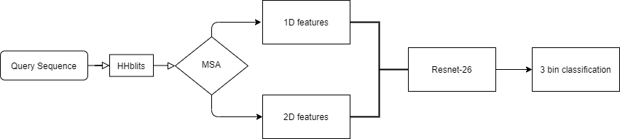
Pipeline

Slide 8
New Progress
Rewrote the network in Pytorch to tackle memory issues
Extend the network from 3 bin classification to 36 bin classification
Adding structure features
Wrote a pipeline to increase atomic range for LOMETS/CEThreader

Slide 9
Naive Method
Predict randomly with native chi1-distribution
Accuracy: 46.34%
Predict with most likely native chi1-distribution
Accuracy: 57.7%

Slide 10
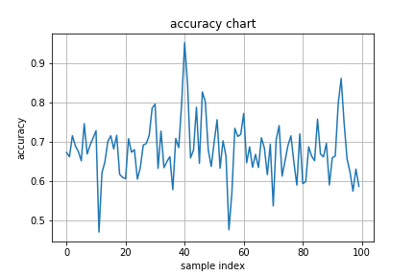
ResNet (26 Block)/Accuracy
Accuracy: ~67%
Loss: 0.68

Slide 11
Rot1Pred Accuracy Table

Slide 12
Accuracy per Amino Acid

Slide 13
Full atoms LOMETS template
Full atoms ranked templates
Sequence
lomets
New output

Slide 14
Problems regarding structure features
Training easy target would make the model rely heavily on structural features
Applying this model on hard target would deteriorate accuracy
Construct a weight factor onto structure features
Adding additional training samples from hard target templates.

Slide 15
Future Directions
CEthreader on the training samples vs. pretrained Lomets samples

