Slide 1
Decision & Risk Management Project
Team 7 Group Members:
Chen Gao, Haofu Wu, Jingsi Wu, Haoning Liu

Slide 2
Overview
How to promote PC MacTerm?
Option A:
Launch a Marketing Campaign
Option B:
Outsourcing Contract with Catalina
Manage marketing to a new niche market.
Pros:
Gain direct recognition
High profit margin
Cons:
Small market share
Potential market failure
Let Catalina distribute and promote the product.
Pros:
Easy entry into Mac world
Wide distribution
Valuable learning experience
Cons:
Low profit margin
Indirect brand presence

Slide 3
Distributions
Triangular and Normal
The normal distribution is symmetrical, it has greatest probability at its mean, and values farther from the mean are less likely. Most of the events in our life follows this distribution.
For this case, we assume that Market Growth Rate and Annual Market Share Growth Multiplier follows the normal distribution because we cannot gain a most likely value, each value within the bound is possible to show up, but the extreme value may has quiet low probability.
For triangular distribution, maximum and minimum values are given. Also, in this distribution, we can get a most likely value from historical data or from assumption. Triangular distribution can be asymmetrical if the most likely value are not fall in the center of the bound.
For this case we assume that the Initial Market size, Variable costs and Initial Market share follows the triangular distribution, use estimation value as the most likely value.

Slide 4
Calculation and Equations
Distribution by DMA

Slide 5
Calculation and Equations
Distribution by Catalina

Slide 6
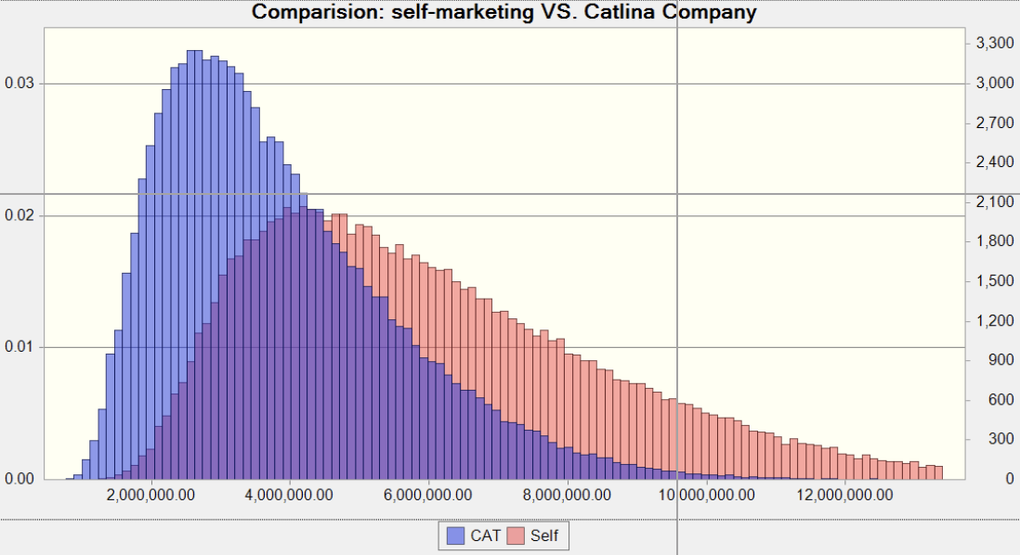
Forecast Comparison
Notes:
We did 100,000 trails for these two decisions.
We build an overlay chart to compare the forecasts of these two decisions. From the distribution chart, we can find that launching a Marketing Campaign definitely works better than outsourcing Catalina to distribute and promote. We can find that if we sell by Catalina company, there is higher probability that expected revenue will be gathered from 2,000,000 to 6,000,000. If we sell by the company self, we have much more possibility to achieve more revenues. Now, let’s check the statistics of these two forecast situations.

Slide 7

Forecast Comparison & Conclusion
 | The Catalina Deal | Marketing by Self
Trials | 99999 | 99999
Base Case | 2311920.42 | 3694470.01
Mean | 3835927.21 | 6076444.25
Median | 3489575.63 | 5578136.59
Maximum | 13872047.91 | 24829591.46
Minimum | 769540.63 | 1213155.76
Mean Std. Error | 5317.46 | 8266.43
Notes:
From this table, we can find that if we sell the product by company self, all parameters were better except the mean std. error. In conclusion, we think marketing by company self is better than the Catalina deal.

Slide 8
Thank you

