Slide 1

Chicago 2016
Taxi Rides Analysis
Group 5
Jingsi WU Yidan WANG
Jingyi LIU Xiaonan ZHAN

Slide 2

Part 1: Selecting
Why this dataset?
Why
Chicago residents and visitors took more than 27 million taxi rides, spend more than $400 million.
Development of app-based rides services such and Uber and lyft.
Chicago
Taxi Rides
January 2016
What is the dataset?
What
The database contains of over 100 thousands taxi rides in Chicago for January 2016, which describes the rides from multiple aspects including companies, times , fares, duration, ext.
How
How to analysis?
Explore how the behavior of Chicago taxi riders being affected by location, time etc.
Explore how the taxi rides are priced and the elements which may affect the fares of rides.
After being
selected
2

Slide 3
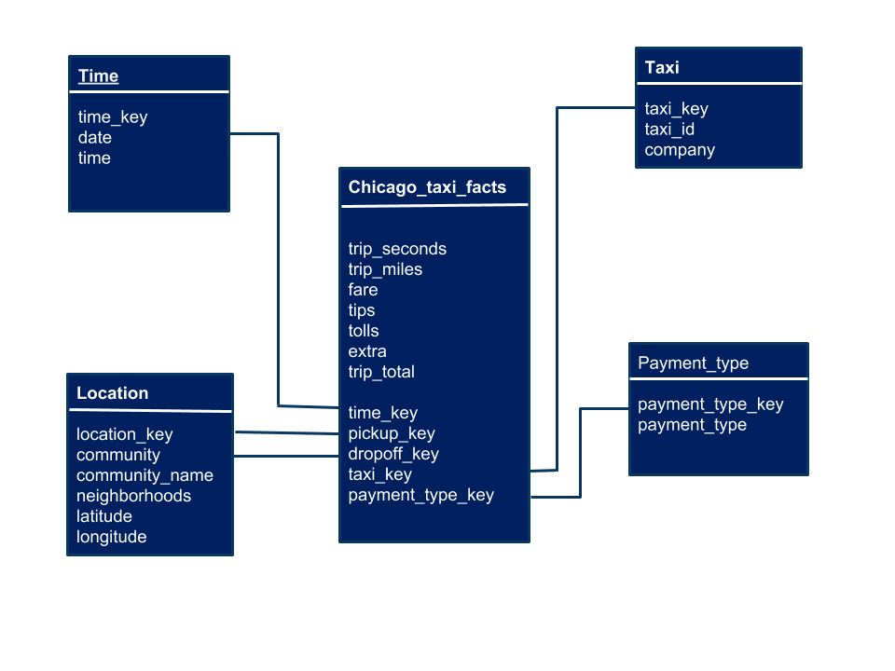
Part 2: Wrangling
Create the
fact table
Create the
Dimension tables
Add Foreign Key to fact table
Connect the fact and the dimension tables
3

Slide 4
Part 3: Analysis
Taxi pricing system
Taxi industry
Popular destinations
Reason behind high tips
Reason behind high startup prices
Chicago
market
analysis
Economic Environment
Peak hour
Payment preference
Periodic pattern
Consumer Behavior
4
Notes:
‹#›

Slide 5
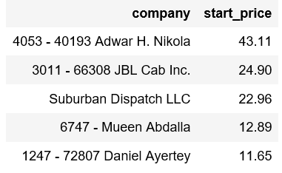
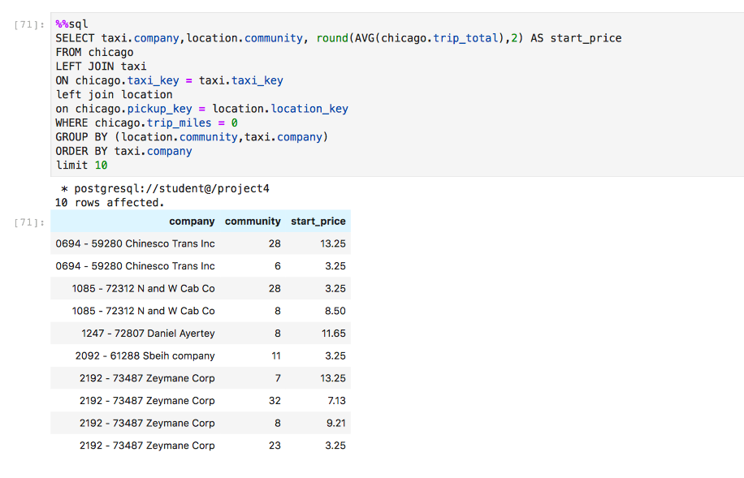
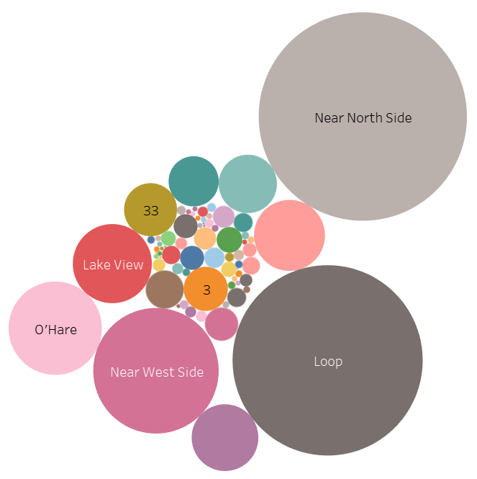
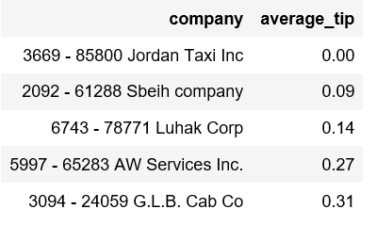
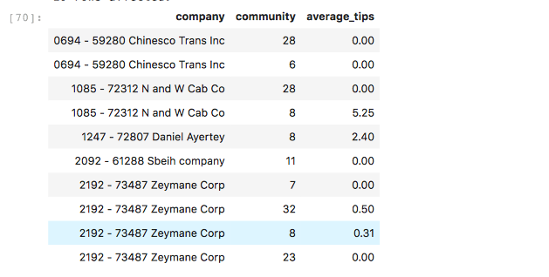
Part 3: Analysis
5

Slide 6
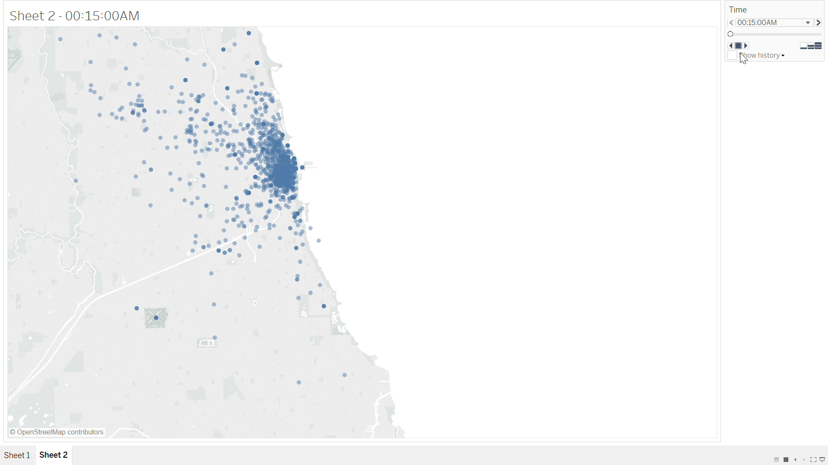
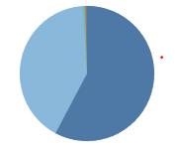
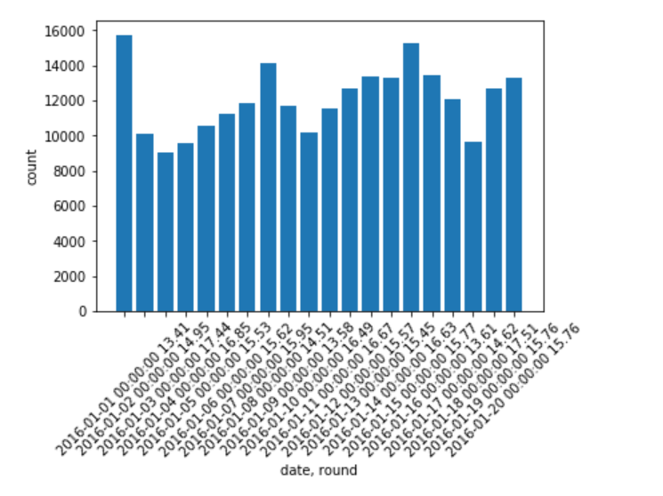
Credit card
Credit card
Cash
Cash

Slide 7
Part 4: Additional Analysis and Conclusion
Pick-up location
Little effect
7 Weather types
&
No null values
Weather
Data in 2016
Tips
Does not have much influence
Behavior
Tend to use taxi service during sunny days
8

Slide 8
Conclusion
How Uber impact the industry?
The base price and price per mile of Uber are all cheaper than taxi.
What we analyze?
When people tend to use taxis, which community area is popular destination, what is the pricing strategy,How weather influence consumer behavior
03
What is the purpose of the analysis
01
02
Suggest Uber to maintain the competitive advantage, balance high demand at rush hours, optimizing the whole operation
04
05
What tools we use?
Porter’s 5 Forces
Tableau, SQL , shelles,
pandas, Trifica, ect.
The whole industry is quite competitive
9

Slide 9
Thank you !

