Slide 1
CAFE POINT OF SALE SYSTEM INCEPTION PHASE

Slide 2
PROBLEM STATEMENT
The café has a slow ordering system leading to customer dissatisfaction and manual tracking of sales through book keeping with no automatic way of identifying sold items and automatically calculating sales leading to susceptibility of loosing records from book-keeping.
This gap creates a demand for a website to automate the café’s sales and stock.
Notes:
Problem Statement
Cafés face slow ordering, pricing mistakes, unclear role separation, and difficulty tracking daily sales. The POS system eliminates manual errors, accelerates service, and centralizes operations through a fast, browser-based interface.

Slide 3
BUSINESS CASE
Creating a point of sale system will benefit the stakeholders in the following ways;
Owners: Accurate revenue
Cashiers: Faster workflow
Customers: Quicker service
Business: Reduced training overhead and improved decision making.
Notes:
Business Case
Stakeholder Benefits:
- Owners: Accurate revenue tracking, reduced fraud.
- Cashiers: Faster workflow, fewer mistakes.
- Customers: Quicker service.
- Business: Reduced training overhead, improved decision making.
The system provides strong ROI by speeding up order processing, reducing errors, and improving customer satisfaction.

Slide 4
HIGH-LEVEL REQUIREMENTS
FUNCTIONAL REQUIREMENTS
Role switching (Cashier/Manager)
Category-based menu
Order creation, quantity adjustments, clearing orders
Payment by cash or card
Pending approval system for managers
Daily summary with revenue, top items, statistics
Local storage for offline operation
Notes:
Non‑Functional Requirements:
- Touch-friendly UI
- Fast performance
- Offline capability
- Role‑based permissions
- Simple deployment

Slide 5
CONTINUATION OF HIGH-LEVEL REQUIREMENTS
NON- FUNTIONAL REQUIREMENTS
Fast and responsive: The system must be fast and quick to handle peak hours without delay.
Reliability: The system must have minimal downtime
Security: The system must protect customer payment data

Slide 6
USE CASES (10%)
Create Order
Adjust Quantity
Approve Orders
View Daily Summary
Switch Role
Process payment
Notes:
Example Use Cases (10%)
UC1: Create Order – Cashier selects menu items, adjusts quantities, enters customer name, submits order.
UC2: Adjust Quantity – Cashier increases or decreases item quantities.
UC3: Approve Pending Order – Manager reviews and approves/rejects.
UC4: View Daily Summary – Manager views metrics and exports data.
UC5: Switch Role – User toggles between cashier and manager modes.

Slide 7
RISKS LIST & FEASIBILITY STUDY
RISK LIST
Technical: Data loss, performance, Internet failure, Sytem downtime and Hardware failure
Operational Risk: Staff resistance to change, Incorrect Data Entry, Poor Vendor Support
Security Risks: Data Breach, Payment Fraud, Unauthorized Access.
Notes:
Risk List & Feasibility
Technical Risks:
- Local storage may lead to data loss.
- No authentication layer reduces manager security.
- Performance may degrade with large data sets.
Business Risks:
- Staff may struggle to adopt new system.
Mitigation:
- Future cloud sync
- Authentication enhancement
- UI/UX iterative improvement

Slide 8
FEASIBILITY STUDY
Technical Feasibility:
Reliable internet connection
Compatible hardware (tablet or touchscreen terminal)
Secure payment processing
Cloud or local server setup
Conclusion: Technically feasible with standard café infrastructure.

Slide 9
CONTINUATION OF FEASIBILITY STUDY
Operational Feasibility
Impact on Staff:
Simplifies order taking
Faster billing
Reduced human error
Easy reporting for management
Conclusion: High operational benefit and manageable training requirements.

Slide 10
CONTINUATION OF FEASIBILITY STUDY
Economic Feasibility
POS terminal/tablet
Receipt printer
Cash drawer
Software subscription
Installation/setup
Conclusion: Investment justified by long-term efficiency and revenue optimization.

Slide 11
CONTINUITION OF FEASIBILITY STUDY
Legal & Compliance Feasibility
PCI-DSS compliance for card payments
Data privacy compliance (customer data)
Tax reporting compliance
Conclusion: Feasible if compliant POS provider is selected.

Slide 12
ITERATION PLAN
Inception-
Vision and Feasibility
Elaboration
Iteration 1- Core Architecture and Requirements
Iteration 2- Risk- Driven Design
Construction
Iteration 1:Feature Implementation
Iteration 2: Polishing and Deployment Preparations
Transition
Demonstration
Notes:
Iteration Plan (Unified Process)
Inception:
- Vision, high-level requirements, risk list.
Elaboration:
- Architecture design, UI wireframes, detailed use cases.
Construction:
- Order module
- Manager approvals
- Daily summary
- Data persistence
- Full UI
Transition:
- Deployment
- Documentation
- Training
- Bug fixes

Slide 13
ELABORATION • ITERATION 1
FROM VISION TO SYSTEM DESIGN
Domain model • expanded use cases • interaction sequence
Goal
Translate the café’s business requirements into clear conceptual classes and complete user interactions.
GROUP 10 • CAFÉ POINT OF SALE SYSTEM

Slide 14
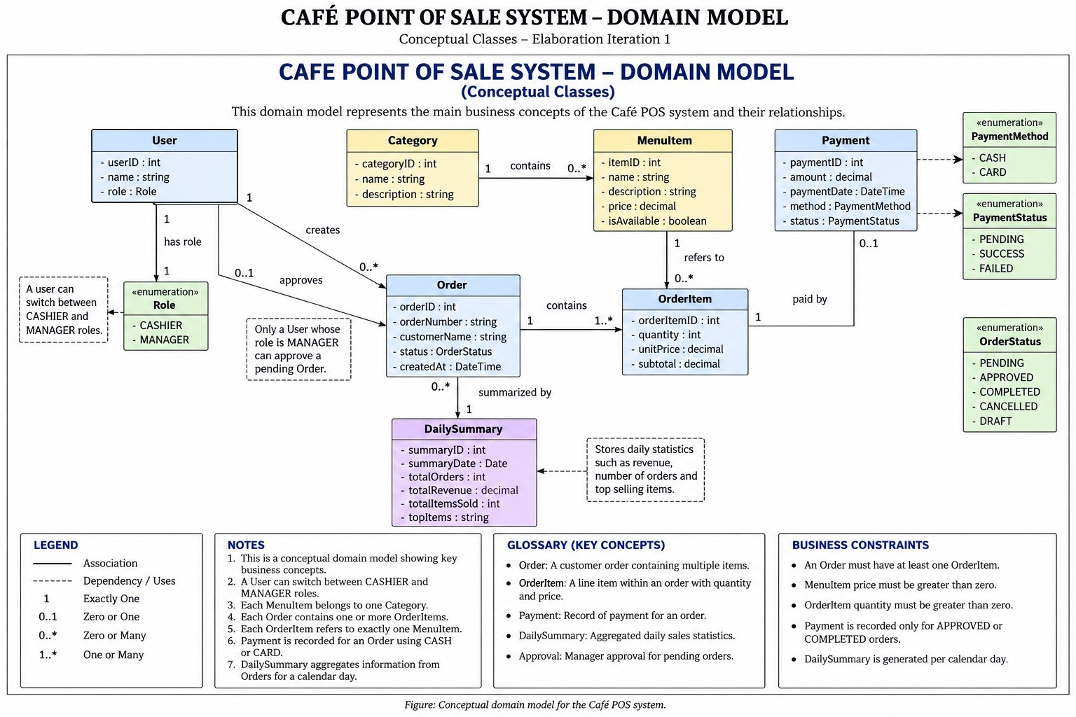
DOMAIN MODEL
Conceptual classes and business relationships
GROUP 10 • CAFÉ POS
14

Slide 15
EXPANDED USE CASES
Beyond the 10% presented during Inception
CASHIER
MANAGER
UC06 • Browse Menu
UC10 • Manage Menu
View category-based menu and item availability before building an order.
Add or edit menu items, prices, descriptions and availability.
UC07 • Clear / Reset Order
UC11 • Void Order
Remove all current line items and restart the order before submission.
Cancel an eligible order and release any reserved stock.
UC08 • Collect Payment
UC12 • Review Refund Request
Record cash or card payment for an approved/completed order.
Approve or deny a customer refund request and record the final state.
UC09 • Advance Order Status
UC13 • Monitor Item Availability
Move an order through the permitted service states after payment.
Review menu/stock state to prevent unavailable items being sold.
GROUP 10 • CAFÉ POS
15

Slide 16
USE CASE COVERAGE & TRACEABILITY
Additional interactions implied by the requirements and attached sequence
CUSTOMER / SERVICE
ACCESS & SESSION
REPORTING
UC14 • Place Order
UC16 • Log In
UC18 • Generate Daily Summary
Submit a selected set of menu items for processing.
Authenticate and establish a session token.
Aggregate orders, revenue, items sold and top items by calendar day.
UC15 • Request Refund
UC17 • Enforce Role Permissions
UC19 • Export Summary
Request a refund for an eligible paid order.
Allow manager-only actions only to the Manager role.
Export or share daily metrics for management review.
REQUIREMENT → USE CASE → MODEL
Category menu → Browse Menu → Category / MenuItem • Payment → Collect Payment → Payment • Daily metrics → Generate Daily Summary → DailySummary
GROUP 10 • CAFÉ POS
16

Slide 17
USE CASE INTERACTION MAP
Who interacts with which capabilities?
CAFÉ POS SYSTEM
Shared: Log In • Role Permissions • Session
CASHIER
Create / Adjust Order
Collect Payment
Advance Status
MANAGER
Approve Pending Order
Manage Menu
Void / Refund Decision
Browse Menu
Place Order
Request Refund
CUSTOMER
Daily Summary / Export
GROUP 10 • CAFÉ POS
17

Slide 18
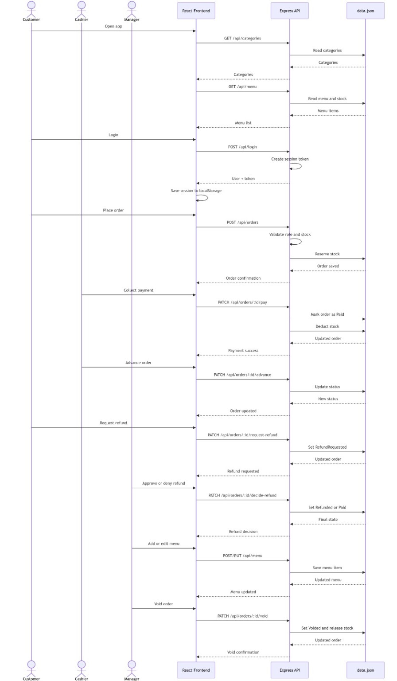
SEQUENCE DIAGRAM
End-to-end interaction across actors, frontend, API and data store
KEY FLOW
1
Load menu
Frontend reads categories and menu/stock through the API.
2
Authenticate
Login creates a session token and establishes the active role.
3
Order & pay
Order is validated, saved, then payment updates the order and stock.
4
Progress service
Cashier advances the order through permitted states.
5
Exception handling
Refund requests and voids follow controlled manager decisions.
6
Maintain menu
Manager adds or edits menu items through protected endpoints.
GROUP 10 • CAFÉ POS
18

