Slide 1


LIN protocol description

Slide 2

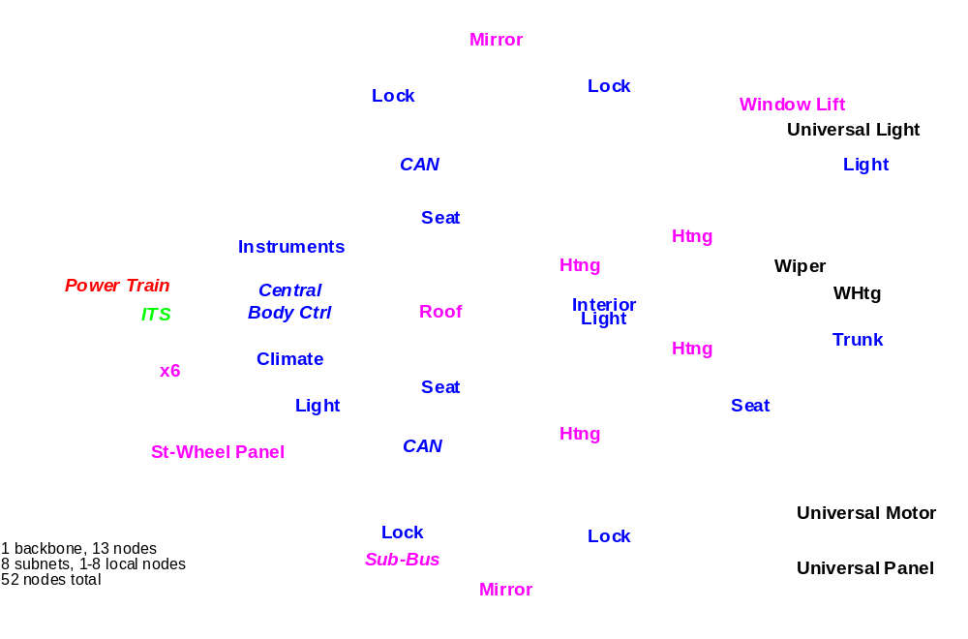
Automotive Body Network
LIN Sub Bus
W. Specks, H.-C. Wense
Notes:
3
Today a typical automotive network uses CAN to connect the various ECU with each other.
But we have now more and more ECUs, that need to communicate.
On this page we look at a simple network.
We see a hierachical structure with ECUs and their Sub-Nets
We see a lot of small Mechatronic elements that only need local communications

Slide 3
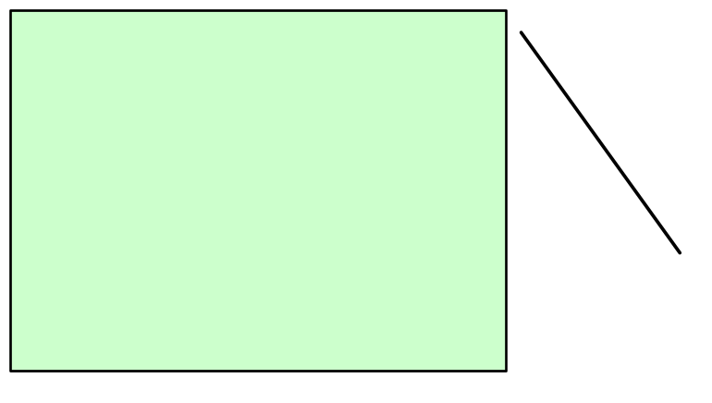
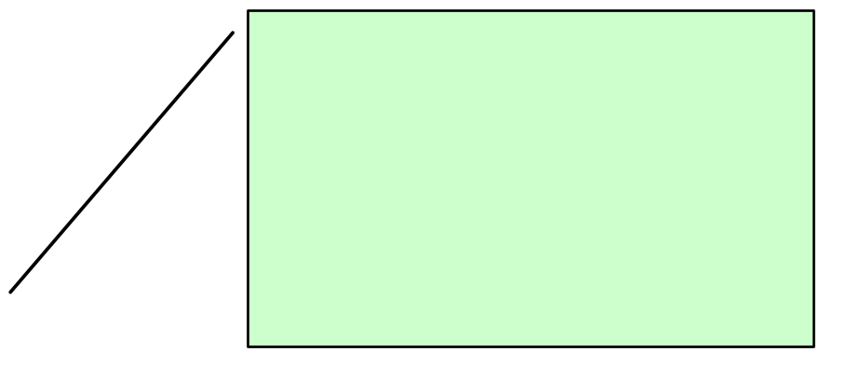
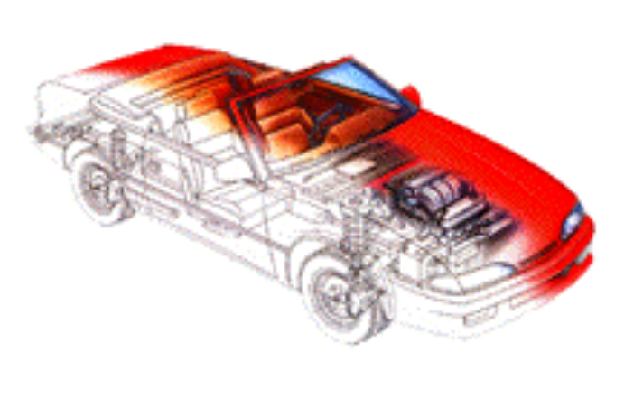
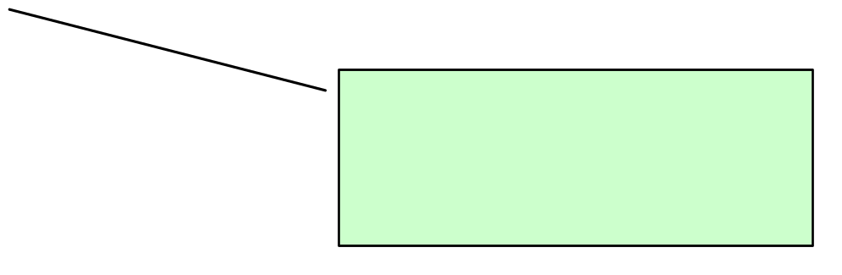
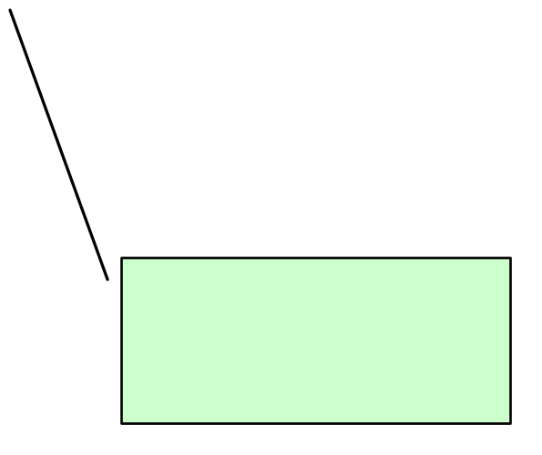
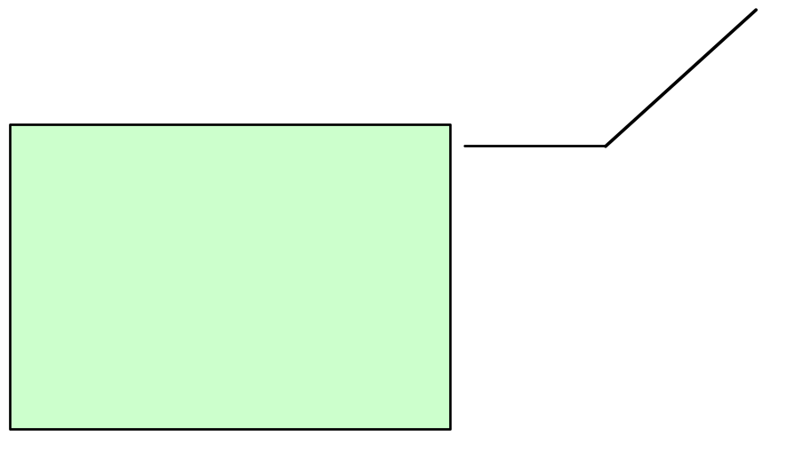
Typical LIN Applications
Roof:
(high amount of wiring)
  Rain Sensor, Light Sensor, Light Control, Sun Roof …
  (Rain Sensor needs to be interrogated every 10-20ms)
Steering Wheel:
(very many controls are going to be positioned on the steering wheel)
  Cruise Control, Wiper,
  Turning Light, …
  Optional: Climate Control, Radio, Telephone, etc.
Seat:
  many Seat Position Motors,
  Occupancy Sensor,
  Control Panel
Door/window/seat:
  Mirror,Central ECU,
  Mirror, Switch, Window Lift,
  Seat Control Switch,
  Door Lock, etc.
Climate:
  many Small Motors
  Control Panel
Notes:
9

Slide 4
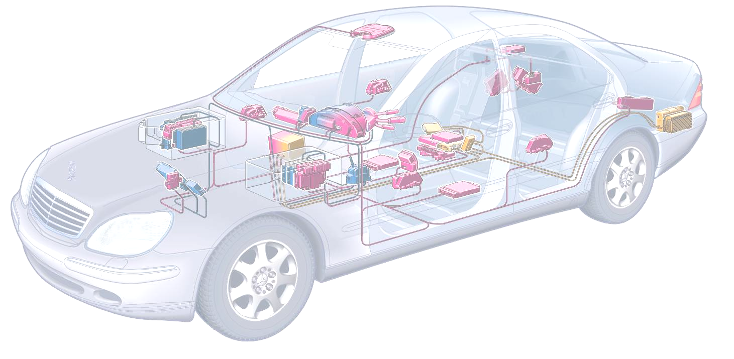
MUX Standards (Costs and Speeds)
25.6M
D2B, MOST
token ring
optical bus
Byteflight
optical bus
2M
TTx (in definition)
time triggered
fault tol, dependable
2x2 wire
Speed [bit/s]
1M
CAN-C
event triggered
dual wire
125K
LIN Fits in at the low end of in car multiplexing, making a LIN system a cost effective solution
CAN-B
event triggered
fault tolerant
dual wire
20K
LIN
master-slave
single wire bus
no quartz
1
2
4.5
10
incremental cost per node [$]

Slide 5

LIN Consortium
Consortium formed in 1998.
Five Car manufacturers
ONE Semiconductor Supplier (Motorola)
One tool Supplier (VCT)
Specification finalised on 02/02/00
Official Launch at SAE March ‘00
Open Specification.
Motorola Ready to support LIN with extensive
device families and new parts already in the
discussion/ spec finalization loop.
First dedicated LIN part available Q3 ‘00
BMW
Daimler-
Chrysler
Volvo
LIN
Spec
VW
AUDI
VCT
Notes:
4
LIN History:
1996: Volvo and VCT (Tool Supplier) developed SCI based protocol (Volcano Lite) for Vovo S80. Volcano lite is an integral part of the vehicle MUX communication system.
1997: Volvo, VCT & Motorola jointly defined an improved Version fo the protocol to meet the requirements of mechatronics, such as self synchronization without crystal and form an open standard that is able to support a wide range of semiconductor protucts.
In December 1998 The car companies Audi, BMW, DaimlerChrysler and VW joined the activities and a workgroup was formed to set up the LIN communication protocol.
Begin of Q3/1999 the LIN Protocol Spec. and the LIN Configuration Language Spec. have been released (Revision 1.0). Begin of September the LIN API specification draft has been released (Rev. 0.1)

Slide 6
LIN Standard - Overview
ECU
(LIN relevant functions only)
Tools
LIN Conformance Test Specification
Operating System
Application
LIN Recommended Use of Messages and Identifiers
Software
Level
Signal Database
Manager (SDM/L)
LIN API Specification
Communication Manager
LIN Config. Language
Network Configuration
Generator (LCFG)
LIN Protocol Specification
LIN Config Language
Hardware
Level
Bus Transceiver
Bus Analyzer
(LINSpector)
LIN Physical Layer Spec.
LIN Physical Layer Spec.
Vehicle Network

Slide 7
Hierarchical Network Structure
Flat Network
Hierarchical Network
Subnets are necessary to reduce Busload on main Bus
Solution examples:
CAN
  Automotive Standard Bus
  Compatible with Main Bus
  Expensive (Die Size/ Dual Wire)
Serial Sub Bus
  no standard Bus System
  not compatible with Main Bus
  inexpensive
  SCI-Based: Interface exists even on cheap devices
  Interface can easily be reconstructed by ASIC or CPLD
  Protocol can be done in Software
Notes:
6
In this slide we see the advantages of a hierarchical Network structure. The comunication within subnets reduce the busload of the main network.
Drawback: Communication between nodes of different subnodes is delayed due to the gateways.

Slide 8
Sub-Network: LIN vs. CAN
ECU & Gateway
Satellite 1
Satellite 2
Satellite 3
Satellite 4
CAN
phys
IF
5V
CAN
SCI
SCI
SCI
SCI
LIN phys IF
LIN phys IF
LIN phys IF
LIN phys IF
SCI
LIN phys IF
LIN
ECU & Gateway
Satellite 1
Satellite 2
Satellite 3
Satellite 4
5V
CAN
5V
CAN
5V
CAN
5V
CAN
5V
CAN
CAN phys IF
CAN phys IF
CAN phys IF
CAN phys IF
CAN phys IF
Dual Wire CAN
Cost Factors: CAN Module Dual Wire Interface
Crystal 5V supply for bus
2nd Wire / Connector
Notes:
8
This slide shows two solutions of connecting remote nodes to the main network:
The second solution operates on CAN: All nodes need to have a CAN interface, a crystal, there is a two wire connection between the nodes.
The upper solution works with a simple SCI and an enhanced ISO 9141 interface, the subnodes don't need a crystal and the connection is just one wire.

Slide 9
SubNets
Necessary to reduce Busload on main Bus
Solutions
  CAN
      Automotive Standard Bus
      Compatible with Main Bus
      Expensive (Die Size/ Dual Wire)
  Serial Sub Bus
      no standard Bus System
      not compatible with Main Bus
      inexpensive
      SCI-Based: Interface exists even on cheap devices
      Interface can easily be reconstructed by ASIC or CPLD
Notes:
5

Slide 10
Sub Bus Concept
Basic Requirements:
    Satisfy Need for a Standard for Sub Busses
    Cost driven: The solution must be cheaper than CAN
    Reliability: Same Level as CAN expected
    Long Term Solution
    Logical Extension to CAN
    Scalable: Capability to extend Systems with additional nodes
    Lowering Cost of Satellite nodes:
      No Crystal or Resonator
      Easy implementation
      Simple State Machines
    Low Reaction Time (100 ms max)
    Predictable Worst Case Timing

Slide 11
LIN Concept
Technical Solution
  Low cost single-wire implementation (enhanced ISO 9141)
  Speed up to 20Kbit/s (limited for EMI-reasons)
  Single Master / Multiple Slave Concept
      No arbitration necessary
  Low cost silicon implementation based on common UART/SCI interface hardware
      Almost any Microcontroller has necessary hardware on chip
  Self synchronization without crystal or ceramics resonator in the slave nodes
      Significant cost reduction of hardware platform
  Guaranteed latency times for signal transmission
  (Predictability)
Notes:
enhanced ISO 9141 means basically:
sender Level Low / High: 20% / 80% UBAT
receiver Low /High: 40% / 60% UBAT
Slew rate 1-2 V/µs

Slide 12
Master / Slave Protocol
Master Task
  Determines order and priority of messages.
  Monitors Data and check byte and controls the error handler.
  Serves as a reference with its clock base (stable clock necessary)
  Receives Wake- Up Break from slave nodes
Slave Task
  Is one of 2-16 members on the bus
  Receives or transmits data when an appropriate ID is sent by the master.
  The node serving as a master can be slave, too!

Slide 13
Master / Slave Protocol
Master
  has control over the whole Bus and Protocol
  The master controls which message at what time is to be transferred over the bus. It also does the error handling.
  To accomplish this the master
    sends Sync Break
    sends Sync Byte
    sends ID-Field
    monitors Data Bytes and Check Byte, and evaluates them on consistance
    receives WakeUp Break from slave nodes when the bus is inactive and they request some action.
    serves as a reference with it’s clock base (stable clock necessary)

Slide 14
Master/Slave Protocol
Slave
  Is one of 2-16 Members on the Bus and receives or transmits Data when an appropriate ID is sent by the master.
    Slave snoops for ID.
    According to ID, slave determines what to do.
      either receive data
      or transmit data
      or do nothing.
    When transmitting the slave
      sends 1, 2, 4, or 8 Data Bytes
      sends Check-Byte
    The node serving as a master can be slave, too!

Slide 15
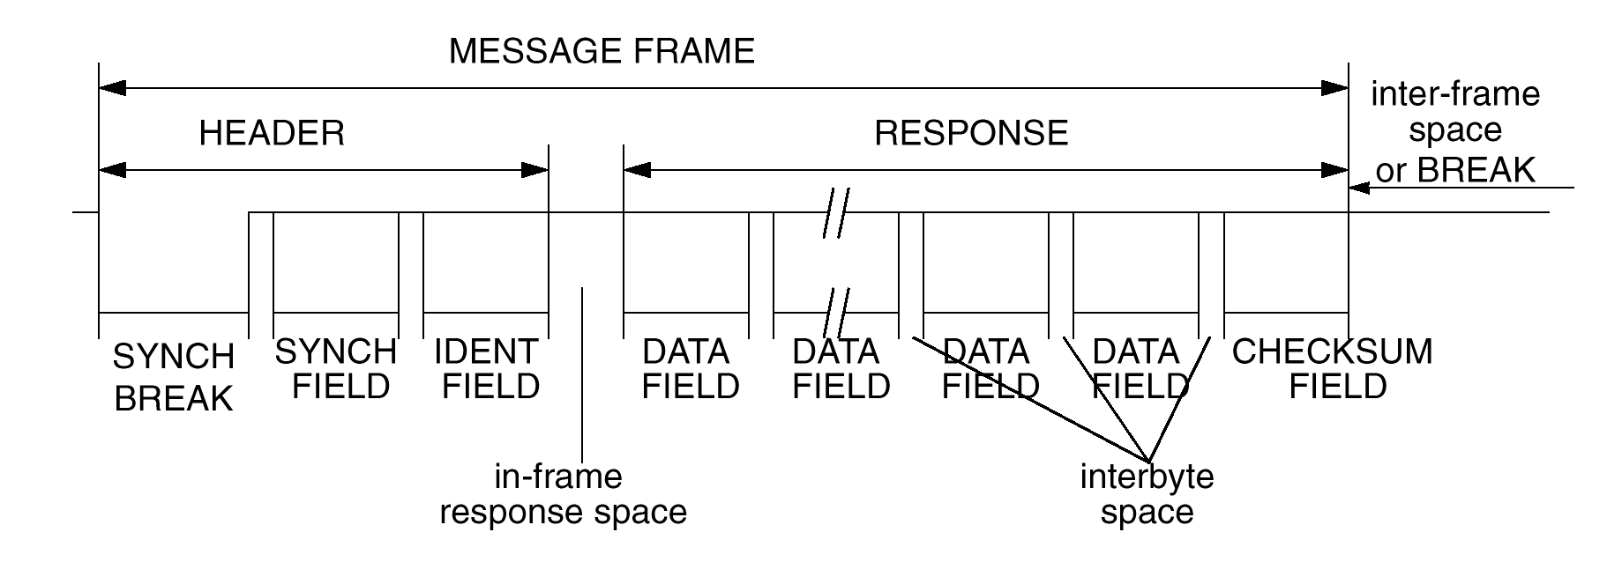
LIN protocol offers message timing predictability
Time Triggered Approach
Message Length is known
  Number of transmitted data bytes is known
  → minimum length can be calculated
  Each Message has length budget of 140% of it’s minimum length
  → maximum allowed length is known
  → distance between beginning of two messages

Slide 16
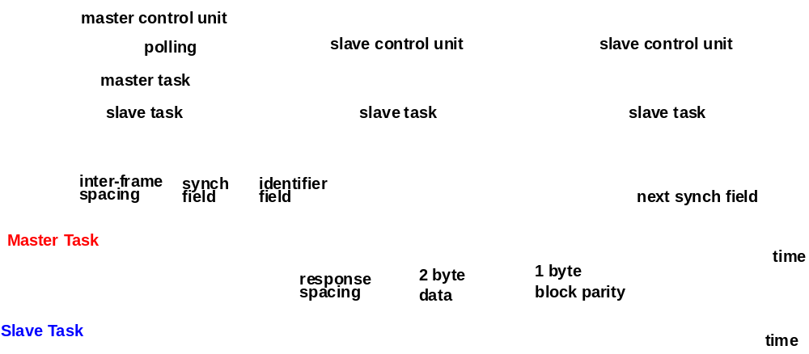
Data Transmission
13 bit
Break
Next 13 bit break
$55

Slide 17
Message Frame
Synch Byte:
  Specific Pattern for Determination of Time Base
  (Determination of the time between two rising edges)
  A Synch Byte precedes any Message Frame
ID-Field:
  Message Identifier: Incorporates Information about the sender, the receiver(s), the purpose, and the Data field length.
  Length 6 Bit.
  4 classes of 1/2/4/8 Data Bytes. The length coding is in the
  2 LSB of the ID-Field. Each class has 16 Identifiers. A total of 64 Message Identifiers are possible.
  2 Parity Bits protect this highly sensitive ID-Field.

Slide 18
Identifier
The identifier field is sent by the master node to all LIN nodes
This identifier normally contains one of 64 different values and includes 2 parity bits in the 8 bit data
The identifier is normally associated with a collection of signals that are subsequently transmitted on the LIN bus
In a specific case this can initiate SLEEP mode in the LIN slave nodes – in this case no further data is transmitted on the LIN bus
message header
synch break
≥ 13 bit
synch field
identifier

Slide 19
LIN Message Frame
message header
message response
synch break
≥ 13 bit
synch field
identifier
0 to 8 data fields
checksum
byte field
SCI / UART format
0
1
2
3
4
5
6
7
start
LSB
stop

Slide 20
LIN Communication - Data from Slave to Master
Master Node
identifier
synch field
synch break
Slave Node
LIN Master Task
Slave Task Rec
quartz
Slave Task Trans
Slave Task Rec
data byte
data byte
checksum
Slave Task Trans
Single-master / multi-slave protocol
Time triggered, no arbitration
Identifier denotes message content, not physical address
Multicast messages
Baud rate synchronization through protocol
Power saving sleep mode

Slide 21
LIN Communication - Data from Master to Slave(s)
Master Node
Slave Node A
LIN Master Task
Slave Task Rec
quartz
Slave Task Trans
Slave Task Rec
Slave Task Trans
Slave Node B
Slave Task Rec
Slave Task Trans

Slide 22
LIN Communication - Data from Slave to Slave
Master Node
Slave Node A
LIN Master Task
Slave Task Rec
quartz
Slave Task Trans
Slave Task Rec
Slave Task Trans
Slave Node B
Slave Task Rec
Slave Task Trans

Slide 23
LIN Message Frame
message header
message response
synch break
≥ 13 bit
synch field
identifier
0 to 8 data fields
checksum
Identifier byte
Synchronisation
frame
Message
Synchronisation field

Slide 24
Frame Synchronisation (1)
Initial conditions: +/- 4% baud rate accuracy relative the transmitting source
A standard transmission of data will require matched send and receiver baud rates
Standard UART byte
Start-Bit
Stop bit
A normal UART with <4% baud rate error will read back the data correctly

Slide 25
Frame Synchronisation (2)
Initial conditions: +/- 15% baud rate accuracy relative the the LIN master transmitting the synchronisation frame
A synch break must be at least 13 bit periods in duration to allow for this initial variation in oscillator accuracy within the LIN slave
Normal UART message
1
10
13
Start-Bit
Master sends a break (13 bits period duration or more)
A slow LIN slave may see fewer bit periods
1
2
11

Slide 26
Bit-Synchronisation
A start bit transition to a low logic level (dominant) indicates a start of a byte, least significiant first and completing with a logic high level (resessive) bit to indicate the STOP bit
Start-Bit
Stop-Bit
Data is sampled in the middle of the bit field:
Sample Clock

Slide 27
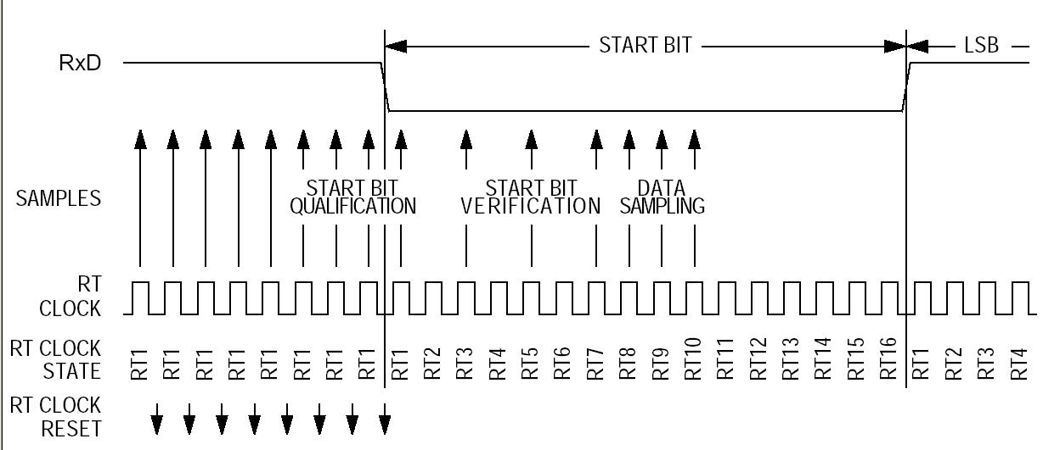
Bit Sampling

Slide 28
Bit-Synchronisation
Start-Bit
Stop-Bit
After recognition of a Low level in the start bit, the data is sampled at a rate 16 times the bit rate expected. The middle 3 samples must all agree for an error free reception of the data.
A stop bit is expected after 1 start bit and 8 data bits in a typical message
Sample Clock

Slide 29
Taking account of Ground-Shift
The detection point for data transitions can be affected by voltage references. Ground shift can change this reference by a significant amount, affecting the bit timing of the data
Sense voltage
Data timing
Available bit sampling zone can reduce worst case bit width to around 40us at 20k baud
This affects the overall baud rate tolerance required for safe LIN communications

Slide 30
LIN Physical Interface
Electronic Control Unit
Bus Voltage
VBAT
8...18V
recessive
logic ‘1’
master: 1kΩ
slave: 30kΩ
60%
controlled slope
~2V/µs
Rx
Bus
UART
40%
Tx
dominant
logic ‘0’
GND
Time
Example capacitances
master: 2.2nF
slave: 220pF
Note:
The LIN specification refers to the ECU connector voltages !

Slide 31
Examination of whether the Deadline is met
Signal based messaging with static latency analysis ensures that all signals meet defined minimum latency times
Drives need for complete configuration tool support to ensure guaranteed timing of all signals in a LIN network
longest observed
response time
probability
deadline
response time
best-case
worst-case

Slide 32
Message latency
notional
generation
new value available for trans-mission
start of frame trans-mission
completion of frame trans-mission
new value available for read call
notional
consump-tion
generation
latency
(signal)
scheduling
latency
(frame)
message
length
(frame)
notification
latency
(frame)
consumption
latency
(signal)
time
LIN availability time (signal)
maximum age (signal)

Slide 33
Message latency across a network
notional
generation
new value available for trans-mission
start of frame trans-mission
completion of frame trans-mission
new value available for read call
new value available for trans-mission
start of frame trans-mission
completion of frame trans-mission
new value available for read call
notional
consump-tion
generation
latency
(signal)
scheduling
latency
(frame)
message
length
(frame)
notification
latency
(frame)
Gateway
latency
(signal)
scheduling
latency
(frame)
message
length
(frame)
notification
latency
(frame)
consumption
latency
(signal)
time
LIN availability time (signal)
CAN availability time (signal)
maximum age (signal)
Notes:
Bei mehreren Netzwerken addieren sich die Latenzzeiten.

Slide 34
Latency optimisation with LIN
Basic schedule
Window
Status
Lock
Status
Mirror
Status
Master
Command
Keyboard
Status
Alternate schedule for low latency signals from a keyboard
Window
Status
Keyboard
Status
Lock
Status
Keyboard
Status
Mirror
Status
Keyboard
Status
Master
Command
Keyboard
Status

Slide 35
Variables Scheduling
Alternate
Schedule Table
Main
Schedule Table
Sub
Schedule Table
Sub Schedule Table
Sub Schedule Table
Decision
Msg A
Msg B
Msg C
Msg A
Msg D
Msg B
Msg A
Msg E
Msg F
Msg G
Msg A
Msg E
Msg F

Slide 36
Event Triggered Message
Problem
  Specific node communication required but this takes up too much time for all network messages
Solution : Event Triggered frame:
  Header is sent out
    normal case: no answer
    Rare response: only one node responds
    Very rare response : several nodes respond simultaneously
Cases 1 and 3 are exceptions that should be addressed at the application design.
Event triggered messaging is complementary to the regular signal based messaging scheme

Slide 37

Further information
- Consortium
http://www.lin-subbus.org

Slide 38
LIN Development Flow
Database
Manager
Database
LIN
Configuration
Description File
User provided
Information
(Target-Hardware-
Information)
LIN
Configuration
Tool
LIN
Bus-Emulator
LIN
Bus-Analyzer
LIN API
LIN Application
& Configuration
Code
ECU Application
Code
LIN-Bus
Compiler / Linker
ECU
ECU
ECU
Target
Image

Slide 39
LIN Configuration Description File
Includes all essential information of network signals, latency periods, cycle times, nodes affected
Input file serves as a development interface for a node
LIN Application Generator
  LIN-Emulator
  LIN Analyser

Slide 40
The Workflow
Data Input
  Definition of objects
  Definition of relations between the objects
Data Processing
  Signal Packing (Frame Editor/Frame Compiler)
  Timing Analysis
Data Output
  Configuration file generation
  Various optional customer-defined post-operations

