Slide 1

AUTOSAR LIN DRIVER TRAINING
Author: Le Sy Cuong - SMCAL team

Slide 2
Objective

Slide 3

Content

Slide 4
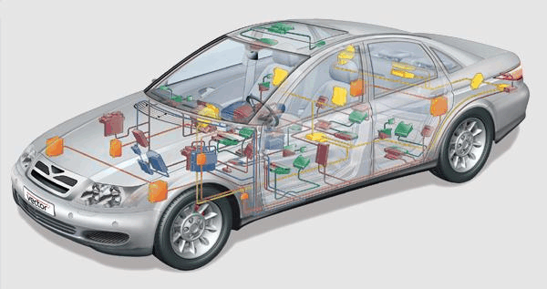
1. Overview of LIN
Basic Concepts:
Definition: LIN (Local Interconnect Network) is a serial network protocol used for communication between components in vehicles.
Notes:
Master node:
Slave node:

Slide 5
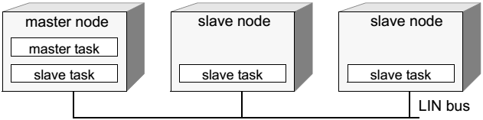
1. Overview of LIN
Basic Concepts:
Network topology: LIN is a broadcast serial network comprising one master and typically up to 16 slaves:
Notes:
Master node:
Slave node:

Slide 7
Reference
[1] LIN Specification Package Revision 2.1, November 24, 2006: http://tge.cmaisonneuve.qc.ca/barbaud/R%C3%A9f%C3%A9rences%20techniques/Bus%20LIN/LIN-Spec_Pac2_1.pdf
[2] AUTOSAR Specification of LIN Driver, Release 4.0, Revision 3: http://studylib.net/doc/18466256/release-4.0-overview-and-revision-history

Slide 8
Thank you

