Slide 1
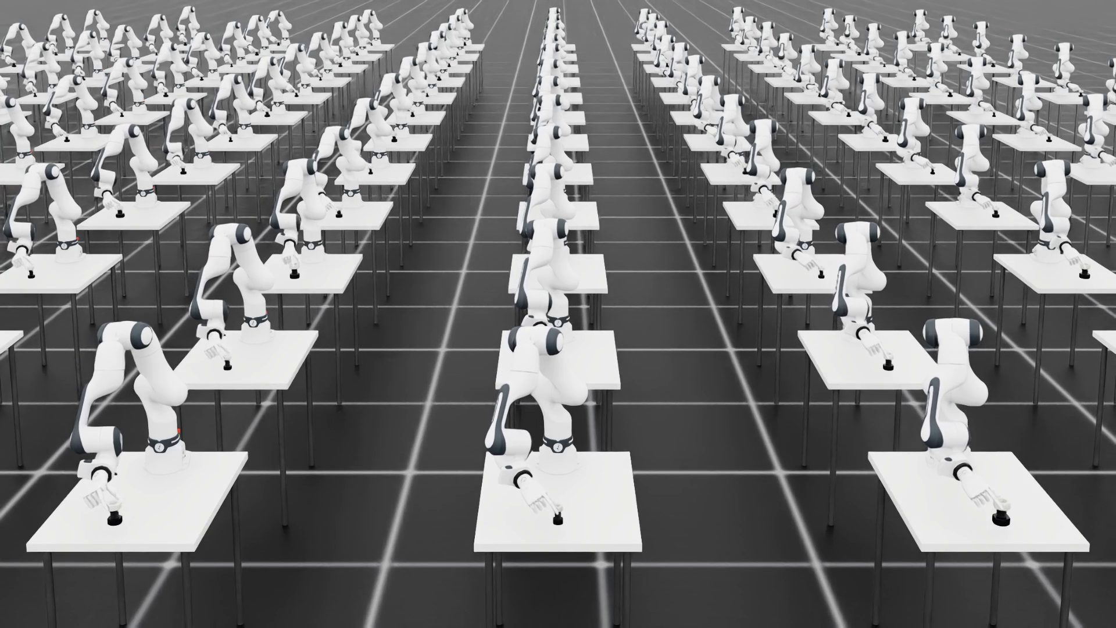
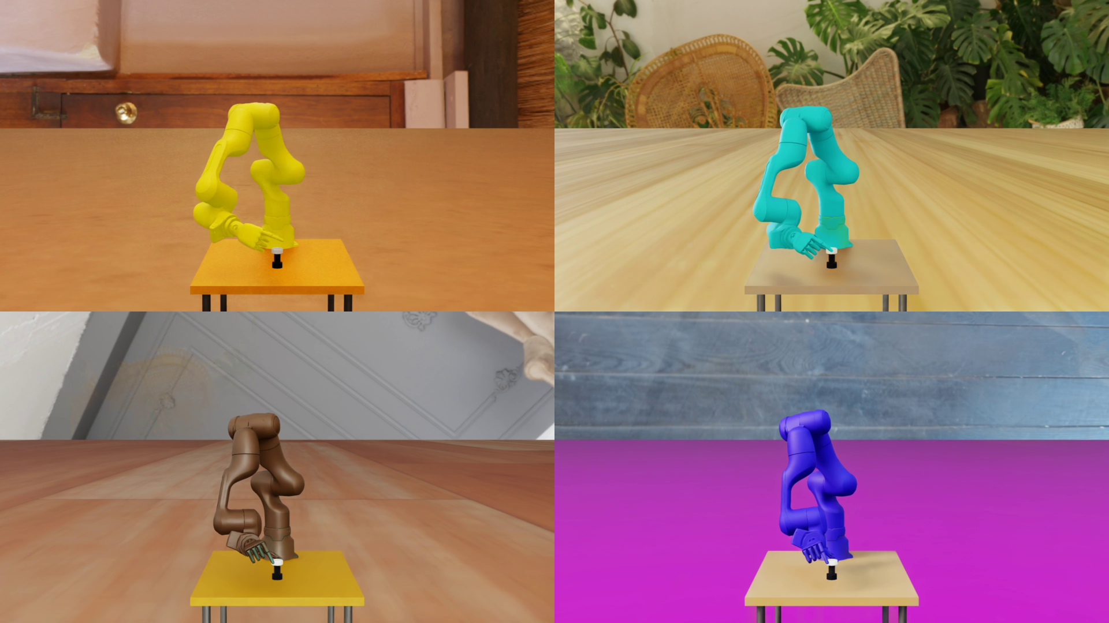
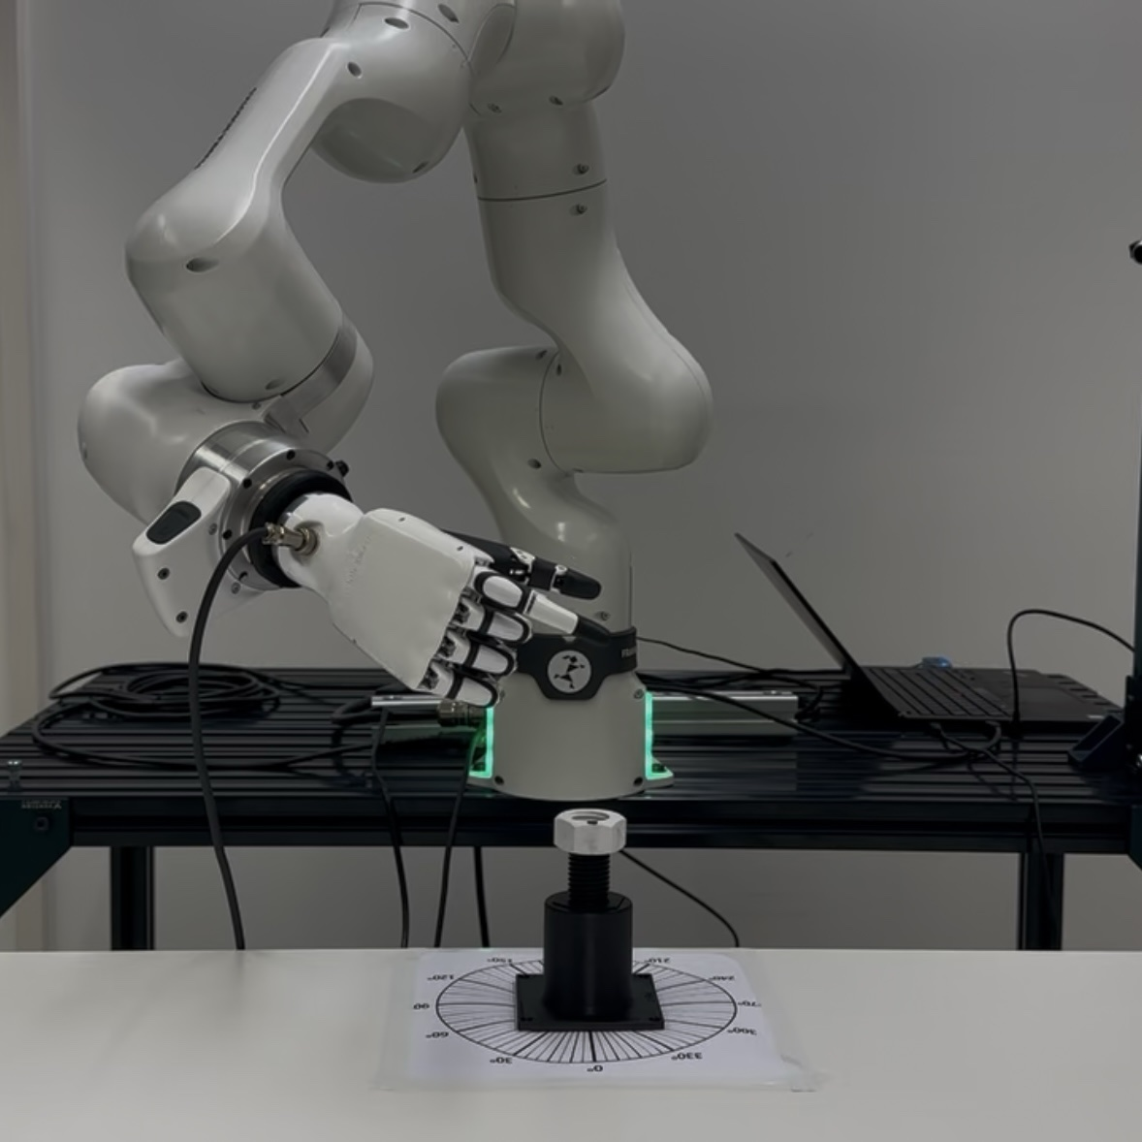
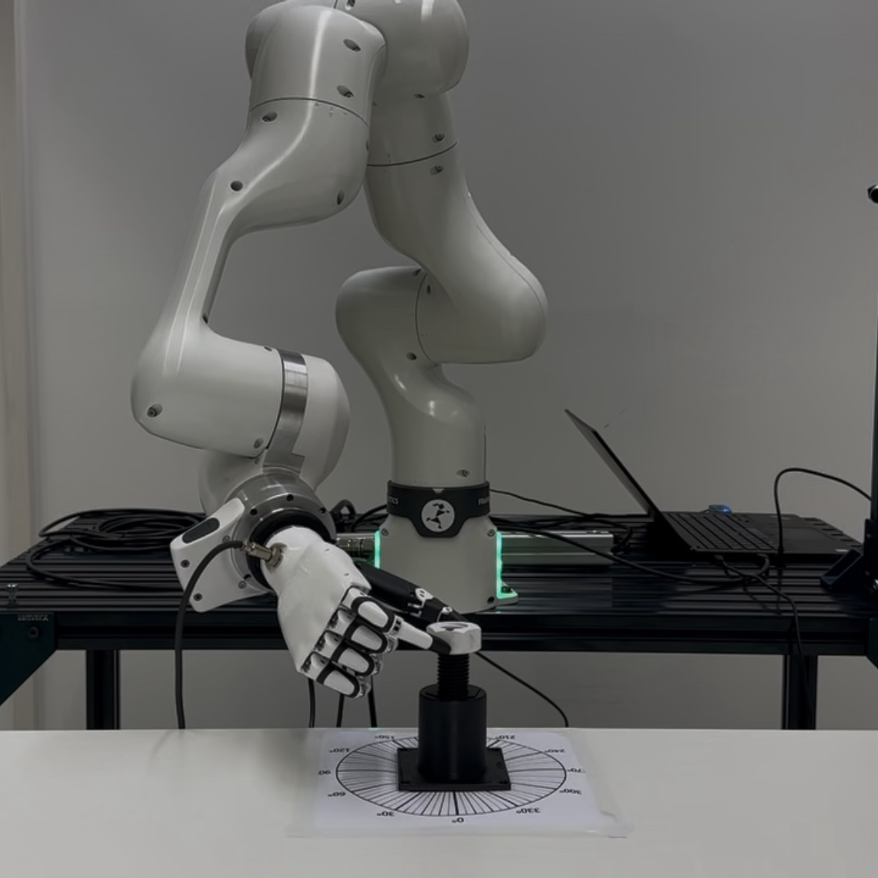
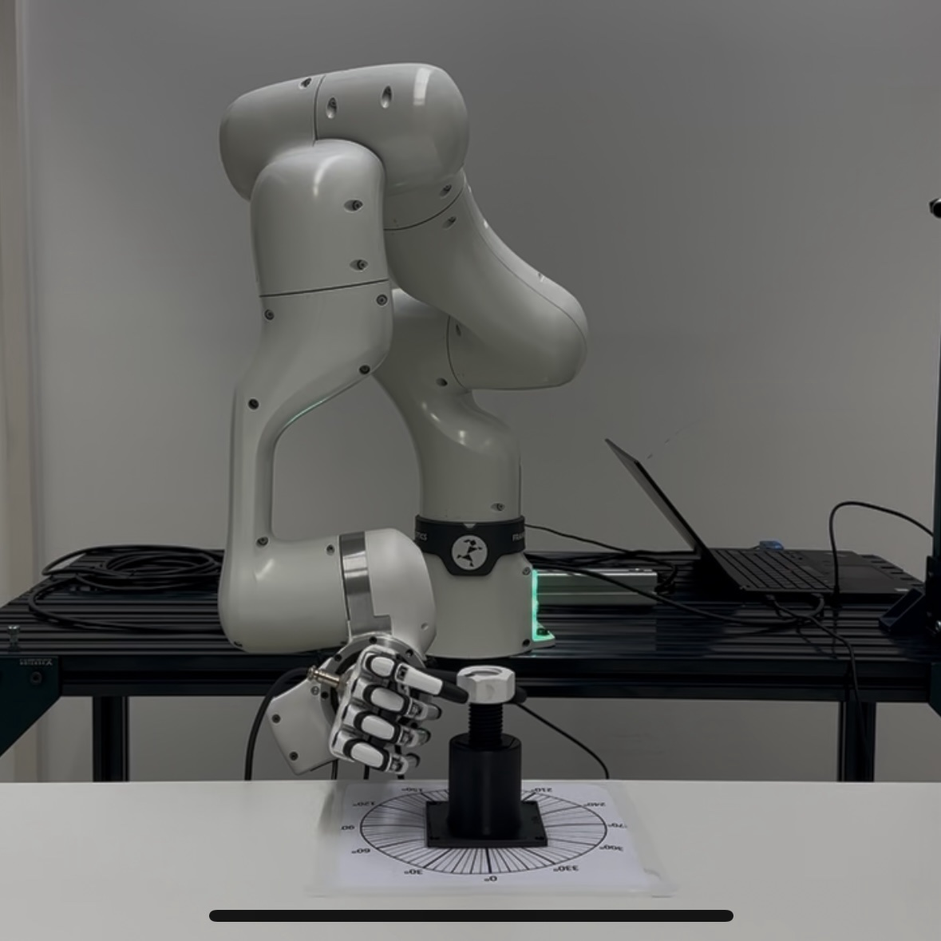
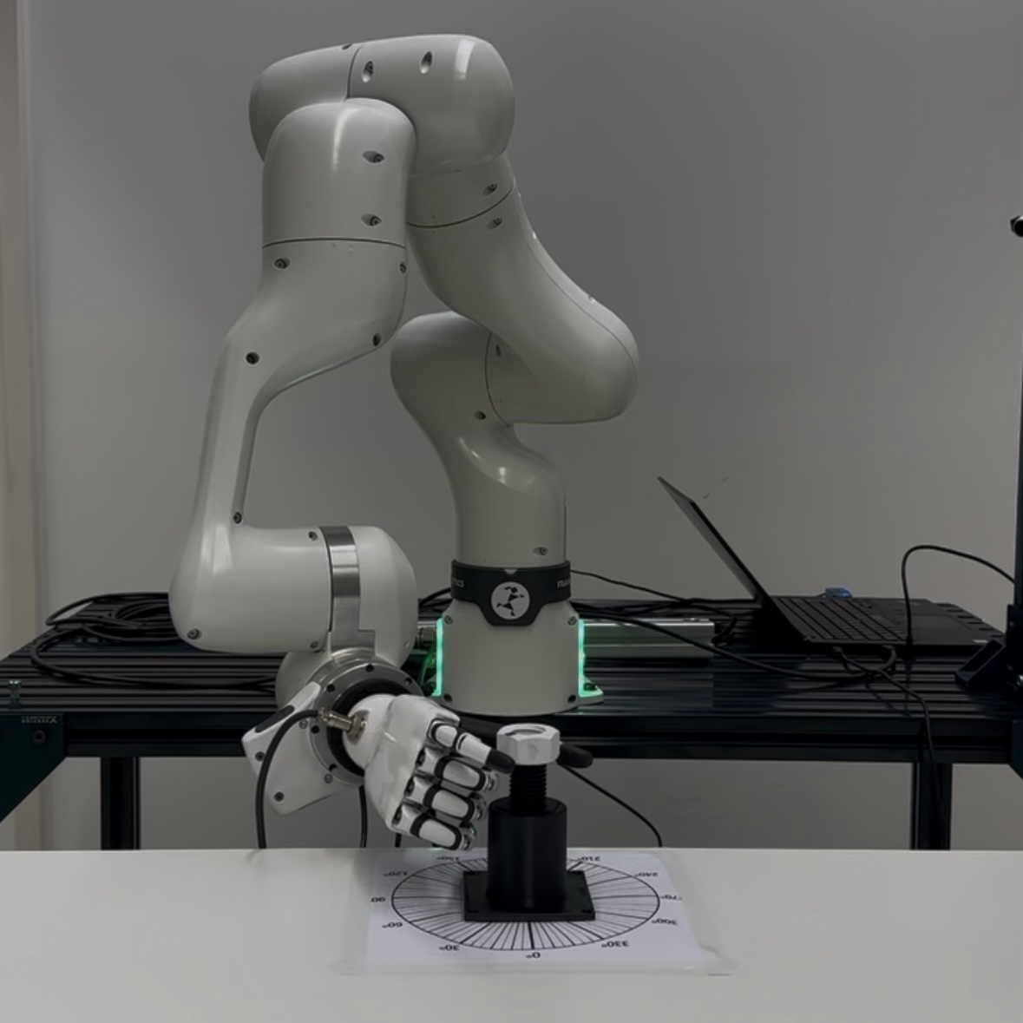
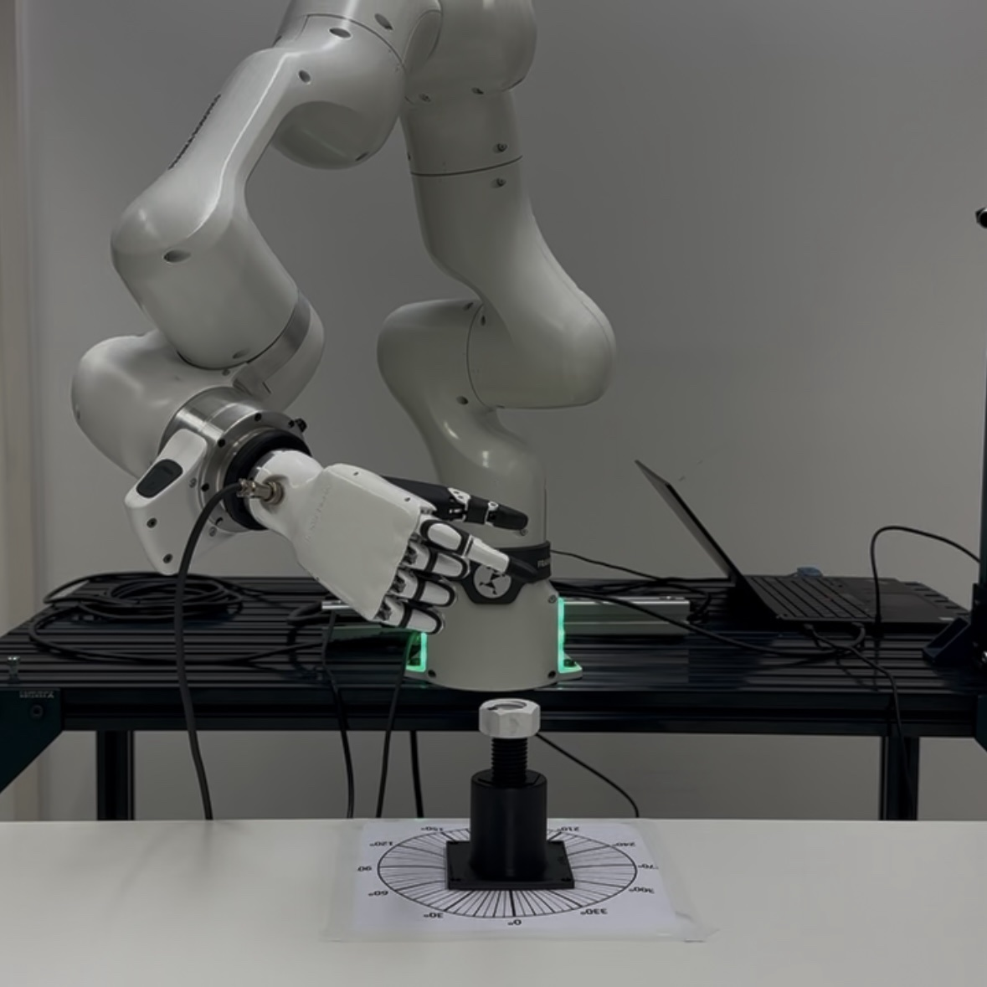
SimThreadReal
2 Cyclic State-Machine Replay
Turn
(teacher)
Release
Return
Re-engage
repeat for multiple turns
Repeated Rollouts → Long-Horizon Dataset
complete cyclic trajectories for flow matching
1 Single-Turn Teacher Policy Training
3 Vision-Conditioned Flow Matching
4 Sim-to-Real Deployment
Initial Pose
Grasp
Rotate
Release
Reset
cyclic return and re-engagement

Slide 2
