Slide 1
Planning anything is not that easy

Slide 2
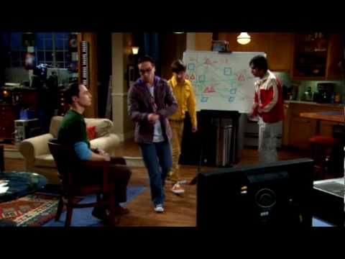
It should look like this

Slide 3
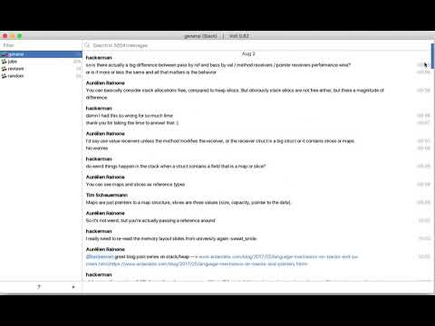
But we usually converse over chat apps

Slide 4
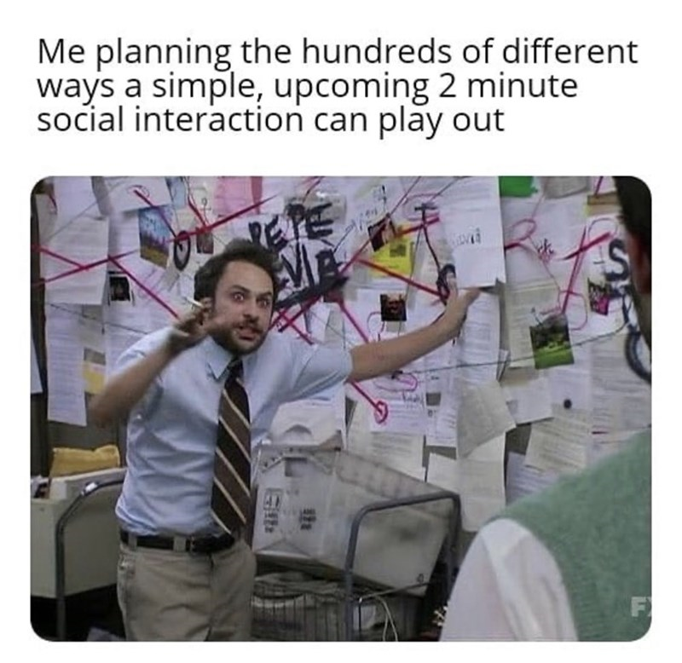
But mapping anything based on a group chat is daunting
Notes:
Video of scrolling through group chat

Slide 5
Mind Mapper
A project to plan over chat or conversations across all platform majorly on (slack & discord) for chat and (twitter space/facebook voice/spotify & apple music podcast/ simple call) for voice based conversations.
Based on the voice/chat this app will graph out conversation and create a mind-map of all those chats.
Thus mapping out a solution based on voice/chat history will be easier.
Convert your unread chats to a simple and easily visualiable graphs so that you don’t have to miss out on a plan.

Slide 6
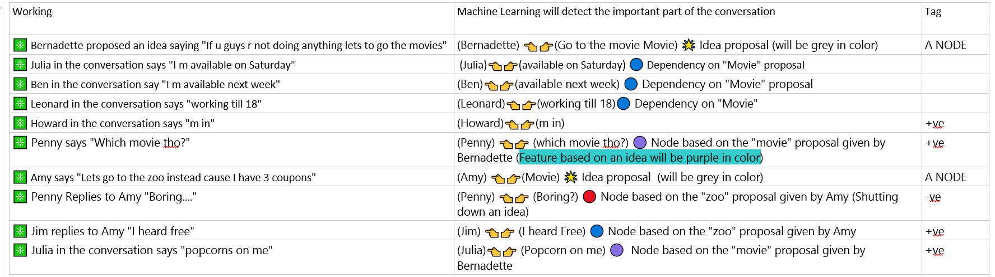
Example, this is a group chat thread discussing what to do coming saturday
❇ Bernadette proposed an idea saying "If u guys r not doing anything lets to go the movies"
❇ Julia in the conversation says "I’m available on Saturday"
❇ Ben in the conversation say "I'm available next week"
❇ Leonard in the conversation says "working till 18"
❇ Howard in the conversation says "m in"
❇ Penny says "Which movie tho?"
❇ Amy says "Lets go to the zoo instead cause I have 3 coupons"
❇ Penny Replies to Amy "Boring...."
❇ Jim replies to Amy "I heard free"
❇ Julia in the conversation says "popcorns on me"

Slide 7
For better representation

Slide 8
{@Bernadette,Movie Idea}

Slide 9
{@Julia, [“available on Saturday”]}
{@Bernadette,Movie Idea}

Slide 10
{@Julia, [“available on Saturday”]}
{@Ben,[“available next week”]}
{@Bernadette,Movie Idea}

Slide 11
{@Julia, [“available on Saturday”]}
{@Ben,[“available next week”]}
{@Bernadette,Movie Idea}
{@Leonard, [“working till 18”]}

Slide 12
{@Julia, [“available on Saturday”]}
{@Ben,[“available next week”]}
{@Bernadette,Movie Idea}
{@Howard,[“I’m in”]}
{@Leonard, [“working till 18”]}

Slide 13
{@Penny 👉 @Bernadette, [“which movie tho?”]}
{@Julia, [“available on Saturday”]}
{@Ben,[“available next week”]}
{@Bernadette,Movie Idea}
{@Howard,[“I’m in”]}
{@Leonard, [“working till 18”]}

Slide 14
{@Penny 👉 @Bernadette, [“which movie tho?”]}
{@Julia, [“available on Saturday”]}
{@Ben,[“available next week”]}
{@Bernadette,Movie Idea}
{@Howard,[“I’m in”]}
{@Leonard, [“working till 18”]}
Through NLP we can figure that it is a feature based on an idea to further that ideas progress

Slide 15
{@Penny 👉 @Bernadette, [“which movie tho?”]}
{@Julia, [“available on Saturday”]}
{@Ben,[“available next week”]}
{@Amy, Zoo idea}
{@Bernadette,Movie Idea}
{@Howard,[“I’m in”]}
{@Leonard, [“working till 18”]}

Slide 16
{@Penny 👉 @Bernadette, [“which movie tho?”] ||
@Amy 👉 [“Boring…”]}
{@Julia, [“available on Saturday”]}
{@Ben,[“available next week”]}
{@Amy, Zoo idea}
{@Bernadette,Movie Idea}
{@Howard,[“I’m in”]}
{@Leonard, [“working till 18”]}

Slide 17
{@Penny 👉 @Bernadette, [“which movie tho?”] ||
@Amy 👉 [“Boring…”]}
{@Julia, [“available on Saturday”]}
{@Ben,[“available next week”]}
{@Amy, Zoo idea}
{@Bernadette,Movie Idea}
{@Howard,[“I’m in”]}
{@Leonard, [“working till 18”]}
{@Jim,[“I heard free”]}

Slide 18
{@Penny 👉 @Bernadette, [“which movie tho?”] ||
@Amy 👉 [“Boring…”]}
{@Julia, [“available on Saturday”,”Popcorns on me”]}
{@Ben,[“available next week”]}
{@Amy, Zoo idea}
{@Bernadette,Movie Idea}
{@Howard,[“I’m in”]}
{@Leonard, [“working till 18”]}
{@Jim,[“I heard free”]}

Slide 19
{@Penny 👉 @Bernadette, [“which movie tho?”] ||
@Amy 👉 [“Boring…”]}
{@Julia, [“available on Saturday”,”Popcorns on me”]}
{@Ben,[“available next week”]}
{@Amy, Zoo idea}
{@Bernadette,Movie Idea}
{@Howard,[“I’m in”]}
{@Leonard, [“working till 18”]}
{@Jim,[“I heard free”]}

Slide 20
{@Penny 👉 @Bernadette, [“which movie tho?”] ||
@Amy 👉 [“Boring…”,]}
{@Julia, [“available on Saturday”,”Popcorns on me”]}
{@Ben,[“available next week”]}
{@Amy, Zoo idea}
{@Bernadette,Movie Idea}
{@Howard,[“I’m in”]}
{@Leonard, [“working till 18”]}
{@Jim,[“I heard free”]}
Adding sentiment analysis when the conversation stop for 10/20 mins

Slide 21
I know this is a poor representation of how it should look but this is what I was thinking about
It should look something like this https://npm.anvaka.com/#/
And type “express” in the search box.

Slide 22
Use-Case
Add weights to certain edges of the graph to calculate (metric of choice will based on the user)
how feasible the idea is ⇒ after performing sentiment analysis an AI can predict the likeliness of that idea coming to future based on the conversation and how long it continued (or other interesting parameters)
A custom feature for all the users: Based upon your schedule/interests, can you join movie proposal or zoo proposal (in this case based former example, an automation script that can check your availability [which can be found using google-calendar(it’s just an example) task scheduling APIs] on that day when everyone is planning).
if working on a Software project
Derive flow-chart
Based on individual skill level directly associate a bug or an issue token to a contributor on github(using github-APIs or create a JIRA token).
Notes:
At the moment we will keep our scope of project quiet small but we can flourish later.

Slide 23
Why am I dropping the chat-messages in Real-Time
Every symbol.ai user gets specific number of APIs usage packet, if we choose to keep real-time it shouldn’t be for chat (IMO).
We will keep a date-time field for query to be resolved; the “from-date” would be of a channel(discord)/workspace(slack) since the “last-online till now”. But the user can specifically add the from & to date-time field.
To not write CQL we will be using GraphQL so as to query all the graph and nodes.

Slide 24
TOOLS
MVP product
MERN stack based chat-app web-app by Prakash Jha
Integration with slack+discord+microsoft-teams for chats and audio-video-calls (online-real-time)
Integration with zoom
Integration with whatsApp(if it is possible) +
NLP (Conversation AI) APIs (for text & speech in real-time)
Symbl_AI
IBM watson conversation API
Neo4j ===> If the set of group of people choose to save that graph we need a graph DB (for easy traversals)
React-flow-render to showcase graphical representation.
Redis for channels

Slide 25
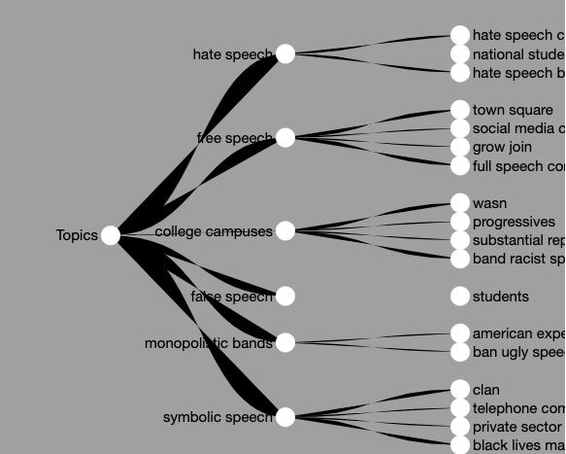

Slide 26
Pipeline of the workflow
https://www.figma.com/file/8tPqKd3fqSc7nGskGEkJp2/Conversation-Mind-Mapper?node-id=0%3A1

Slide 27
How the chat-data should look
{
}

Slide 28
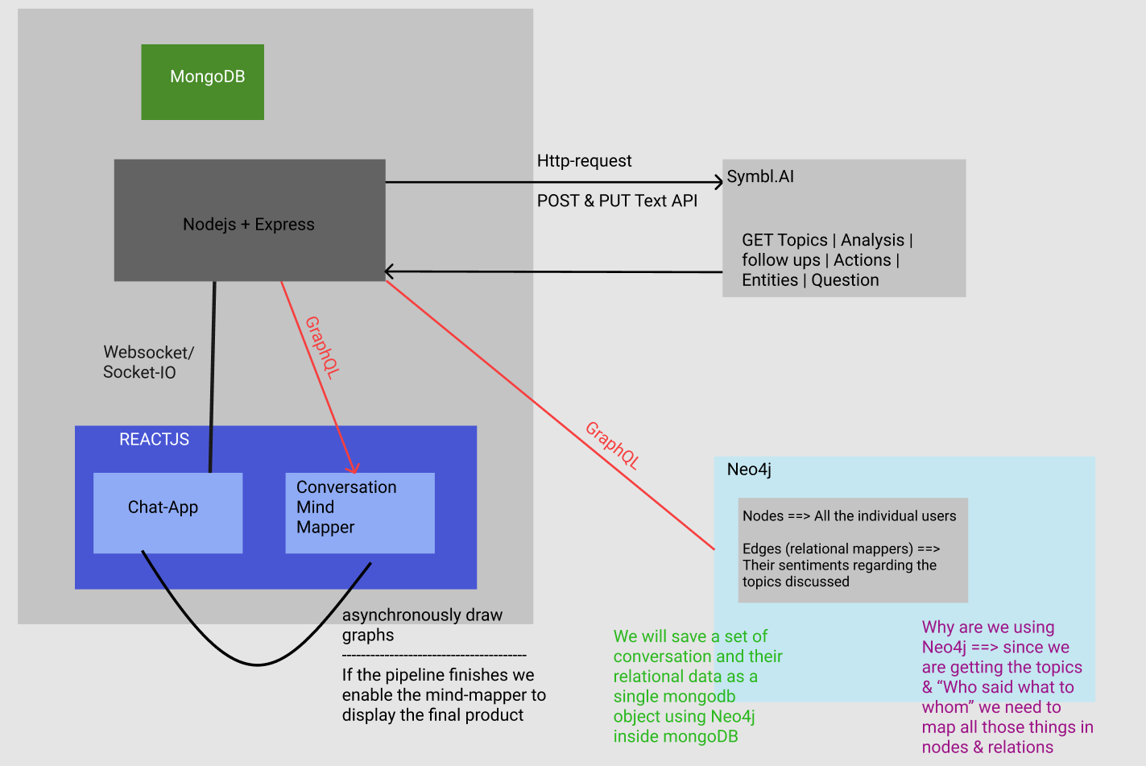

Slide 29
List of edge cases
“If there is meme war or lots of images have been shared to convey a message” ⇒ should we use image analysis

