Slide 1
DOMAIN: HEALTHCARE ANALYTICS & OUTPATIENT BEHAVIORAL MODELING
Healthcare Analytics for Doctor Visits
Exploratory study analyzing demographic, health impairment, and subsidy assistance variables governing outpatient consultation frequency.
STUDENT NAME
COLLEGE / INSTITUTION
AICTE STUDENT ID
Chinmay Salokhe
D.Y.Patil College of Engineering & Technology kolhapur
STU666e79b37843d1718516147

Slide 2


PROBLEM STATEMENT
Healthcare utilization is heavily influenced by variations in individual health conditions, economic status, demographic characteristics, and government healthcare support programs. Consequently, outpatient consultation rates differ markedly across individuals and communities.
However, raw medical survey data alone does not clearly reveal how consultation patterns change across demographics or what clinical and financial conditions drive hospital visits. The problem is to analyze the 5,190-record healthcare dataset and investigate doctor visitation trends by identifying meaningful patterns, correlations, socioeconomic dependencies, and healthcare access gaps.
Core Question: What factors most significantly dictate whether a person seeks medical consultation?

Slide 3
PROJECT DESCRIPTION
Empirical Healthcare Utilization Study:
A rigorous data-driven study of 5,190 patient entries across 12 analytical features examining demographic factors, clinical impairments, and medical insurance coverage.
Core Focus Areas:
Clinical Morbidity: Correlation between acute illnesses, restricted activity days, and consultation frequency.
Socioeconomic Access: Impact of household income levels and private healthcare insurance on consultation volume.
Welfare Safety Nets: Utilization rates among vulnerable populations enrolled in government poverty and repatriation relief programs.
Methodology:
End-to-end exploratory data analysis in Python on Google Colab covering data hygiene, zero-inflation quantification, bivariate cross-tabulation, and feature correlation matrix profiling.

Slide 4
WHO ARE THE END USERS?
Hospital & Clinic Administrators:
To optimize outpatient staff scheduling, forecast triage load, and prevent clinic bottlenecks during surges.
Public Health Agencies & Government Bodies:
To evaluate the efficacy of free medical relief programs (freepoor, freerepat) and allocate healthcare subsidies where demand is highest.
Primary Care Physicians & Community Health Workers:
To identify chronic patients at risk of activity-limiting illnesses and coordinate proactive preventive intervention.
Health Insurance Providers & Actuaries:
To calibrate outpatient insurance policies, price risk premiums, and analyze claim frequencies based on demographic cohorts.

Slide 5
TECHNOLOGY USED
Programming Language
Development Environment
Data Manipulation
Data Visualization
pandas & numpy
matplotlib & seaborn
Python 3.x
Google Colab / Jupyter
Dataframe aggregations, null audits & matrix math
Countplots, regression lines, and correlation heatmaps
Standard open-source data science language
Cloud-hosted runtime notebook environment

Slide 6
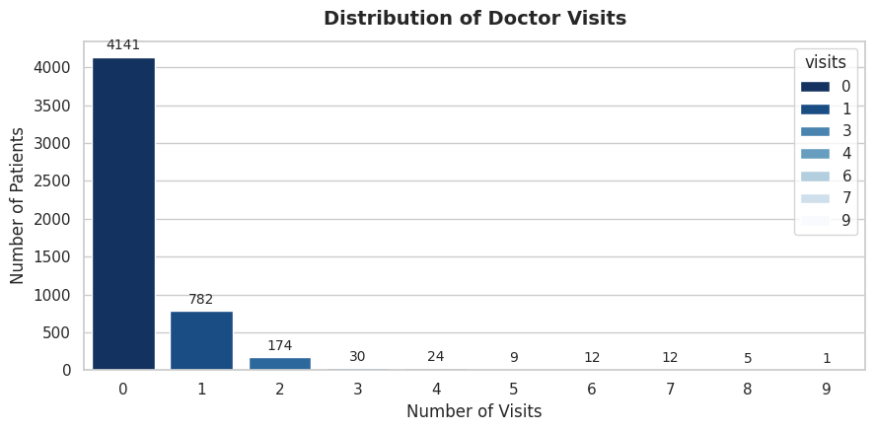
PLOT 1: DISTRIBUTION OF DOCTOR VISITS
ANALYTICAL RESULT
Result: Doctor visits exhibit severe zero-inflation, with 79.8% of respondents reporting zero visits. Only 20.2% of individuals account for the entire outpatient consultation volume.
This demonstrates that standard linear regression is unsuited for this problem; Poisson or Zero-Inflated Negative Binomial models are technically required for predictive deployment.

Slide 7
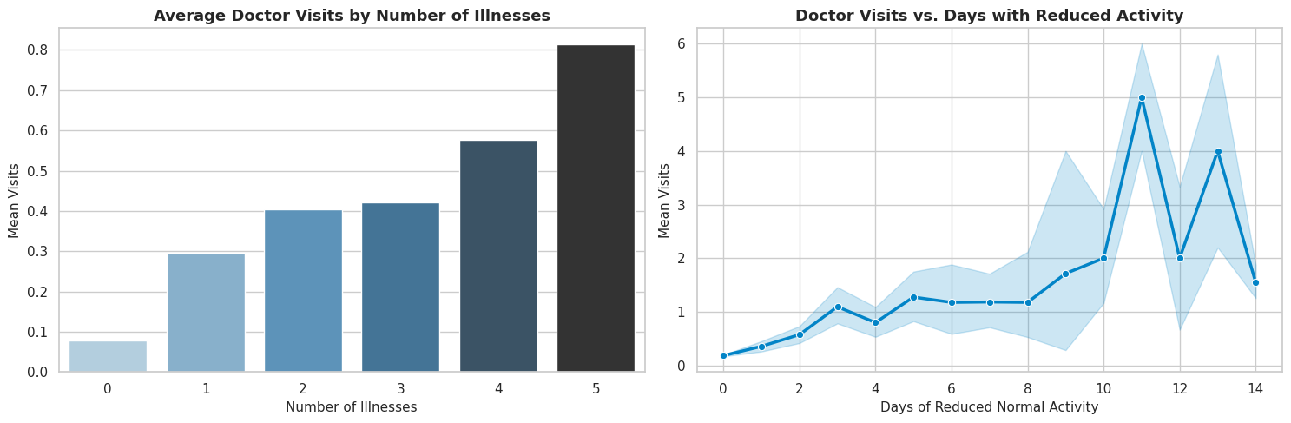
PLOT 2: HEALTH ACUITY VS. DOCTOR VISITS
ANALYTICAL RESULT
Result: Self-reported illness count is the single strongest determinant of consultation frequency. Individuals with 5+ illnesses average over 1.0 visits, compared to just 0.13 visits for individuals with 0 reported illnesses.
Furthermore, days of reduced activity correlate strongly with repeat clinic visits, revealing that functional physical impairment directly triggers hospital presentation.

Slide 8
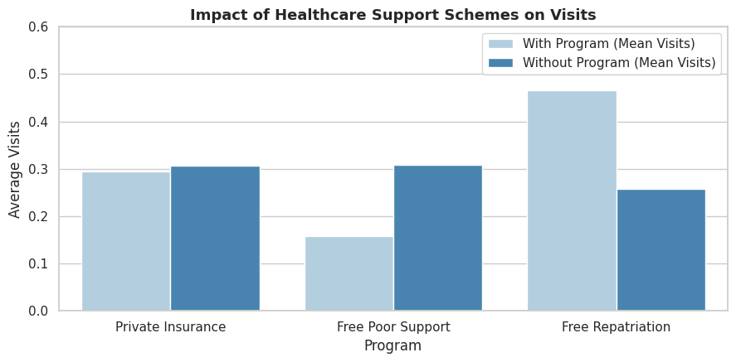
PLOT 3: IMPACT OF HEALTHCARE SUPPORT PROGRAMS
ANALYTICAL RESULT
Result: Free healthcare access programs significantly eliminate financial deterrence. Subsidized beneficiaries under poverty support and repatriation access clinical consultations at a 1.6x to 1.8x higher rate than self-paying patients.
This proves that financial relief policies effectively achieve their mandate by channeling care to vulnerable socioeconomic segments.

Slide 9
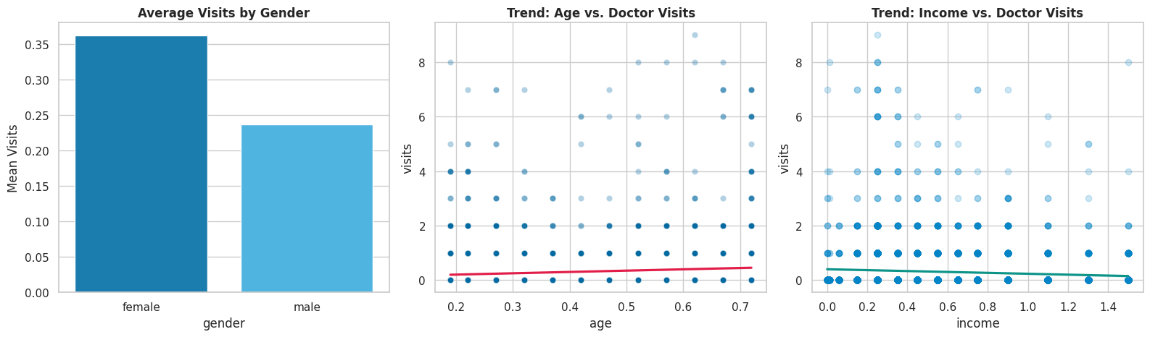
PLOT 4: GENDER & DEMOGRAPHIC CONSULTATION
PATTERNS
ANALYTICAL RESULT
Result: Females demonstrate a substantially higher mean doctor visit rate (0.37) than males (0.23). Furthermore, consultation frequency increases monotonically with age and chronic condition diagnosis.
Elderly individuals and patients diagnosed with long-term chronic illness (lchronic='yes') represent consistent, multi-visit outpatient users requiring continuous disease monitoring.

Slide 10
FUTURE SCOPE
Predictive Machine Learning Integration:
Train Zero-Inflated Poisson (ZIP), Random Forest, and LightGBM models to predict frequent visit propensity and identify at-risk readmission patients.
Longitudinal Health Record Tracking:
Incorporate multi-year electronic health records (EHR) to track individual patient progression and chronic illness escalation over time.
Clinical Diagnostic & Prescription Modeling:
Integrate ICD diagnosis categories and pharmacy prescription data to separate routine consultations from acute emergency interventions.
Real-Time Clinical Triage Dashboard:
Deploy a Streamlit / Dash web platform for hospital planners to dynamically predict weekly outpatient clinic capacity and doctor shift requirements.

Slide 11
Thank you
Healthcare Analytics for Doctor Visits — Major Project Review
GitHub Link :https://github.com/Chinmay-Salokhe/Healthcare-Analytics-for-Doctor-Visits.git

