Slide 1

Hotel Booking Data Analysis using Python
Prepared by: Chinmay Ashok Murkar
Tools & Technologies
Python · Pandas · NumPy · Matplotlib · Seaborn · Jupyter Notebook
Notes:
1

Slide 2
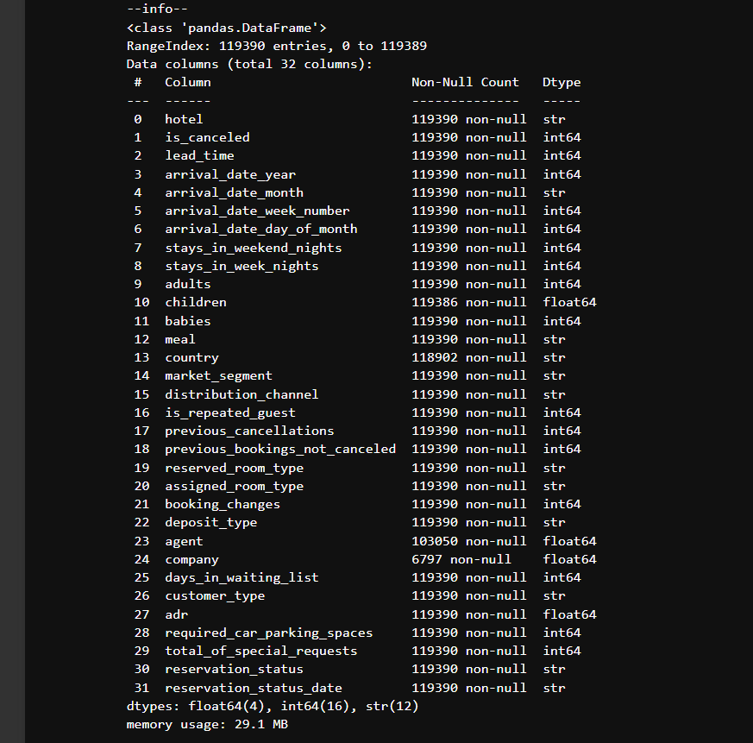


Project Overview & Objectives
Data Cleaning
Exploratory Analysis
Visualization
Insights & Actions
Analyze hotel booking data to reveal customer behavior, booking patterns, and cancellation drivers so stakeholders can take targeted actions to increase revenue and reduce churn.
01
02
Understand dataset
Clean & preprocess
Assess structure, quality, and scope
Deduplicate, impute, and convert types
03
04
EDA & visualization
Deliver insights
Uncover trends, outliers, and correlations
Actionable recommendations for operations and marketing
Notes:
2

Slide 3
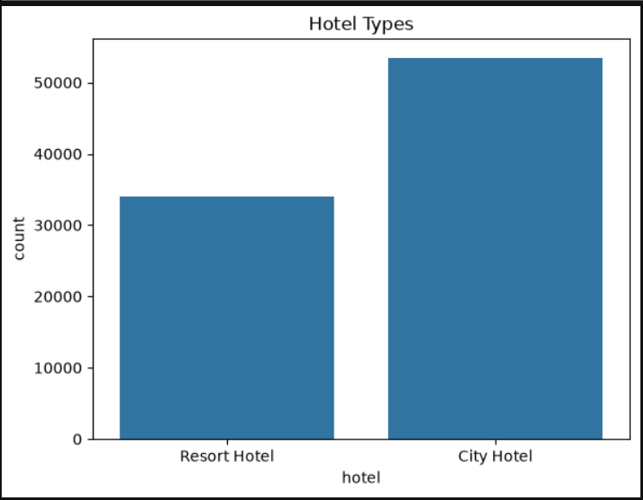
Dataset Overview
Summary
Original records: 119,390
Cleaned records: 87,396
Total features: 32 (20 numeric, 12 categorical)
Dataset size: 29.1 MB | Period: 2015–2017
Contains customer profiles, booking metadata, hotel type, reservation status, ADR, and market segment.
Notes:
3

Slide 4
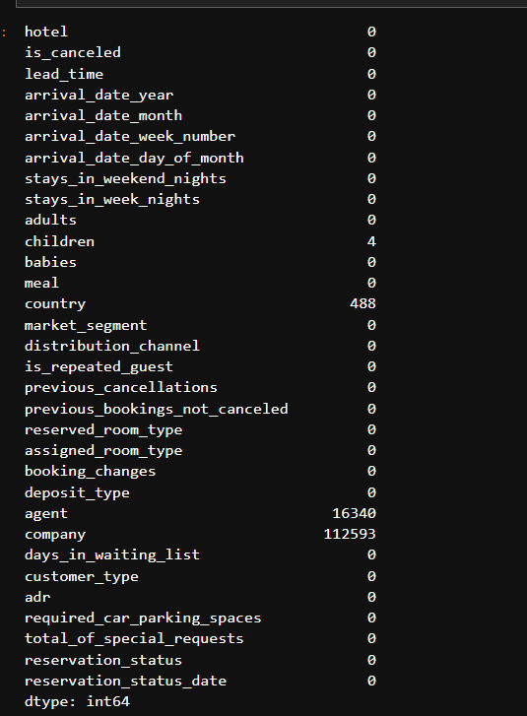
Data Cleaning & Preprocessing
We removed duplicates, handled missing values, and standardized types to prepare a reliable dataset for analysis.
Key Actions
Missing values (notable)
Removed 31,994 duplicate records; imputed/flagged missing values; verified data types; sanitized ADR and lead-time fields.
Children: 0.003% · Country: 0.41% · Agent: 13.69% · Company: 94.31%
Record counts
Before: 119,390 → After cleaning: 87,396
Notes:
4

Slide 5
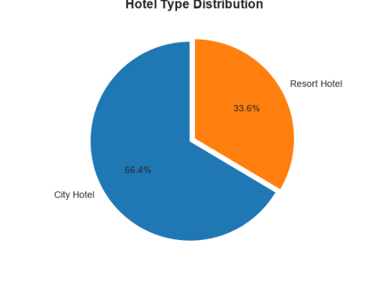
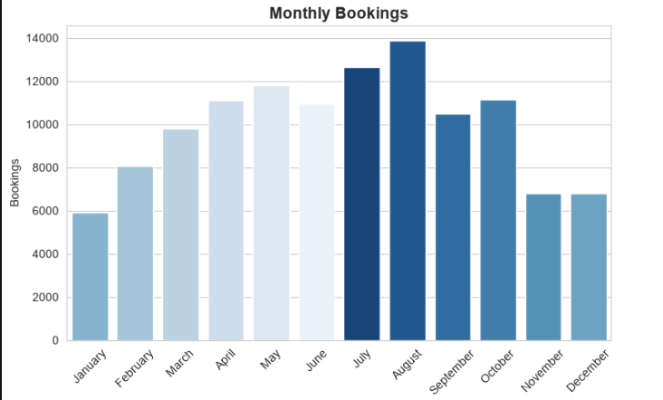


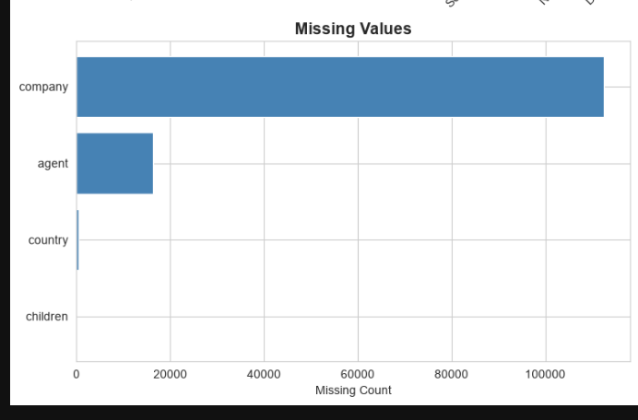
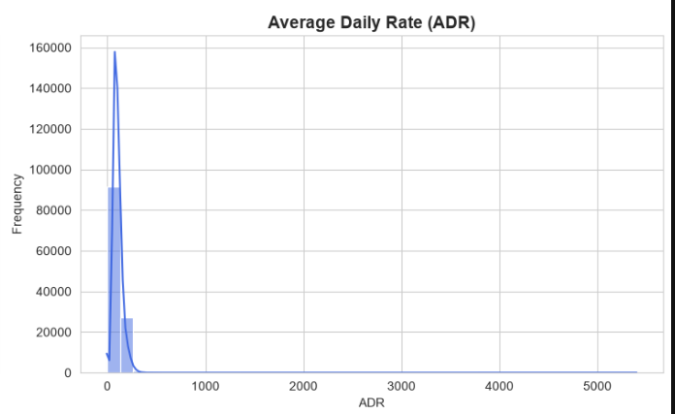

Exploratory Data Analysis (EDA)
Focused EDA areas: hotel distribution, cancellations, lead time, ADR, customer composition, repeat guests, booking changes, and special requests.
Booking Trends
Seasonality and weekly patterns examined
Hotel Mix
City vs Resort distributions
Data Quality
Outliers in ADR and gaps in agent/company fields
Notes:
5

Slide 6
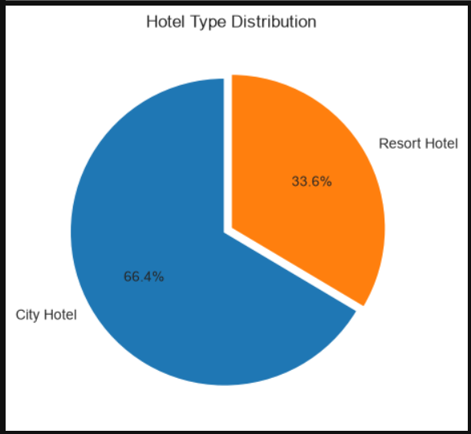
Booking & Customer Analysis
Hotel Distribution & Customer Snapshot
Bookings by hotel type
City Hotel: 53,428 (61%)
Resort Hotel: 33,968 (39%)
Customer composition
Average party: 2 adults
Repeat guests: 3.2%
Recommended visuals: Pie for hotel split; bar chart for group sizes and repeat-guest share.
Notes:
6

Slide 7
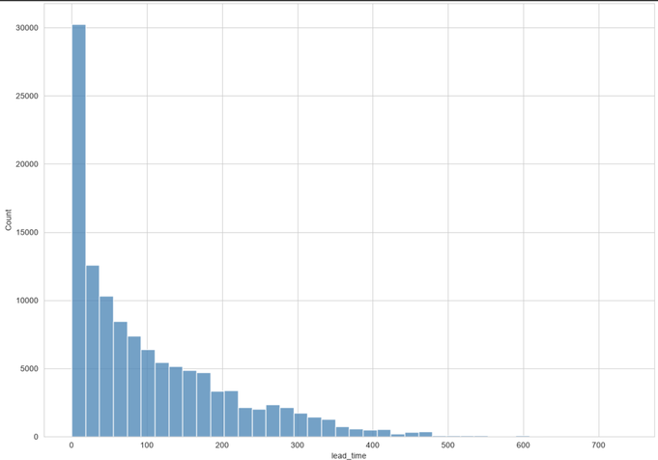
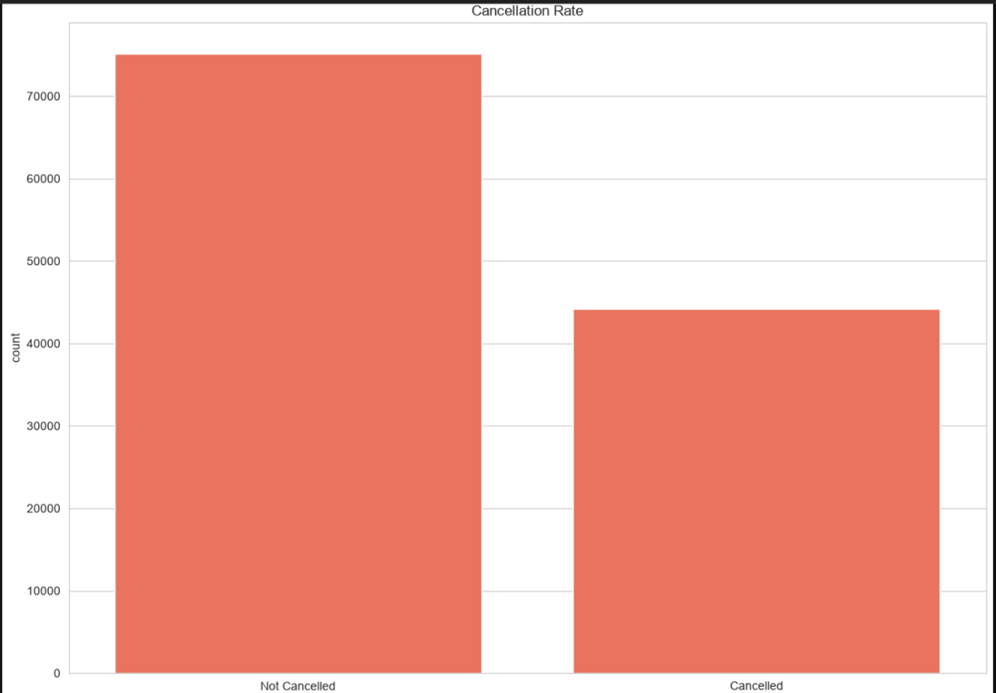
Cancellation & Pricing Analysis
Cancellation: 37% — a material revenue leak that requires targeted countermeasures.
Lead time: Mean 104 days (some bookings >700 days) — indicates advanced planning behavior.
ADR: Mean $101.83 with suspicious values (negative and extremely high) — needs cleansing and business validation.
Recommended visuals: Donut for cancellations, histogram for lead time, box plot for ADR with flagged outliers.
Notes:
7

Slide 8
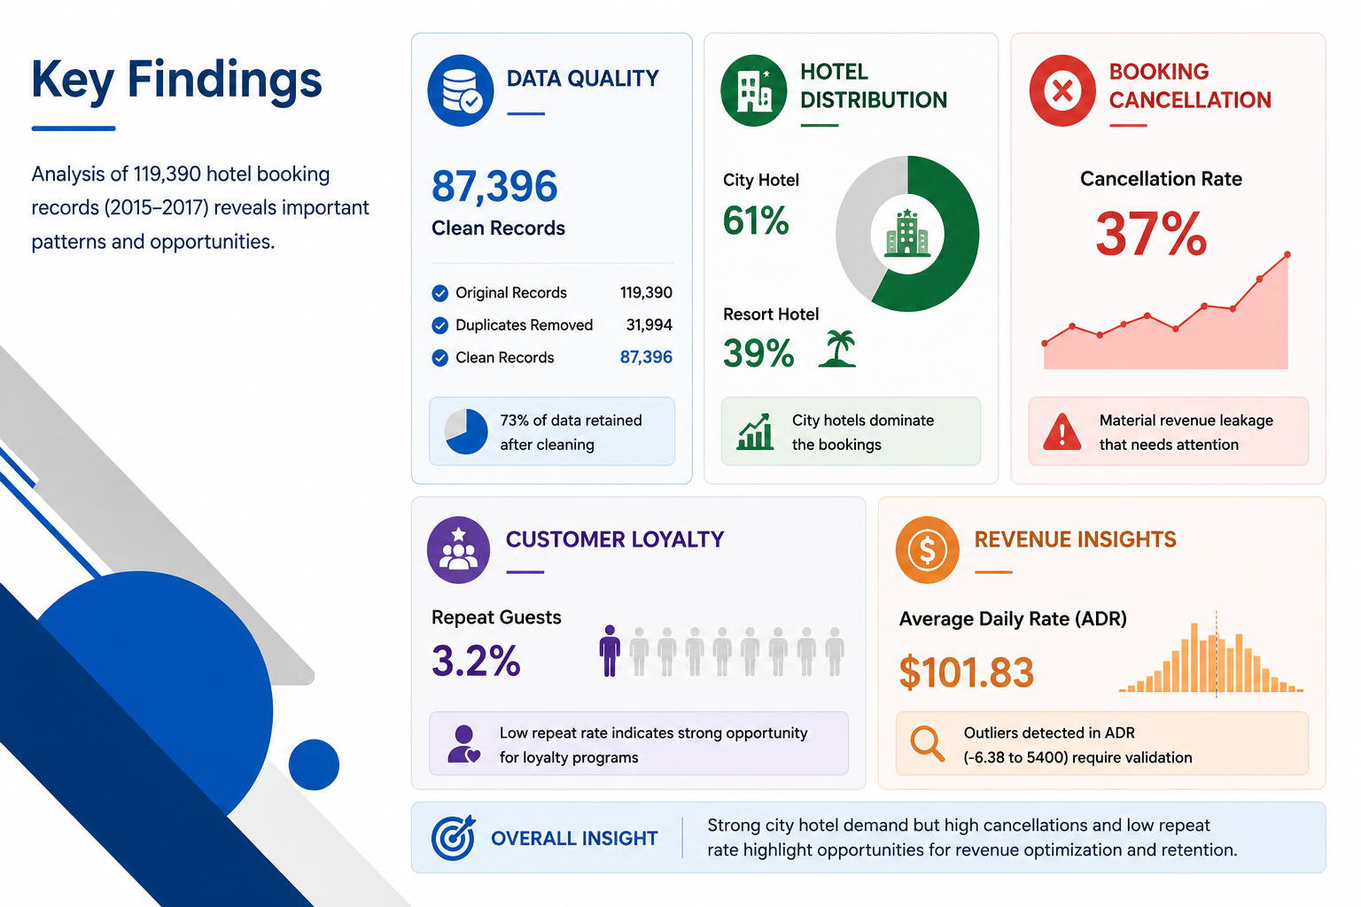
Key Findings
Data & Quality
Cleaned dataset of 87,396 records after removing 31,994 duplicates; notable missing agent/company fields and ADR anomalies.
Business Patterns
City hotels dominate (61%). Average lead time is long (104 days). Repeat guests are low (~3%).
Risks
Cancellation rate at 37% materially affects revenue; ADR outliers could distort pricing analytics.
Notes:
8

Slide 9
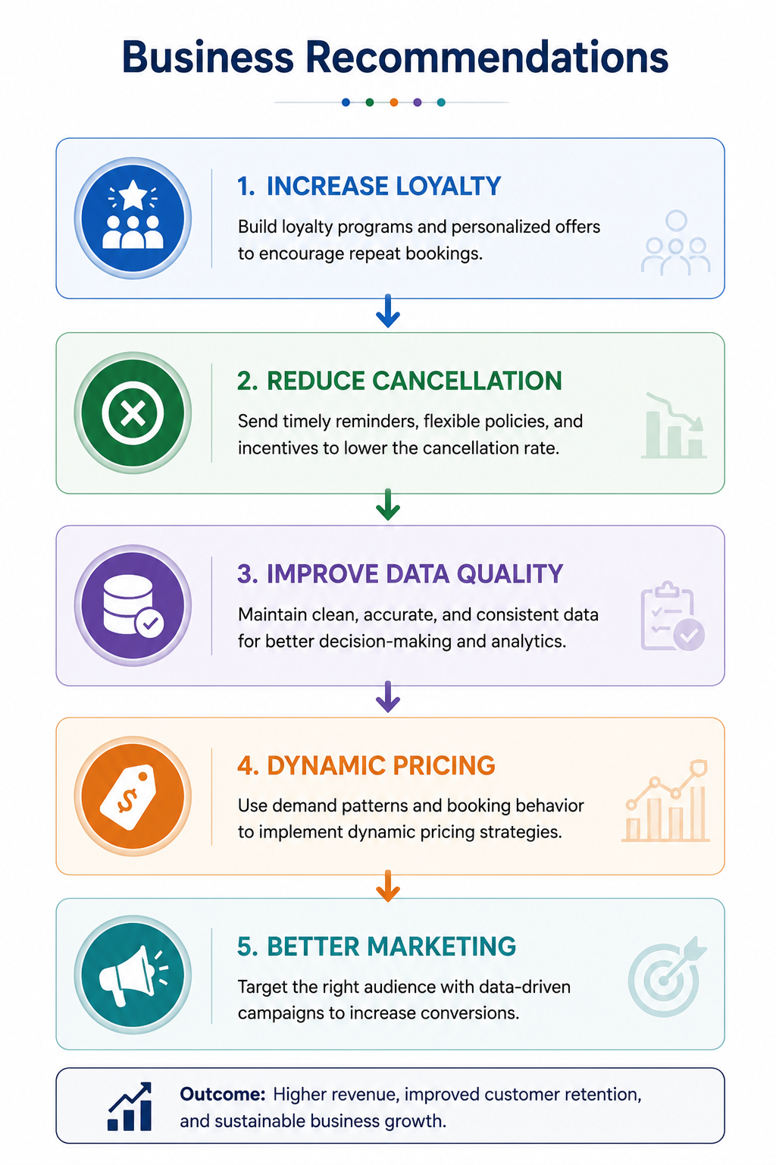
Business Recommendations
Strategic Priorities
Increase retention through loyalty & targeted offers
Reduce cancellations with reminders and flexible policies
Improve data capture and ADR validation rules
Operational tactics
Promote non-refundable discounts for price-sensitive segments
Target city hotel guests with personalized upsells (F&B, late checkout)
Audit ADR entries and implement bounds/alerts to remove negative or implausible values
Priority: Fix ADR and agent data first — this improves revenue models and customer segmentation.
Notes:
9

Slide 10

Conclusion & Next Steps
Summary
Next Steps
Cleaned and analyzed booking data to surface trends: high cancellations, long lead times, city-hotel concentration, low repeat business, and ADR issues.
Investigate ADR outliers and enforce validation rules
Run retention pilots (loyalty offers, targeted email campaigns)
Implement cancellation-reduction experiments and measure impact
Thank you
Questions? Contact: Chinmay Ashok Murkar
Notes:
10

