Slide 1
Image Processing Studio
Diagnose, fix and verify: a live walkthrough of every feature
Image & Video Processing | Mini Project
Team Members
E221 Chinmay Soni
E226 Atharva Khandelwal
E272 Akshat Katiyar
Notes:
IN THE APP: Open the dashboard next to the slides.
One line: the app checks what is wrong with an image, fixes only that, and proves the result with numbers.

Slide 2
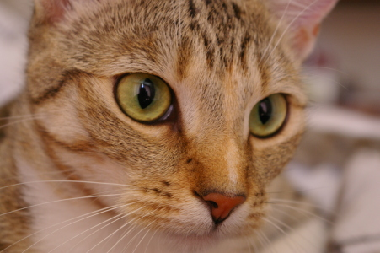
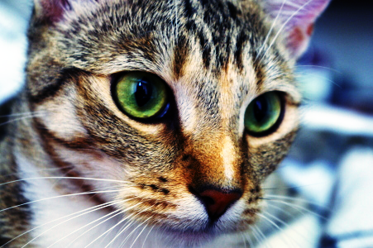
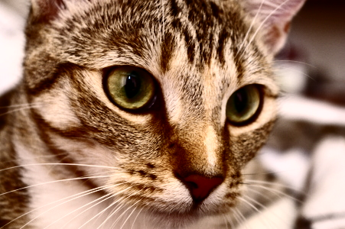
How Colour (RGB) Images Are Handled
Lab methods work on one gray plane; each feature picks the right way to apply them to colour.
Each plane: R, G, B separately
Remove noise · DCT / Hadamard compression
Same filter on all 3 planes, stacked back. Never stretched per plane.
1
Brightness only: Y of YCrCb
Light & contrast · Sharpen
Change Y, keep Cr and Cb untouched: colours cannot shift.
Original
2
Gray: Y = 0.299R + 0.587G + 0.114B
Image Health tests · Edges · Otsu
The output is a number, an edge map or a mask.
3
Equalised per R, G, B: colours shift
YCbCr + colour subsampling
JPEG-style compression
Colour planes stored at half size: the eye barely sees colour detail.
4
Equalised on Y only (ours): colours kept
Notes:
IN THE APP: Upload a colour photo (e.g. the cat sample) and run Equalize histogram.
A colour image is three gray planes R, G, B. If a contrast curve is applied to each plane separately, each plane gets a different curve, the R:G:B ratios change and the hue shifts (middle picture: blue background, green eyes). So contrast and sharpening change only the brightness Y and keep the colour planes Cr, Cb. Noise filters and the transform study run on every plane. Measurements, edges and Otsu need one number per pixel, so they use gray Y. JPEG converts to YCbCr and stores colour at half size.

Slide 3
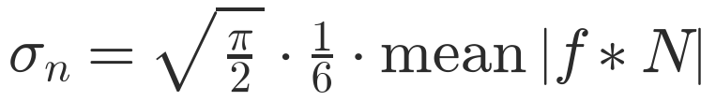
Auto Fix (1/2): The Image Health Tests
On upload the image is measured; each number is compared with a threshold tested on 391 images.
Test | What it measures (simply) | Flag when | Auto Fix does
Brightness | Average brightness, 0 = black, 1 = white | < 0.30 or > 0.70 | Auto gamma
Contrast range | Gap between darkest and brightest 1 % | < 100 levels | Contrast stretch
Grain (sensor noise) | Noise σ: pixel-to-pixel jitter (Immerkær) | σ > 5 (strong > 8) | Gaussian σ 0.6 / 1.0
Specks (salt & pepper) | Share of near-black/white odd-one-out pixels | > 0.75 % | Median 3×3 (5×5 if > 10 %)
Enlarged noise | Same tests at half scale (screenshots) | specks > 2.3 % · grain 3.5× σ | Median 5×5/7×7 · σ 1.5
Uneven lighting | How much the background brightness varies | U > 0.15 | info (used in Compare)
Separability η | How cleanly Otsu can split the histogram | < 0.70 | info
Clipping | Pixels stuck at pure black / white | > 5 % | cannot be recovered
Immerkær mask N: 1 −2 1 / −2 4 −2 / 1 −2 1
Zero on flat areas and slopes, so only noise is left
Notes:
IN THE APP: Upload the salt & pepper sample and point at the Image Health card.
Go row by row in plain words. Grain: the Immerkaer mask cancels flat areas and smooth slopes, so what is left is noise. Specks: a pixel is a speck if it is almost pure black/white AND differs from its 3x3 median by more than 50. Enlarged noise: the same tests on every 2nd pixel catch screenshots. Lighting, Otsu eta and clipping are information only: Auto Fix does not act on them; Compare uses lighting.

Slide 4
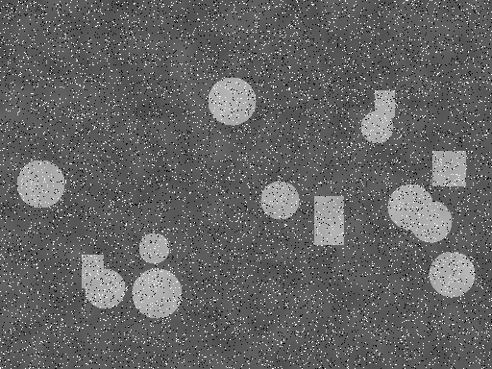
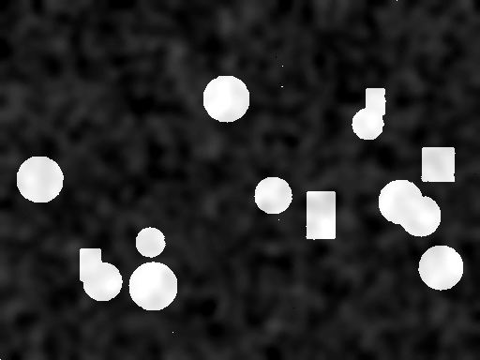
Auto Fix (2/2): How the Fixes Are Applied
Five rules in a fixed order; the image is measured again after every fix.
1 Specks?
2 Grain?
3 Exposure?
4 Flat?
5 Sharpen?
median
Gaussian
auto gamma
stretch
only if no noise
Why this order
Specks inflate the grain number, so remove them first
Brightening amplifies noise, so denoise before gamma
Sharpening amplifies noise, so only on clean images, last
Before
After Auto Fix
After every fix
1. Median 3×3: specks on 8.07 % of pixels
2. Grain re-measured: gone, no blur needed
3. Stretch: range only 96 levels
The image is measured again
The next rule uses the new numbers
Notes:
IN THE APP: Click Auto Fix on the salt & pepper sample; show the step list and the before/after histograms.
Why this order: specks first, because a speck is a huge jump and inflates the grain measurement; after the median the grain test is run again. On this image σ was 20 only because of the specks, so no Gaussian blur was added. Noise before brightness, because brightening also amplifies noise. Sharpening last, and never when noise was found, because sharpening amplifies noise. Steps here: salt-and-pepper noise on 8.07% of pixels; narrow intensity range (96 levels).

Slide 5

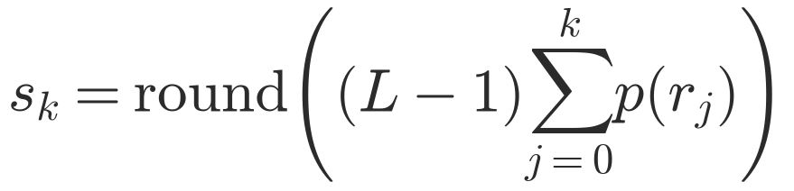
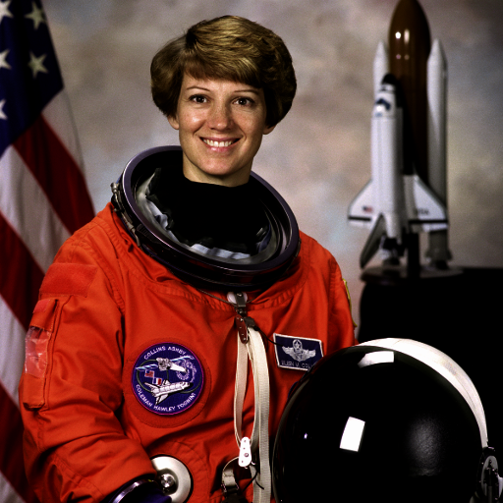
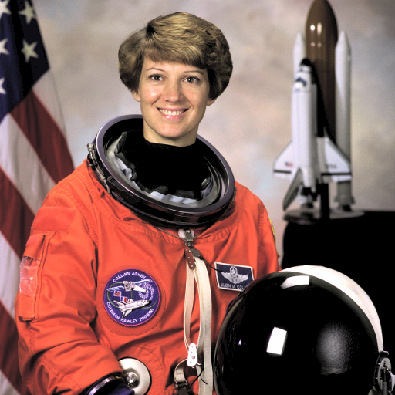
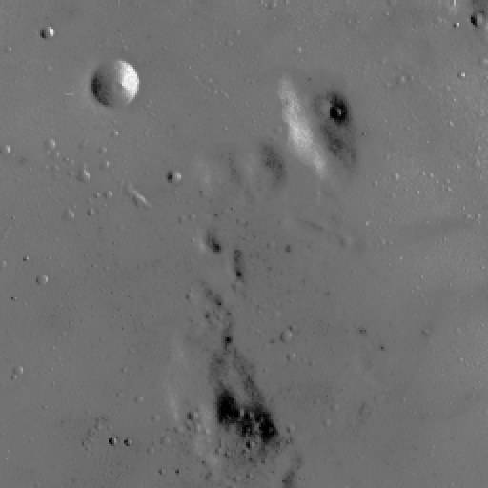
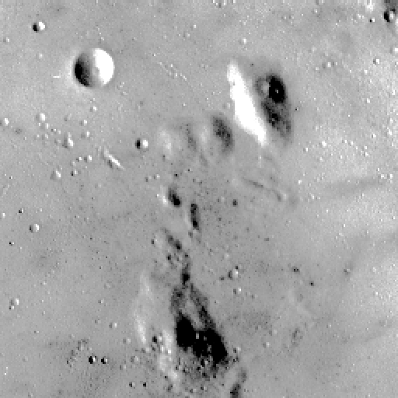
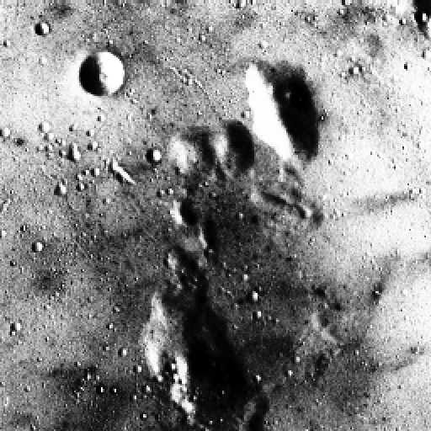
Tools: Light & Contrast
Three presets, each a brightness curve applied to Y only, so colours never change.
Auto brightness
Boost contrast
Equalize histogram
s = (r − lo)/(hi − lo) × 255
γ = ln 0.5 / ln(mean): γ < 1 brightens, > 1 darkens
lo / hi = darkest / brightest after ignoring 1 % at each end
New level = 255 × share of pixels at or below it
Dark → γ 0.52
58–141 → 0–255
Levels spread evenly
Each pair: before | after
Notes:
IN THE APP: Tools > Light & contrast: run Auto brightness on the dark astronaut, then Boost contrast and Equalize on the moon.
Auto brightness: gamma is chosen so the average lands on mid-gray; here γ = 0.52, mean 0.27 -> 0.42. Boost contrast: the moon only uses levels 58-141; stretching maps them to 0-255. Equalize: crowded levels are spread out, so even small differences become visible (stronger, can look harsh).

Slide 6
Light & Contrast: Curves & Settings
Every preset is a lookup table: input brightness 0–255 → output brightness 0–255.
Advanced setting | What changing it does
Method | Equalize / Gamma / Stretch: which curve is used
Gamma (γ) | 0.1–3 or Auto. Smaller = brighter shadows, larger = darker
Clip each end (%) | 0–5 %. Higher = stronger contrast, more pixels clipped to pure black/white
Always on brightness Y
Curve built from Y and applied to Y
Cr, Cb unchanged, so colours stay
Before/after mean and spread shown
Notes:
IN THE APP: Open Advanced settings in Light & contrast and change Gamma and Clip each end; show the curve plot.
Read the chart: the dashed diagonal means 'no change'. Above the diagonal = brighter. Gamma bends the curve smoothly. Stretch is a steep straight line that clips the ends. Equalize follows the cumulative histogram, so it is steep where many pixels are. Advanced settings: Method picks the curve; Gamma lets you type γ yourself (0.1-3); Clip each end decides how many pixels may be pushed to pure black/white.

Slide 7
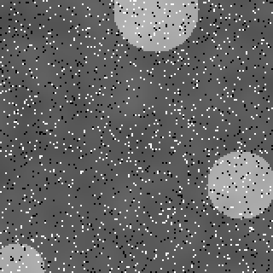
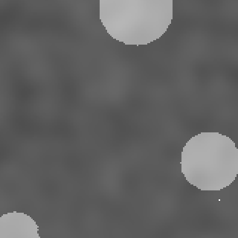
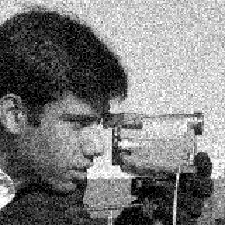

Tools: Remove Noise
Median for specks, Gaussian for grain, box for a plain blur.
Preset | Filter | Use for
Salt & pepper specks | Median 3×3 | single-pixel specks
Heavy specks | Median 5×5 | dense specks
Big specks | Median 7×7 | 2–3 px specks (screenshots)
Grainy / sensor noise | Gaussian σ 1 | random grain
Coarse grain | Gaussian σ 1.5 | enlarged grain
Simple blur | Box 3×3 | plain averaging
Specks
Median 3×3
Advanced settings
Filter: Median / Box / Gaussian
Window size 3, 5, 7: bigger removes bigger noise, blurs more
Gaussian σ 0.5–3: kernel = 2⌈3σ⌉ + 1, rows then columns
Grain σ ≈ 24
Gaussian σ 1
Notes:
IN THE APP: Tools > Remove noise: salt & pepper sample with Salt & pepper specks; noisy camera with Grainy noise.
Median: sort the 9 values, take the middle. Window 12,10,255,11,13,9,0,12,11 -> sorted middle = 11, the mean would be 37: the median ignores the speck, averaging smears it. Gaussian: a weighted average, centre weighted most, for random grain. Bigger windows / σ remove bigger noise but blur more detail. The screenshot presets (7x7, σ 1.5) exist for noise enlarged to 2-3 px.

Slide 8

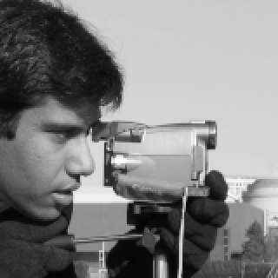

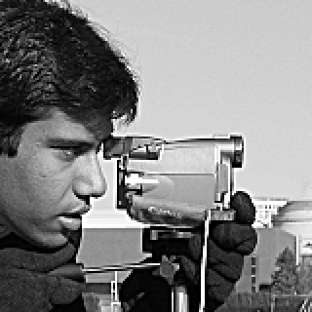
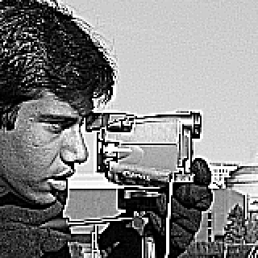
Tools: Sharpen
Find the fine detail, then add more of it back.
Unsharp masking
LAPLACIAN HIGH-BOOST MASK
-1 -1 -1
-1 A+8 -1
-1 -1 -1
detail = image − blurred image; add k × detail
Preset / setting | Meaning
Sharpen | Unsharp, k = 1
Strong sharpen | Unsharp, k = 2 (high-boost)
Laplacian sharpen | A = 1 → centre 9
Unsharp gain k | 0.2–3: how much detail is added
Blur σ | 0.5–3: bigger = coarser detail boosted
High-boost A | 0 = edges only, 1 = sharpen, > 1 = also brightens
Original
Sharpen k = 1
Strong k = 2
Laplacian A = 1
Notes:
IN THE APP: Tools > Sharpen & edges: Sharpen, Strong sharpen, Laplacian sharpen on the camera man.
Unsharp masking: blur the image, subtract the blur from the original: what is left is the detail (edges). Add k times that detail back. k = 1 normal, k = 2 strong (high-boost). Laplacian: a mask that measures how different a pixel is from its 4 neighbours; centre weight A + 8 keeps the image and adds the detail. Sharpening also amplifies noise, which is why Auto Fix never sharpens a noisy image.

Slide 9
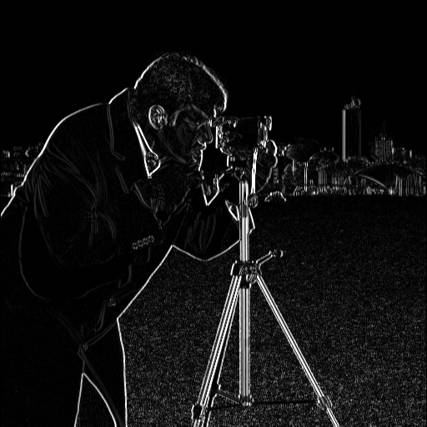
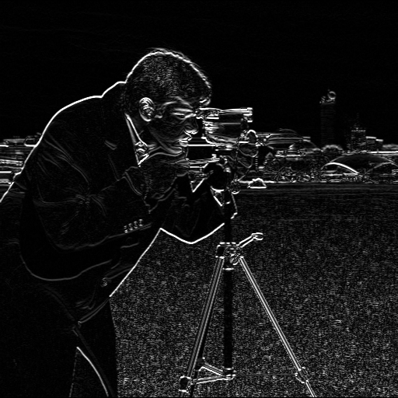
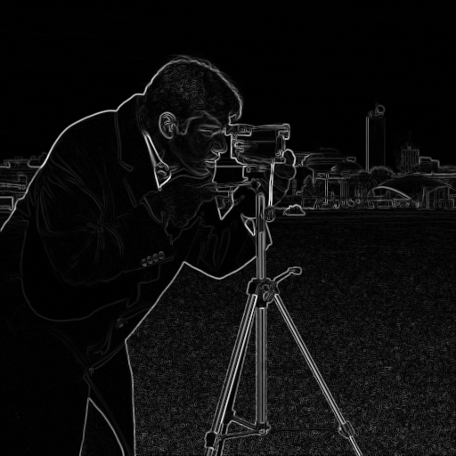
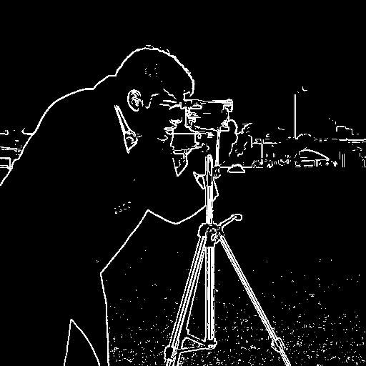
Tools: Edges
An edge is where brightness changes fast: two masks measure the change left-right (Gx) and up-down (Gy).
SOBEL GX | GY
PREWITT GX | GY
ROBERTS (2×2 DIAGONALS)
-1 0 1 -1 -2 -1
-2 0 2 0 0 0
-1 0 1 1 2 1
-1 0 1 -1 -1 -1
-1 0 1 0 0 0
-1 0 1 1 1 1
-1 0 0 -1
0 1 1 0
Advanced setting | What it does
Operator | Sobel / Prewitt / Roberts mask pair
Magnitude | √(Gx² + Gy²) exact, or |Gx| + |Gy| faster
Show | Magnitude, only Gx, or only Gy
Edge threshold | 0 = gray strength map; 0.2 = edge if M > 20 % of max
Gx: vertical edges (brightened)
Gy: horizontal edges (brightened)
Presets: Sobel · Black & white (Sobel, 0.2) · Prewitt · Roberts · Laplacian (A = 0, all directions)
Magnitude
Threshold 0.2
Notes:
IN THE APP: Tools > Sharpen & edges: Edges - Sobel, then Advanced: Show Gx, Gy, then Edge threshold 0.2.
Gx responds to vertical edges, Gy to horizontal ones; the magnitude combines both. Sobel's 1-2-1 weights also smooth across the edge, so it is less noise-sensitive than Prewitt; Roberts uses 2x2 diagonals: sharpest but most noise-sensitive. Laplacian (A = 0) finds edges in all directions at once but is very noise-sensitive. Edge threshold: keep only pixels above that fraction of the strongest edge -> black & white.

Slide 10
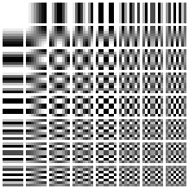
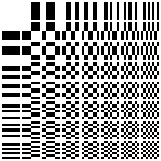

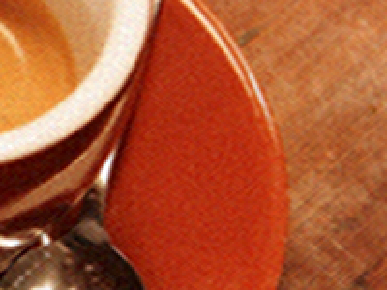


Compression: DCT vs Walsh–Hadamard
Same idea, different building blocks: rewrite the image as patterns, keep only the biggest 10 %.
DCT
Walsh–Hadamard
Patterns: smooth cosine waves
Any image size
Best for natural, smooth images
Patterns: +1 / −1 square waves
Pads to power-of-two sides
Only + and −: very fast, but blocky
F = H f Hᵀ, H entries ±1/√N
Keep 10 %: 30.0 dB
Original
Keep 10 %: 27.7 dB
Original
Notes:
IN THE APP: Tools > Compression: Whole-image DCT keep 10 %, then Walsh-Hadamard keep 10 %, on the coffee photo.
Both transforms rewrite the image as a weighted sum of patterns (the grids). DCT patterns are smooth cosine waves; Hadamard patterns are blocky +1/-1 squares. Natural images are smooth, so the DCT needs fewer patterns: at the same 10 % the DCT gives 30.0 dB, Hadamard 27.7 dB with blocky artefacts. Hadamard only uses + and -, so it is faster, and it needs power-of-two sides, so the image is mirror-padded and cropped back. Both run on R, G, B separately and are orthonormal: inverse = transpose, energy preserved.

Slide 11


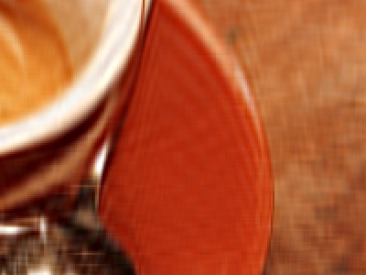
Compression: Coefficient Selection
Advanced setting for DCT and Hadamard: which coefficients survive (the rest are set to 0).
Keep largest %
Threshold
Zonal: square
Zonal: L-shape
Keep the N % biggest |F|, anywhere
Setting: 0.1–100 %
Zero every |F| below T
Setting: T 0–5000
Keep rows < k and columns < k
Setting: k as fraction of side
Zero only where row ≥ k and column ≥ k
Setting: k, shape
10.0 % kept · 30.0 dB
0.1 % kept · 20.4 dB
1.0 % kept · 23.5 dB
19.8 % kept · 26.2 dB
Examples on the coffee photo (DCT): keep 10 % · T = 500 · square and L-shape with k = 1/8. Keeping by size beats keeping by position: L-shape keeps 19.8 % but scores lower than “largest 10 %”.
Notes:
IN THE APP: Compression > Advanced settings > Coefficient selection; try each mode and watch PSNR.
Keep largest %: keeps the strongest patterns wherever they are: best quality for the amount kept. Threshold: zero every coefficient smaller than T; how many survive depends on the image. Zonal: keep by position, the low-frequency corner (top-left), regardless of size: simple but wasteful. Square keeps rows < k AND columns < k; L-shape removes only the block where both are high, so it keeps more.

Slide 12
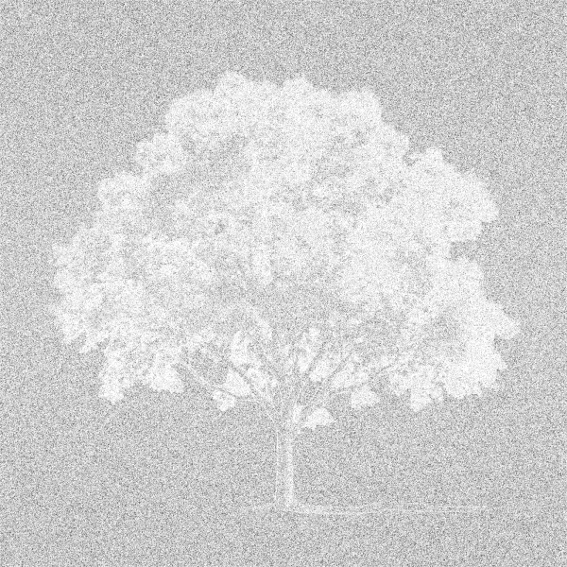
Why a PNG Gets Bigger After DCT Compression
PNG is lossless: it shrinks a file by finding repeats. DCT leaves tiny changes everywhere, so the repeats are gone.
Background before (6×6 pixels)
After DCT keep 10 %
112 | 112 | 112 | 112 | 112 | 112
112 | 112 | 112 | 112 | 112 | 112
112 | 112 | 112 | 112 | 112 | 112
112 | 112 | 112 | 112 | 112 | 112
112 | 112 | 112 | 112 | 112 | 112
112 | 112 | 112 | 112 | 112 | 112
105 | 107 | 114 | 111 | 113 | 116
104 | 109 | 115 | 113 | 109 | 112
114 | 116 | 116 | 114 | 107 | 107
118 | 117 | 112 | 109 | 105 | 109
114 | 113 | 110 | 107 | 109 | 115
104 | 106 | 109 | 108 | 115 | 117
Pixels changed by DCT: all of them
Original
After DCT
Raw (no compression)
JPEG-style q 75
1.9 MB
~11 MB
12 MB
≈ 0.5 MB
Flat background → “112, ×3 million”
Every pixel slightly different → no repeats
2000 × 2000 × 3 bytes
Stores rounded coefficients, not pixels
Notes:
IN THE APP: Compress the transparent tree PNG with Whole-image DCT 10 % and show the downloaded file size.
Like reading numbers over the phone: '112, a million times' is one sentence, but slightly different numbers must be read one by one. The original background is perfectly flat, so PNG stores it almost for free (1.9 MB). The DCT result is a full image again, rebuilt from 10 % of the patterns, so every background pixel is off by a few levels: no repeats left, the PNG becomes ~11 MB, close to the 12 MB raw size. The DCT/Hadamard tools study transforms; they do not make files. JPEG does (next slides).

Slide 13




JPEG-Style Compression (1/2): The Pipeline
Split colour from brightness, shrink the colour, then work on small 8×8 blocks.
RGB → YCbCr
Shrink colour
8×8 blocks
DCT
Quantise
Entropy code
Brightness vs colour
Colour subsampling
Each 8×8 block → DCT
Y = brightness, Cb / Cr = colour
Eye: sharp for Y, weak for colour
4:4:4 full colour · 51 KB
4:2:2 half width · 45 KB
4:2:0 half each way · 41 KB
64 pixels → 64 numbers
1st = block average
Others = finer and finer detail
Quality 90: 71 KB · 35.5 dB
Quality 75: 41 KB · 32.4 dB
Quality 50: 27 KB · 30.5 dB
Quality 20: 15 KB · 28.1 dB
Presets: High 90 · Balanced 75 · Small 50 · Smallest 20 (PNG of the same photo: 449 KB)
Notes:
IN THE APP: Compression presets High quality / Balanced / Small / Smallest; then Advanced > Colour subsampling.
Step 1: YCbCr separates brightness Y from colour Cb, Cr. Step 2: the eye sees colour detail poorly, so Cb, Cr are stored at half width and height (4:2:0); 4:2:2 halves only the width; 4:4:4 keeps full colour. At q75 on the coffee photo: 4:4:4 = 51 KB, 4:2:2 = 45 KB, 4:2:0 = 41 KB. Step 3: 8x8 blocks, because small blocks are smooth inside. Step 4: DCT of each block (after subtracting 128): 1 average + 63 detail numbers. Steps 5-6 next slide.

Slide 14
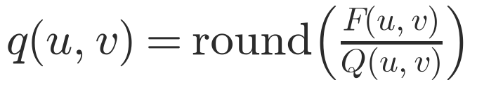
JPEG-Style Compression (2/2): Quantisation
Divide each coefficient by a step and round: small detail becomes 0. This is where the file shrinks.
1. DCT numbers F
2. Step table Q (quality 50)
3. q = round(F ÷ Q)
-403 | -11 | -5 | 6 | -5 | 0 | 0 | 1
-3 | -7 | 1 | -1 | -1 | 2 | -3 | 5
1 | 0 | -2 | -2 | 0 | 1 | 1 | -4
1 | -1 | 2 | -2 | 2 | -2 | 0 | 0
-1 | -1 | -1 | 3 | 1 | -2 | 1 | 2
-2 | 2 | 0 | 4 | 1 | -1 | 0 | -1
1 | 0 | 1 | -1 | 2 | -2 | 0 | -1
-1 | -1 | 0 | -1 | -1 | -1 | -2 | -2
16 | 11 | 10 | 16 | 24 | 40 | 51 | 61
12 | 12 | 14 | 19 | 26 | 58 | 60 | 55
14 | 13 | 16 | 24 | 40 | 57 | 69 | 56
14 | 17 | 22 | 29 | 51 | 87 | 80 | 62
18 | 22 | 37 | 56 | 68 | 109 | 103 | 77
24 | 35 | 55 | 64 | 81 | 104 | 113 | 92
49 | 64 | 78 | 87 | 103 | 121 | 120 | 101
72 | 92 | 95 | 98 | 112 | 100 | 103 | 99
-25 | -1 | 0 | 0 | 0 | 0 | 0 | 0
0 | -1 | 0 | 0 | 0 | 0 | 0 | 0
0 | 0 | 0 | 0 | 0 | 0 | 0 | 0
0 | 0 | 0 | 0 | 0 | 0 | 0 | 0
0 | 0 | 0 | 0 | 0 | 0 | 0 | 0
0 | 0 | 0 | 0 | 0 | 0 | 0 | 0
0 | 0 | 0 | 0 | 0 | 0 | 0 | 0
0 | 0 | 0 | 0 | 0 | 0 | 0 | 0
61 of 64 numbers become 0 → stored as “−25, −1, −1, end of block”
Quality → step size
Entropy coding
Why it works
Zig-zag order: zeros end up together
Runs of zeros and small numbers get short codes
Eye ignores fine detail
Rounding throws it away
Zeros cost almost nothing
Notes:
IN THE APP: Advanced > Quality: move from 90 to 20 and watch the file size and the 8×8 blocks appear.
A real 8x8 block from the coffee photo. Left: its 64 DCT numbers; the first is the average (-403). Middle: the step table at quality 50: small steps top-left (eye sees coarse changes), big steps bottom-right (fine detail). Right: round(F / Q): -403 / 16 = -25.2 -> -25; most detail numbers are tiny, so 61 of 64 become 0. Entropy coding then stores '-25, -1, -1, then all zeros' in a few bits. Quality scales the whole table: higher quality = smaller steps = fewer zeros = bigger file. Decoding: multiply back (q x Q), inverse DCT, add 128.

Slide 15
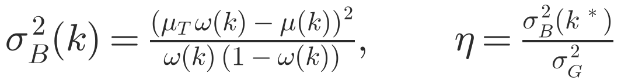
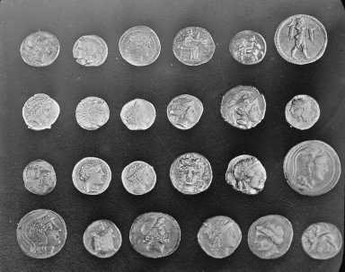
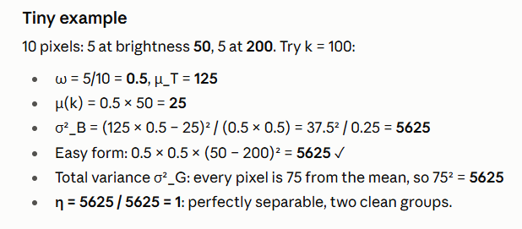
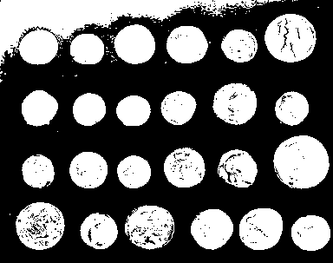
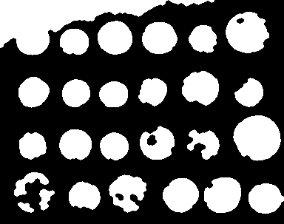
Compare → Segment (1/2): Otsu’s Thresholding
Try every threshold k; keep the one that best separates dark pixels from bright pixels.
ω = share of pixels below k, μ = their mean brightness, μT = overall mean, σG² = total variance
Coins: k = 107, η = 0.76
Clean-up: morphology
Raw Otsu mask
Opening + closing
Opening: removes specks smaller than the disk
Closing: fills holes smaller than the disk
Notes:
IN THE APP: Compare tab > Segment on the uneven-lighting sample.
The histogram counts pixels per brightness. Otsu tries every k from 0 to 255, splits the pixels into 'below k' and 'above k', and measures how far apart the two group averages are (between-class variance, the red curve). The best k is the peak: here k = 107 on the coins photo. Eta = how separable the image is, 0 to 1: 0.76 here. The mask is then cleaned: opening removes specks, closing fills holes (disk radius 3). Object = the smaller class unless told otherwise.

Slide 16
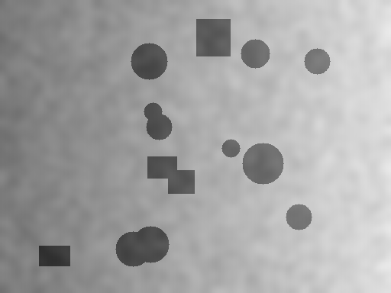

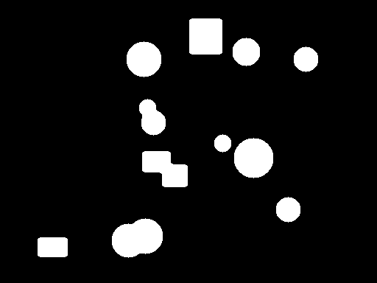
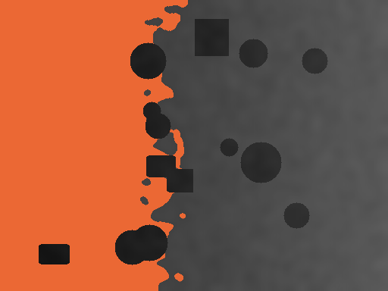
Compare → Segment (2/2): Guided vs Direct
Run Otsu twice, on the image as it is and after fixing what the diagnosis found, then measure.
Specks?
Grain?
Lighting?
Otsu
median
Gaussian
flatten
same settings
Input: uneven light
Direct: η 0.70
Guided: η 0.97
Difference map
Fix that ran | Measured by | Guided wins if
Median / Gaussian | Islands + holes | fewer
Flatten lighting | Otsu η | rises ≥ 0.02
Verdicts
Fixing first clearly helps: all checks pass
Partly better: some pass
Did not help: none pass
Image is ready: nothing to fix
Noise is only fixed above Otsu’s break-even point σ > 8
Notes:
IN THE APP: Same Compare > Segment result: point at the two masks, the verdict and the difference map.
Direct: one global threshold on uneven light splits bright half from dark half (k = 161, eta 0.70). Guided: the checklist finds uneven lighting, flattens it (g = f - B + mean B), then runs the SAME Otsu: eta 0.97. One measurement per fix decides; here eta rose by more than 0.02, so the verdict is 'Fixing first clearly helps'. Orange = only direct (wrong regions), green = only guided.

Slide 17
Thank You
Questions?
Project links
GitHub: github.com/AkshatKatiyar081/IVP_2026
Live app: [paste Vercel link]
Image Processing Studio: diagnose · fix · verify
Notes:
IN THE APP: Keep the dashboard open for questions.
Hidden backup slides follow if a detailed question comes up.

Slide 18
Backup: All Filter Masks
Every mask used, applied as correlation (no flip), like OpenCV.
SMOOTHING / LAPLACIAN
SHARPEN / NOISE
Box 3×3 (×1/9) Laplacian (4-nbr)
1 1 1 0 1 0
1 1 1 1 -4 1
1 1 1 0 1 0
High-boost (A) Immerkær N
-1 -1 -1 1 -2 1
-1 A+8 -1 -2 4 -2
-1 -1 -1 1 -2 1
Conventions
Borders: reflect-101 for linear filters, replicate for the median
Gaussian: K = 2⌈3σ⌉ + 1, separable (rows then columns)
Morphology: disk structuring element, erosion pads 255, dilation pads 0
High-boost: A = 1 sharpen, A = 0 edges only, A > 1 also brightens

Slide 19

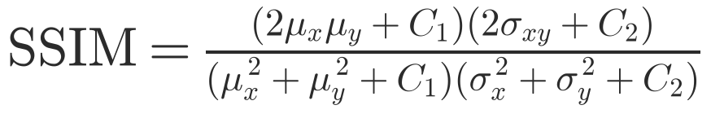
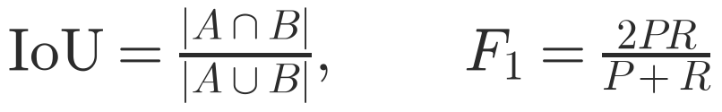
Backup: Quality Metrics
How every result in the project is scored.
PSNR
Pixel error in dB; > 40 dB invisible, < 25 dB clearly degraded
SSIM
Local brightness, contrast and structure in 7×7 windows; 1 = identical
IoU and edge F1
Masks overlap / edges matched within 1 pixel

Slide 20
Backup: Threshold Calibration
Thresholds tested on labelled images, not guessed.
Rule | Images | Precision | Recall | F1
Noise σ > 5 | normal (119) | 0.944 | 1.000 | 0.971
Salt & pepper > 0.75 % | normal (187) | 0.986 | 1.000 | 0.993
Lighting U > 0.15 | normal (187) | 0.370 | 1.000 | 0.540
Grain, any scale | screenshots (102) | 0.986 | 1.000 | 0.993
Specks, any scale | screenshots (204) | 0.990 | 1.000 | 0.995
Why lighting U is kept low
A false alarm only costs an extra guided run that reports “did not help”; a miss would hide the biggest improvement (IoU 0.14 → 0.99). So recall is kept at 100 %.

Slide 21
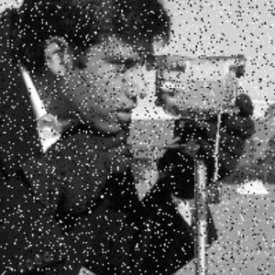
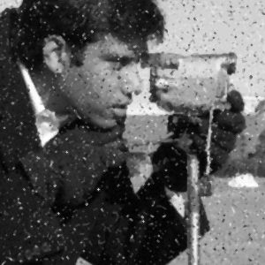

Backup: Screenshot Noise
Enlarging smears noise over 2–3 px; measured at half scale it is pixel-sized again.
Enlarged specks
3×3 median: specks remain
5×5 median: removed
204 screenshot-like test images: noisy screenshots caught 0 / 170 with the pixel-scale tests, 170 / 170 with the half-scale tests.

Slide 22
Backup: References
Sources behind the algorithms.
Gonzalez, R. C., Woods, R. E. Digital Image Processing, 4th ed. Pearson, 2018.
Otsu, N. A threshold selection method from gray-level histograms. IEEE Trans. SMC, 9(1), 62–66, 1979.
Immerkær, J. Fast noise variance estimation. Computer Vision and Image Understanding, 64(2), 300–302, 1996.
Wallace, G. K. The JPEG still picture compression standard. IEEE Trans. Consumer Electronics, 38(1), 1992.
ITU-T T.81 (JPEG), Annex K: example quantisation tables.
Wang, Z. et al. Image quality assessment: from error visibility to structural similarity. IEEE TIP, 13(4), 2004.

